Slide 1

Project Title - Seasonal Agriculture Performance Analysis
Abhishek Tiwari Lovely Professional University
AICTE STU ID : STU6a6712e6035db1785139942

Slide 2

PROBLEM STATEMENT
Agricultural performance is influenced by seasonal variations in environmental conditions, farming practices, resource availability and market conditions. Raw agricultural data does not clearly explain how performance changes across seasons. This project analyzes the provided agricultural dataset to identify seasonal differences, patterns, trends, relationships and variations in yield, profitability, resource usage and environmental conditions.

Slide 3
Project Description
The project uses a structured dataset of 4,000 farm records and 28 variables covering crop, season, location, farm area, weather, soil, inputs, irrigation, yield, production, cost, revenue, profit, water usage and disease/pest risk. Workflow: data exploration → quality checks → missing-value treatment → descriptive statistics → seasonal/group comparisons → correlation analysis → visualization → evidence-based interpretation.

Slide 4

WHO ARE THE END USERS?
Farmers and farm managers – compare seasonal yield, profitability and resource efficiency.
Agricultural planners – identify seasonal patterns for evidence-based planning.
Agribusiness stakeholders – understand crop and economic performance.
Data analysts / students – reproduce and extend the analysis.
Researchers – investigate relationships between environmental conditions and outcomes.

Slide 5

Technology Used
Python • Pandas – data loading, cleaning and aggregation • NumPy – numerical analysis • Matplotlib – charts and visualization • Jupyter Notebook – analysis documentation Analytical techniques • Descriptive statistics • Group-by seasonal comparisons • Correlation analysis • Trend / relationship visualization Data source: provided Seasonal Agriculture Performance Analysis dataset.

Slide 6
RESULTS – DATA QUALITY & PREPARATION
4,000 records 28 variables
120 missing values 0 duplicate rows
Data quality checks • 48 missing Rainfall values • 40 missing Soil Moisture values • 32 missing Yield values • No duplicate rows detected • Numeric missing values were median-imputed for analysis Prepared dataset used for comparisons and visualizations.
Why this matters Cleaning prevents incomplete records from distorting seasonal averages and relationships. The original dataset contains 4,000 observations; missingness is limited to three numeric fields.

Slide 7
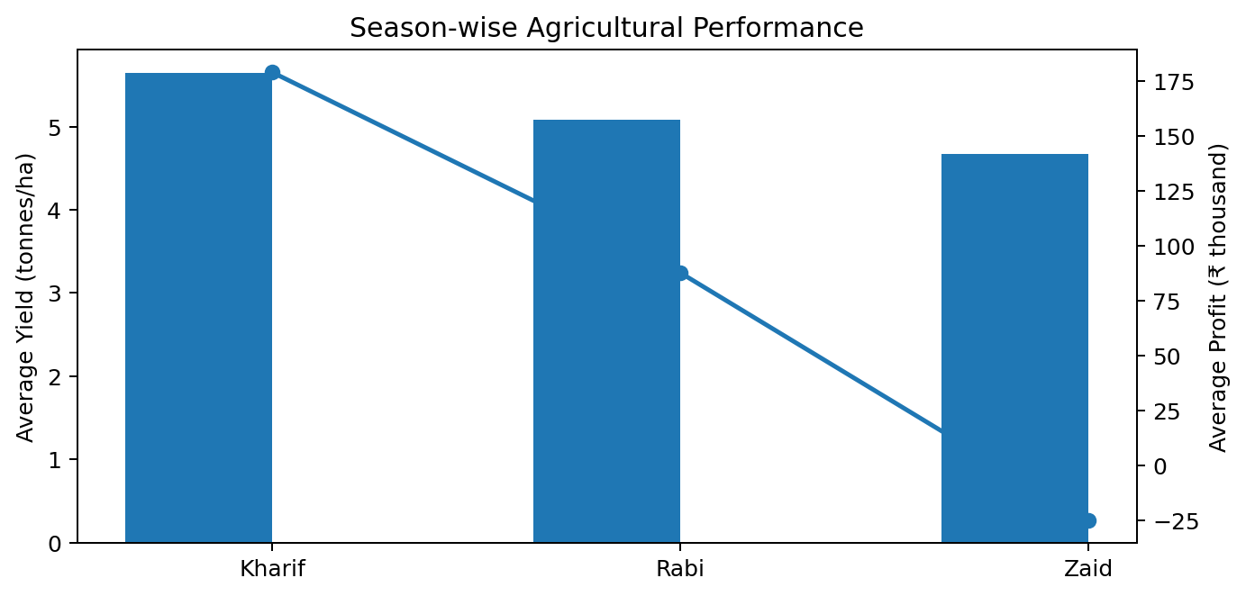
RESULTS – SEASONAL PERFORMANCE
Kharif: 5.64 t/ha Highest average yield
Kharif: ₹178.9k Highest average profit
Key insight Kharif has the strongest average yield and profit among the three seasons. Rabi is intermediate, while Zaid has the lowest average yield and a negative average profit. Seasonal differences therefore matter for both production and economics.

Slide 8
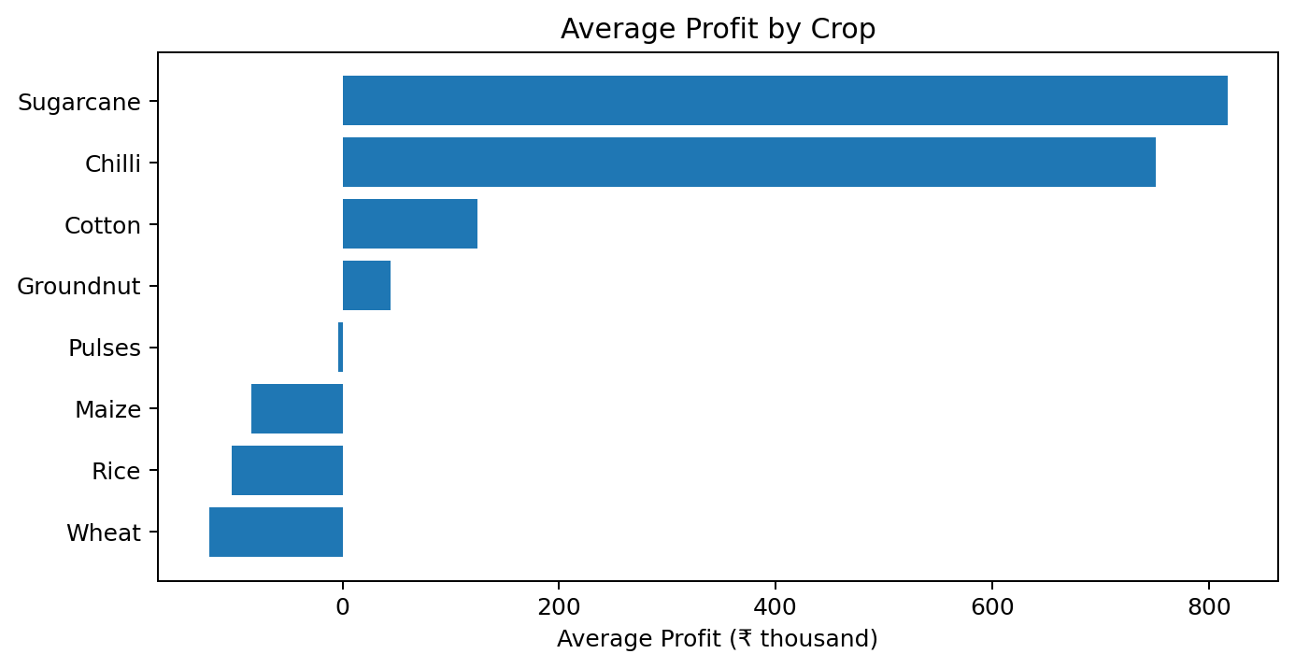
RESULTS – CROP PROFITABILITY
Sugarcane: ₹817.2k Highest avg profit
Sugarcane: 46.94 t/ha Highest avg yield
Key insight Sugarcane leads on both average yield and average profit. Chilli is a close second in profitability (₹750.9k) despite yielding far less per hectare (1.54 t/ha vs 46.94 t/ha), showing that crop pricing and cost structure matter as much as yield for economic success.

Slide 9
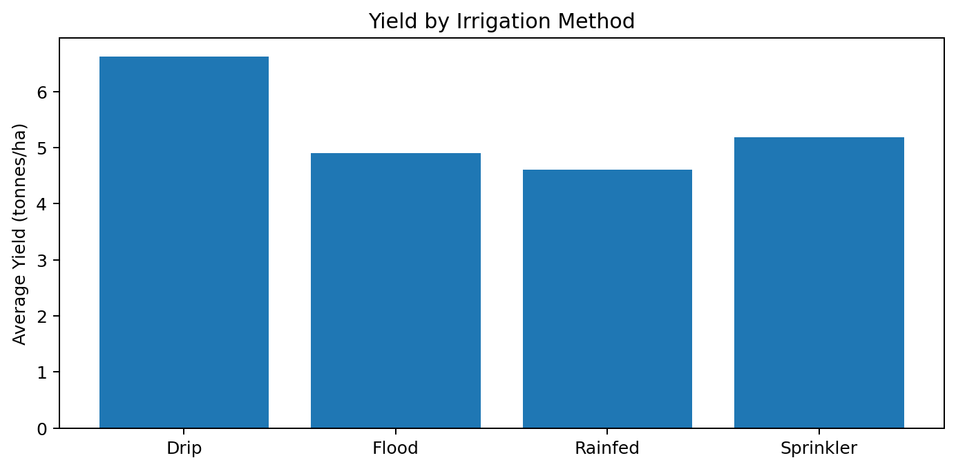
RESULTS – IRRIGATION COMPARISON
Drip: 6.62 t/ha Highest avg yield
Rainfed: 7.56 t/1000m³ Highest efficiency
Key insight Drip irrigation records the highest average yield and profit, whereas Rainfed farms show the highest water-efficiency metric. Flood irrigation has lower average yield and water efficiency than Drip.

Slide 10
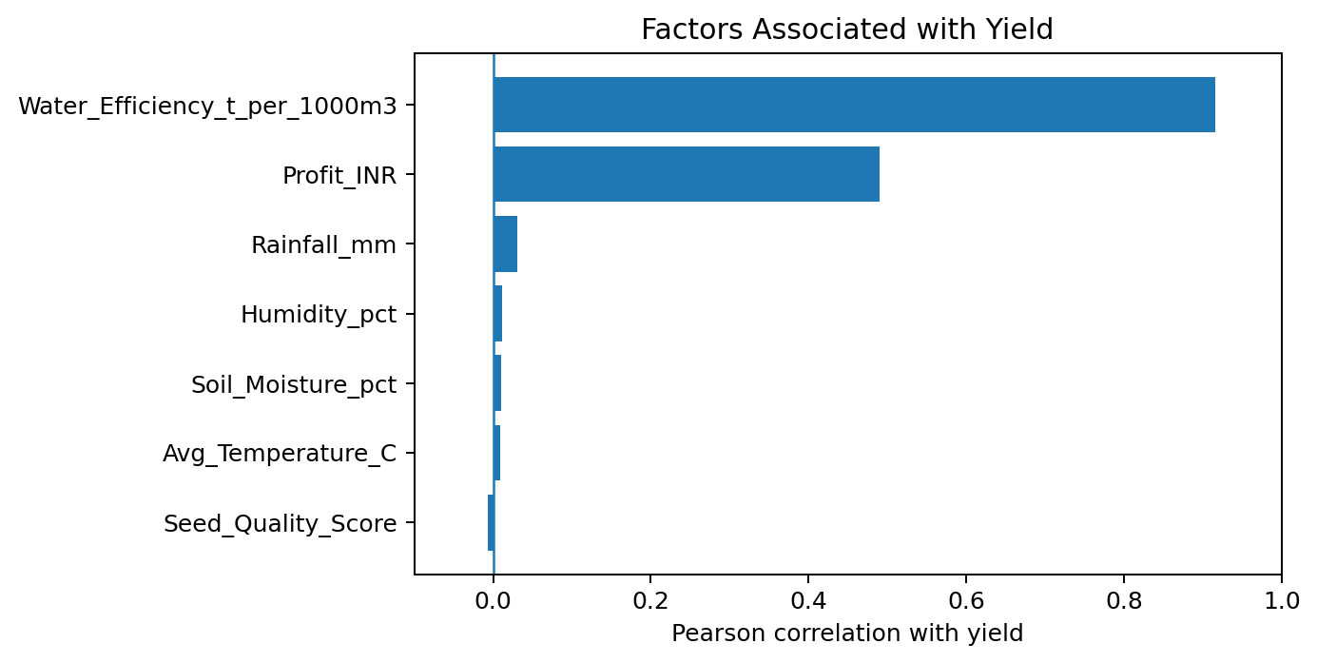
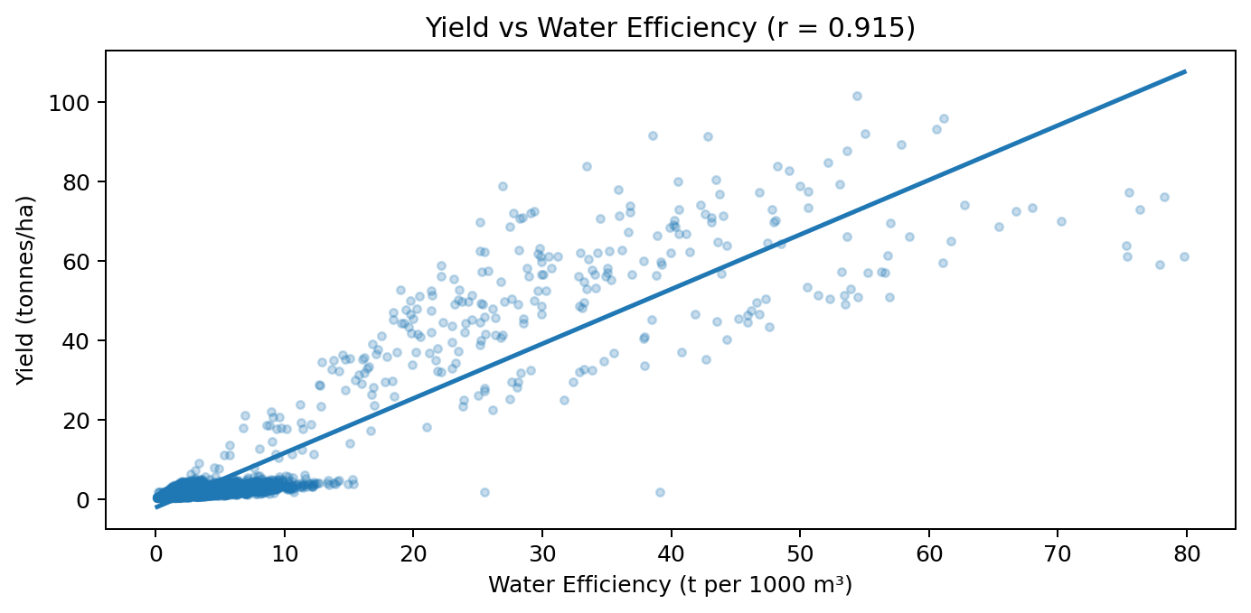
RESULTS – FACTOR RELATIONSHIPS
Yield ↔ Water Efficiency r = 0.915
Yield ↔ Profit r = 0.490
Key insight Yield is strongly associated with water efficiency in this dataset. Profit also has a positive relationship with yield. Correlation indicates association, not causation, so the result should not be interpreted as proof that one variable directly causes another.
Interpretation Water efficiency is the strongest measured association with yield in the provided numeric variables. Rainfall, temperature, humidity and soil moisture show very weak linear correlations with yield in this dataset. These findings describe the observed data and should be validated with further statistical modelling.

Slide 11
Future scope
NEXT STEPS
EXTENSIONS
Build predictive models for yield and profit.
Analyze performance at state/district level.
Test interaction effects between season, crop and irrigation.
Use time-series data for multi-year seasonal forecasting.
Develop an interactive dashboard.
Add anomaly detection for unusual seasonal outcomes.
Compare input costs with marginal yield/profit gains.
Validate findings on larger, real-world agricultural datasets.

Slide 12
GitHub Link
REPOSITORY STATUS
github.com/abhishektiwari36/Seasonal-Agriculture-Performance-Analysis
GitHub repository: https://github.com/abhishektiwari36/Seasonal-Agriculture-Performance-Analysis The analysis is uploaded with: • Jupyter Notebook • seasonal_agriculture_performance_dataset.csv • Generated visualizations • Project PPT

Slide 13

VOIS Course completion certificate - Course name- Data Visualization
CERTIFICATE
Presented to Abhishek Tiwari

Slide 14
Thank you
AICTE STU ID STU6a6712e6035db1785139942
Lovely Professional University
Abhishek Tiwari

