Slide 1
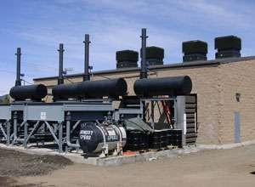
DIESEL ENGINE POWER PLANT

Slide 2
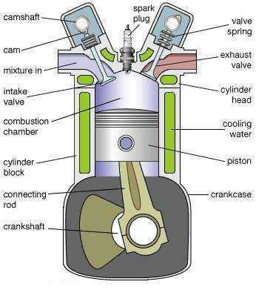
BASIC TYPE OF IC ENGINE

Slide 3
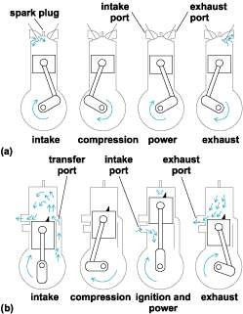
FUNCTION
(a) FOUR STROCK
(b)TWO STROCK

Slide 4
Diesel engine
The two stroke cycle engine is more favored for diesel power plant.
The air required for the diesel engine is drown through the air filter
from the atmosphere and compressed inside the cylinder.
The fuel from the diesel engine is drawn through a filter from the all day tank and injected into the cylinder through fuel injectors.
Because of the high temperature and pressure of the compressed air,
the fuel burns and the burnt gases expand to do work on the
moving part inside the cylinder called piston.
This movement of the piston rotates a flywheel and the engine is directly coupled to electric generator.
The gases after expansion inside the cylinder is exhausted into the atmosphere and passes through a silencer in order to reduce the noise.

Slide 5
INTRODUCTION
Diesel power plants produce power in the range of 2 to 50MW.
They are used as standby sets for continuity of supply such as hospitals , telephone exchanges , radio station , cinema theatres and industries (peak load).
They are suitable for mobile power generation and widely
used in railways and ships.

Slide 6
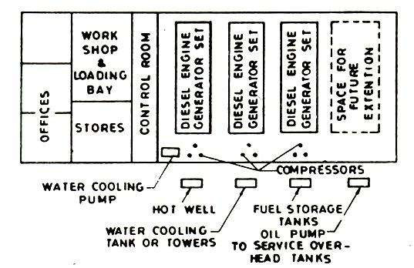
GENERAL LAYOUT

Slide 7
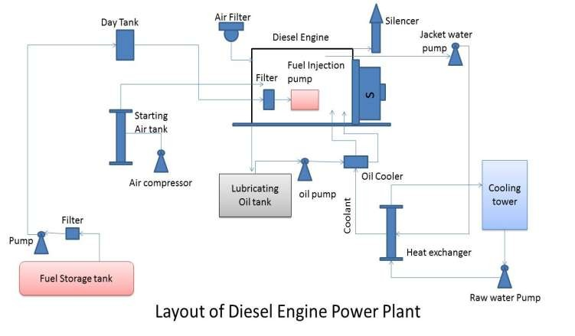
Simple layout

Slide 8
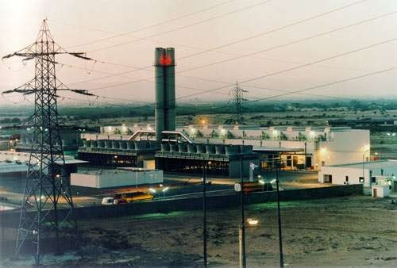
Diesel plant equipment
Air intake system
Fuel supply system
Exhaust system
Cooling system
Lubricating system
Starting system

Slide 9
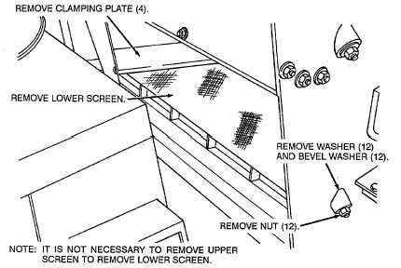
Air intake system
The air required for the combustion of fuel inside the diesel engine cylinder is drawn through the air filter. The purpose of the filter is to remove dust from the incoming air.
dry filter- may be made of felt , wood or cloth.
wet filter- oil bath is used.

Slide 10
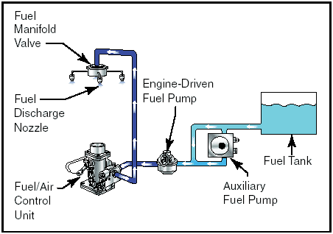
Fuel supply system
Fuel from the storage tank is pumped through a filter into a smaller tank called all day tank . this tank supplies the daily requirements of the diesel engine.

Slide 11
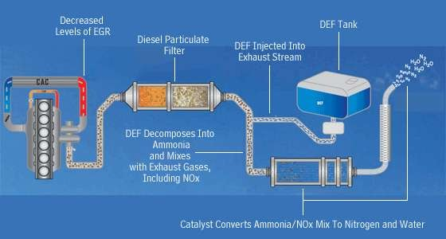
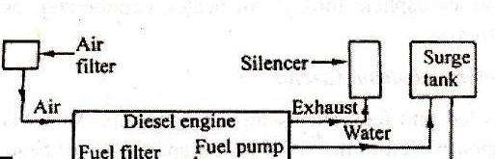
Exhaust system
The exhaust gases coming out of the engine is very noisy. In order to reduce the noise a silencer is used.

Slide 12
Cooling system
The temperature of the burning fuel inside the engine cylinder -15000C to 20000C. In order to lower this temperature water is circulated around the engine.
The hot water leaving the jacket is passed through the heat
exchanger.
The heat from the heat exchanger is carried away by the raw water circulated through the heat exchanger and is cooled in the cooling tower

Slide 13
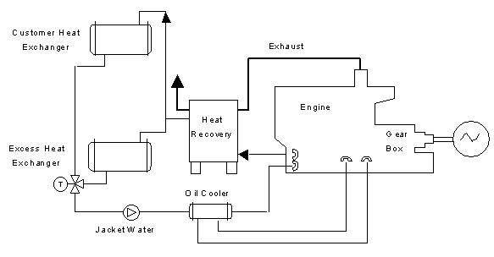
Cooling system

Slide 14
Lubricating system
This circuit includes lubricating oil tank , oil pump and oil cooler.
The purpose of the lubrication system is to reduce the wear of the engine moving parts .part of the cylinder such as piston
, shafts , valves must be lubricated.
Lubrication also helps to cool the engine.

Slide 15
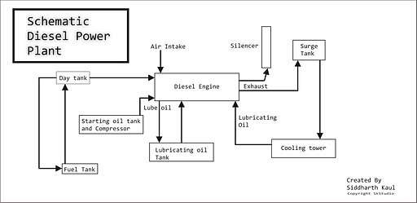
Starting system
Diesel engine used in diesel power plant is not self starting . The engine is started from cold condition whit the help of an air compressor.
Schematic diesel engine power

Slide 16
ADVANTAGE OF DIESEL POWER PLANT
Very simple design also simple installation and occupies less space.
Limited cooling water requirement.
Diesel power plant are more efficient than steam power in the range of 150MW capacity.
Quickly started and put on load.
It can respond to varying loads without any difficulty.
Smaller storage is needed for the fuel.
Layout of power plant is quite simple.
There is no problem of ash handling.
Less supervision required.

Slide 17
DISADVANTAGE OF DIESEL POWER PLANT
High Maintenance ,lubrication cost and operating cost.
Fuel cost is more, since in India diesel is costly.
The plant cost per kW is comparatively more.
The life of diesel power plant is small due to high
maintenance.
Noise is a serious problem in diesel power plant.
Diesel power plant cannot be constructed for large scale.

Slide 18
THANK YOU

