Slide 1
SOLAR ENERGY

Slide 2
SOLAR POWER PLANT

Slide 3
Introduction
Solar power plant is based on the conversion ofsunlight into electricity, either directly usingphotovoltaic(PV), or indirectly using concentrated solar power(CSP) is thermal power plant.
Photovoltaic converts light into electric current using thephotoelectric effect.
Concentrated solar power plants first appeared in the 1980s.
Concentrated solar power systems use lenses or mirrors and tracking systems to focus a large area of sunlight into a
small beam.

Slide 4
WHAT IS SOLAR ENERGY?
SOLAR ENERGY RADIANT LIGHT AND HEAT FROM THE SUN IS HARDNESSED USING A RANGE OF EVER-EVOLVING TECHNOLOGIES.
SUCH AS SOLAR HEATING, SOLAR PHOTOVOLTAICS, SOLAR THERMAL ELECTRICITY SOLAR ARICHITECTURE AND ARITIFICAL
PHOTOSYNTHESIS.

Slide 5
BASIC PRINCIPLE OF SOLAR ENERGY
Solar radiation is reduce in intensity in the atmosphere by dust,clouds,haze and fog.
➢The radiation strikes a solid or liquid, it is absorbed and transformed in to heat energy.
➢The heat energy is collected in a fluid generally water.
➢This energy can be used in a solar heater or drier or can trated type collector is used to collect or parabolic concentrated the solar energy.

Slide 6
Working of solar power plant
Photovoltaic Electricity – This method uses photovoltaic cells that absorb the direct sunlight just like the solar cells you see on some calculators.
Solar-Thermal Electricity – This also uses a solar collector: it has a mirrored surface that reflects the sunlight onto a receiver that heats up a liquid. This heated liquid is used to make steam that produces electricity.

Slide 7
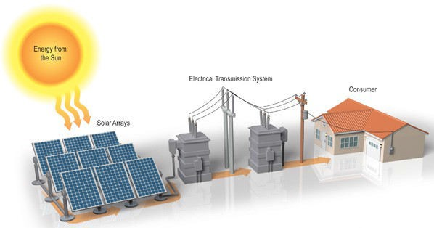
Concept of Solar Photovoltaic Power Plant

Slide 8
Component used in PV System
Solar Panel
Controller
➢Battery
➢Inverter

Slide 9
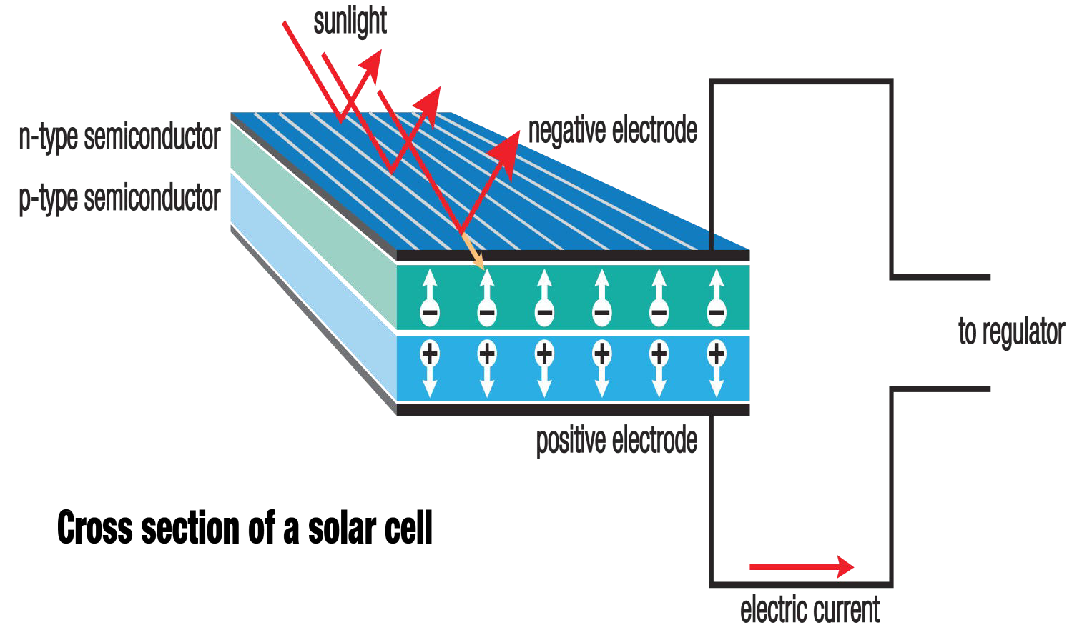
1. Solar panel : they are need to convert the solar energy into Electrical energy.

Slide 10
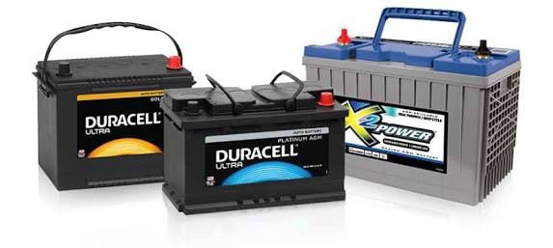
2. Batteries :
batteries are use for to store energy offline(DC). If we direct use to any load it works but on the time like night there no sun light in this time if we connect the load to active we need this.

Slide 11
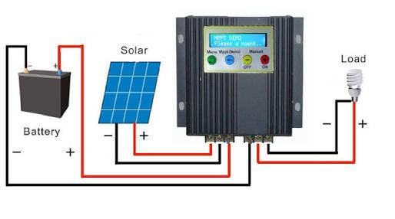
3. Controller :
charge controller is a one type of Voltage controller to charge the batteries and keep away cell from over charging.

Slide 12
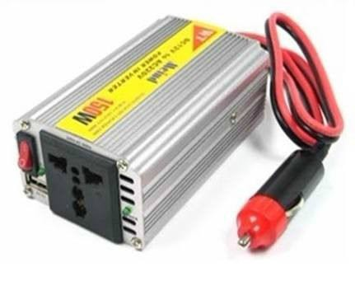
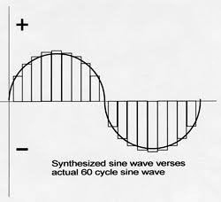
4. Power inverter:
it is one type of converter.it is convert the Dc to the 230 volt AC as per need of application

Slide 13
SOLAR-THERMAL ELECTIRICITY
➢Solar collectors capture and concentrate sunlight to heat a synthetic oil called terminal, which then heats water to create steam.
➢The steam is piped to an onsite turbine-generator to produce electricity, which is then transmitted over power lines. On cloudy days, the plant has a supplementary natural gas boiler.
➢The plant can burn natural gas to heat the water, creating steam to generate electricity.

Slide 14
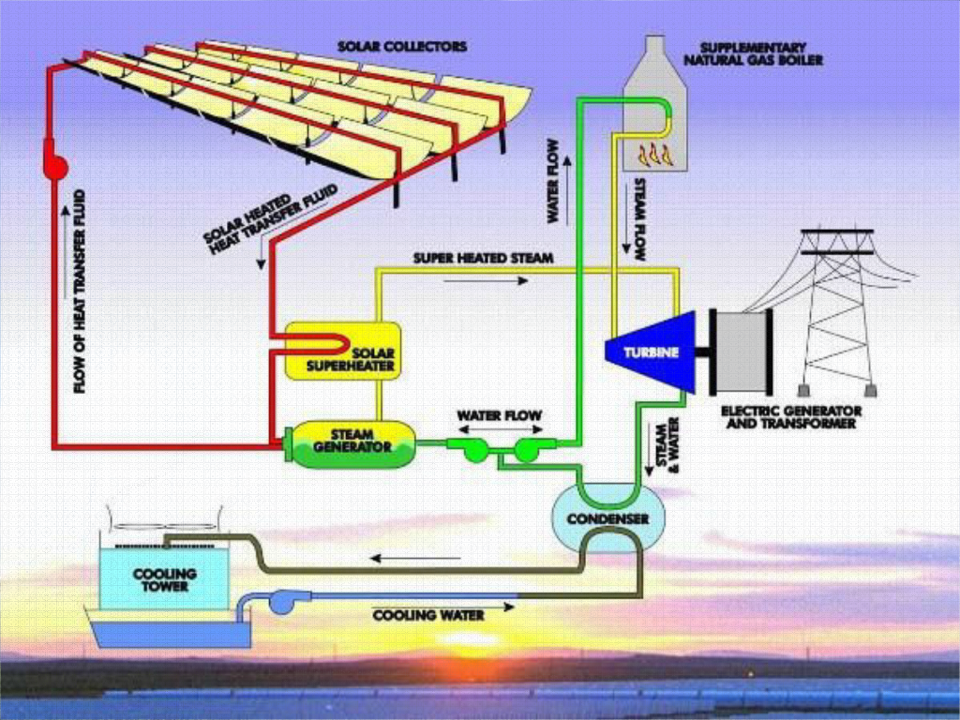

Slide 15
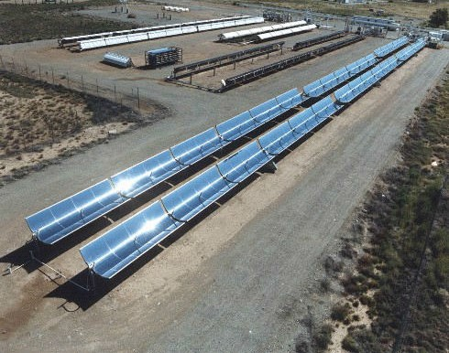
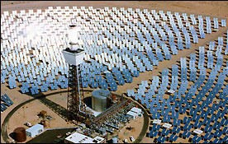
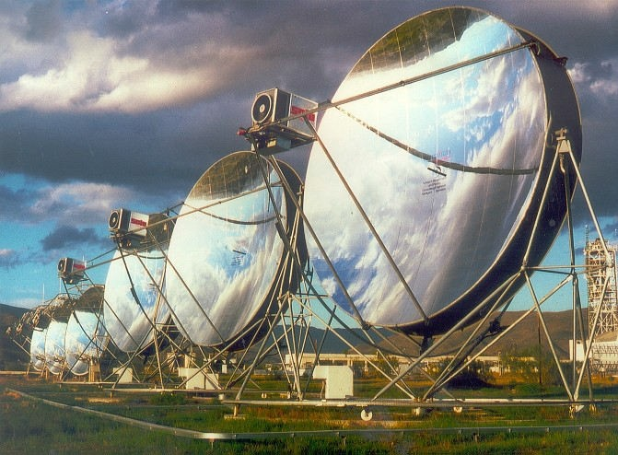
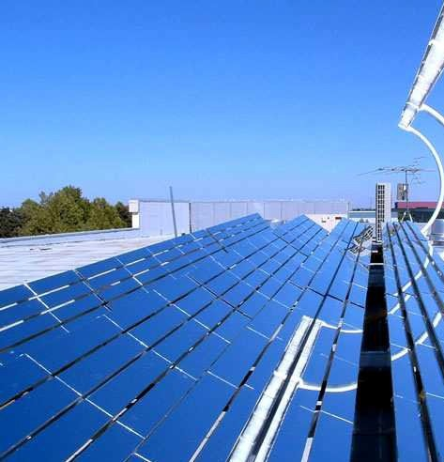

Slide 16
Application of solar energy
➢SOLAR ENGINES FOR WATER PUMPIN
SOLAR WATER HEATERS
➢SOLAR COOKERS
➢SOLAR DRIERS
➢SOLAR FURNACES
➢PHOTO-VOLTAIC CONVERSION(SOLAR CELLS)
➢SOLAR POWER GENERATION
➢SOLAR DISTILLATION

Slide 17
Side selection
➢Availability of solar radiation.
➢Availability of large land.
➢Accessibility from national highway (transport).
➢Distance from transmission line.
➢Local weathering concision.
➢Land prices and future rise.

Slide 18
ADVANTAGES
➢Sun is essentially an infinite source of energy.
➢The solar energy is a very large inexhaustible and renewable source of energy.
➢It is environmentally very clean and is hence pollution free.
➢It is dependable energy source without new requirements of highly technical and specialized nature for its wide spread utilization.
➢It is the best alternative for the rapid depletion of fossil fuels.

Slide 19
Disadvantages
➢It is available in a dilute form and is at low potential.
➢The intensity of solar energy on sunny day India is about 1.1kw/meter area.
➢Solar energy is not available at night or during cloudy or rainy days.

Slide 20
Total capacity of India (S.P.P)
State
MW
Andaman & Nicobar | 5.10
Andhra Pradesh | 475.74
Arunachal Pradesh | 0.26
Bihar | 5.00
Daman & div | 4.00
Delhi | 6.71
Gujarat | 1024.15
Haryana | 12.80
Kerala | 12.02
Punjab | 300.2

Slide 21
State Rajasthan |  | MW 1264.35
Telangana |  | 392.39
Utter Pradesh |  | 140.00
Uttarakhand |  | 5.00
West Bengal |  | 7.21
 | Total | 3654.93

Slide 22
THANKYOU

