Slide 1
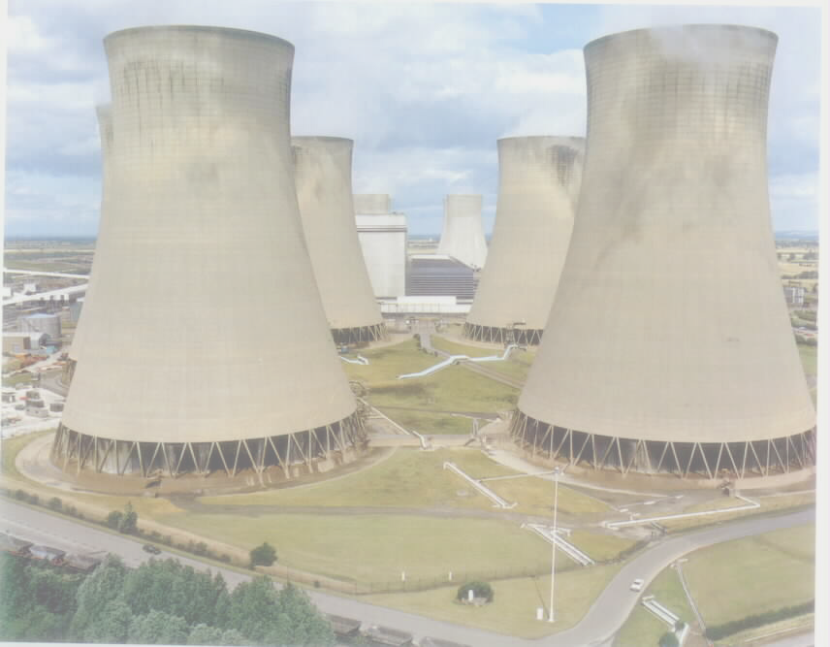
Thermal Power Plant
Steam (Vapour) Power Plant
Coal based Power Plant

Slide 2
Sources of energy:
Primary energy sources Secondary energy sources
Coal, Oil, Nuclear fuels, Water → Electricity
Wood → Heat
Candles, Oil lamps → Light
Conventional sources of energy → Non-renewable sources of energy
Non-conventional sources of energy → Renewable sources of energy
Fossil fuels → Coal, Oil, Natural gas

Slide 3
Power Plant: Power plant is an assembly of equipments that produces and delivers mechanical and electrical energy.
Types of power plant
1. Non-conventional Energy Source
  a. Solar energy
  b. Wind energy
  c. Geothermal energy
  d. Tidal energy
  e. Biomass energy
2.Conventional Energy Sources
  a. Solid, Liquid and gaseous fuels
  b. Hydraulic energy

Slide 4
Classification of Power plants
Power plants using conventional (non-renewable) sources of energy
Steam power plant
Nuclear(Atomic) power plant
Diesel power plant
Gas power plant
Hydro electric(Hydel) power plant
Power plants using Non-conventional(renewable) sources of energy
Solar thermal power plant
Wind powered generation(aerogeneration)
Wave power plant
Tidal power plant
Geothermal power plant
Bio-mass power plant
Oceanthermal power plant

Slide 5
INDIAN POWER SCENARIO GENERATION BY)
58.7 % - Coal
25.4 % - Hydro
10.7 % - Gas based
02.5 % - Nuclear
2.7 % - Non- Conventional & Diesel

Slide 6
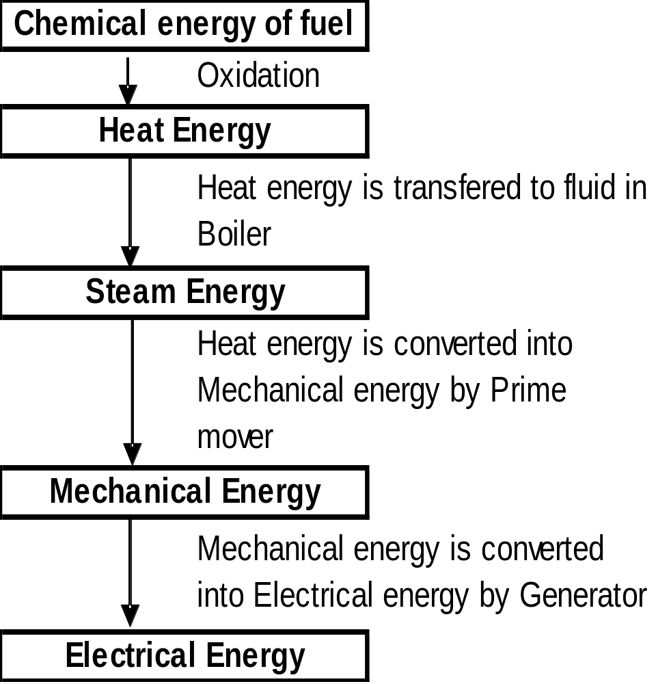
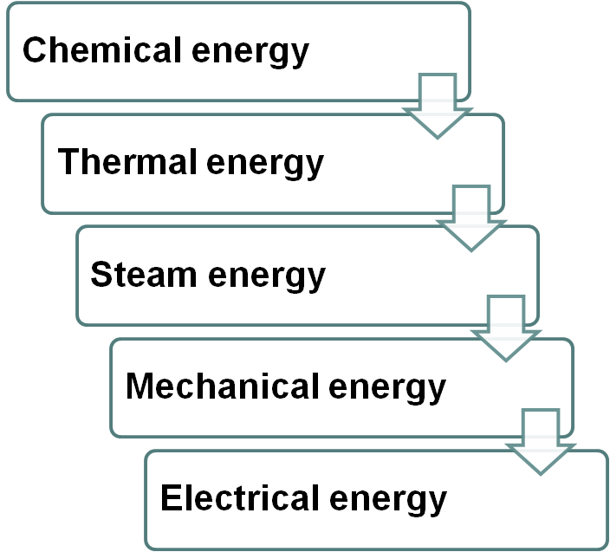
- INTRODUCTION:
Steam power plant is an energy converter

Slide 7
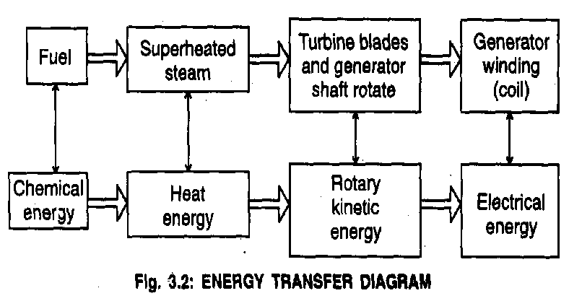
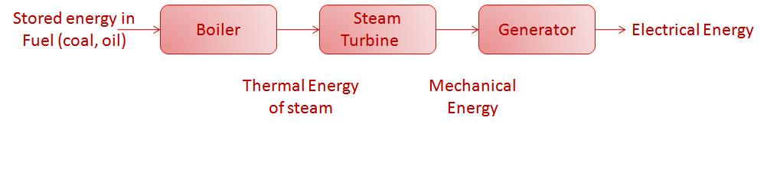
Steam (Thermal) Power Plant
Fuel : Coal or Oil
Main parts : Boiler, Turbine,
Generator , condenser, pump

Slide 8
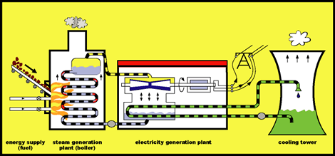

Slide 9
Steam Turbines
Turbines perform the energy conversion in two steps:
Step 1: Thermal energy of the steam to kinetic energy of the steam
Step 2: Kinetic energy of the steam to mechanical energy of the rotor

Slide 10
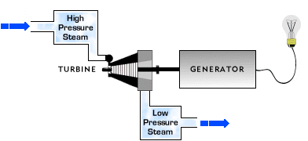

Slide 11
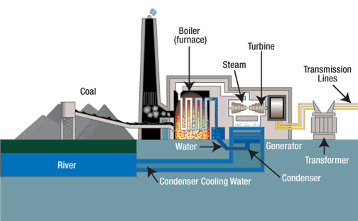
How a coal power station works.mp4

Slide 12
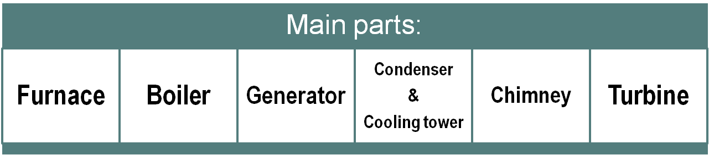


Slide 13
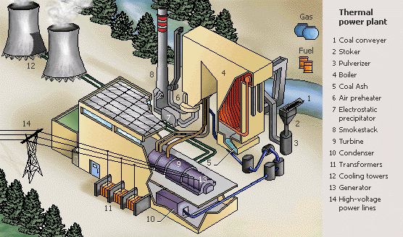

Slide 14
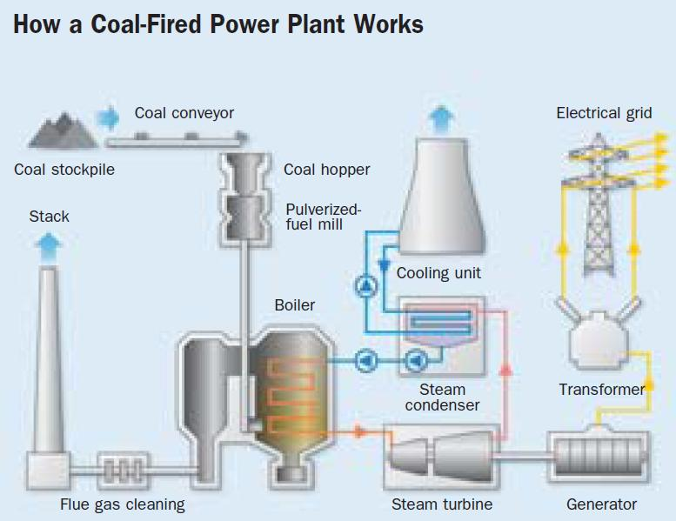

Slide 15
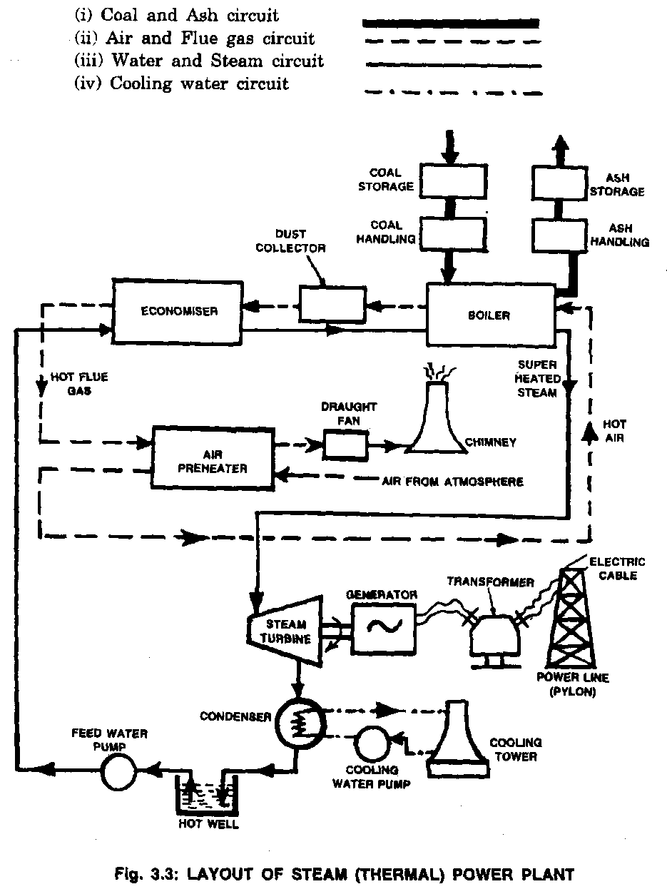
Steam (Thermal) Power Plant…
Coal and Ash circuit
Pulverised coal from the storage area (called stack) is taken to the boiler by means of coal handling equipment such as belt conveyors, bucket elevators etc.
Note : A thermal power plant of 400 MW capacity requires 5000 to 6000 tonnes of coal per day.
After the pulverised coal is burnt at 1500⁰C to 2000⁰C by combustion it gets collected in the ash pit.
It is removed from the ash pit by ash handling systems like belt conveyors, screw conveyors etc.
Note : A thermal power plant of 400 MW capacity requires 10 hectares area per year if ash is damped to a height of 6.5 metres.

Slide 16
Steam (Thermal) Power Plant…
Air and flue gas circuit
The air from the atmosphere gets heated in the air preheater. The air receives its heat from the hot flue gases passing to the chimney.
The hot air enters the boiler and helps in combustion of fuel in the boiler.
The flue gases, after combustion in the boiler furnace, pass around the boiler tubes, heating the water present in the tubes.
The flue gases then pass through a dust collector which removes any dust or solid particles.
The filtered flue gas passes through the economiser and preheater and is forced out through the chimney by a draught fan.

Slide 17
Steam (Thermal) Power Plant…
Feed water and steam circuit
The superheated steam from the boiler enters the steam turbine. The superheated steam temperature is about 600⁰C at a pressure of 30 Mpa(300 kg/cm²)
The steam expands in the turbine causing the turbine blades to rotate. After doing mechanical work on the blades and loosing its energy, the steam becomes wet and the pressure of steam becomes less.
The wet steam passes through a condenser where it completely becomes water. The condensed water that has a temperature of 30⁰C to 40⁰C is collected in a tank called hot well.
The water from the hot well is fed into the boiler through the economiser.
The economiser preheats the water before entering the boiler. The economiser receives its heat from the flue gases leaving the boiler .
Preheating the feed water in the economiser increases the boiler efficiency and helps quicker production of steam.

Slide 18



Steam (Thermal) Power Plant…
Cooling water circuit
Water is circulated around the condenser to condense the steam coming out of the turbine.
Cooling water enters the condenser at 10⁰C to 15⁰C and leaves at 20⁰C to 25⁰C.
Plenty of water is required for condensing the steam in the condenser. The water may be taken from sources such as river or lake.

Slide 19
SITE SELECTION FOR THERMAL POWER PLANT
A few important factors to be considered for the selection of site for thermal plants are listed below:
Availability of Coal
Ash Disposal Facility
Space Requirements
Nature of Land
Availability of Water
Transport Facilities
Availability of a Labour
Public Problems
Size of the Plant

Slide 20
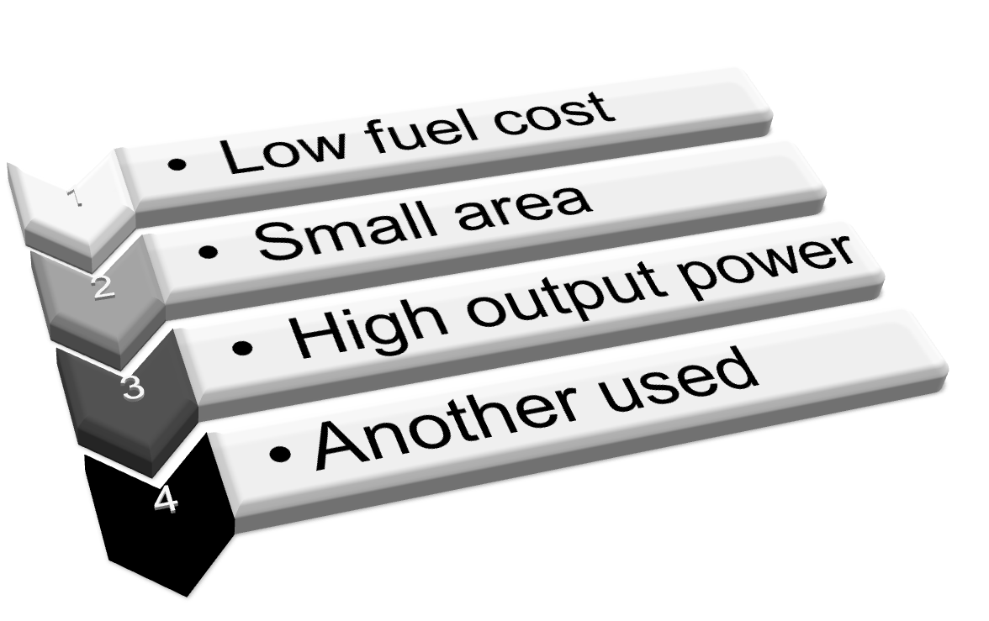
- Advantages:

Slide 21
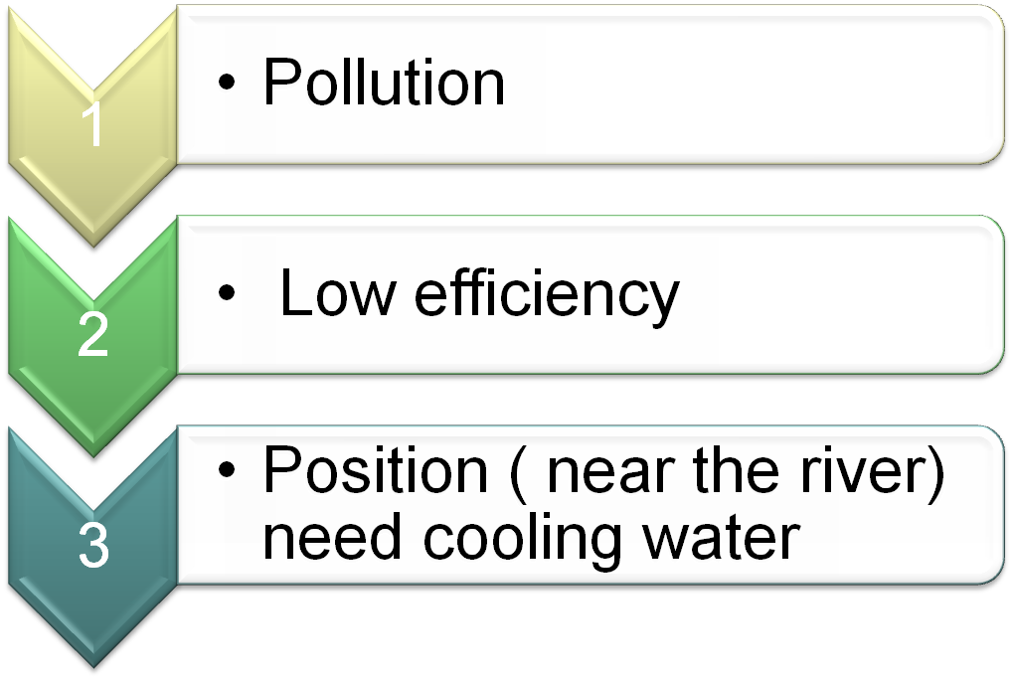
- Disadvantages:

Slide 22
Steam (Thermal) Power Plant…
Advantages of thermal power plant :
Low initial cost
Since located near the load centre, the cost of transmission and the losses due to transmission are considerably reduced.
The construction and commissioning of thermal power plant takes lesser period.
Disadvantages of thermal power plant:
Fuel is a non-renewable source of energy.
Efficiency decreases with decreasing load.
Cost of power generation is high.
Smoke produced by burning the fuel causes air pollution.
Life of thermal power plant is 25 years. The efficiency decreases to less than 10% after its life period.
Turbines has a high running speed of 3000 to 4000 rpm.

