Slide 1
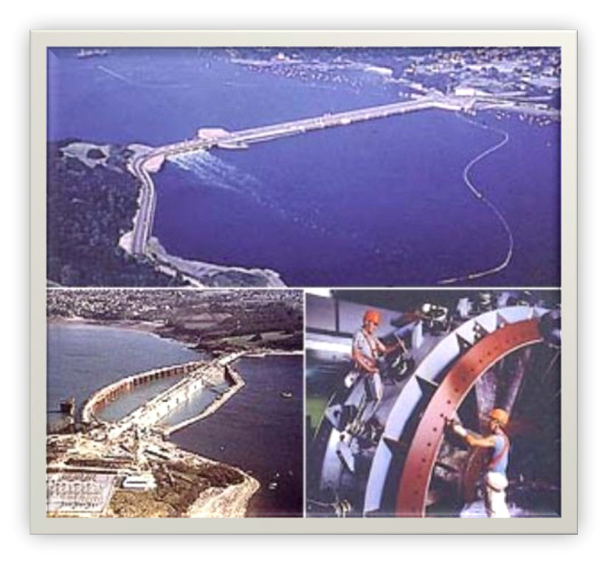
Tidal Energy

Slide 2
INDEX
Introduction
Tides
History
Types of tidal power plants
Major kinds of generators used
Pros and Cons
Facts

Slide 3

Tidal power, also called tidal energy, is a form of hydropower that converts the energy of tides into useful forms of power - mainly electricity. This is the only form of energy whose source is the moon.

Slide 4
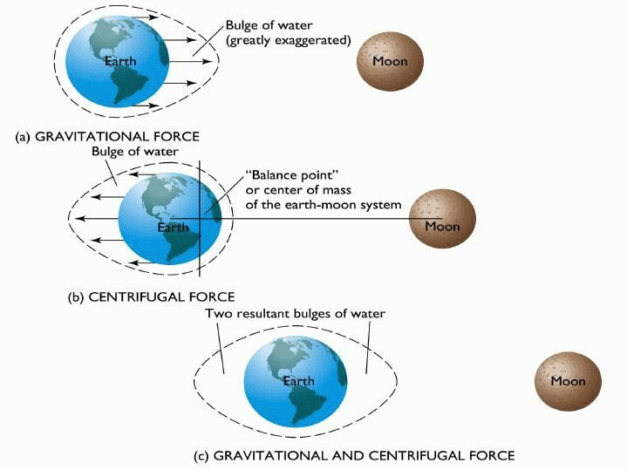
Basic physics of tides
•Gravitational pull of the sun and moon and the pull of the centrifugal force of rotation of the earth-moon system.
There are two high tides and two low tides during each period of rotation of the earth.
Spring and Neap tides depend on the orientation of the sun, moon, and the earth.
▫ High spring tides occur when the sun and moon line up with the earth. This occurs whether they are either on same or opposite side.
▫ Low neap tides occur when the sun and moon line up at 90 a to each other.
Flood Currents: currents moving in the direction of the coast.
Ebb Currents: the current receding from the coast
•When a landmass lines up with the earth-moon system, the water around it is at high tide.
•When a landmass is at 90 to the earth-moon system, the water around it is at low tide.

Slide 5
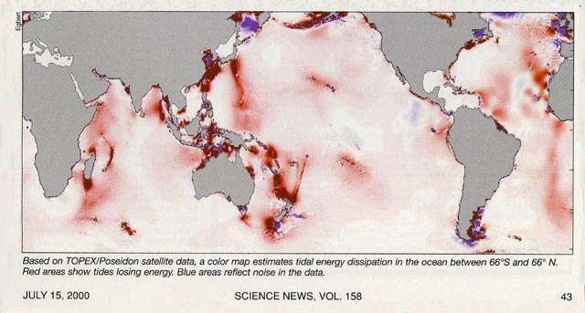
World Map of the Distribution of Tidal
Energy
Red areas show most intense tidal energy

Slide 6
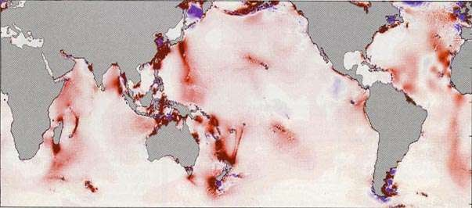
Developing Nations
that could receive significant benefits from Tidal Energy
Indian Ocean: Comoros, Madagascar, Maldives, Seychelles. Asia: China, India, Indonesia, Korea, Philippines, Vietnam.
Pacific Ocean: Fiji, Kiribati, Micronesia, Palau, Papua New Guinea, Samoa, Solomon Islands, Timor, Tuvalu, Vanuatu.
Central and South America: Argentina, Brazil, Ecuador, Guyana, Panama, Surinam.
Atlantic Ocean: Cape Verde.
All coastal nations with tidal passes between coral reefs or offshore islands.

Slide 7
History
The first tidal power station was
the Rance tidal power plant built over a period of 6 years from 1960 to 1966 at La Rance, France. It has 240 MW installed capacity.
also the world's second biggest tidal power station.

Slide 8
With a peak rating of 240 Megawatts, generated by its 24 turbines, it supplies 0.012% of the power demand of France. With a capacity factor of approximately 40%, it supplies an average 96 Megawatts, giving an annual output of approximately 600GWh. The barrage is 750 m (2,461 ft) long, from Brebis point in the west to Briantais point in the east. The power plant portion of the dam is 332.5 m (1,091 ft) long. The tidal basin measures 22.5 km² (9 sq mi).

Slide 9
Two types of tidal plant facilities.
Tidal barrages
Tidal current turbines
Dynamic tidal power plants

Slide 10
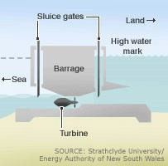
1.) Tidal Barrage
Utilize potential energy
Tidal barrages are typically dams built across an estuary or bay.
consist of turbines, sluice gates, embankments, and ship locks.
Two types:
Single basin system
Double-basin system
Basin

Slide 11
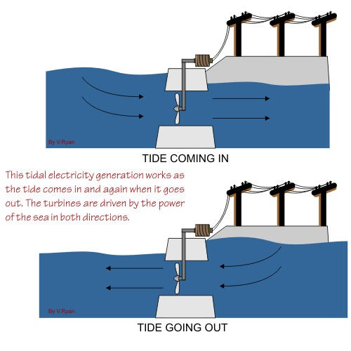

Slide 12
Single basin system-
Ebb generation: During flood tide basin is filled and sluice gates are closed , trapping water. Gates are kept closed until the tide has ebbed sufficiently and thus turbines start spinning and generating electricity.
Flood generation: The basin is filled through the turbine which generate at flood tide.
Two way generation: Sluice gates and turbines are closed until near the end of the flood tide when water is allowed to flow through the turbines into the basin creating electricity. At the point where the hydrostatic head is insufficient for power generation the sluice gates are opened and kept open until high tide when they are closed. When the tide outside the barrage has dropped sufficiently water is allowed to flow out of the basin through the turbines again creating electricity.

Slide 13
Double-basin system
There are two basins, but it operates similar to en ebb generation, single-basin system. The only difference is a proportion of the electricity is used to pump water into the second basin allowing storage.

Slide 14
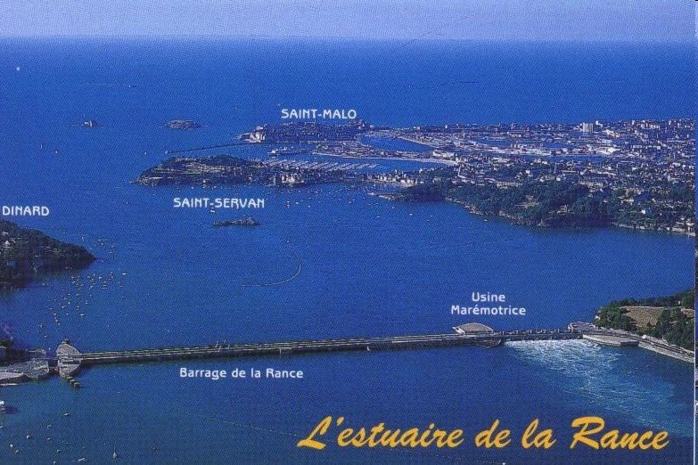
Current sites of tidal barrages
La Rance, Brittany, France
▫ The first and 2nd largest tidal barrage power plant
▫ Constructed between 1961 and 1967.
▫ Situated on the Rance River.
▫ Contains 24 reversible 10 MW bulb turbines generating a capacity of 240 MW and a net power output of 480 GWh per year.
▫ Two- way generation system and pumped storage.

Slide 15
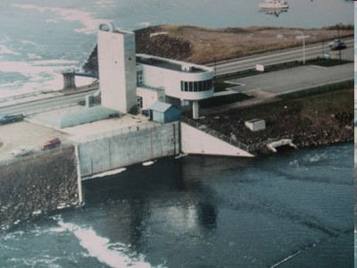
Annapolis Tidal Generation Facility on the
Bay of Fundy, Canada
Constructed between 1981
and 1984.
Generating capacity of 20 MW and a net output of 30 GW h per year.
Further development is being considered in the Bay of Fundy.

Slide 16
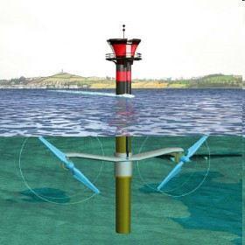
2.)Tidal current
turbines
Make use of the kinetic energy of moving water to power turbines, in a similar way to wind turbines that use wind to power turbines.
Operate during flood and ebb tides.
Consists of a rotor, gearbox, and a generator. These three parts are mounted onto a support structure. There are three main types:
▫ Gravity structure
▫ Piled structure
▫ Floating structure

Slide 17
Gravity Structures are massive steel or concrete structures attached to the base of the units to achieve stability by their own inertia.
Piled Structures are pinned to the seabed by one or more steel or concrete piles. The piles are fixed to the seabed by hammering if the ground conditions are sufficiently soft or by pre-drilling, positioning and grouting if the rock is harder.
Floating Structures provide a potentially more convincing solution for deep water locations.

Slide 18
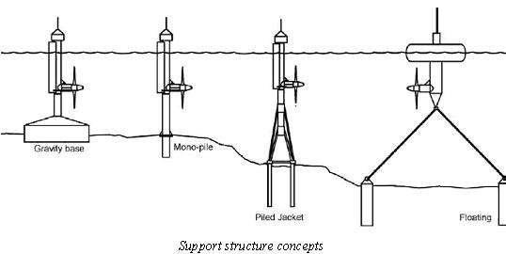

Slide 19
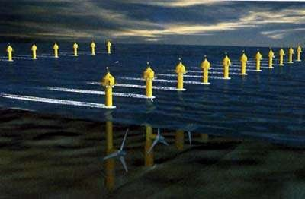

Slide 20
3)DYNAMIC TIDAL POWER PLANT
•Dynamic tidal power or DTP is a new and untested method of tidal power generation. It would involve creating large dam-like structure extending from the coast straight to the ocean, with a perpendicular barrier at the far end, forming a large 'T' shape.
•A single dam can accommodate over 8 GW (8000 MW) of installed capacity.

Slide 21
A DTP dam is a long dam of 30 to 60 km which is built perpendicular to the coast, running straight out into the ocean, without enclosing an area.
Other concerns include: shipping routes, marine ecology, sediments, and storm surges.

Slide 22
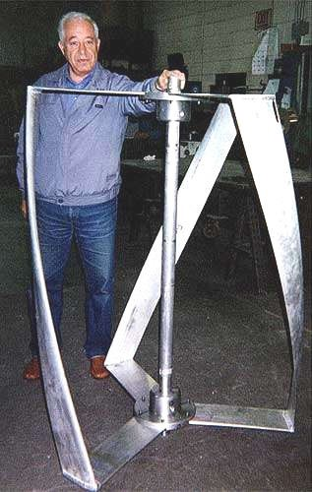
Tidal Energy can be captured
efficiently and
inexpensively using the helical
turbine
Prof. AlEXANDEr Gorlov of NorthEAstErN UNIvErsIty wIth thE hElIcAl tUrbINE.
hE INvENtED AND PErfEctED It.

Slide 23
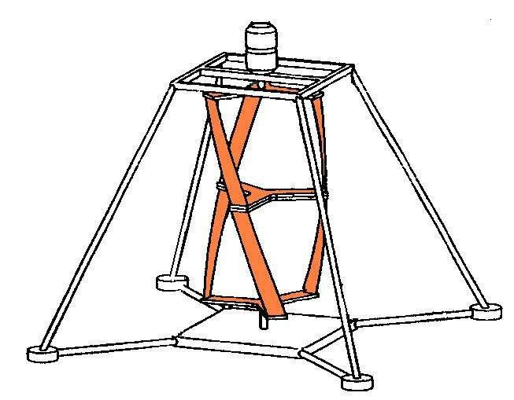
Features of the Helical Turbine:
Basic Concept
designed for hydroelectric applications in free-flowing water
operates in ocean, tidal, and river currents
does not require expensive dams that can harm the environment

Slide 24
Features of the Helical Turbine
Operation
self-starting with flow as low as 0.6 m/s
smooth-running
rotates in same direction regardless of the direction of flow, making it ideal for tidal applications

Slide 25
Types of tidal stream generators
Since tidal stream generators are an immature technology, no standard technology has yet emerged as the clear winner.
but a large variety of designs are being experimented with, some very close to large scale deployment.

Slide 26
Major 2 Types of tidal stream generators
Axial turbines
Vertical and horizontal axis cross flow turbines

Slide 27
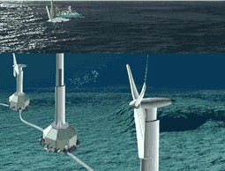
Axial turbines
These are close in concept to traditional windmills operating under the sea.

Slide 28
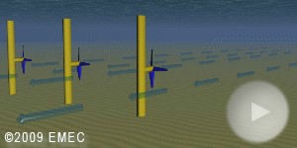
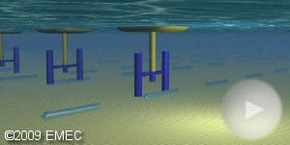
Vertical and horizontal axis cross flow turbines
These turbines that can be deployed either vertically or horizontally.

Slide 29
Significant benefits
from using Tidal Energy include:
Electrification of isolated communities
Generation for the grid
•Regrowth of coral reefs using mineral accretion technology
Substitution of imported petroleum used to generate electricity

Slide 30
Multiple Benefits from Tidal Energy.
Practical Examples:
•
Electrification of isolated communities.
Regrowth of coral reefs using mineral accretion technology.
•

Slide 31
Pros AND coNs of both tIDAl PowEr fAcIlItIEs

Slide 32
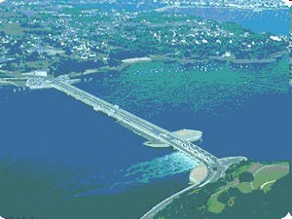
Tidal Barrages
•Mature technology that has been around for nearly 50 years.
•Reliable energy source.
BUT
•High costs of construction
•Environmental impacts on marine life
•Low power output in comparison to other energy source like coal and nuclear power plants
.

Slide 33
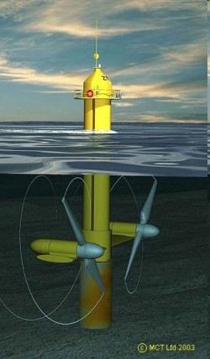
Tidal Current Turbines
Able to utilize both ebb and flood tides.
Tidal current turbines are not large massive dam structure.
BUT
Tidal current turbine technology is young in its development.
Installation and maintenance challenges.
Environmental impacts are still being tested

Slide 34
ENVIRONMENTAL FRIENDLINESS
Tidal energy use involving dams creates many of the same environmental concerns as damming rivers. Tidal dams restrict fish migration and cause silt build up which affects tidal basin ecosystems in negative ways.
Systems that take advantage of natural narrow channels with high tidal flow rates have less negative environmental impact than dammed systems. But they are not without environmental problems.

Slide 35
Both systems use turbines that can cause fish kills. But these are being replaced by new, more fish friendly turbines. The art and science of environmentally friendly hydro engineering is well advanced and will certainly be applied to any tidal energy project.
But even with dams, the environmental impact of tidal energy projects may prove to be smaller than our use of any other energy resource. Economics will severely limit the number of tidal energy projects.

Slide 36
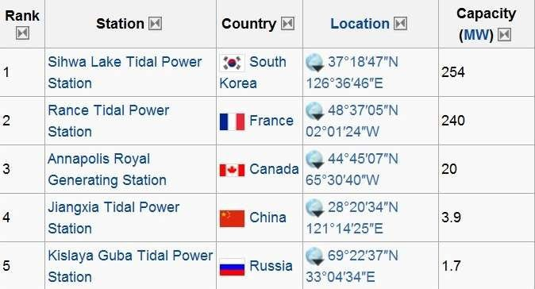
Major Tidal plants in World

Slide 37
Tidal plants in India
West Bengal Renewable Energy Development Agency in sunderbans.
The Indian state of Gujarat is planning to host South Asia's first commercial-scale tidal power station. The company Atlantis Resources is to install a 50MW tidal farm in the Gulf of Kutch on India's west coast, with construction starting early in 2012. later on it is decided to increase the capacity up to 250MW plants.

Slide 38
Tidal plants in Kerala
Situated near the breakwaters of Vizhinjam Port which is about 20 km
from Thiruvananthapuram city. The station started its commercial operation in 1991. This oscillating water column (OWC) produces about 150 kw of power.

Slide 39
Economics
Tidal energy is not cost competitive because it is generally not commercially available.
When selecting a spot to set up a tidal energy station it is important to make sure that it will be economically feasible.
To set up a tidal facility with an average annual output of 1050 MW would cost about
1.2 billion dollars, not including maintenance and running costs.
This is far more expensive than coal and oil.

Slide 40
FUTURE?
In a society with increasing energy needs, it is becoming more and more important to have alternative sources of power to keep up with the ever growing energy demand.
The capacity of tidal energy exceeds that of coal and oil and is renewable.
The Department of Energy has shown great enthusiasm in regards to tidal power as the perfect energy source for the future.

