Slide 1
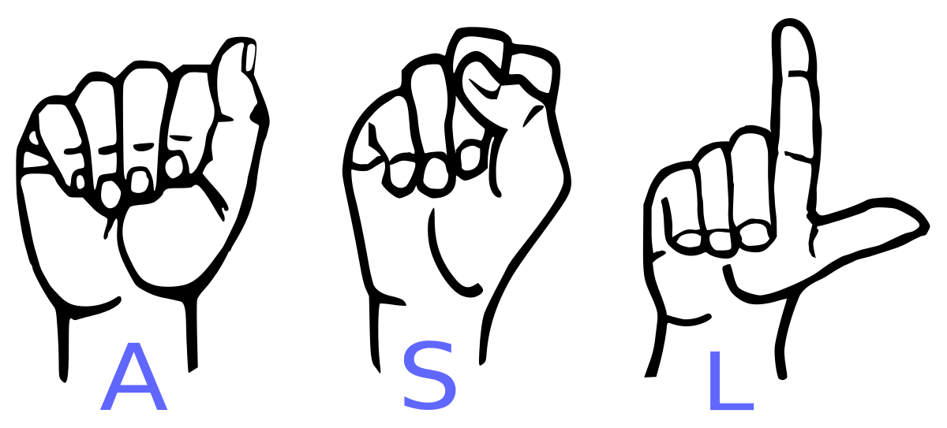
SIGN LANGUAGE TO TEXT/SPEECH
Breaking Mute walls

Slide 2
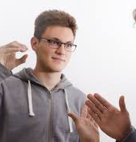
OBJECTIVE
More than 70 million deaf people around the world use sign languages to communicate. Sign language allows them to learn, work, access services, and be included in the communities.
It is hard to make everybody learn the use of sign language with the goal of ensuring that people with disabilities can enjoy their rights on an equal basis with others.
So, the aim is to develop a user-friendly human computer interface (HCI) where the computer understands the sign language This Project will help the dumb and deaf people by making their life easy.

Slide 3
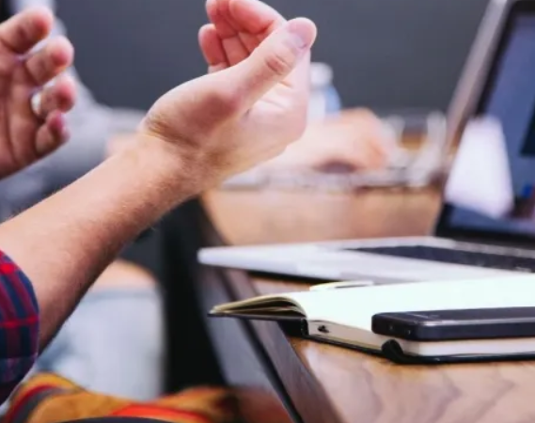
SCOPE
THIS SYSTEM WILL BE BENEFICIAL FOR BOTH DUMB/DEAF PEOPLE AND THE PEOPLE WHO DO NOT UNDERSTANDS THE SIGN LANGUAGE. THEY JUST NEED TO DO THAT WITH SIGN LANGUAGE GESTURES AND THIS SYSTEM WILL IDENTIFY WHAT HE/SHE IS TRYING TO SAY AFTER IDENTIFICATION IT GIVES THE OUTPUT IN THE FORM OF TEXT AS WELL AS SPEECH FORMAT.

Slide 4
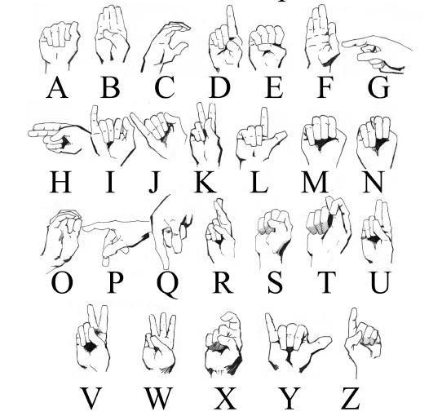
TO CREATE A COMPUTER SOFTWARE AND TRAIN A MODEL USING CNN WHICH TAKES AN IMAGE OF HAND GESTURE OF AMERICAN SIGN LANGUAGE AND SHOWS THE OUTPUT OF THE PARTICULAR SIGN LANGUAGE IN TEXT FORMAT AND CONVERTS IT INTO AUDIO FORMAT AS WELL.
INTRODUCTION

Slide 5
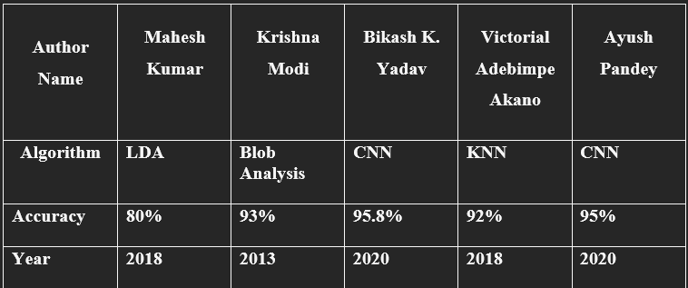
LITERATURE SURVEY

Slide 6
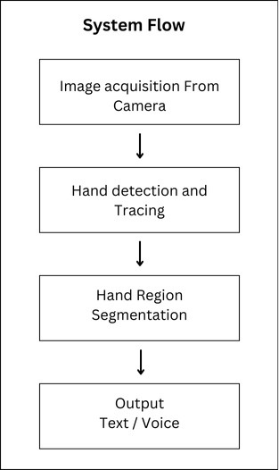
SYSTEM FLOWCHART

Slide 7
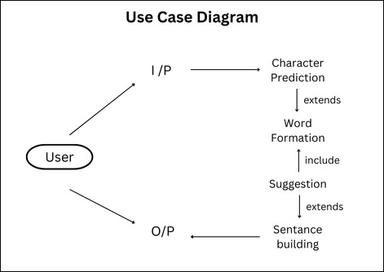
USE-CASE DIAGRAM

Slide 8
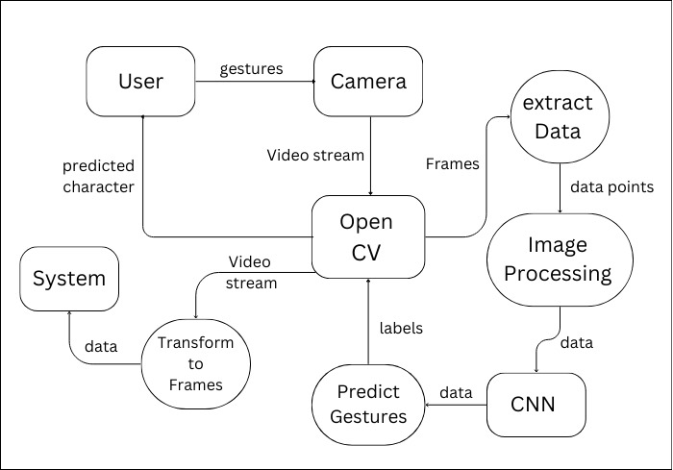
DFD DIAGRAM
LEVEL-1
LEVEL-0

Slide 9
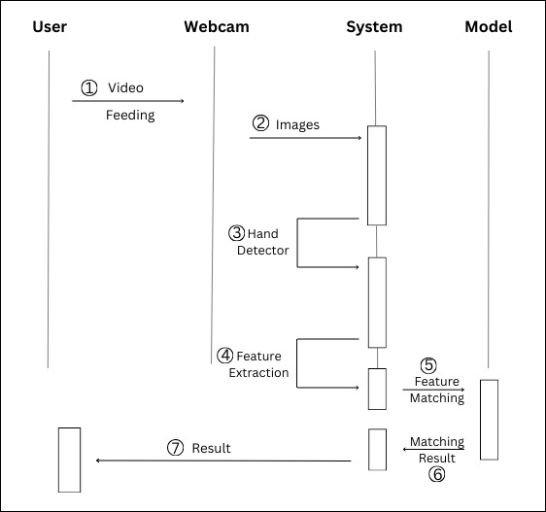
SEQUANCE DIAGRAM

Slide 10
PROJECT MODULES
1.Data Acquisition
2.Data pre-processing and Feature extraction
3.Gesture Classification
4. Text and Speech Translation

Slide 11
THANK YOU

