Slide 1
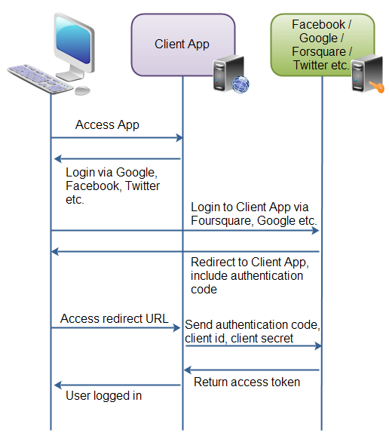
Notes:
First the user accesses the client web application. In this web app is button saying "Login via Facebook" (or some other system like Google or Twitter).
Second, when the user clicks the login button, the user is redirected to the authenticating application (e.g. Facebook). The user then logs into the authenticating application, and is asked if she wants to grant access to her data in the authenticating application, to the client application. The user accepts.
Third, the authenticating application redirects the user to a redirect URI, which the client app has provided to the authenticating app. Providing this redirect URI is normally done by registering the client application with the authenticating application. During this registration the owner of the client application registers the redirect URI. It is also during this registration that the authenticating application gives the client application a client id and a client password. To the URI is appended an authentication code. This code represents the authentication.
Fourth, the user accesses the page located at the redirect URI in the client application. In the background the client application contacts the authenticating application and sends client id, client password and the authentication code received in the redirect request parameters. The authenticating application sends back an access token.
Once the client application has obtained an access token, this access token can be sent to the Facebook, Google, Twitter etc. to access resources in these systems, related to the user who logged in.

Slide 2
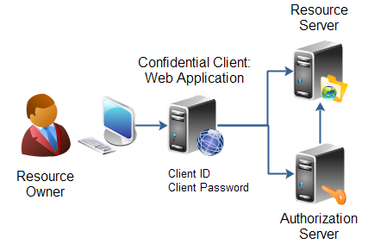
Client Profiles
The OAuth 2.0 specification also mentions a set of client profiles. These profiles are concrete types of applications, that can be either confidential or public. The profiles are:
Web Application
User Agent
Native
Web Application
A web application is an application running on a web server. In reality, a web application typically consists of both a browser part and a server part. If a web application needs access to a resource server (e.g. to Facebook user accounts), then the client password could be stored on the server. The password would thus be confidential.

Slide 3
When a client applications wants access to the resources of a resource owner, hosted on a resource server, the client application must first obtain an Authorization grant..
Client ID, Client Secret and Redirect URI
Before a client application can request access to resources on a resource server, the client application must first register with the authorization server associated with the resource server.
The registration is typically a one-time task. Once registered, the registration remains valid, unless the client app registration is revoked.
At registration the client application is assigned a client ID and a client secret (password) by the authorization server. The client ID and secret is unique to the client application on that authorization server. If a client application registers with multiple authorization servers (e.g. both Facebook, Twitter and Google), each authorization server will issue its own unique client ID to the client application.
Whenever the client application requests access to resources stored on that same resource server, the client application needs to authenticate itself by sending along the client ID and the client secret to the authorization server.
During the registration the client also registers a redirect URI. This redirect URI is used when a resource owner grants authorization to the client application. When a resource owner has successfully authorized the client application via the authorization server, the resource owner is redirected back to the client application, to the redirect URI.
Notes:
Authorization Grant
The authorization grant is given to a client application by the resource owner, in cooperation with the authorization server associated with the resource server.
The OAuth 2.0 specification lists four different types of authorization grants. Each type has different security characteristics. The authorization grant types are:
Authorization Code
Implicit
Resource Owner Password Credentials
Client Credentials

Slide 4
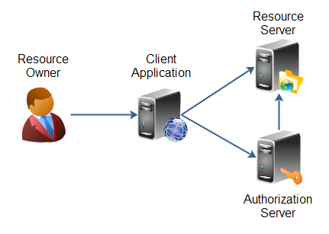
OAuth 2.0 defines the following roles of users and applications:
Resource Owner
Resource Server
Client Application
Authorization Server
Notes:
The resource owner is the person or application that owns the data that is to be shared. For instance, a user on Facebook or Google could be a resource owner. The resource they own is their data. The resource owner is depicted in the diagram as a person, which is probably the most common situation. The resource owner could also be an application. The OAuth 2.0 specification mentions both possibilities.
The resource server is the server hosting the resources. For instance, Facebook or Google is a resource server (or has a resource server).
The client application is the application requesting access to the resources stored on the resource server. The resources, which are owned by the resource owner. A client application could be a game requesting access to a users Facebook account.
The authorization server is the server authorizing the client app to access the resources of the resource owner. The authorization server and the resource server can be the same server, but it doesn't have to. The OAuth 2.0 specification does not say anything about how these two servers should communicate, if they are separate. This is an internal design decision to be made by the resource server + authorization server developers.

Slide 5
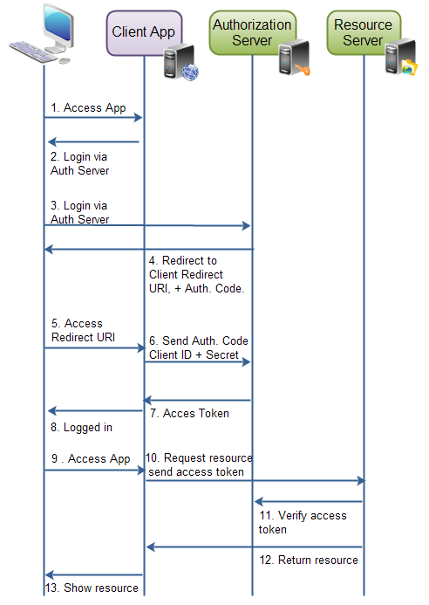

Slide 6
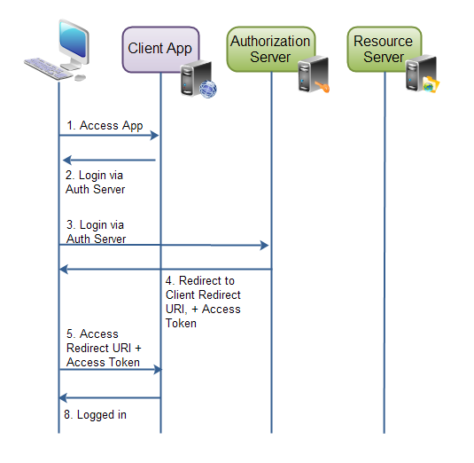

Slide 7
Simple Authentication Using JWT
OAuth2 Authorisation Server and Open ID Provider
Submits User credentials
and gets the JWT Token
Presents the JWT token with all related
user information about its membership MID etc
to the exposed
REST API in the header
University
Web Application
REST API’s
The REST API can do validation again if
required and extract is member of (umn . ***
And MID

Slide 8
Exchange external OAuth2 Token with Internal Tokens
OAuth2 Social Identity provider
OAuth2 Authorisation Server and Open ID Provider
2. Call REST Token Exchange service
with Social Identity provider tokens
3. Authorisation server checks if issuer is supported
If yes then provides new token
4. Access and ID tokens returned to the client
5. Presents the JWT token to the exposed
REST API in the header
University
Web Application
REST API’s
6. The REST API can do validation again if
required and extract is member of (umn . ***
And MID

