Slide 1
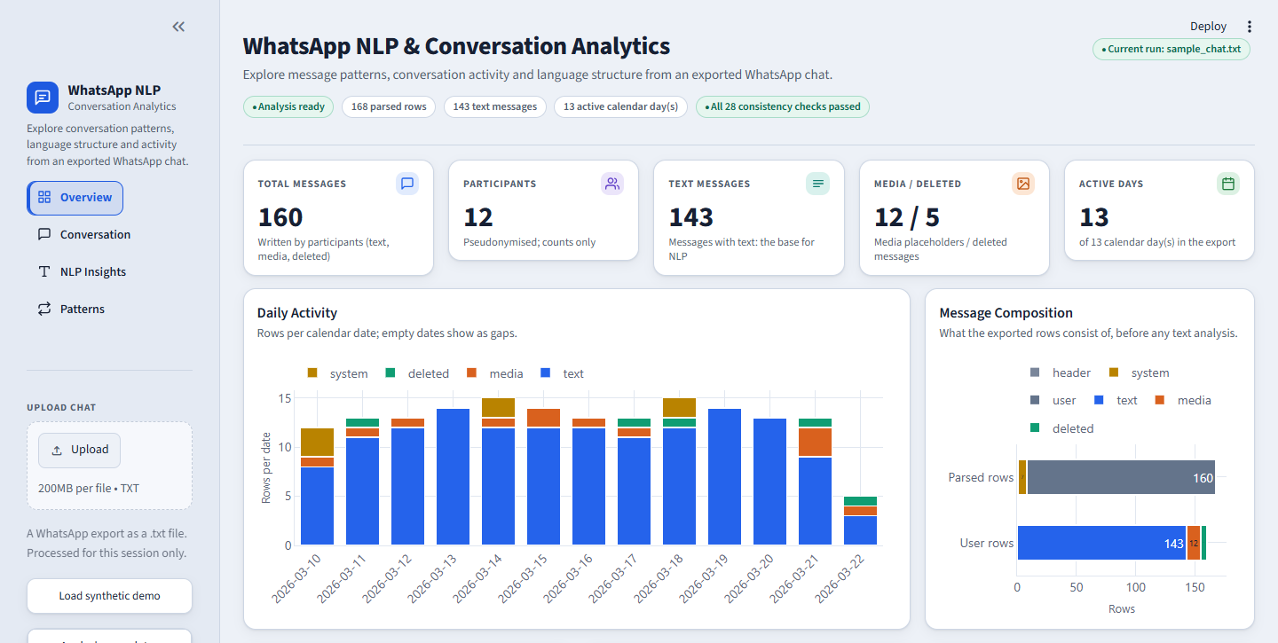
MSc DATA SCIENCE
WhatsApp NLP &
Conversation Analytics
Dashboard
A privacy-aware pipeline and interactive dashboard for describing the language and activity structure of exported WhatsApp chats
Abhishek Vanahalli
CHRIST (Deemed to be University)
Supervisor: Himani Sivaraman, Faculty, CHRIST (Deemed to be University)
10/10/2026
Overview page, fictional sample chat
Notes:
Introduce the project in one sentence: a reproducible, privacy-aware pipeline and dashboard that describes the language and activity structure of an exported WhatsApp chat. Mention that the public demonstration uses a fictional chat.

Slide 2
Problem & Objectives
Why a raw chat export needs a careful, explainable analysis pipeline
PROBLEM
OBJECTIVES
An exported WhatsApp chat is a raw text file. It is hard to see directly:
1
Build a robust WhatsApp parser and preprocessing pipeline
Message patterns
2
Apply NLP techniques: n-grams and TF-IDF
Frequently used terms
3
Analyse Script Mix and key conversational terms
Activity over time
Repeated content
4
Extract activity and repetition patterns
Writing-system usage
Conversation composition
5
Present results in a privacy-conscious interactive dashboard
WhatsApp NLP & Conversation Analytics Dashboard | MSc Data Science | Abhishek Vanahalli
2
Notes:
Problem: an exported chat is a raw text file mixing messages, system events, media placeholders and several scripts. Objectives: parse robustly, apply NLP (n-grams, TF-IDF), describe script usage and key terms, extract conversation-level patterns, and present everything in a privacy-conscious dashboard.

Slide 3
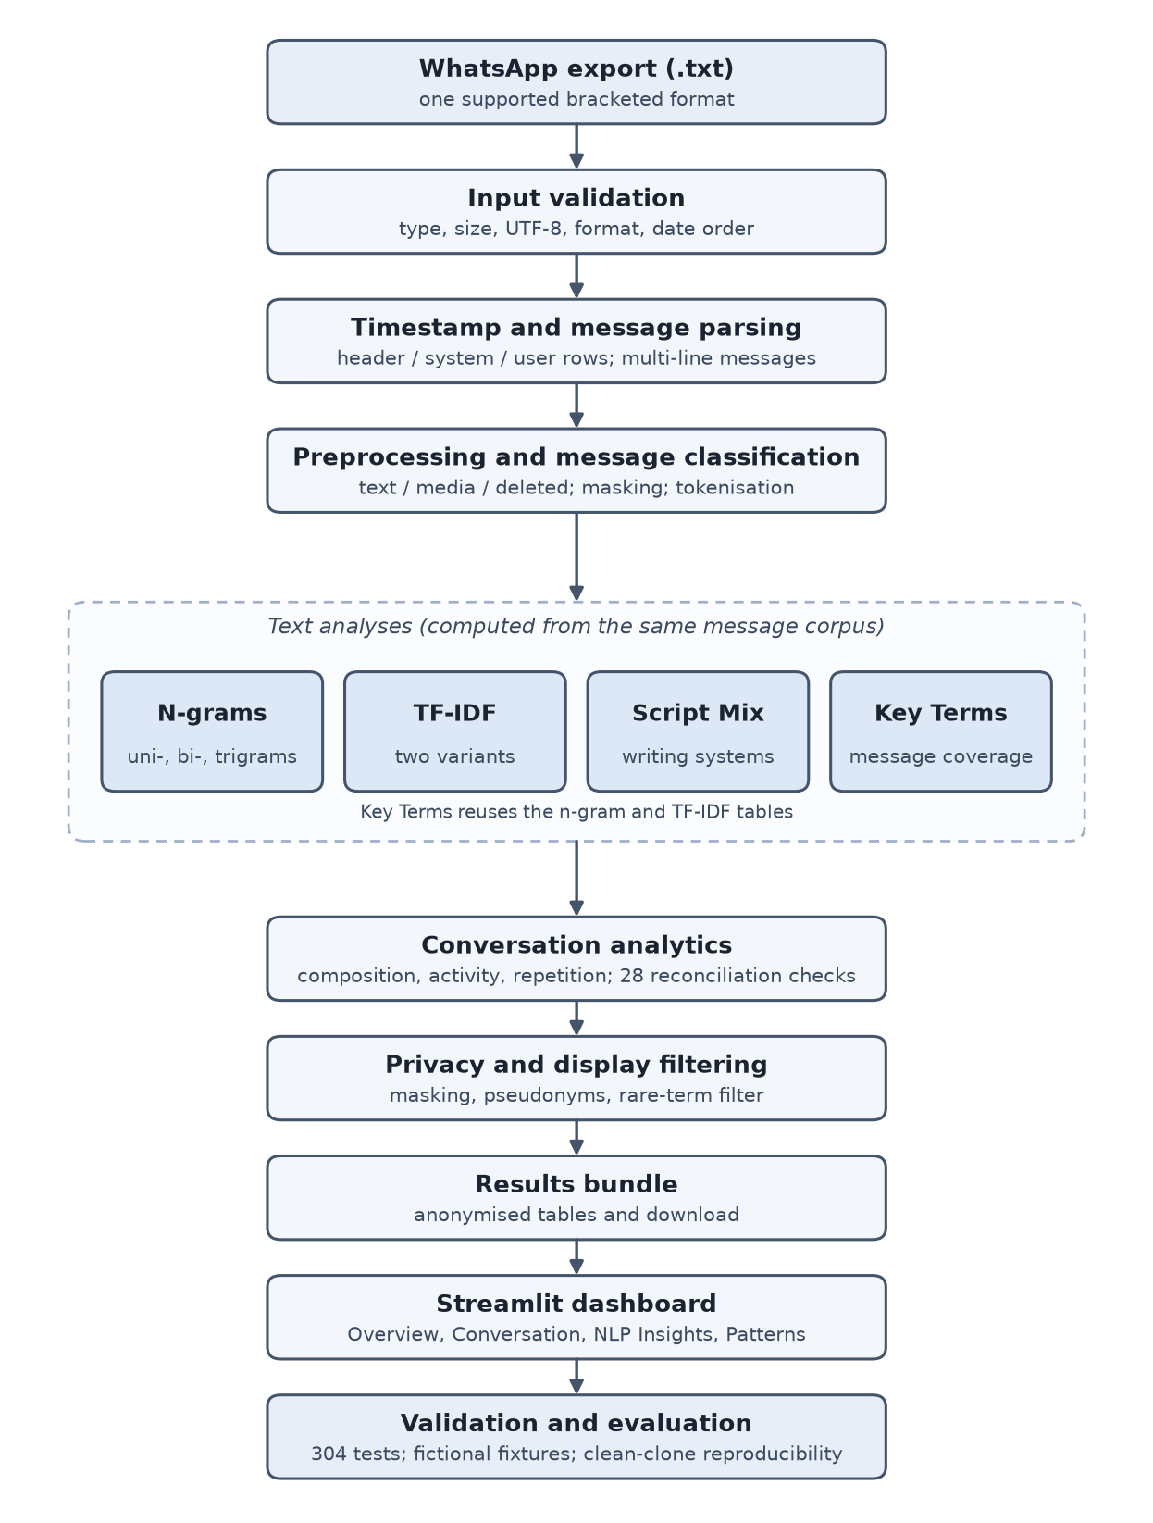
Data & Methodology
One supported export format, one reproducible pipeline
WHAT HAPPENS TO AN UPLOADED CHAT
1
Validate and parse
Bracketed .txt export; header, system and user rows; multi-line messages kept together
2
Preprocess and classify
Text, media or deleted; links and phone numbers masked; Unicode-aware tokens
3
Analyse
N-grams, TF-IDF, Script Mix, Key Terms and conversation analytics (28 reconciliation checks)
4
Filter and present
Privacy filter, anonymised results bundle, Streamlit dashboard
Public demonstration uses a fictional WhatsApp-style dataset for privacy and reproducibility.
WhatsApp NLP & Conversation Analytics Dashboard | MSc Data Science | Abhishek Vanahalli
3
Notes:
Walk down the pipeline: validate, parse, preprocess and classify rows, then the four text analyses and conversation analytics with 28 reconciliation checks, then privacy filtering, the results bundle and the dashboard. Stress that the public demonstration uses a fictional chat so nothing private is exposed.

Slide 4
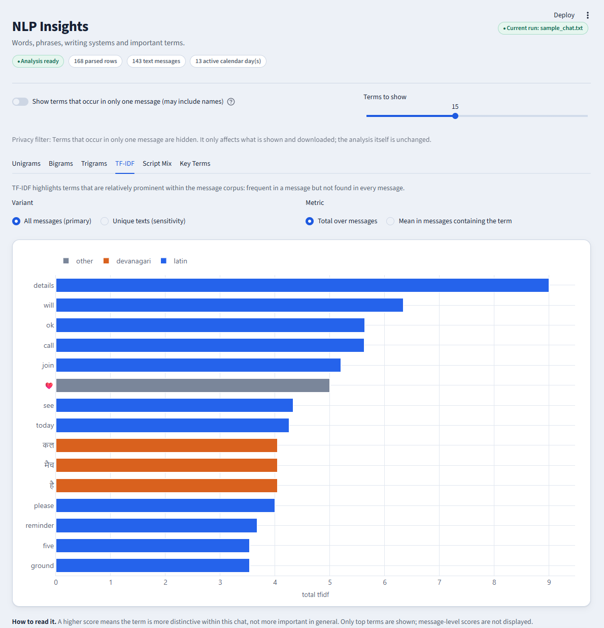
NLP Analysis
N-GRAMS
TF-IDF
Unigrams
Term distinctiveness
Bigrams
Primary + unique-text variants
Trigrams
Validated against scikit-learn
All messages vs unique texts
SCRIPT MIX
KEY TERMS
Latin
Message coverage
Devanagari
Total occurrences
Mixed-script
Repeated-message effect
No-alphabetic
TF-IDF tab, fictional sample chat
Script Mix is a writing-system analysis, not language identification.
WhatsApp NLP & Conversation Analytics Dashboard | MSc Data Science | Abhishek Vanahalli
4
Notes:
Four analyses. N-grams are counted per message over all messages and over unique texts, so repetition is visible. TF-IDF weights distinctiveness within the chat and was validated against scikit-learn. Script Mix describes writing systems and is NOT language identification. Key Terms rank terms by the number of distinct messages containing them.

Slide 5
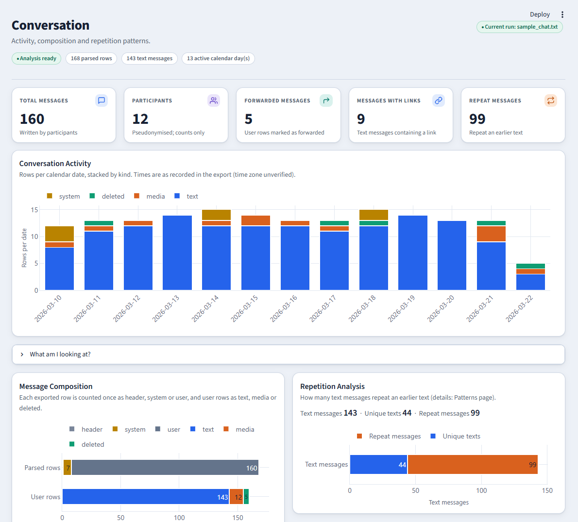
Conversation Analytics
Fictional sample dataset: 12 invented participants
TOTAL ROWS
USER ROWS
TEXT MESSAGES
168
160
143
parsed
of 168 rows
analysed
MEDIA ROWS
DELETED ROWS
PARTICIPANTS
12
5
12
placeholders
placeholders
pseudonymised
ACTIVE DAYS
PEAK ACTIVITY
REPEATED TEXTS
13
15 rows
99 / 143
calendar days
on 2026-03-14
text messages
UNIQUE TEXTS
TEMPLATES
Fictional sample dataset
44
35
after masking
repeated
Conversation page, fictional sample chat
WhatsApp NLP & Conversation Analytics Dashboard | MSc Data Science | Abhishek Vanahalli
5
Notes:
All numbers are from the fictional sample chat. 168 rows: 1 header, 7 system, 160 user rows. Of the user rows, 143 text, 12 media, 5 deleted; 12 participants. Activity on 13 calendar days with a peak of 15 rows on 2026-03-14. 99 of 143 text messages repeat an earlier text, leaving 44 unique texts in 35 repeated templates.

Slide 6
Interactive Dashboard
Streamlit + Plotly academic prototype; upload-driven, session-based analysis
Overview
key figures, daily activity, composition, key findings
Conversation
activity, composition, repetition, hour and weekday tables
NLP Insights
six tabs: n-grams, TF-IDF, Script Mix, Key Terms
Patterns
repetition summary and anonymous templates
Overview page loaded with the fictional sample chat (12 invented participants)
Privacy-conscious display
Anonymised download
Optional theme image
WhatsApp NLP & Conversation Analytics Dashboard | MSc Data Science | Abhishek Vanahalli
6
Notes:
The dashboard is a Streamlit and Plotly prototype. Upload a chat, it is processed in a temporary folder for the session, and four areas show the results with privacy filtering applied. The screenshot is the Overview page for the fictional sample chat.

Slide 7
Validation & Limitations
What was checked, and what the results do not show
VALIDATION
PRIVACY
LIMITATIONS
304 tests passed in a clean clone
Fictional public dataset
Supported export format is limited
308 tests locally (4 are local-only)
Private chat excluded from the repository
Android / no-bracket formats unsupported
28 reconciliation checks
Privacy and display filtering
Script Mix is not language identification
TF-IDF vs scikit-learn: max difference about 1.1 × 10⁻¹⁶
Repository privacy scan
Privacy filter is not complete PII detection
Committed outputs reproduced
No private chat results shown publicly
Public results are not population-level findings
WhatsApp NLP & Conversation Analytics Dashboard | MSc Data Science | Abhishek Vanahalli
7
Notes:
Validation: 304 tests pass in a clean clone (308 locally, including 4 tests that need a private chat and are excluded from the public repository), 28 reconciliation checks, TF-IDF agrees with scikit-learn to within about 1.1e-16, and the committed outputs are reproduced. Privacy: fictional public dataset, private chat excluded, repository scanned. Limitations are stated openly: one supported format, Script Mix is not language identification, the privacy filter is not complete PII detection, and results are not population-level.

Slide 8
Conclusion & Future Work
CONCLUSION
FUTURE WORK
A reproducible pipeline for analysing WhatsApp-style exported conversations, with its limits stated.
1
Broader WhatsApp export-format support
2
Larger, real-world evaluation (group and iOS exports)
Preprocessing, n-grams and TF-IDF
Script Mix and Key Terms
3
Richer multilingual analysis and stopword handling
Conversation analytics and an interactive dashboard
4
Stronger personal-data detection
Validation shows reproducibility and robustness
5
More robust large-scale TF-IDF evaluation
A fictional public dataset enables safe demonstration
Thank you
Questions?
WhatsApp NLP & Conversation Analytics Dashboard | MSc Data Science | Abhishek Vanahalli
8
Notes:
Conclusion: a reproducible, tested pipeline and dashboard for exported chats, with limits stated. The fictional dataset allows safe demonstration; the numbers show pipeline behaviour and reproducibility, not general WhatsApp use. Future work comes from the report: wider export formats, larger real evaluation, better multilingual handling, stronger personal-data detection. Then invite questions.

