Slide 1
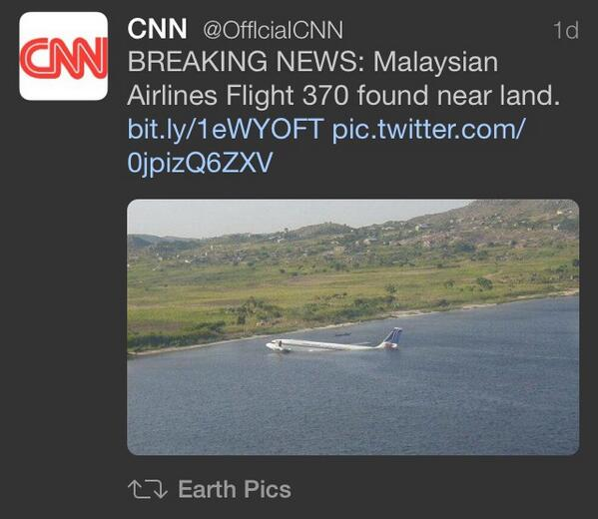

Slide 3
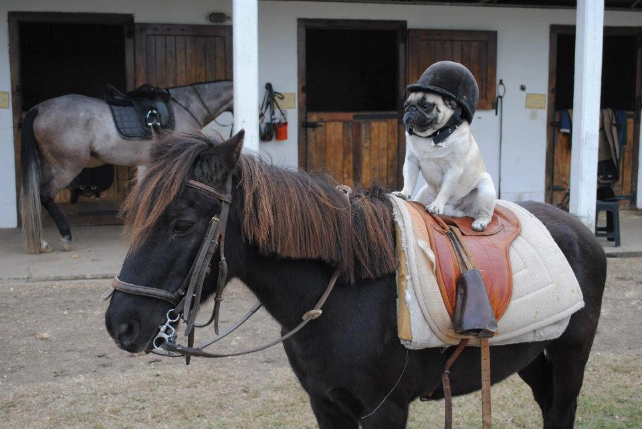

Slide 4
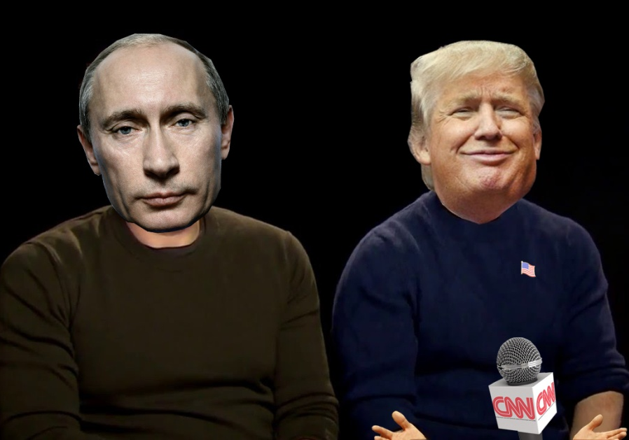

Slide 5
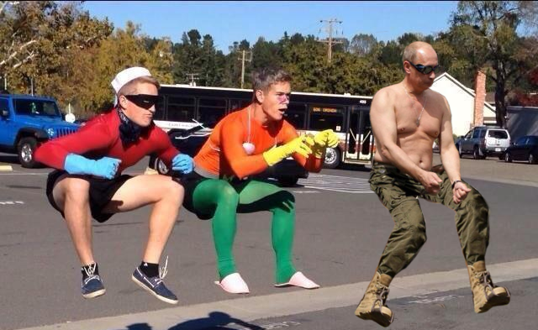

Slide 6
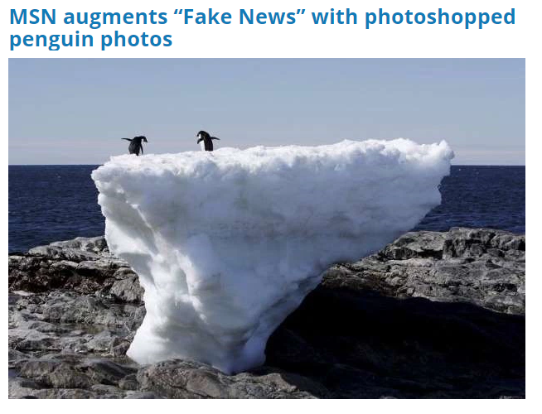
Antarctica hits record high temperature at balmy 63.5°F

Slide 8



Our model

Slide 9

Double-fold model
Extraction of Key Phrases from the massive kaggle dataset of 13,000 fake news articles.
Use Clarifai API to measure associativity between the image to its article.
Feed the tool with enormous dataset of real and fake images.
Use their advanced image recognition systems to help build a robust classification model.
Detect fake images. PROFIT.

Slide 10
Achievements and progress
Our detailed analysis shows a whooping x% of the fake news articles have unrelated images. Our application now helps provide a way to reduce further analysis of fake news x times by eliminating the .

Slide 11

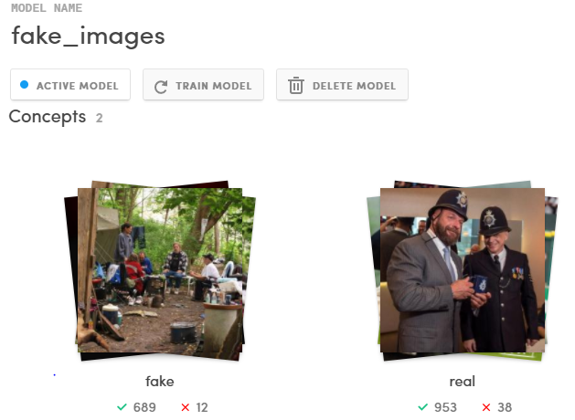
Massive dataset
SOURCE: /r/photoshopbattles

Slide 12
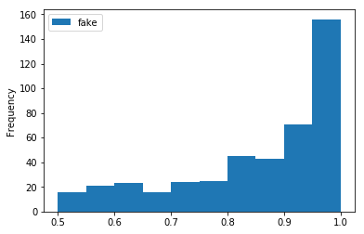
Fake image detector performance

