Slide 1

AI-Powered Insider Threat Detection System.
Kanchan Swami (12310484)
Viraj Zende (12311574)
Abhishek Veer (12311391)
Vedant Patil (12311206)
Department of Computer Engineering
Under the Guidance of
Prof. Jyoti Yadav
Department of Computer Engineering
VIT Pune
BRACT’S, Vishwakarma Institute of Technology, Pune-48
(An Autonomous Institute affiliated to Savitribai Phule Pune University)
(NBA and NAAC accredited, ISO 9001:2015 certified)

Slide 2
Contents
Introduction
Literature Review
Problem Statement
Objective
Proposed Framework/System Architecture
Methodology
Domain Knowledge/technology and tools being used
Expected Outcome
Conclusion
Department of Computer Engineering, VIT, Pune-48

Slide 3

Introduction
Insider threats are one of the biggest challenges for organizations today because they come from people who already have trusted access, like employees or contractors.
Most companies have experienced these incidents, and dealing with the damage can be very costly. Traditional security methods often fail to catch such threats since the activities look normal on the surface.
This is why AI and machine learning are so important—they can understand what “normal” behavior looks like, spot unusual patterns, and help organizations detect insider risks quickly and effectively.
Department of Computer Engineering, VIT, Pune-48

Slide 4
Literature Survey And Research Gaps
Paper Title (Year) | Approach | Key Findings | Research Gaps
LSTM for Behavioral Insider Threat Detection — [S. Paul et al.(arXiv)(2025) ] | unsupervised LSTM trained on per-user time-series of activities (day-wise sequences). | The model learns “normal” user routines and flags significant reconstruction loss as anomalous insider behavior. | This approach often leads to a high number of false positives, as even minor legitimate changes in an employee’s work pattern—arising from new tasks or role shifts
Department of Computer Engineering, VIT, Pune-48

Slide 5
Paper Title (Year) | Approach | Key Findings | Research Gaps
Research on insider threat detection based on personalized federated learning and behavior log analysis(2025) | Federated Learning framework using DeepInsight (converting logs to images) + CNNs to train models across multiple sites without sharing raw data. | Improved accuracy and recall by leveraging distributed data while preserving privacy. | High computational cost; data heterogeneity (nonIID) can lead to suboptimal model convergence.
Insider Threat Detection Using Machine Learning Approach (2023) | Deep feature synthesis (automated feature engineering) + ML (anomaly detectors and SVM) on the CERT insider threat dataset. | Anomaly model reached ~91% accuracy, and the SVM classifier achieved up to 97% accuracy in tests. | Evaluated on a static public dataset; risk of overfitting. Doesn’t address online/adaptive learning or real-world deployment.
Department of Computer Engineering, VIT, Pune-48

Slide 6
Problem Statement
Insider threats have become one of the toughest challenges for modern IT enterprises. Unlike external attacks, these threats come from trusted users who already have access to sensitive systems.
Existing solutions like SIEM, UEBA, and DLP mostly rely on static rules.
As a result, they either flood security teams with too many false alerts or fail to detect subtle, malicious activities.
What organizations really need is an intelligent system that can continuously monitor user and system activity, understand context, adapt to new attack patterns, and give timely, accurate alerts without disrupting normal operations.
Department of Computer Engineering, VIT, Pune-48

Slide 7

Objectives
Risk scoring & alerts: Prioritize threats with dynamic risk scores.
Reduce false positives: Improve accuracy using feedback.
Multiple models trained for various use cases
Train models on dynamic datasets to reduce overfitting .
Department of Computer Engineering, VIT, Pune-48

Slide 8
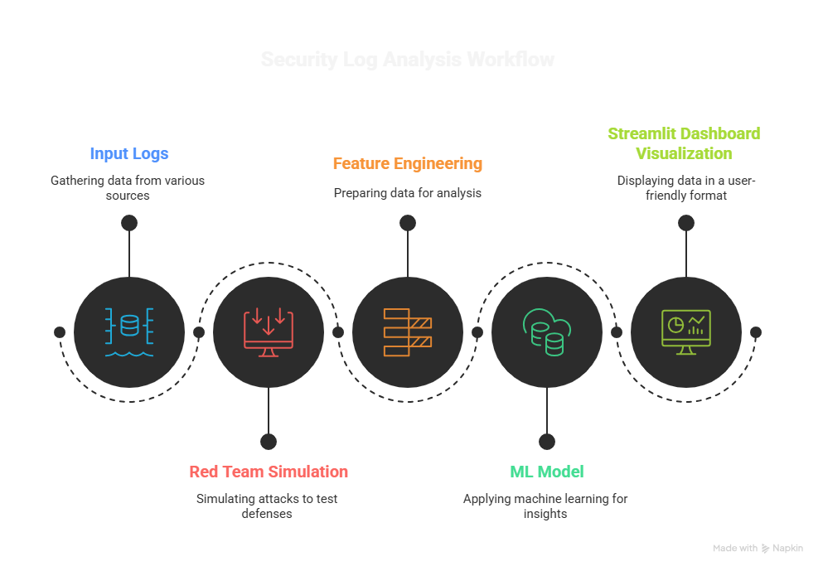
System Architecture
Department of Computer Engineering, VIT, Pune-48

Slide 9
Methodology
Data Preparation:
Use CSV logs: logins.csv, file_access.csv, usb_usage.csv.
Data is synthetic to avoid privacy issues.
Red Team Simulation:
Select few users as malicious.
Inject after-hours file access, mass downloads, suspicious USB events.
Feature Engineering:
Merge multiple logs to extract behavior patterns.
Examples: login frequency, files accessed at odd hours, USB usage.
Model Training:
Train ML model (e.g., Isolation Forest / anomaly detection algorithm).
Output: anomaly_scores.csv for each user.
Dashboard Visualization:
Display red-team users, anomaly scores, file/USB access patterns.
Provides actionable insights for security monitoring.

Slide 10
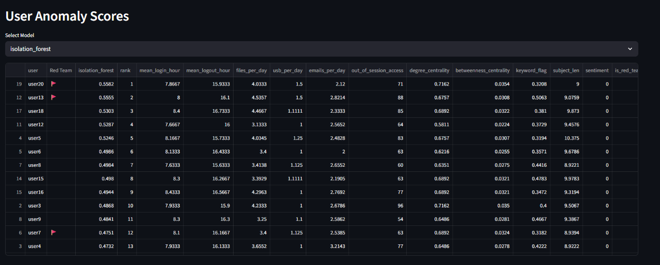
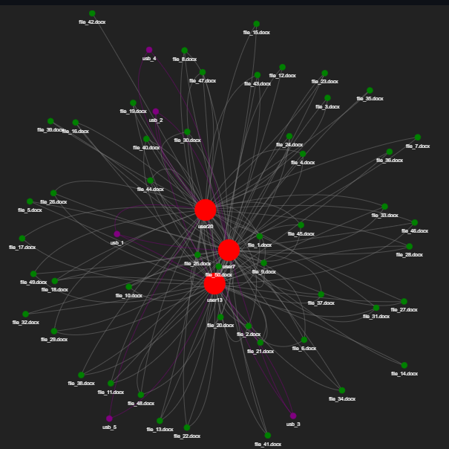
Evaluation Results
At-Risk Nodes and Their Connections

Slide 11


Domain Knowledge/technology and tools being used
Domain Knowledge:
Cybersecurity & Insider Threat Detection
Behavioral Analytics & Anomaly Detection
Machine Learning
Technologies & Tools:
Python Libraries: pandas, numpy, scikit-learn, shap, seaborn, matplotlib
Visualization: Streamlit, PyVis
Data: Synthetic CSV logs (logins.csv, file_access.csv, usb_usage.csv)
Department of Computer Engineering, VIT, Pune-48

Slide 12
Expected Outcome
Identify suspicious users based on their behavior.
Generate anomaly scores for each user.
Interactive dashboard visualizing:
Red-team malicious users.
File access anomalies.
Demonstrates effectiveness of AI-powered threat detection.
Department of Computer Engineering, VIT, Pune-48

Slide 13
Conclusion
Insider threats are significant security risks that can be mitigated using AI.
Synthetic data allows safe experimentation and model training.
Red-team simulation helps test edge cases of malicious behavior.
Project demonstrates end-to-end workflow:
Data generation → Feature engineering → ML training → Dashboard visualization.
Future scope: Real-time monitoring, integration with corporate security systems.
Department of Computer Engineering, VIT, Pune-48

Slide 14
Suggestions
Add an interactive dashboard with a time-range filter to display users’ file access and activity details.
Include summary reports showing top active users, access frequency, and flagged anomalies.
Enable visual charts and export options (PDF/CSV) for easier analysis and presentation.

Slide 15
Thank You!
Department of Computer Engineering, VIT, Pune-48

