Slide 1


Git
Presented By : Abhishek Verma

Slide 2
Agenda
Introduction
Benefits of Git
Some basic commands
Git Commit

Slide 3

Introduction
An open source distributed version control system.
Created by Linus Torvalds in 2005.
Designed to handle minor to major projects efficiently.
Developed to co-ordinate the work among developers.
Git can be used publicly and privately.

Slide 4
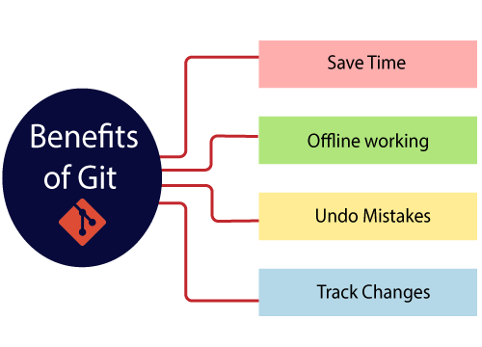
Benefits of Git
Saves Time Git is lightning fast technology. Each command takes only a few seconds to execute.
Offline Working If we are facing internet connectivity issues, it will not affect our work. In Git, we can do almost everything locally.
Undo Mistakes Sometimes the undo can be a savior option for us. Git provides the undo option for almost everything.
Track the Changes Git facilitates with some exciting features such as Diff, Log, and Status, which allows us to track changes.

Slide 5
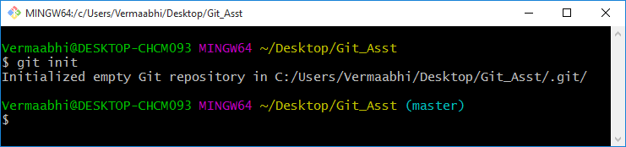
Basic Commands
Git init
The git init command is used to create a new blank repository.

Slide 6
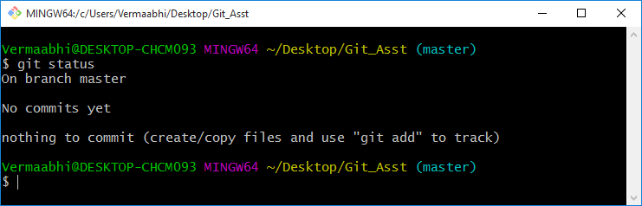
Basic Commands
Git status
Displays the status of working directory and the staging area.

Slide 7
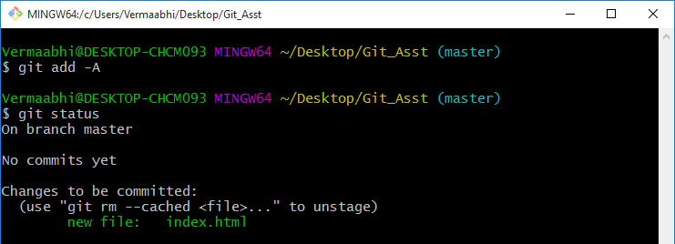
Basic Commands
Git add
git add <file_name> : It adds the <file_name> file to staging area.
git add –A : It adds all the files in the directory to staging area.

Slide 8
Git Commit
It is used to record the changes in the repository.
It is the next command after the git add.
Every commit contains the index data and the commit message.
Commits are the snapshots of the project. Every commit is recorded in the master branch of the repository.
Two different commits will never overwrite because each commit has its own commit-id.

Slide 9
Git Commit
Let’s see different type of commits
$ git commit : It will prompt a default text editor and ask for a commit message.
$ git commit -a : It is used to commit the snapshots of all changes. This option only consider already added files in Git. It will not commit the newly created files.
$ git commit -m “commit message” : It will make a commit with the given commit message.
$ git commit –amend : It will prompt the default text editor and allow us to edit the commit message.

Slide 10
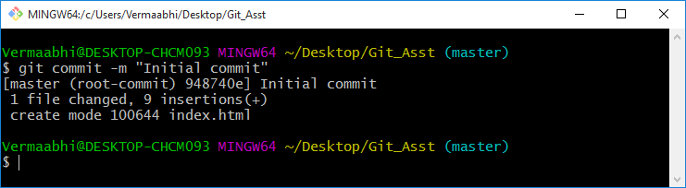
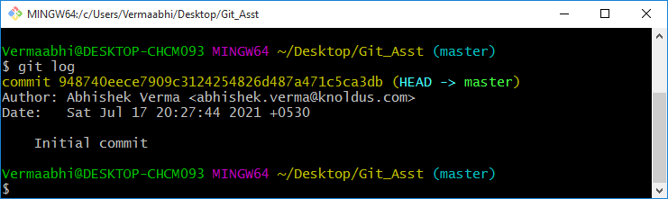
Git Commit Example
Git commit with a message:
Use git log to see all the commits:

Slide 11
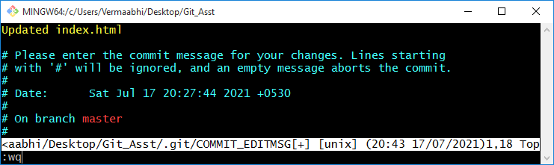
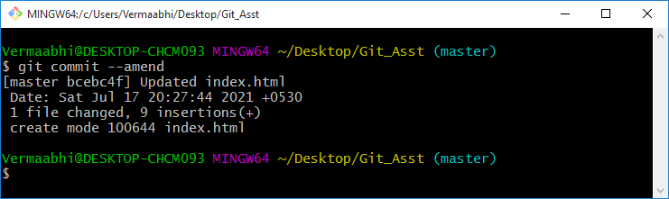
Git Commit Example
Git commit –ammend to edit the commit message:

Slide 12

Thank You!

