Slide 1


Solution Architectures – AGCS GDP
AGCS GDP Data Engineering

Slide 2
Index
Hybrid Data Flow Architecture
EIM – GDP Integration Data Platform Architecture
Technical Stack – Developer layer (Data Engineering)
Technical Data Architecture
CICD Technical Stack
CICD Infinity Diagram
CICD Data Flow Diagram

Slide 3





Hybrid Data Flow Architecture
Source Systems
Data Ingestion
Data Processing & Storage
Data Access
Analytics & Insights
Core Data Zone
Internal & external data sources
Structured & Unstructured Data
Known data
In-memory DWH (GRID)
Business Intelligence
Functional Data Zone
Known data
Workflows, Visualization
Distributed data processing
Exploration
Advanced Analytics
Functional & Unexplored data
Exploration

Slide 4

EIM – GDP Integration Data Platform Architecture
EIM
SAP Hana
SAP BO / MSTR
AZ Group's answer to data integration, governance and advanced analytics
Pros
Compliant with AZ Group strategy
Standard open source technology - reusable code, widely available resources and talent
Built on MS Azure - new capabilities from Azure can be used after the AZ Group approval
ISO requirements are taken care - compliant to store strictly confidential data
Has capabilities for advanced analytics
We can reuse the IP developed over the last 2 years (reuse Spark code)
Cons
The platform is under development and not all the components are available
Not all the tools in Azure are approved by Group Architecture team for use
Need a larger technical team to develop and run the platform
SAP FI@AGCS
Presentation Layer
Fixed
Assets
Reporting& Analytics
Tax
General Ledger
Cost Accounting
Non Insurance AP/AR
Business & Cost Planning
Integration Layer
GRID Functions
Posting Engine
Raw Vault
Comments, Corrections, other
Landing Zone
Business View
Landing Zone
(Smart Data Access)
GRID sMarts
Policies, Claims, etc
Data sources
GRID Control
Front, Mid, Back Office
Global Data Platform
Integration Layer
Semantic Data Layer
Analytics Layer
Data
Visualization
Collect + Connect
(Apache Kafka,
Spark)
Semantic Data Layer
(Parquet, Relational DB)
Data Exploration & Analytics
(Jupyter, Zeppelin, Databricks, Anaconda)
Power BI
..

Slide 5
EIM – GDP Integration Data Platform Architecture
AZ Group's answer to data integration, governance and advanced analytics
Pros
Consistent approach for data transformation across the use cases
Abstraction layer between data and technology components to hide the technical complexities
Scope for
Cons
The platform is under development and not all the components are available
Not all the tools in Azure are approved by Group Architecture team for use
Need a larger technical team to develop and run the platform
User Interface
APIs
Data Intelligence Framework
AGCS Transformation Logic
Data sources

Slide 6
Technical Stack – Developer layer (Data Engineering)
SCALA - Core development Programming Skill.
Spark - Data Engineering Framework for better persistence.
AZURE Blob(HDFS Integrated) - Parallel I/O Support
MAVEN - Build Tool (Better support in CICD Chain and Granular control)
GIT - Version Control System (GITLAB/GITHUB/BITBUCKET)
KAFKA – Streaming or Scheduling Pipeline for ingestion (Usage TBD)
PostGre SQL – RDBMS Enable Database will be used for metadata control, Logic Flow charting and Visualization

Slide 7

















Technical Data Architecture
Allianz GITLab Integration
Data ingestion
Apache Kafka streaming pipelines
Data transformation
Apache Spark data pipelines (Scala, PySpark)
Data Storage
Azure Blob Storage, Postgres DB, Cassandra, Neo4j
Data Exploration & Advanced Analytics
Python in Jupyter Notebook, Spark in Zeppelin, Spark in Data Bricks
Data Visualization & Writeback
Power BI +
Data Apps
Container Runtime Platform (RedHat Openshift)
Data Source {1}
WRITEBACK
AZURE
Writeback
Power ON Visual Planning
SPARK Pipelines
Relational Data
Oracle, SQL, fileshares, SAP
Data Transformer Pipelines
Multiple ETL Lines
Semi-Structure Data
Azure, AWS, GCP
Power BI
FUNCTIONAL LAYER
EXPLORATORY LAYER
Ingestion Pipelines
PREPARE
TRANSFORM
& ENRICH
BUSINESS LAYER
VISUALIZE
Unstructured data
Salesforce, Dynamics
KAFKA Pipelines
One pipeline per
source
AZURE VM
Power BI
INGEST
Azure
Spark Pipelines
Azure
Spark Pipelines
Azure
Spark Pipelines
POSTGRES DB
Creation of First level Transformation Spark Pipelines
Creation of Pre-Business Views Pipelines
Creation of Business Required Views Pipelines
Data Source {n}
KAFKA Streaming
Pipelines
Relational Data
Oracle, SQL,,, fileshares, SAP
Trigger Based Pipelines for Source Data Pull
AZURE BLOB STORAGE, CASSANDRA
Persistence Layer 1
Persistence Layer 2
Semi-Structure Data
Azure, AWS, GCP
Unstructured data
Salesforce, Dynamics
Controlled Data Access Layer
NO Business Access
Business Level Analytics
Data Science Teams
Selective Business
User Access
Multiple Business like
claims, Underwriters
& analytics Teams
Regressive Analytics
Full Business Access

Slide 8
CICD Technical Stack (DEV-OPS)
MAVEN - Build Tool (Better support in CICD Chain and Granular control)
GIT - Version Control System (GITLAB/GITHUB/BITBUCKET)
JENKINS – Continuous Build
Ansible – Configuration Management and Deployments
ZULL – Gating System for code pipeline stability
SonarQube – Static Code Analyzer

Slide 9
CICD Infinity Diagram
GIT
MAVEN
ANSIBLE
CODE
BUILD
DATABRICKS
SPARK
DEPLOY
RELEASE
OPERATE
TEST
PLAN
MONITOR
SCALA-TEST
JENKINS
SONAR-QUBE
JIRA
DATABRICKS
SPARK UI / AIRFLOW

Slide 10


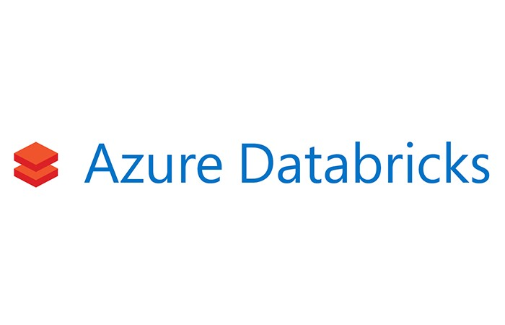
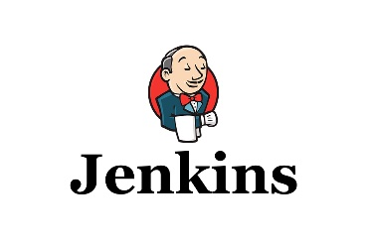
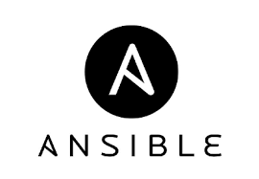



CICD CODE Flow Diagram
STATIC CODE ANALYSIS
BUILD AND TEST
TRIGGER DEPLOY
RUN JOB
STORE ARTIFACTS
CODE COMMIT
DEVELOPERS

