Slide 1
Process Instrumentation and Control System
Present By: Prakash Bahadur Thapa
Memorial University
St. Johns Newfoundland Canada
Email: pbt750@mun.ca
Tel: (1) 709 – 330 8666

Slide 2
Process Instrumentation & Control
Control valves make a significant contribution to pressure drop (see later lecture on hydraulics)
Control valve location can create a need for additional pumps and compressors, and must be decided in order to size the pumps and compressors
It is therefore necessary for the design engineer to understand the plant control philosophy even at the PFD stage and the PFD usually shows the location of control valves
More details of process control are usually included in the piping and instrumentation diagram (P&ID) – see Ch 5
This lecture is a very brief overview of control for design purposes – more will come in your process control class

Slide 3
Process Instrumentation & Control
Basics of process control
Process instrumentation
Reading a P&ID
Control of unit operations
Process safety instrumentation
Plant-wide control and optimization

Slide 4
Objectives of Process Control
Ensure stable process operation
  Particularly, keep the plant operating under safe conditions
  Minimize damage to equipment due to variation in plant conditions
Ensure operation meets product specifications
Minimize impact of external disturbances
  Example: change in ambient temperature
Optimize process performance
  Maintain process throughput
  Minimize operating costs

Slide 5
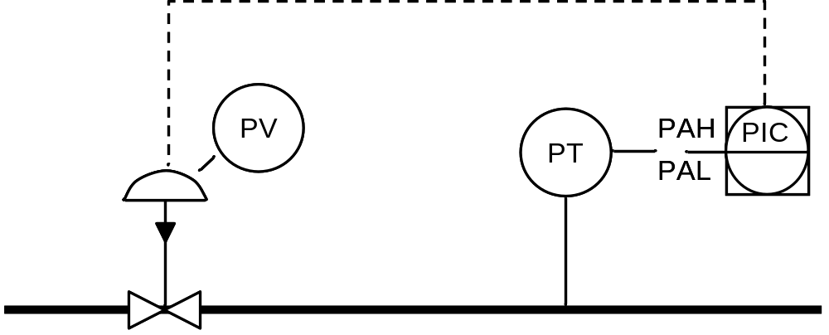
Control Loop Components
Instrument line
Alarms
Actuator
Controller
Process or
utility stream
Final control element
Sensing
element
The sensing instrument detects the measured variable and sends a signal to a controller, which signals the actuator to close or open a control valve and adjust the manipulated variable (usually a flow rate)

Slide 6
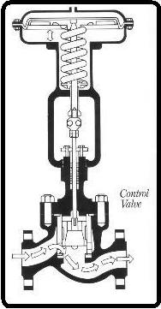
Control Valves
The final control element is usually a control valve
  Exceptions: electric heaters, mixers, variable speed drives
The actuator is either a motor or a bellows that opens or closes the valve in response to the signal
Actuator
Valve

Slide 7
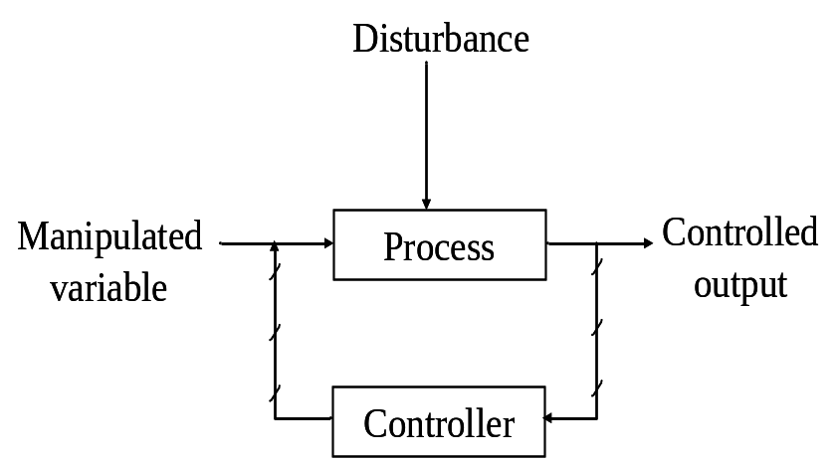
Types of Control Loop
Feedback
Control system measures changes in a process output and then adjusts manipulated variable to return output to set point
Can be slow if process response time is long
Feed Forward
Control system measures disturbance and adjusts manipulated variable to compensate for it so that controlled output is not affected
Requires greater knowledge of system response
Disturbance
Controller
Manipulated
Process
Controlled
variable
output

Slide 8
Feedback Control
Error
signal
Controller
Set
point
+
Function
generator
-
Output
Input
Sensing
element
Final control
element
Measured variable
Manipulated variable
Process
Controller computes error between input and set point and adjusts output based on a control algorithm

Slide 9
Typical Control Algorithms
P: Proportional
    Controller output is proportional to error
    The proportionality constant is called the controller gain
    High gain gives fast response, but can lead to instability
    Low gain can cause offsets
I: Integral
    Output is proportional to integral of error
    Eliminates offsets from P control, but makes response more sluggish
D: Derivative
    Output is proportional to rate of change of error
    Damps out instability and allows higher gain to be used
Other functions such as summation, multipliers, and advanced models can be easily coded in digital controllers
SP
time

Slide 10
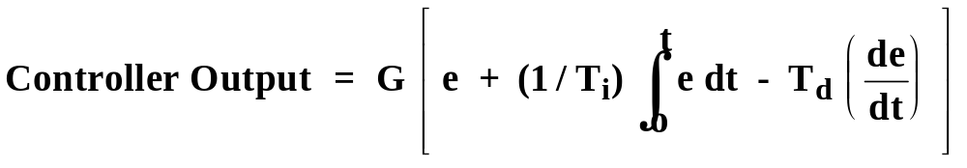
PID Controller Response
For a PID Controller,
where: G = Controller gain
e = Error (set point minus measured variable)
T_{i} = Integral time constant
T_{d} = Derivative time constant
The controller output is proportional to the error, the time integral of the error, and the rate of change of the error. G, T_{i} and T_{d} are the controller tuning parameters.
Much more of this in control class
Notes:
24

Slide 11
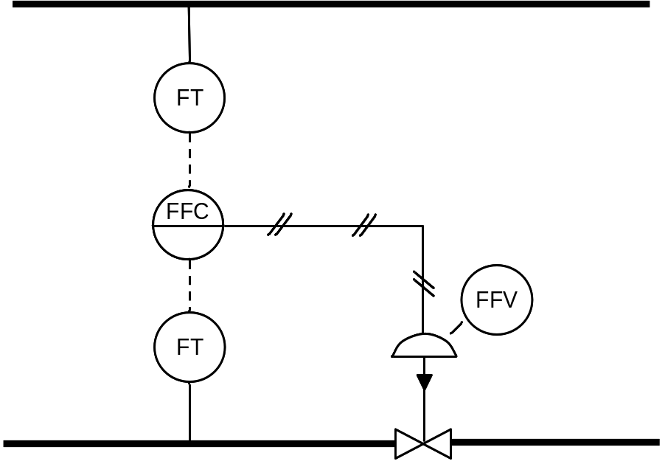
Ratio Control
One stream is controlled in ratio to another
Often used for controlling feed rates to try to maintain stoichiometry
Also used in some types of distillation column control to set reflux or boil-up ratios

Slide 12
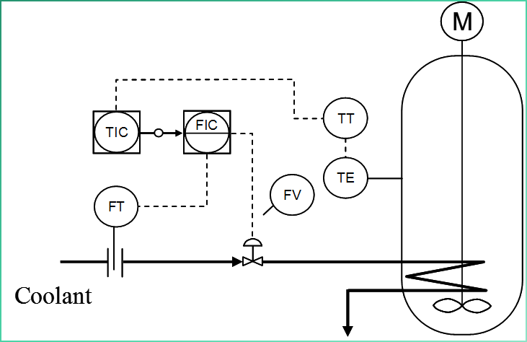
Cascade Control
One primary controller is used to adjust the set point of a second secondary controller
Used to minimize outside load variations and increase process stability
Example: reactor temperature (primary controller) cascades onto coolant flow controller (secondary) to control reactor temperature

Slide 13
Process Instrumentation & Control
Basics of process control
Process instrumentation
Reading a P&ID
Control of unit operations
Process safety instrumentation
Plant-wide control and optimization

Slide 14
What Can Be Measured?
(& How Easily)
Easy
Temperature
Pressure
Flow rate
V/L Level
Pressure difference
Conductivity
Difficult
L/L level
pH
Certain components oxygen, sulfur, hydrogen, CO
Composition
Density
Voidage
Easy means cheap, reliable instrument with fast response time and accurate measurement

Slide 15
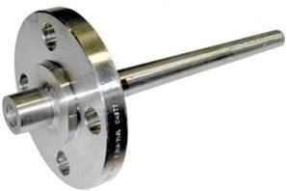
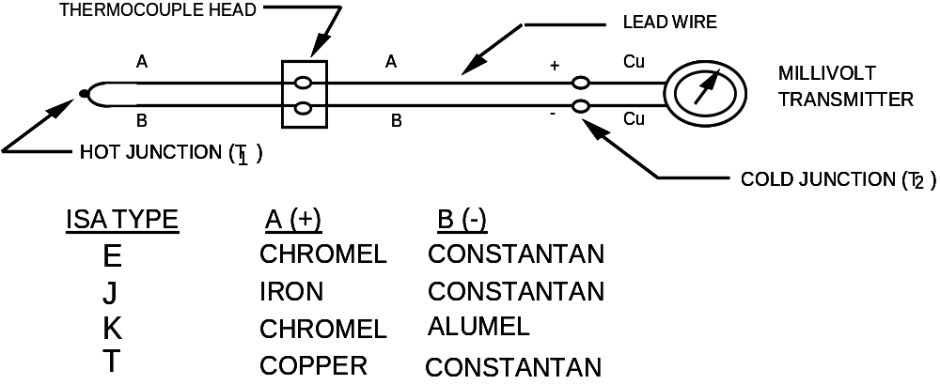
Temperature Measurement: Thermocouples
When a junction between dissimilar wires is heated, an EMF (voltage) is developed, which can be read by a millivolt transmitter
The junction is usually housed in a thermowell
Typical
High T

Slide 16
Temperature Measurement: Thermocouples
Response depends on thermowell location and heat transfer
  Instrument error is usually ± 3 to 4 F
  There may be additional offsets if the thermowell is incorrectly located
Response is fast if located in a flowing stream
Sometimes thermocouples are also strapped to walls of vessels
  For high temperature processes or processes with large exotherms

Slide 17
Pressure Measurement
Pressure instruments usually measure differential pressure
If one side is atmospheric pressure then the difference is the process gauge pressure (usually written barg or psig), not absolute pressure (bara, psia)
Several possible methods:
  Mechanical: measure displacement of a bellows or Bourdon tube
  Electrical: attach a strain gauge to a bellows
  Capacitance: diaphragm moves capacitor plate (most common type)
  Piezoelectric: measures change in semiconductor conductivity
Pressure measurement devices respond quickly and accurately
Differential pressure measurement is used as the basis for flow and level measurement

Slide 18
Flow Rate Measurement
Place a restriction in the flow path and measure the resulting pressure drop using a differential pressure (PD) cell
If fluid properties are known, results can be calibrated to flow rates
PD
PD
Orifice Meter
Venturi Meter

Slide 19
Level Measurement
Displacement
Displacer moves up and down with level due to bouyancy
Displacer movement is detected via mechanical or magnetic linkage
Differential Pressure
Measures static head of liquid using a differential pressure cell
Density of the liquid and vapor must be known and constant
Sensor element
PD

Slide 20
Composition Measurement
Some components can be detected at low concentrations using sensors that have been designed to pick up that component
  Examples: O₂, CO, H₂S, H₂
  Component sensors are often sensitive to other components, so check carefully with vendor to make sure the device is rated for the application
More detailed composition can be measured by on-line GC methods
  TCD: thermal conductivity detector
  FID: flame ionization detector
  Response can be slow (5 to 30 minutes), particularly if a long column is used
Online NIR can be used in some cases
Composition is often inferred from other properties
  Boiling point
  Conductivity

Slide 21
Process Instrumentation & Control
Basics of process control
Process instrumentation
Reading a P&ID
Control of unit operations
Process safety instrumentation
Plant-wide control and optimization

Slide 22
Piping and Instrument Diagrams
The P&ID shows all the instruments and valves in the process
  Not just control loops
  Vents, drains, sample points, relief valves, steam traps, isolation valves, etc.
The P&ID usually also indicates line sizes and pipe metallurgy
Companies occasionally use their own symbols, but U.S. standard is ISA-5.1-1984 (R1992) from the International Society for Automation
The P&ID is usually produced in consultation with a specialist controls engineer
Example of real P&ID: see Ch5

Slide 23
ISA 5.1 P&ID Symbols
Control Valves
General
Three-way
Globe
Diaphragm
Actuators
S
D
M
Diaphragm or unspecified actuator
Solenoid
Digital
Rotary motor

Slide 24
Valve Failure Positions
Fails open
Fails closed
Fails locked in current position
Failure mode indeterminate
It is important to specify what happens to a control valve if the signal fails
The final valve position has an impact on process safety and pressure relief scenarios and may affect other instrumentation

Slide 25
ISA 5.1 Instrument Lines
Most newer plants use electric signals
Pneumatic signals are found in older plants and locations where electric signals would be unsafe
Binary signals are used for digital signals and for solenoids and other on-off devices
Instrument lines are always drawn lighter than process lines on the P&ID
Instrument supply or connection to process
Undefined signal
Pneumatic (instrument air) signal
or
Electric signal (4 to 20 mA)
or
Electric binary (on-off) signal
Internal system link (software or data link)

Slide 26
ISA 5.1 Controller Symbols
Field mounted
Panel mounted in primary location
Panel mounted in auxiliary location (local panel)
Dual function instrument
Distributed Control Shared Display Symbols
Field mounted shared display device with limited access to adjustments
Shared display device with operator access to adjustments
*AH
Shared display device with software alarms (* is measured variable)
*AL

Slide 27
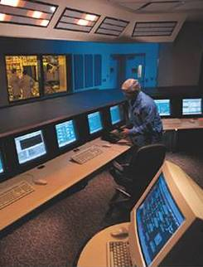
Shared Display Devices
Most plant control rooms now use shared display devices that show the outputs of multiple instruments on a VDU screen
Operator can see a flow diagram that identifies where the instrument is and can enter set points
Software also allows data to be plotted as trends
Data can be accessed remotely
Data is collected and logged for process records
Source: UOP

Slide 28
ISA 5.1 Nomenclature
PIC
Pressure Indicator Controller
Two- to four-letter codes are used to identify the instrument or controller
First letter always indicates the initiating or measured variable
Subsequent letters I = indicator, R = recorder, C = controller, T = transmitter, V = valve, Z = other final control element, S = switch, Y = compute function, AH = high alarm, AL = low alarm

Slide 29
ISA 5.1 Nomenclature: First Letters
A Analysis (composition)
F Flow
FF Flow ratio
J Power
L Level
P Pressure (or vacuum)
PD Pressure differential
Q Quantity
R Radiation
T Temperature
TD Temperature differential
W Weight
C, D, G, M, N, O can be user-defined variables

Slide 30
Exercise: Identify The Instrument
Can you figure out what each of these ISA 5.1 codes means and what the instrument does?
  TRC
  AR
  PAH
  PAHH
  LI
  PC
  TSH
  FFY
  PT
  JIAL

Slide 31
ISA 5.1 Other Common Symbols
Restriction orifice
Pressure relief or safety valve
Hand control valve
Gate valve or isolation valve
Self-contained backpressure regulator
Stop check (non-return) valve

Slide 32
Process Instrumentation & Control
Basics of process control
Process instrumentation
Reading a P&ID
Control of unit operations
Process safety instrumentation
Plant-wide control and optimization

Slide 33
Level Control
A level control is needed whenever there is a V/L or L/L interface
Level control sets inventories in process equipment
Many smaller vessels are sized based on level control response time
LT
LAH
LIC
LAL
LV
M

Slide 34
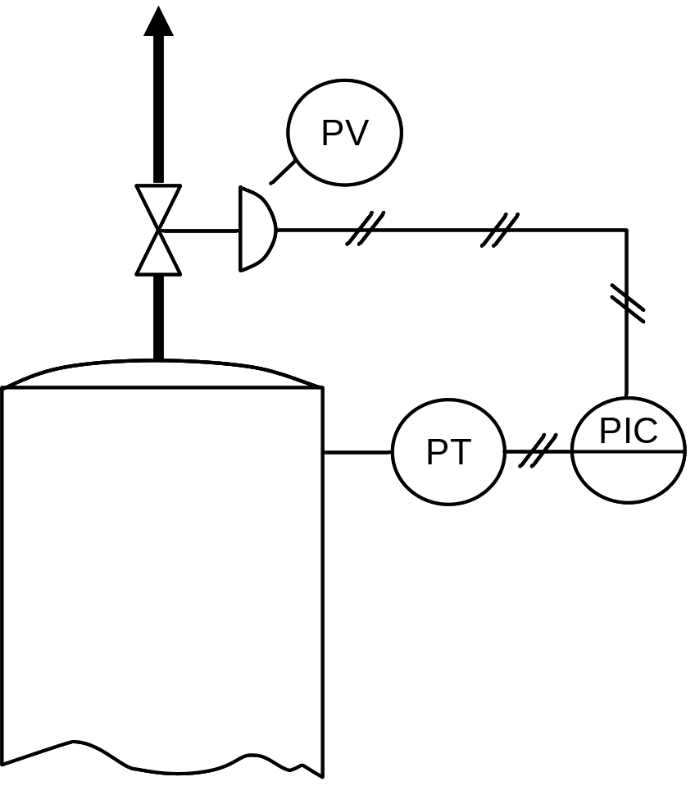
Pressure Control
Pressure control is usually by venting a gas or vapor
In hydrocarbon processes, off-gas is often vented to fuel
In other processes, nitrogen may be brought in to maintain pressure and vented via scrubbers
Most common arrangement is direct venting (shown)
Several vessels that are connected together may have a single pressure controller

Slide 35
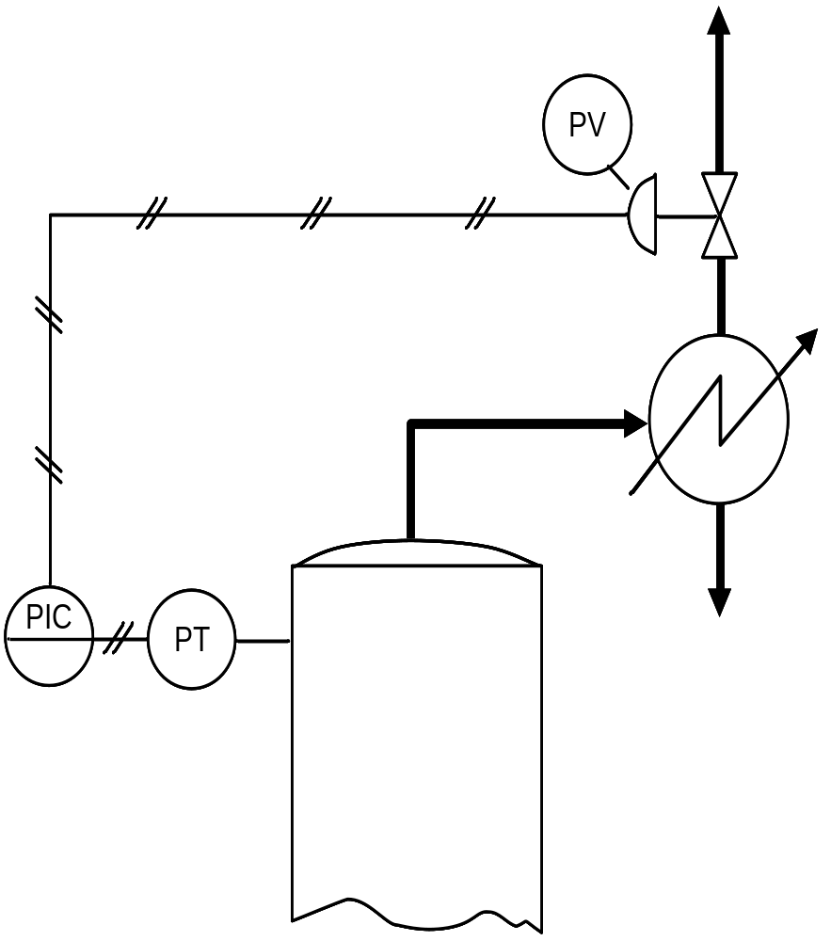
Pressure Control
If vapor has a high loading of condensable material, then pressure control is on the vent gas stream from the condenser

Slide 36
Pressure Control: Condensers
Coolant
PIC
PT
PV
Process
vapor
Process
PIC
PT
PV
Coolant
Alternatively, for a condenser, we can control the coolant supply or the heat transfer surface (by varying the liquid level)
These methods control pressure by changing the rate of condensation

Slide 37
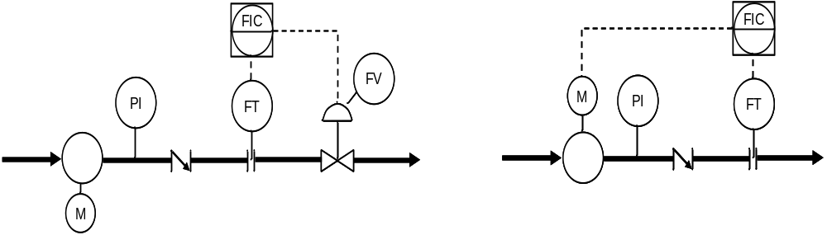
Flow Control
Most common arrangement is a control valve downstream of a pump or compressor
Using a variable speed drive is a more efficient method, but higher capital cost

Slide 38
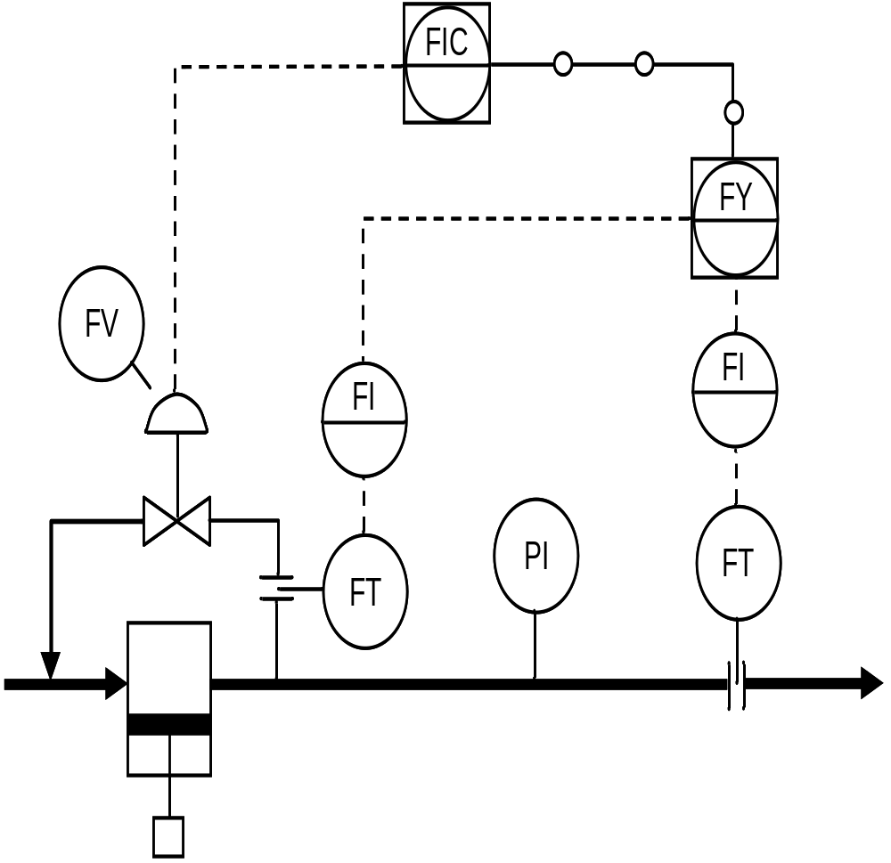
Flow Control: Reciprocating Pump
Reciprocating pumps and compressors and other positive displacement devices deliver constant flow rate
Flow can be controlled by manipulating a spill-back to the pump feed

Slide 39
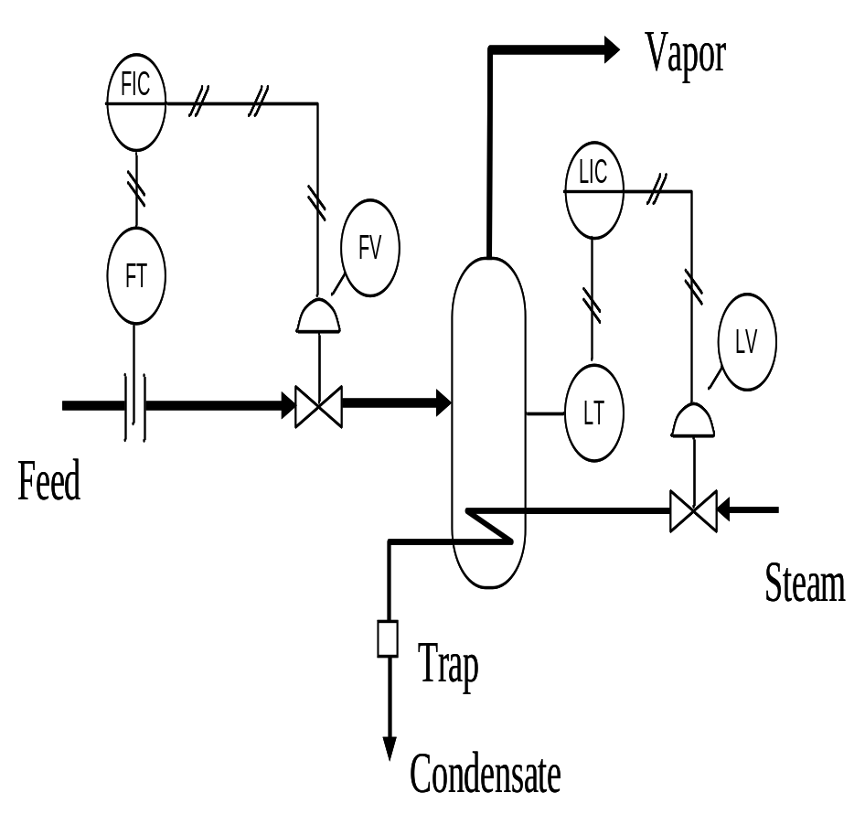
Flow Control: Vaporizer
Vaporizer flow control needs to prevent liquid accumulation
Hence use level controller to actuate heat input to the vaporizer and maintain a constant inventory
Control of liquid flow in is easier than control of vapor flow out

Slide 40
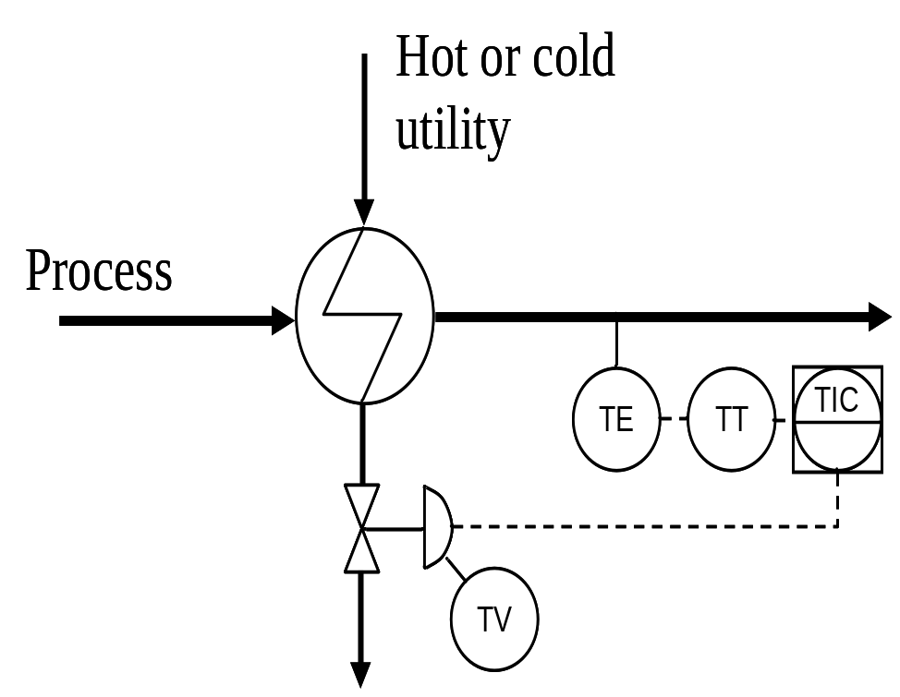
Temperature Control: Single Stream
Heaters and coolers are usually controlled by manipulating the flow rate of the hot or cold utility stream
Final control element can be on inlet or outlet of utility side

Slide 41
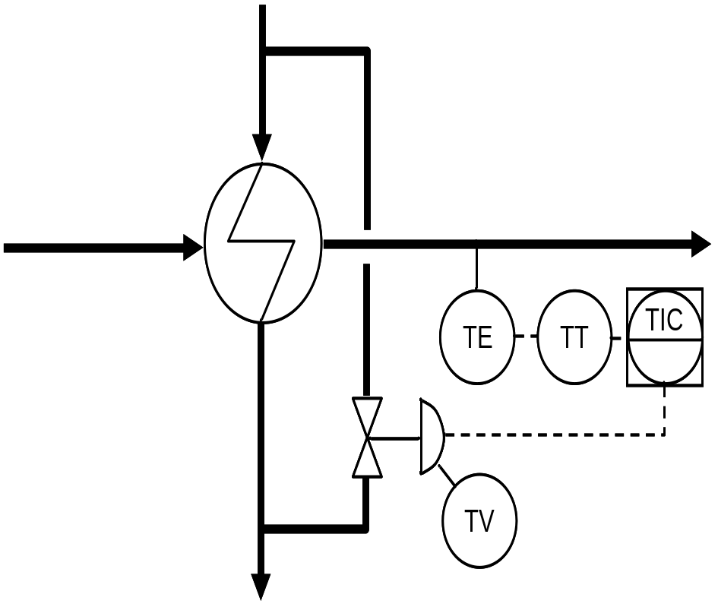
Temperature Control: Heat Exchangers
Temperature control for an exchanger is usually by manipulating the flow through a bypass
Only one side of an exchanger can be temperature controlled
It is also common to see exchangers with no temperature control and have temperature control on the downstream heater and cooler

Slide 42
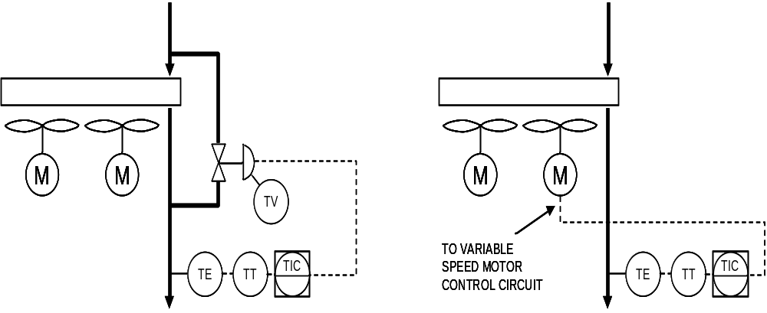
Temperature Control: Air Coolers
Ambient air temperature varies, so air coolers are oversized and controlled by manipulating a bypass
Alternatively, air cooler can use a variable speed motor, louvers or variable pitch fans – see lectures on heat exchange equipment

Slide 43
Distillation Control
Distillation control is a specialized subject in its own right
In addition to controlling condenser pressure and level in the sump, a simple distillation column has two degrees of freedom
    Material balance (split) and energy balance (heat input or removed)
    Therefore needs two controllers
    Therefore has the possibility that the controllers will interact and “fight” each other
Side streams, intermediate condensers & reboilers, pump-arounds, etc. all add extra complexity and degrees of freedom
There are several good books on this subject
    Kister, H.Z., 1989, Distillation Operation, McGraw-Hill
    Luyben, W.L. 2006, Distillation Design and Control Using Aspen Simulation, Wiley

Slide 44
Distillation: Temperature Pattern Control
Tray temperature is used to infer composition
Composition is used to adjust reflux rate and reboiler heat input
Tray locations for temperature detectors need to be chosen carefully
Controllers can fight each other – not a good scheme
Material balance control schemes are more robust
TC
TC
LC
Steam

Slide 45
Distillation: Material Balance Control
PC
Direct control of distillate composition by using tray temperature to infer composition and control distillate flow rate
Flow control on (constant) boil-up rate could be set in ratio to feed if feed flow rate was highly variable
LC
TC
LC
FC

Slide 46
Distillation: Material Balance Control
PC
Indirect control of distillate composition by using tray temperature to infer composition and control reflux rate
Flow control on (constant) boil-up rate could be set in ratio to feed if feed flow rate varies
LC
TC
LC
FC

Slide 47
Distillation: Material Balance Control
PC
Direct control of bottoms composition by using tray temperature to infer composition and control bottoms flow rate
Flow control on (constant) reflux rate could be set in ratio to feed if feed flow rate varies
LC
FC
TC
LC

Slide 48
Distillation: Material Balance Control
PC
Indirect control of bottoms composition by using tray temperature to infer composition and control boil-up rate
Flow control on (constant) reflux rate could be set in ratio to feed if feed flow rate varies
LC
FC
TC
LC

Slide 49
Batch Distillation
FV
FIC
FT
TE
FIC
TT
FY
FT
FV
Intermittent drain
Steam
Intermittent charge
Trap
Reflux flow control adjusted based on temperature (used to infer composition)

Slide 50
Reactor Control
Control of flow is usually carried out on cold reactor feeds
  Flows are often ratio controlled to get close to desired stoichiometry or maintain desired excess of one feed
Pressure control is on reactor vapor outlet or on vent space
Level control maintains inventory for liquid phase reactors
Temperature control can be
  On feeds
  On heating or cooling jacket
  On recirculation through external heaters or cooler
  By controlling flow of quench/reheat streams

Slide 51
Typical Stirred Tank Reactor Control Scheme
PIC
PT
To vent system
M
FV
FIC
FT
Feed A
TIC
FIC
TT
FV
FIC
FT
TE
LT
LAH
LIC
FV
LAL
FT
Feed B
Coolant
Temperature cascade control of coolant flow
Independent flow control of feeds
Product

Slide 52
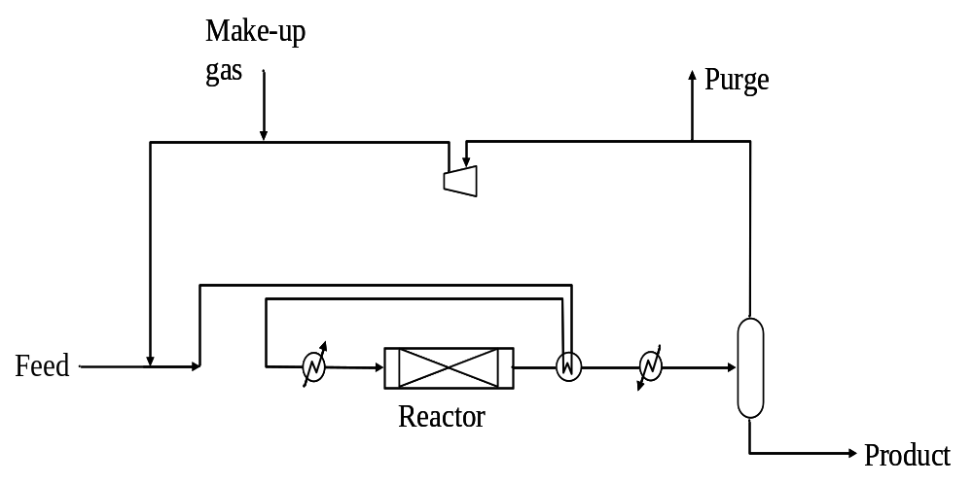
Exercise: Gas Recycle Process
Remember the simple flowsheet introduced in the lecture on simulation?
Liquid feed is mixed with recycle gas, heat exchanged against reactor effluent, heated to reactor temperature then passed over fixed bed of catalyst. Product is cooled and liquid product is recovered. Unconverted gas is recycled with purge to prevent accumulation of inerts

Slide 53
Exercise: Gas Recycle Process
What controllers would you use?
Where would you place them?

Slide 54
Process Instrumentation & Control
Basics of process control
Process instrumentation
Reading a P&ID
Control of unit operations
Process safety instrumentation
Plant-wide control and optimization

Slide 55
Role of Controls in Process Safety
Control system is involved in three levels of process safety
  Keeping plant operation steady
  Sounding alarms to notify operator when variables are out of limits
  Automatically shutting the plant down when necessary
Emergency Response
Emergency Response
in Community
in Community
Emergency Response
Emergency Response
in Process Unit
in Process Unit
Pressure
Pressure
Relief System
Relief System
Automatic Safety Shutdowns
Automatic Safety Shutdowns
Critical Alarms & Operator Intervention
Critical Alarms & Operator Intervention
Basic Process Control
Basic Process Control
Plant Design (Inherent Safety)
Plant Design (Inherent Safety)

Slide 56
Process Control, Alarms and Shutdowns
Variable
AH
Set point
AL
time
Shutdown
Controlled parameters naturally fluctuate around set point
If the measured variable exceeds a preset limit an alarm should alert the operator to take appropriate action
    Alarm limits should be set far enough from normal process variation to avoid nuisance alarms
If the measured variable exceeds a safe operating limit then an automatic plant shutdown may be necessary
    Shutdown limit should be set far enough from alarm limit that the operator has a chance to respond to the alarm
    But not so far that no time is left to safely shut the plant down

Slide 57
Standards for Safety Instrumentation
ISA S84.01 Safety Instrumented Systems
    U.S. standard for emergency shutdown systems
    Primary goal is to protect people, not plant or profits
    ISA S84.01 = IEC 61511
IEC 61508 & 61511
    IEC = International Electrotechnical Commission
    International standards for safety instrumented systems
Standards define requirements for sensors, solvers (logic), and final elements (valves, switches)
Consult most recent version of standards for current best practices
Other standards also recommend best practices for alarm levels, vessel sizing to allow adequate control, etc.

Slide 58
Safety Integrity Levels
ISA S84.01 defines three levels of safety integrity depending on the availability of the SIS
Availability = time the system is available / total time
Safety Integrity Levels
  SIL Availability System redudancy
  SIL 1 90 – 99% Non-redundant
  SIL 2 99 – 99.9% Partially redundant
  SIL 3 99.9 – 99.99% Totally redundant
Redundant system means instrumentation is duplicated

Slide 59
Safety Integrity Level
SIL should be determined during a process hazard analysis (see Ch10 and lectures on process safety)
SIL required depends on risk of operator exposure and injury
  Can be calculated using fault trees
  See Ch10 and later lecture
SIL determines the type of instrumentation that should be used

Slide 60
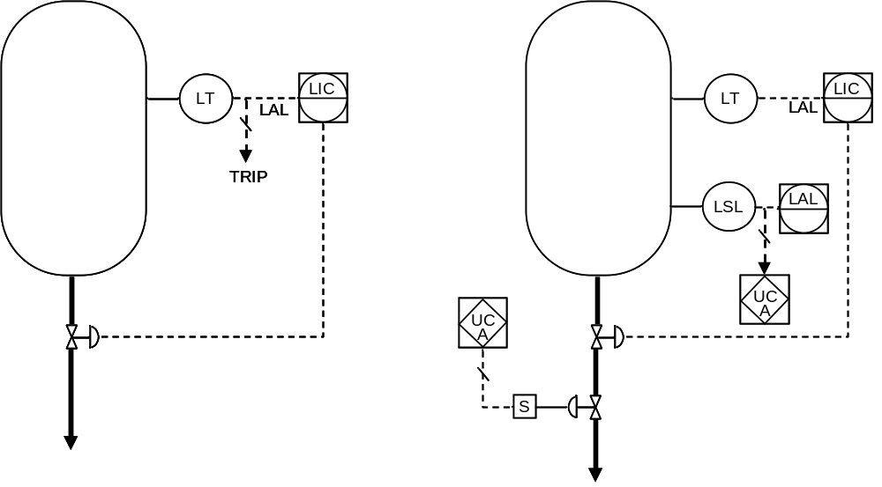
Process Alarms and Shutdown Trips
Software alarms can be set on instruments and controllers through the digital control system and show up on shared displays
Separate alarm and shutdown instrumentation can also be used, for higher redundancy

Slide 61
Caution on Software Alarms
There is a temptation to put lots of software alarms in digital control systems
If there are too many alarms then they can become a distraction to the operators
  Increasing the chance of human error
  Increasing the chance that the operator will ignore the alarm, switch it off, or acknowledge it without taking action
  Increased chance of an “alarm flood”
Alarms should be carefully placed and calibrated to make sure that they serve the purpose of the designer
Operators should be trained to understand the importance of every alarm on the plant

Slide 62
Process Instrumentation & Control
Basics of process control
Process instrumentation
Reading a P&ID
Control of unit operations
Process safety instrumentation
Plant-wide control and optimization

Slide 63
Plant-Wide Control
(Advanced Process Control, APC)
All new plants and most older plants have the instruments and controllers connected to a plant-wide digital control system (DCS). Using the DCS:
Operators can update individual controller set points via shared displays
Plant information systems can log data
Feedforward and multivariable predictive control can be implemented more easily
Plant real-time optimization can be implemented through the control system
Most controllers now have microprocessors built into them, so the computational capacity that is needed is not necessarily located in the control room

Slide 64
Plant-Wide Control Issues
Where do we control inventories?
  All vessels that have a liquid level
  Do we need extra surge volume to keep operations steady?
Where is the best place to control pressure?
  Single PC setting plant back-pressure?
  Need for different pressure levels?
Where is best place to control material balance?
  Can only control flow in one place per feed stream
  Control after removing contaminants?
  Ratio control?
  What about recycles?

Slide 65
Plant-Wide Control Issues
Where is best place to control temperatures?
  Heaters and coolers only?
  Control of heat exchanger networks?
How do we meet product specifications?
  Use of on-line analytical instruments?
  Inference through bubble point?
  Sampling of product storage tank?
How do we optimize the process?
  Maximize throughput and product yield while staying on spec?
  Minimize cost of production?
  Maximize time on stream between shutdowns?

Slide 66
Multivariable Predictive Control
What if we have three manipulated variables that interact with each other through non-linear equations?
Measured variable 1
Measured variable 2
Measured variable 3
Control Valve 1
Control Valve 2
Control Valve 3
Single Input Single Output (SISO) controllers will have a hard time responding and will tend to have strong interactions with each other (tendency to fight)

Slide 67
Multivariable Predictive Control
In this situation, instead of SISO controllers we need a Multiple Input Multiple Output (MIMO) controller
The controller algorithm is a model that captures the non-linear interaction between the manipulated variables
  Does not have to be a “fundamental” model
  Does have to capture dynamic response
  Can be tuned from plant operation
Hence another name for multivariable predictive control is model-based predictive control
With MIMO devices, there is no longer a direct pairing of measured and manipulated variables as in the earlier unit operations examples

Slide 68
MIMO Example: Gas Mass Flow Controller
FY
FIC
FT
PT
TT
FV
Gas mass flow cannot be measured or controlled directly
By measuring volume flow, temperature and pressure we can compute mass flow as long as composition is known and steady
This is actually MISO, not MIMO, but the FY could talk to another device such as a ratio controller

Slide 69
Device Communication Standards
Now that individual controllers (and even instruments) contain microprocessors, the computational power of the DCS is distributed
To make best use of this distributed computation power, the devices need to be able to communicate with each other
Communication standards are set by ISA, IEC and the controller manufacturers and are currently evolving rapidly

Slide 70
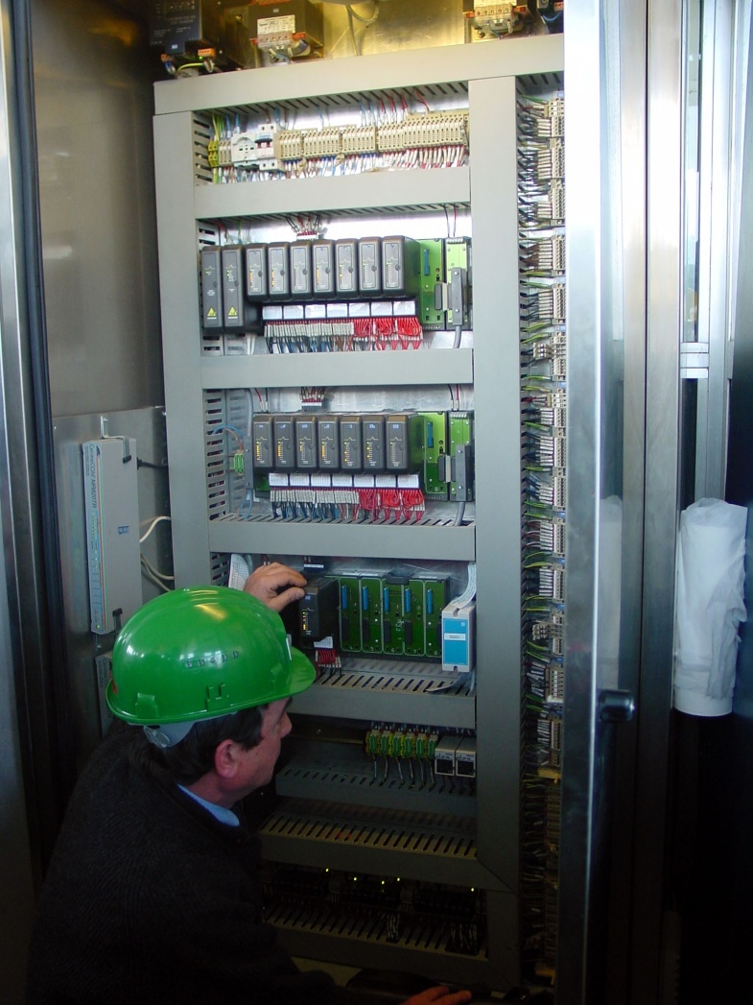
Evolution of Controller Communication Standards
Manual Control
Pneumatic Analog
Electronic Analog
Digital
Fieldbus (ISA SP50)
Wireless (ISA SP100)
?!?!?!?
Source: UOP

Slide 71
Fieldbus (ISA SP50)
Digital device communication protocol that allows “plug and play” connection of devices
Requires less wiring and gives greater reliability through redundancy
Different control companies have variations on the standard, so system compatibility and interoperability are issues
Source: UOP

Slide 72
Wireless Communication (SP100)
Advantages
No cable runs
Quicker and cheaper to set up
Portable control room
Improved safety (electric cables are easily damaged by fires)
Problems
Interference from other wireless devices
Signal blocking due to steelwork
Signal loss creates need for greater redundancy
The controls companies are currently putting a lot of effort into developing the devices and standards for implementing wireless control

Slide 73
Real Time Optimization
A DCS can be programmed to carry out optimization of plant performance by updating controller set points and MPC algorithms
The optimizer is usually a higher level program that runs less frequently and is used to adjust set points periodically by computing target values for key performance indicators (KPIs)
The optimizers used for RTO are often not very sophisticated – typically LP, MILP or simple NLP models
Optimizer
Targets for KPIs
DCS
Set points
Controllers
Adjust manipulated variables
Plant

Slide 74


Types of Real-time Optimization
Optimizer
User
User
Plant DCS
Off-line Optimization
Users take plant data and run the optimizer then send instructions to the plant operators to update the DCS settings
Labor intensive and difficult to update more than daily

Slide 75
Types of Real-time Optimization
Optimizer
Optimizer
User
User
User
User
Plant DCS
Plant DCS
Off-line Optimization
Open Loop On-line Optimization
Users provide input to optimizer, DCS updates optimizer directly with plant settings and user updates DCS with new targets

Slide 76
Types of Real-time Optimization
Optimizer
Optimizer
User
User
User
User
Plant DCS
Plant DCS
Off-line Optimization
Open Loop On-line Optimization
Optimizer
Users only provide input to the optimizer and the DCS is updated directly by the optimizer
User
Plant DCS
Closed Loop On-line Optimization

Slide 77
Real Time Optimization Models
Models and algorithms for RTO have very tough requirements
  Must be robust, i.e., always find a solution
  Must solve quickly
  Must converge to same solution whatever the starting point
  Must allow for model error
  Must reconcile data and filter out bad data
  Must capture plant constraints
  Must give reasonably good description of plant performance
Hence frequent use of simple LP models
Controls companies spend a lot of time setting up and tuning models

Slide 78
Questions ?

