Slide 1



Team Members:
Abhishek Tangod
Aniket Singh
Prajwal Shah
Zaifa Khan
Reg No. : 2019015

Slide 2
Problem Statement
3 W’s
What? ,Why? ,Where?
What?
  General method of sanctioning documents – Digital Signature.
  No robust system.

Slide 3
Why?
Cybercrime generates around $1.5 trillion per year
A hack occurs every 39 seconds
Global cybercrime damages are estimated to cost $6 trillion per year by 2021
Hackers earn around $30,000 per job, whilst their managers can make up to $2 million
60% of fraud goes through mobile devices, 80% of which are generated from mobile apps

Slide 4
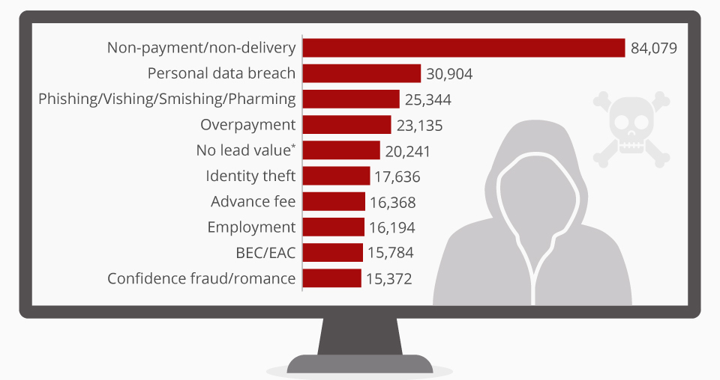
Where?
Cyber Security
Digital Signature
Digital Documents

Slide 5
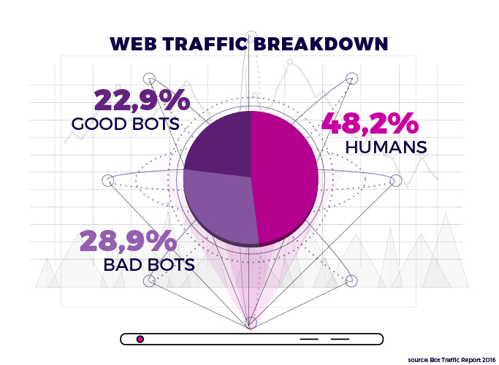
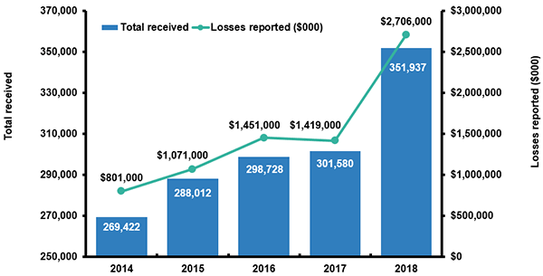
Current situation of cyber crimes
Identity-Theft Crimes

Slide 6




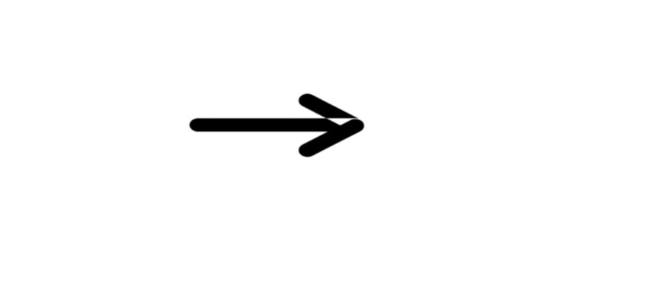



Proposed Workflow
Pass
Fail
Document
NLP-Engine
Verification
Pass
Fail
Document

Slide 7
Business Proposition
Our solution has:
  Easy deployment
  Low maintenance.
  Provision of security by proposal to store data on Block chain servers.
  Requirements:
    Access to employee data(in-terms of email and other sanctioned documents).
    Resource support to develop further ,using real-time computation with Kafka.

Slide 8
Unique Selling Point
Regional Languages.
Number of dependency on digital signature.
Bot-Detection.

Slide 9
Links
Deployed web-app link :
https://dig-sec.herokuapp.com/

Slide 10


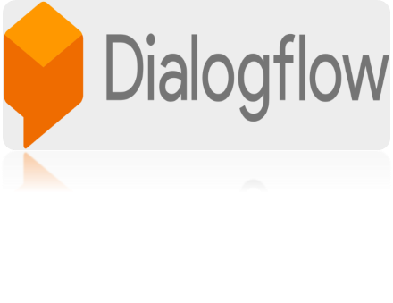




Tech-Stack

Slide 11


