Slide 1
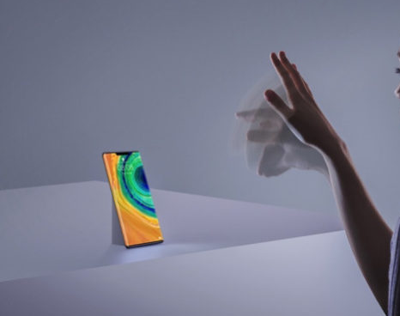
Gesture Control using Computer Vision
AI Mini Project
PB1 Abhishek Wahane
PB13 Akash Kulkarni

Slide 2
INTRODUCTION
With advancements in gesture-based control methods like Samsung’s Air Actions [1] and Google’s Project Soli [2], technology is moving towards more advanced and natural ways of interacting with computers. We explore a rather simpler implementation of gesture control using only a webcam.
Using imagery from the camera the system computes color combinations and detects certain objects. With change in the image and therefore changes in the shape, certain actions can be performed in correspondence to these changes. These actions can be keyboard presses, Mouse clicks or mouse movements.

Slide 3
MOTIVATION
Foreseeing the current situation wherein the general public is more aware about their surroundings and the things they touch, such gesture-based interaction systems can come in handy. Airport kiosks, Ticket Booking kiosks etc where usage by public is higher can benefit from this. People will not need to touch the system in order to interact with it, rather use only certain gestures to perform tasks.

Slide 4
PROBLEM STATEMENT
Developing a touch free input mechanism for performing basic tasks on a computer.

Slide 5
IMPLEMENTATION
The system uses Computer Vision and a variety of python libraries [3][4]
cv2 - Python library for using OpenCV
pynput - allows you to control and monitor input devices.
wx - GUI Library used to get screen access.

Slide 6
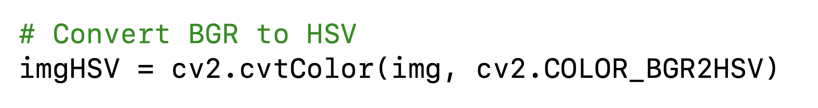
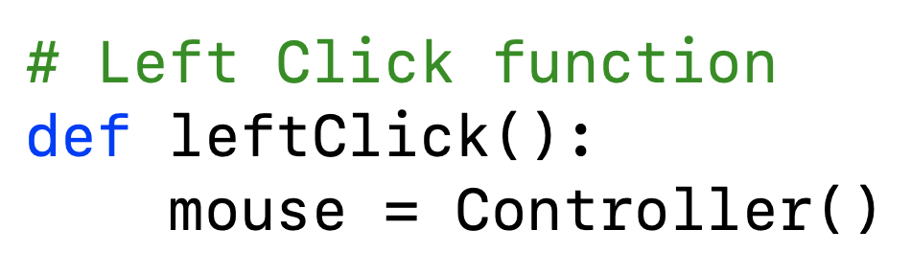
IMPLEMENTATION
The image is converted from BGR to HSV since we want only intensity of colour.
Controller ( ) function used to gain control of mouse functions.

Slide 7
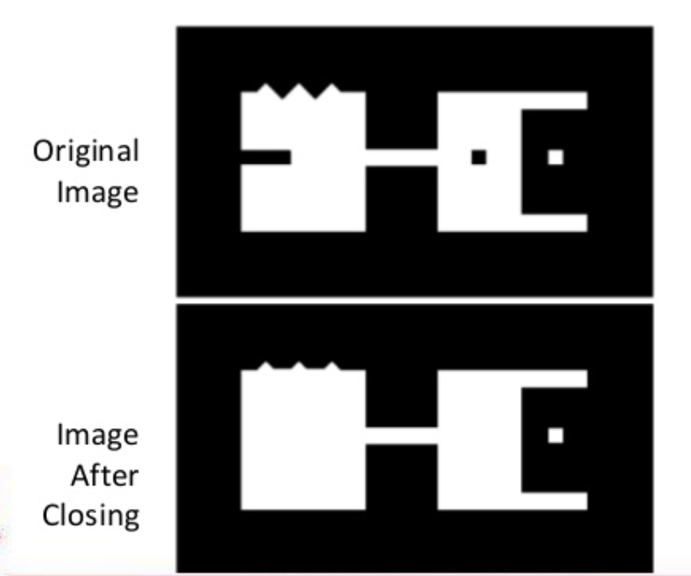
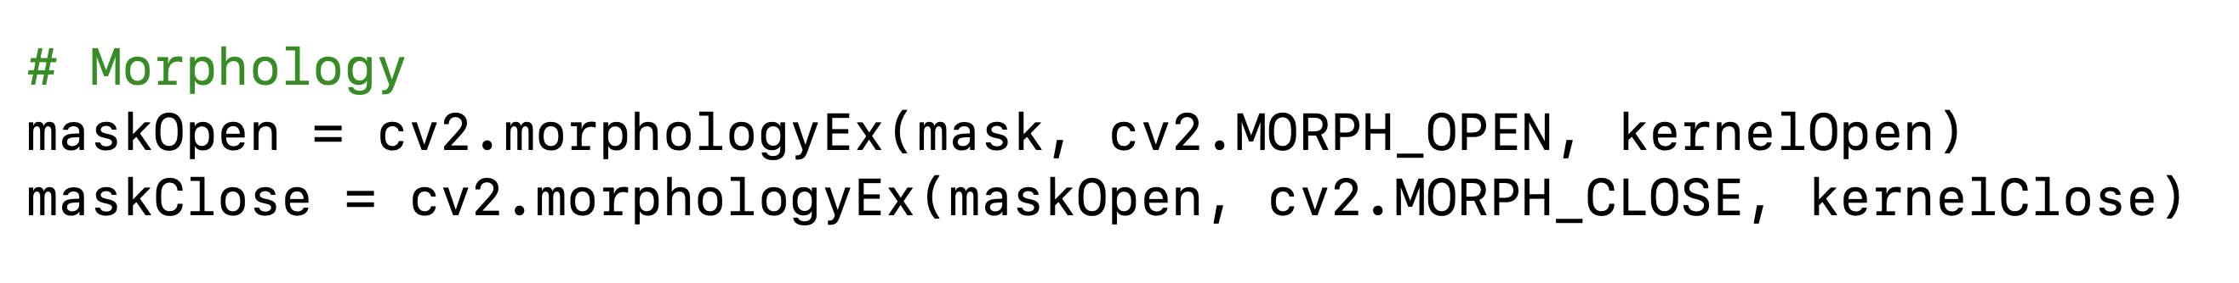
IMPLEMENTATION
Morphology

Slide 8
IMPLEMENTATION
If there are 2 objects
Then mouse controller
Elseif 1 object
Then no mouse controller

Slide 9
CONCLUSION
Gesture control using Computer Vision and webcams may not be as accurate as other sophisticated hardware implementations, but for basic actions like clicking, dragging, swiping, scrolling etc. it is a much cheaper yet effective solution.
Such systems can be deployed at Airport Kiosks, Booking Counters, Ordering placing Kiosks, for touch free interaction with the system thereby maintaining hygiene.

