Slide 1

ZS Associates Hands On Case Round
Abhishek Yadav [15GG20003]
5th Year Under Graduate
IIT Kharagpur

Slide 2
Introduction:
Classifying subjects as potential patients of the rare liver disease based on the transactional level longitudinal medical history.
The following are the problems that we are attempting to solve:
Classify subjects based on longitudinal medical history.
Enumerating features which Influence this classification.
Selection of right parameters for evaluation and model validation.

Slide 3
Exploratory Data Analytics

Slide 4
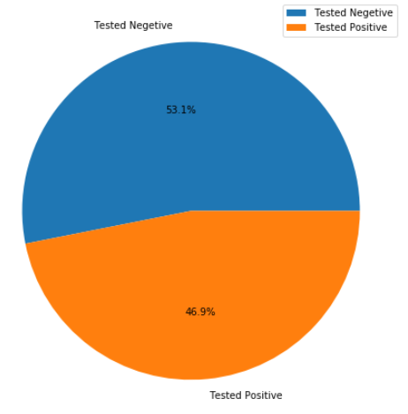

Distribution of Classes.
The training examples are grouped by the pat_iden variable to only compute the unique patient values from the dataset.
The Classes are Balanced with almost equal distribution of values in both classes.
Balanced

Slide 5
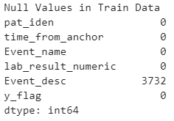
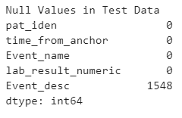
Missing Values.
No major problems with missing values was observed.
Very low fraction of Event_desc are missing at random , But since they represent the same information as represented by Event_name these should be ignore.

Slide 6
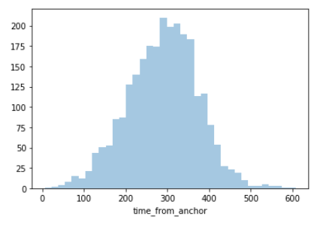
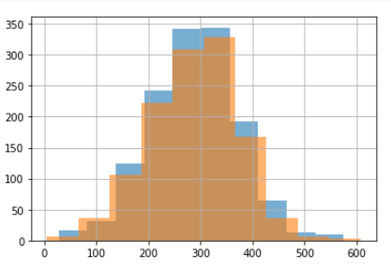
Distribution of time from anchor
Distribution of ‘time_from_anchor' for each value of ‘y_flag' on the same plot.

Slide 7
Feature Engineering

Slide 8
First Thoughts on features
Pat_iden:
A unique identifier for each patient with alpha-numeric characters
About 1.3 Million data points with no missing values
Should not be included into predictive modelling.
Time_from_anchor:
Time data not in time stamp format.
Can be used to track the evolution of patient medical records over time.
Trends in it can separate positive and neg subjects.
Event_name / Event_desc:
Record of medical practice that the subject was subjected to. Categorical
Very useful and could be used to model the prediction on test subjects.
Name with 0 missing value and Desc with 3,000 missing values
Lab_result_numeric:
Numerical data with all result values of each test.
Very useful feature and needs to be further explored.
Scaling and normalization could be applied for better meaning generation.

Slide 9
Extracting Features From Event_name
The Event name column is one hot encoded into around 1000 columns.
The data is then grouped into sub-groups based on unique pat_iden.
Time_from_anchor : The time data can be used to take the weighted average of lab resilt numeric values.
For now the max value from time column is used.
Lab_result_numeric: The lab_result_numeric variable is aggregated to compute the average over the patient history.

Slide 10
Sample Table After Extraction Features From .

Slide 11
Models

Slide 12
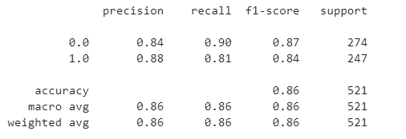
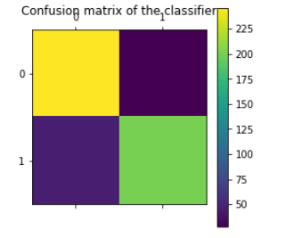
Classification Models.
Made 80-20 split. i.e. 20% of train data was used as Validation Set.
Stored Train and Validation data in DMatrix. (DMatrix is a internal data structure that used by XGBoost which is optimized for both memory efficiency and training speed.)
The classification report for the Validation data set is shown on left for the training dataset.

Slide 13
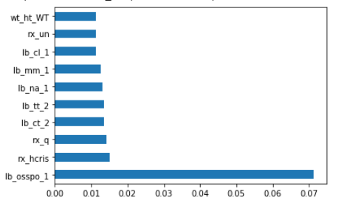
Feature Importance
Top 10 important features

Slide 14
Further Approach

Slide 15
“Bayesian Optimization” to tune XGB’s Parameters.
Model Tuning can be used to further improve the accuracy.
In BO, the Gaussian Surrogate Model defines a prior loss function that can be used to learn from previous predictions or believes about the objective function. We also get an estimation for the uncertainty.
Acquisition function allows the optimizer to exploit an optimal region until a better value is obtained. The goal is to maximise this function, and from this it predicts the sampling points in the search space.

