Slide 1
DATA STRUCTURES & ALGORITHMS | 25CS2103E • A.Y. 2026–2027
E-Commerce Product
Entity-Resolution & Matching Platform
Cleaning, matching, and grouping product listings across sellers to power accurate search and price comparison.
TEAM 9 • SECTION 13
K. Sayee Vansika
2520090239
K. Neha Sreekari
2520090240
K. Abhishek Yadav
2520090208
Under the guidance of Dr. Dyuti Banerjee — Assistant Professor, AI&DS
Notes:
[HIGHLIGHT] Stand together. Point to the project title, the course code (25CS2103E) and your names on the title slide.
Good morning everyone. We are Team 9 from Section 13 — K. Sayee Vansika, K. Neha Sreekari and K. Abhishek Yadav. Under the guidance of Dr. Dyuti Banerjee, we are presenting our Data Structures and Algorithms project: an E-Commerce Product Entity-Resolution and Matching Platform. Today we will explain the idea and also show our working website. Let's begin with what we will cover today.

Slide 2
01
Abstract
02
Introduction
03
Literature Survey
04
Problem Statement & Objectives
05
Hardware & Software Requirements
06
Website Implementation & Live Demo
What we'll
cover
07
Results
08
Conclusion
09
Future Scope
Notes:
[HIGHLIGHT] Run your hand down the agenda list. Pause on item 06, Website Implementation & Live Demo.
Here is our roadmap. We start with the abstract, introduction and literature survey. Then we cover the problem statement, objectives and requirements. After that comes the most important part: the implementation and live demo of our website. We finish with results, conclusion and future scope. Let's start with a short abstract of the project.

Slide 3
01 · ABSTRACT
Making “same product, different listing” solvable
The same physical product is often listed by different sellers with different names, descriptions, and prices — making duplicates hard to spot and fair price comparison hard to do. This project delivers Product Match Lab, a working web platform that cleans messy listing titles, detects listings of the same product, and groups them to show the best price. It then goes a step further: a Smart Cart finds the cheapest way to buy across sellers, and an Order Assignment module allocates bulk customer orders to sellers with limited stock.
Clean & Standardize
1
Normalize messy titles from every seller
2
Match & Group
Find listings of one product; show best price
3
Smart Cart
Cheapest mix of sellers incl. shipping
Goal: Turn scattered, inconsistently-worded listings into one comparable catalogue — and turn that catalogue into the cheapest possible purchase.
Order Assignment
4
Fulfil as many bulk orders as stock allows
E-Commerce Product Entity-Resolution & Matching Platform
3
Notes:
[HIGHLIGHT] Point to the four cards on the right: Clean, Match, Smart Cart, Order Assignment.
The same phone is often listed by different sellers with different names and prices. That makes duplicates hard to spot and price comparison unfair. Our project, Product Match Lab, is a web platform that cleans messy titles, matches listings of the same product, and shows the best price. It also has a Smart Cart and an Order Assignment module. To see why this matters, let's look at a simple example.

Slide 4
02 · INTRODUCTION
One product, many disguises
E-commerce's rapid growth means the same item is sold across many platforms — but sellers describe it differently. A computer sees these as unrelated products unless it's taught otherwise.
SELLER A
SELLER B
“Samsung Galaxy S24
256GB Black”
“Samsung S24 –
256 GB – Black”
Sellers use inconsistent names, abbreviations & attribute formats
Standard search treats near-identical listings as separate products
Product Match Lab cleans, matches, and links listings across sellers
Builds a canonical product catalogue for accurate price comparison
₹ 68,000
₹ 65,499
MATCHED → ONE CANONICAL PRODUCT
Samsung Galaxy S24 (256GB, Black)
Best price: ₹ 65,499 · 2 sellers
The same worked example is shown on the homepage of our website.
E-Commerce Product Entity-Resolution & Matching Platform
4
Notes:
[HIGHLIGHT] Point to Seller A and Seller B, then to the dark canonical product box with the best price.
Look at this example. Seller A lists the Samsung Galaxy S24 at ₹68,000. Seller B lists it with a different name at ₹65,499. To a computer, these look like two unrelated products. Our system cleans, matches and links them into one canonical product, and shows the best price: ₹65,499. So how do others solve this? Let's look at the literature.

Slide 5
03 · LITERATURE SURVEY
Approaches to product entity resolution
1
Rule-Based / Exact Matching
2
String-Similarity Matching
Matches on identifiers like SKU, UPC, or exact-string fields.
Edit-distance & token measures (Levenshtein, Jaccard) score how alike two titles are.
+ Fast & precise when identifiers exist
+ Robust to typos, abbreviations, reordering
– Fails on free-text titles with no shared ID
– Struggles with synonyms & unit variants
3
TF-IDF + Cosine Similarity
4
ML / Embedding-Based Matching
Represents titles as weighted term vectors and measures the angle between them.
Learns semantic similarity from labelled listing pairs using ML models.
+ Captures term importance across a catalogue
+ Handles paraphrasing & context best
– Needs a fitted vocabulary; ignores word order
– Needs labelled data & more compute
This project combines standardization with string-similarity & fuzzy matching (RapidFuzz) for an accurate, lightweight solution.
E-Commerce Product Entity-Resolution & Matching Platform
5
Notes:
[HIGHLIGHT] Touch each of the four cards in order. Finish on the line at the bottom about RapidFuzz.
Researchers use four main approaches. Rule-based matching is fast but needs shared IDs. String similarity handles typos and abbreviations. TF-IDF with cosine similarity weighs important words. Machine learning understands meaning but needs labelled data and more compute. We combine standardization with fuzzy string matching using RapidFuzz, which keeps the solution accurate and lightweight. Now let's see the exact problem we are solving.

Slide 6
04 · PROBLEM STATEMENT & OBJECTIVES
From fragmented listings to one trustworthy catalogue
OBJECTIVES
PROBLEM STATEMENT
1
Standardize product names, brands, models & specs
Inconsistent product naming across sellers makes it difficult to identify identical listings, compare prices accurately, or maintain a clean, duplicate-free catalogue — hurting both search quality and buyer trust.
2
Design a similarity-based matching pipeline across sellers
3
Group matched listings into one canonical product
4
Enable price comparison, best-deal detection & a cheapest-cart finder
5
Assign bulk orders within seller stock limits; test on real listing data
E-Commerce Product Entity-Resolution & Matching Platform
6
Notes:
[HIGHLIGHT] Read the problem statement box briefly, then run down the five numbered objectives.
Our problem is that inconsistent product naming across sellers makes it hard to find identical listings, compare prices, or keep a clean catalogue. To solve it, we set five objectives: standardize product data, build a similarity-based matching pipeline, group matches into one product, enable price comparison and a cheapest cart, and assign bulk orders within seller stock limits. Next, here is what we used to build it.

Slide 7
05 · REQUIREMENTS
What it takes to build & run this
SOFTWARE
HARDWARE
Python 3.x
Intel Core i3 or equivalent
Core programming language
Processor
VS Code
4 GB RAM or higher
Development environment
Memory
Pandas & NumPy
10 GB available storage
Data cleaning & manipulation
Disk space
Scikit-learn
Stable internet connection
Similarity & ML utilities
For package installs & data access
RapidFuzz
No specialized hardware required
Fast fuzzy string matching
Runs on a standard laptop/desktop
E-Commerce Product Entity-Resolution & Matching Platform
7
Notes:
[HIGHLIGHT] Point to SOFTWARE on the left, then HARDWARE on the right. Stress: no special hardware.
The project runs on a standard laptop: an Intel Core i3 or better, 4 GB RAM and 10 GB of storage. On the software side we use Python in VS Code, Pandas and NumPy for data handling, Scikit-learn for utilities, and RapidFuzz for fast fuzzy matching. With the setup clear, let's move to the main part: our website.

Slide 8
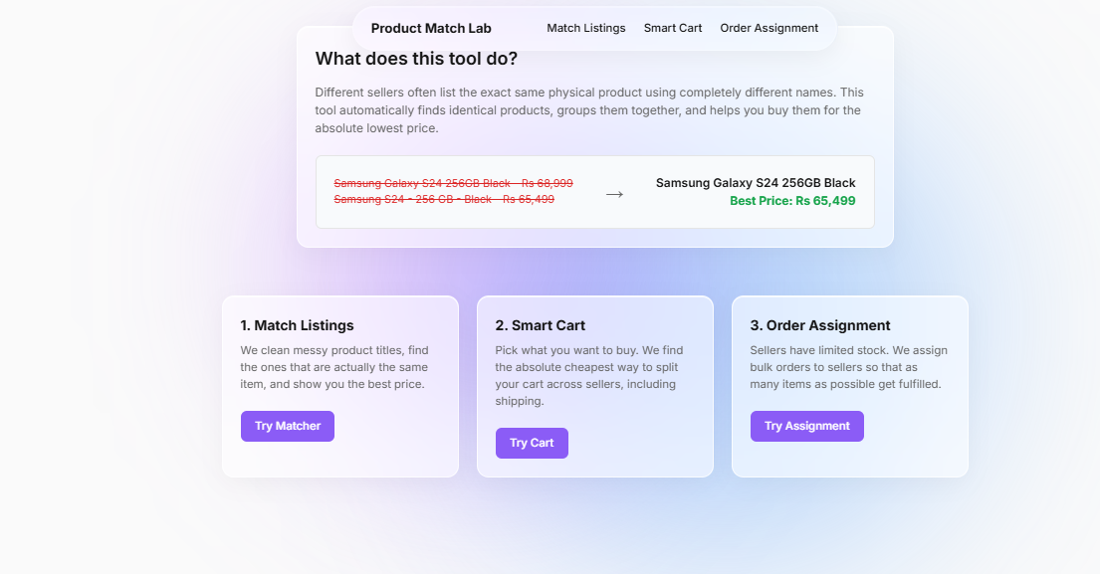
06 · IMPLEMENTATION & LIVE DEMO
Meet Product Match Lab
1
Match Listings
Cleans messy titles, finds identical items, shows the best price
2
Smart Cart
Finds the cheapest way to split your cart across sellers, incl. shipping
3
Order Assignment
Real screenshot: homepage of our website
Assigns bulk orders to limited-stock sellers so more items are fulfilled
EXAMPLE ON THE HOMEPAGE
Samsung Galaxy S24 256GB Black: ₹68,000 and ₹65,499 → Best Price ₹65,499
E-Commerce Product Entity-Resolution & Matching Platform
8
Notes:
[HIGHLIGHT] OPEN THE WEBSITE HOME PAGE. Point to the one-line explanation, the Samsung S24 example, and the three module cards.
This is the homepage of our website, Product Match Lab. It explains the idea in one line: sellers list the same product with different names, and the tool finds them, groups them and helps you buy at the lowest price. See the example: ₹68,000 and ₹65,499 listings become one Samsung Galaxy S24 with a best price of ₹65,499. The site has three modules: Match Listings, Smart Cart and Order Assignment. Before the live demo, here is how each module works in one view.

Slide 9
06 · IMPLEMENTATION & LIVE DEMO
How each module works
Match Listings
Smart Cart
Order Assignment
INPUT
INPUT
INPUT
Raw listings: seller, source, title, price
Products searched and added to the cart
Customer orders (buyer, product, qty) + seller stock & capacity
PROCESS
PROCESS
PROCESS
Clean titles → match similar listings (fuzzy similarity) → group
Dynamic programming picks the best mix of sellers using item price, shipping & import fees
Assign orders to sellers within every stock and capacity limit
OUTPUT
OUTPUT
OUTPUT
Grouped products with the best price
Cheapest total for the whole cart
As many orders fulfilled as possible
E-Commerce Product Entity-Resolution & Matching Platform
9
Notes:
[HIGHLIGHT] Read each column left to right: Input, Process, Output.
Each module follows an input, process and output flow. Match Listings takes raw listings, cleans and matches them, and gives grouped products with the best price. Smart Cart takes the products you add and uses dynamic programming to find the cheapest mix of sellers, including shipping and import fees. Order Assignment takes customer orders and seller stock, and assigns orders so that as many as possible are fulfilled. Now let's see each one live, starting with Match Listings.

Slide 10
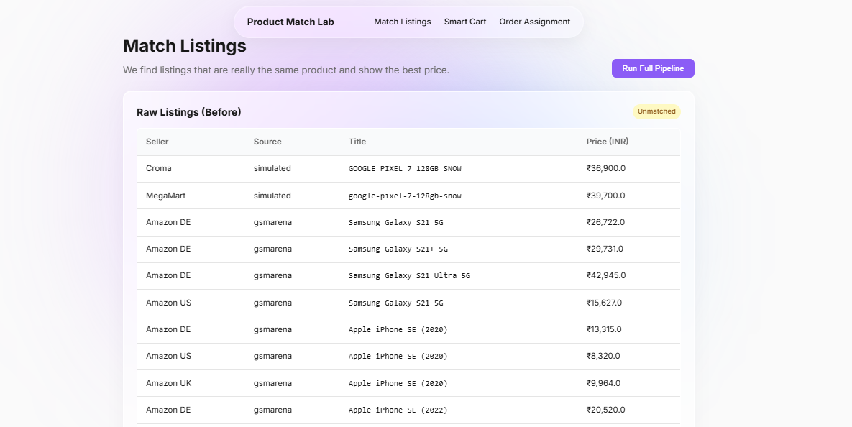
06 · LIVE DEMO 1 OF 3
Match Listings: raw data in, best price out
1
INPUT
Raw Listings (Before): seller, source, messy title and price in ₹, marked “Unmatched”.
2
STEPS
Open Match Listings → read the raw listings → click Run Full Pipeline.
3
PROCESSING
Titles are cleaned and standardized, then similar listings are matched and grouped.
LOOK AT THE RAW DATA
Croma lists “GOOGLE PIXEL 7 128GB SNOW” at ₹36,900; MegaMart lists “google-pixel-7-128gb-snow” at ₹39,700 — same phone, different formatting.
4
OUTPUT
Each real product appears once, with its best price shown.
E-Commerce Product Entity-Resolution & Matching Platform
10
Notes:
[HIGHLIGHT] OPEN /match. Input: show the Raw Listings table and the 'Unmatched' badge. Point to the Croma and MegaMart Pixel 7 rows. Click Run Full Pipeline and show the output.
Demo one: Match Listings. The input is this Raw Listings table, with seller, source, title and price. Everything is marked Unmatched. Notice the messy titles: Croma lists the Google Pixel 7 in capitals at ₹36,900, and MegaMart lists it with hyphens at ₹39,700. Same phone, different format. When I click Run Full Pipeline, titles are cleaned and matched, and each product appears once with its best price. Matching finds the product. Next, the Smart Cart finds the cheapest way to buy it.

Slide 11
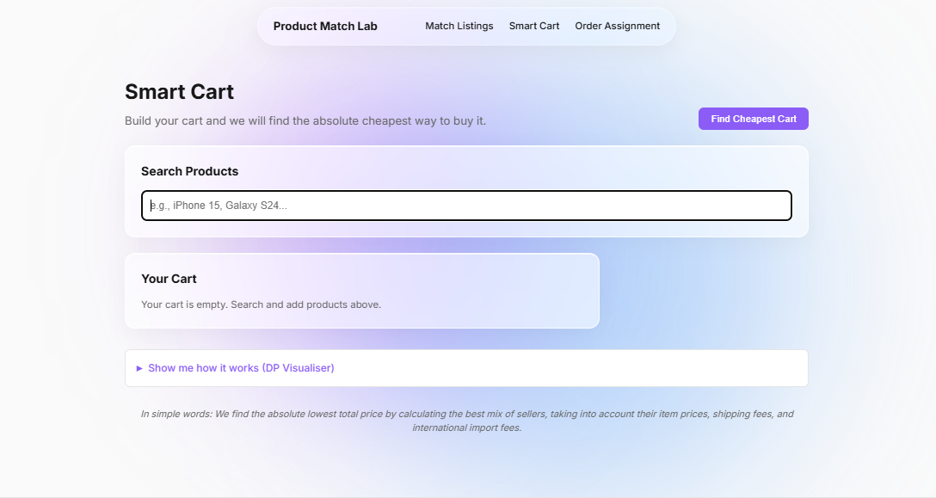
06 · LIVE DEMO 2 OF 3
Smart Cart: the cheapest way to buy
1
INPUT
A search box (e.g., iPhone 15, Galaxy S24). Chosen products go into “Your Cart”.
2
STEPS
Search a product → add it to the cart → click Find Cheapest Cart.
3
PROCESSING
Dynamic programming finds the best mix of sellers using item price, shipping & import fees.
4
OUTPUT
ON THIS PAGE
The cart starts empty. “Show me how it works (DP Visualiser)” explains the dynamic-programming logic behind the cheapest cart.
The lowest total price to buy the whole cart.
E-Commerce Product Entity-Resolution & Matching Platform
11
Notes:
[HIGHLIGHT] OPEN /cart. Type a product (e.g., iPhone 15) in the search box and add it. Click Find Cheapest Cart. Point to the 'DP Visualiser' panel.
Demo two: Smart Cart. The input is a simple search box. I search for a product like iPhone 15 and add it to my cart. Then I click Find Cheapest Cart. Behind the scenes, dynamic programming picks the best mix of sellers, using item prices, shipping fees and international import fees. The result is the lowest total price for the whole cart. The DP Visualiser explains this logic. Finally, let's see how bulk orders are handled.

Slide 12
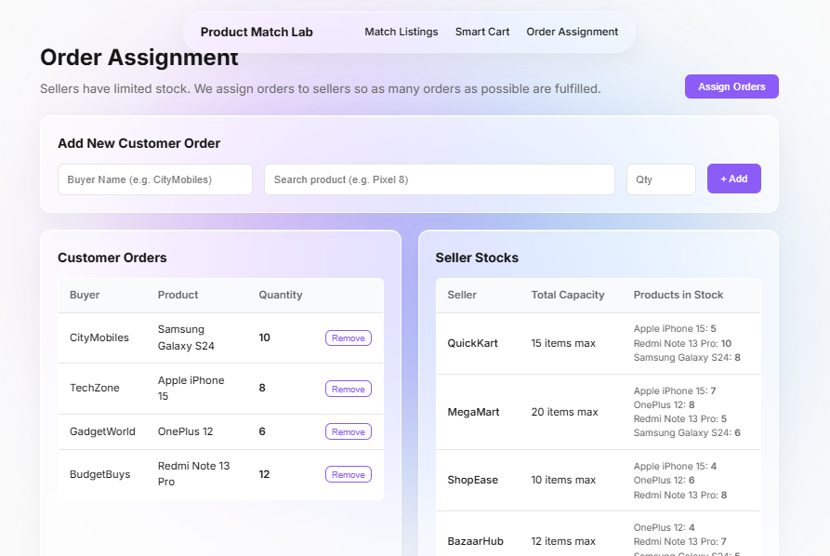
06 · LIVE DEMO 3 OF 3
Order Assignment: orders matched to stock
1
INPUT
Customer orders (buyer, product, qty) and seller stock with capacity limits.
2
STEPS
Add orders with the form → review seller stock → click Assign Orders.
3
PROCESSING
Each order is given to sellers who stock the product, within every capacity limit.
4
OUTPUT
An assignment that fulfils as many orders as possible.
Real screenshot: 4 customer orders (36 units) and sellers with capacity limits (e.g., 15, 20, 10, 12 items max).
E-Commerce Product Entity-Resolution & Matching Platform
12
Notes:
[HIGHLIGHT] OPEN the Order Assignment page. Point to the four customer orders, then the seller stocks and capacity limits. Click Assign Orders and show the result.
Demo three: Order Assignment. Here the input is customer orders on the left: for example, CityMobiles wants 10 Samsung Galaxy S24, and BudgetBuys wants 12 Redmi Note 13 Pro. On the right are the sellers, each with limited stock and a maximum capacity. When I click Assign Orders, the system assigns orders to sellers so that as many orders as possible are fulfilled. Let's now summarize what the website shows.

Slide 13
07 · RESULTS
What the website shows
REAL LISTINGS FROM THE MATCH LISTINGS PAGE
3
Working modules:
matching, cart, assignment
Seller | Raw title (as listed) | Price (INR)
Croma | GOOGLE PIXEL 7 128GB SNOW | ₹36,900
MegaMart | google-pixel-7-128gb-snow | ₹39,700
2
Data sources in the raw
listings: simulated, gsmarena
Same phone, different wording and format. Prices differ by ₹2,800 (₹39,700 − ₹36,900).
EXAMPLE SHOWN ON THE WEBSITE HOMEPAGE
Samsung Galaxy S24 256GB Black
₹68,000 and ₹65,499 → one product
36
Units across 4 customer
orders in the assignment demo
Best Price: ₹65,499 (₹2,501 lower)
E-Commerce Product Entity-Resolution & Matching Platform
13
Notes:
[HIGHLIGHT] Point to the real Pixel 7 listings, the ₹2,800 gap, then the homepage example (₹68,000 vs ₹65,499).
Here is what the website shows us. On the Match Listings page, the same Pixel 7 appears with different formatting and prices ₹2,800 apart. The homepage example shows how matching leads to the best price of ₹65,499, which is ₹2,501 lower than the other listing. Three working modules cover matching, cart optimisation and order assignment. Let's wrap up with our conclusion.

Slide 14
08 · CONCLUSION
A cleaner, more comparable marketplace
Product Match Lab shows that standardizing product data and applying similarity-based matching turns scattered seller listings into one trustworthy catalogue. On top of that foundation, its Smart Cart and Order Assignment modules help buyers find the cheapest way to purchase and help sellers fulfil as many orders as possible — all in one web interface.
THE TAKEAWAY
Same product.
One listing.
Best price.
✓
Standardized, comparable product data
✓
Cross-seller matching using similarity techniques
DSA techniques — string similarity, grouping, and dynamic programming — power the platform.
✓
Canonical grouping with a best-price view
✓
Smart Cart & stock-aware order assignment
E-Commerce Product Entity-Resolution & Matching Platform
14
Notes:
[HIGHLIGHT] Point to the takeaway card: Same product. One listing. Best price.
To conclude, Product Match Lab turns scattered seller listings into one trustworthy catalogue. On top of that, the Smart Cart helps buyers find the cheapest purchase, and Order Assignment helps fulfil as many orders as possible within stock limits. Our takeaway: same product, one listing, best price. Finally, here is where we can take this next.

Slide 15
09 · FUTURE SCOPE
Where this can go next
1
2
3
Semantic Matching
Real-Time Integration
Richer Web Dashboard
Use embedding-based ML models to catch paraphrased or translated titles.
Connect to live seller APIs for continuous, up-to-the-minute price tracking.
Extend our web app with match-confidence views, charts, and export options.
4
5
6
Multi-Language Support
Image-Based Matching
Large-Scale Optimization
Extend matching to listings written in regional languages.
Add product-image similarity to complement text-based matching.
Speed up matching on millions of listings using indexing & blocking.
E-Commerce Product Entity-Resolution & Matching Platform
15
Notes:
[HIGHLIGHT] Mention two or three cards only: Semantic Matching, Real-Time Integration, Richer Web Dashboard.
In the future, we can add embedding-based semantic matching to catch paraphrased titles, and connect live seller APIs for real-time prices. We can also enrich the dashboard with match-confidence views and charts, and add multi-language and image-based matching. Finally, indexing and blocking can scale the matching to millions of listings. That brings us to the end of our presentation.

Slide 16
Thank You
Questions & Discussion
K. Sayee Vansika · K. Neha Sreekari · K. Abhishek Yadav | Team 9, Section 13 | Guide: Dr. Dyuti Banerjee
Notes:
[HIGHLIGHT] Smile, face the audience, and invite questions. Keep the website open in case someone asks for a demo.
Thank you, everyone, for listening. This was our project on E-Commerce Product Entity-Resolution and Matching, presented by Team 9, Section 13, under the guidance of Dr. Dyuti Banerjee. We would be happy to answer any questions, or to run the website again for you. Questions are welcome.

