Slide 1



Water Quality Prediction using Artificial Intelligence
Name: Abhishi Rathore
ID: STU6824246333f991747199075

Slide 2

Learning Objectives
Understand the impact of water's physical and chemical characteristics on potability.
Apply data preprocessing techniques like scaling and imputation.
Build a classification model using Random Forest.
Evaluate and interpret model performance through visual tools like confusion matrices.
GOAL
Source :
www.freepik.com/

Slide 3
Tools and Technology used
Programming Language: Python
Libraries: Pandas, NumPy, Seaborn, Matplotlib, Scikit-learn
Algorithm: Random Forest Classifier
IDE: Google Colab / Jupyter Notebook

Slide 4
Methodology
1. Data Cleaning – Imputed missing values and handled outliers
2. EDA – Used visual tools like histograms and heatmaps
3. Preprocessing – Feature scaling using Standard Scaler, train-test split
4. Modelling – Trained Random Forest Classifier
5. Evaluation – Accuracy score, confusion matrix, and visual validation

Slide 5
Problem Statement:
Millions rely on untreated water sources that may be contaminated. There is a need to automate and accurately classify whether water is potable based on measurable attributes like pH, hardness, sulfate, etc.

Slide 6
Solution:
A supervised machine learning model (Random Forest) was developed to classify water potability. The model achieved ~87.6% accuracy, helping to reliably predict safe water samples based on feature inputs.

Slide 7
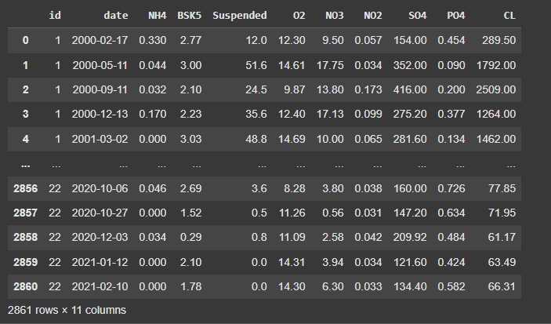
Screenshot of Output:

Slide 8
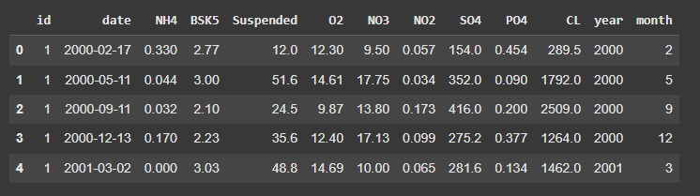
Screenshot of Output:

Slide 9
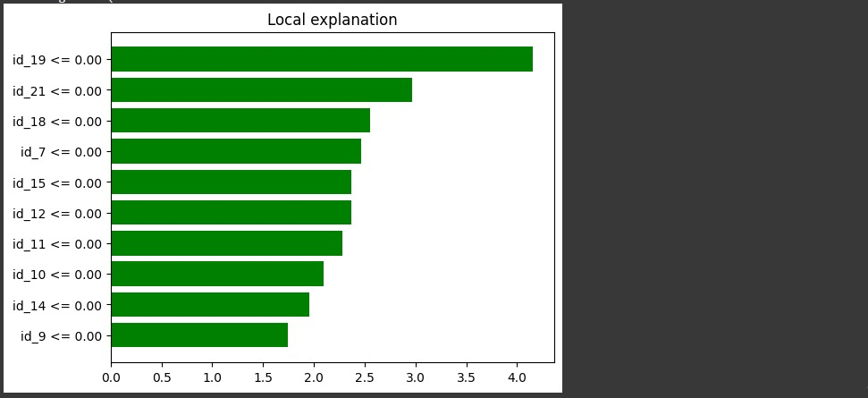
Screenshot of Output:

Slide 10
GitHub Link:
https://github.com/abhishi2307/Edunet-Water-Quality-Prediction-Week-3.git

Slide 11
Conclusion:
The project demonstrates how machine learning can assist in public health by identifying potable water sources. With proper feature analysis and model selection, it is possible to predict water safety efficiently and reliably.

