Slide 1
Blockchain based Medicine tracker
Team Perfectly Balanced
Jai Agarwal, P Abhishikta Sai, Guruprasad M

Slide 2
What is the problem?
One of the major problems in pharmaceutical domain today
Sale of counterfeit medicines
May not contain the intended drug
Sold at price lower/higher than genuine medicine
End users lured into buying them
May lead to dangerous side effects, worsen patient’s condition
End user may not be able to verify medicine’s authenticity
Therefore, a system is needed to prevent the above

Slide 3
Ways of counterfeiting drugs
Manipulation of expiry date
Remove/wrong active agent, high/low dosage of active agent
Forged, blistered, wrong packaging
Replacing correct medicine with the fake medicine in the package
Adding surplus stock/ removal of stock

Slide 4
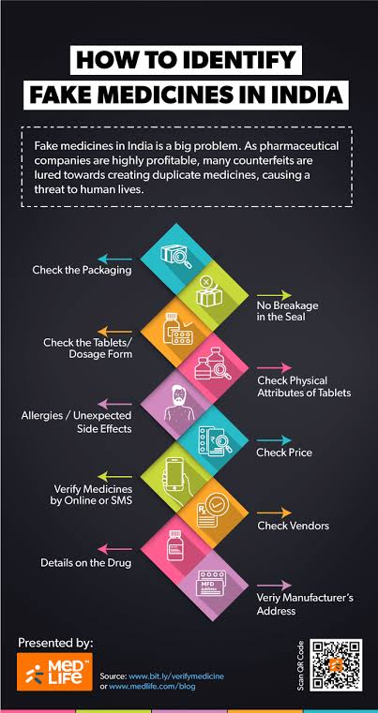
Means of identifying counterfeit drugs

Slide 5
Why use blockchain?
Secure, cannot modify, hashed ledger of all transactions
Enables tracking and tracing of manufactured medicine
Customer can verify that the transaction has been recorded in the ledger when he buys a medicine
Customer can also check which retailer has how much stock of a particular medicine

Slide 6
Perceived Idea Of Solution
Entities of pharmaceutical supply chain
Manufacturer, Wholesaler, Retailer, End user
Ensuring medicine’s authenticity
Security at all points in the chain
Communication between various phases of the chain
Usage of blockchain architecture
Each block : Checking of hashed information, insertion of timestamp
Helps in traceability of the drug
Each entity - varied permissions
To ensure authenticity

Slide 7
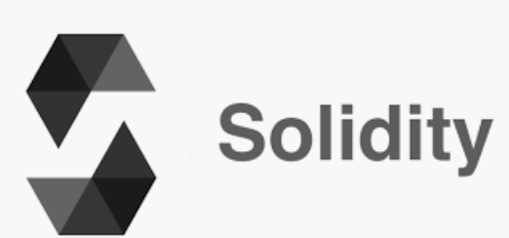


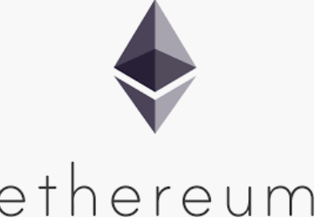
Tech Stack
Smart
Contract
OOPS language for SmartContrat
Security
Scalability
Cost
Development Environment
Deploy & Test
Remix
BlockChain Platform

Slide 8
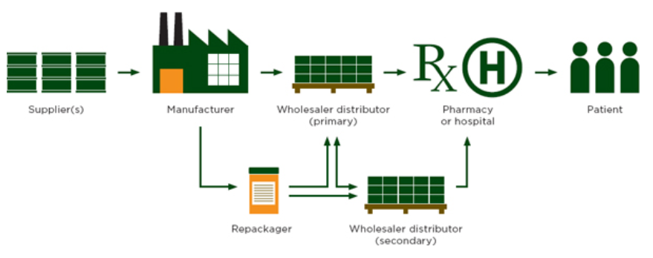
Drug Supply & Distribution Chain
In - Scope

Slide 9
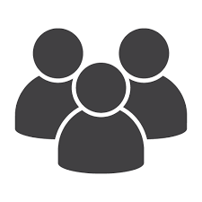
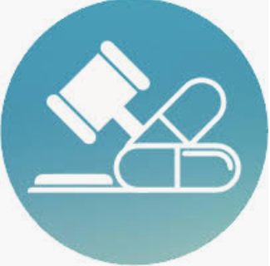
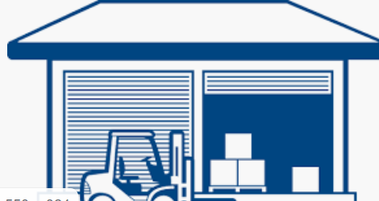
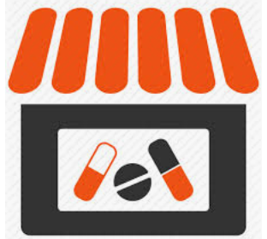
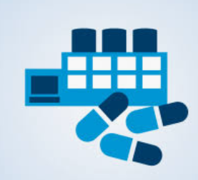
Process ( Functional) Flow
Smart
Contract
Medicine
Quantity
Name
Manu. Dt
Expiry Dt
Medicine ID
Customer
{getWholesaler}
{validate}
{sellMedicine}
Drug Administrator
{buyMedicine}
Drug Wholesaler
{addManufacturerRecord},
{wholesalerTransaction},
{validate},
{sellMedicine}
{addMedicineRecord}
{buy
Medicine}
Drug Retailer
Drug Manufacturer

Slide 10
End users of our application
The drug regulatory authority
Can verify and include entities (manufacturer, wholesaler) in the supply chain network
Can validate every transaction happening on the network
The end user of the App
Can check the stocks of each medicine with a retailer
Can validate medicine using Batch ID

Slide 11
References
https://www.nap.edu/read/18272/chapter/7#198
https://medium.com/medlifecare/how-to-identify-fake-medicines-in-india-7c62244480c0

