Slide 1
NETFLIX DASHBOARD

Slide 2
CREATING A WORKSHEET
Go to "File" Menu and then click on "Open".
Choose the data source type (e.g., Excel, CSV, text file) and Select the data file and click "Open".
Drag any table into working area.

Slide 3
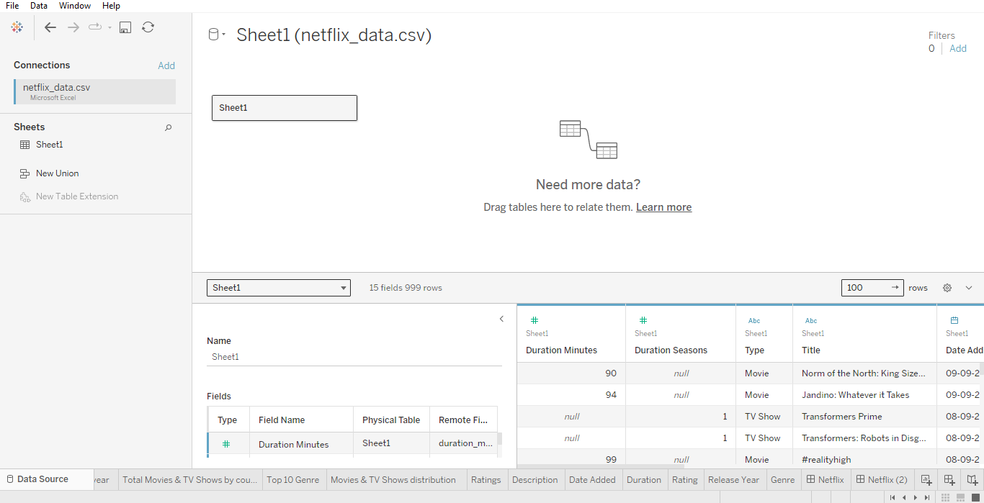

Slide 4
SHEET:
TOTAL MOVIES & TV SHOWS BY YEAR
From the "Data Source pane", drag and drop the Date Added to the Columns shelf and Show ID to the Rows shelf.
Drag and drop Type in Color field and Label field.
Click Area in the drop down box.
Select the Format option. Go to Sheet and select Worksheet color.
Name the Sheet as Total Movies & TV Shows by year.

Slide 5
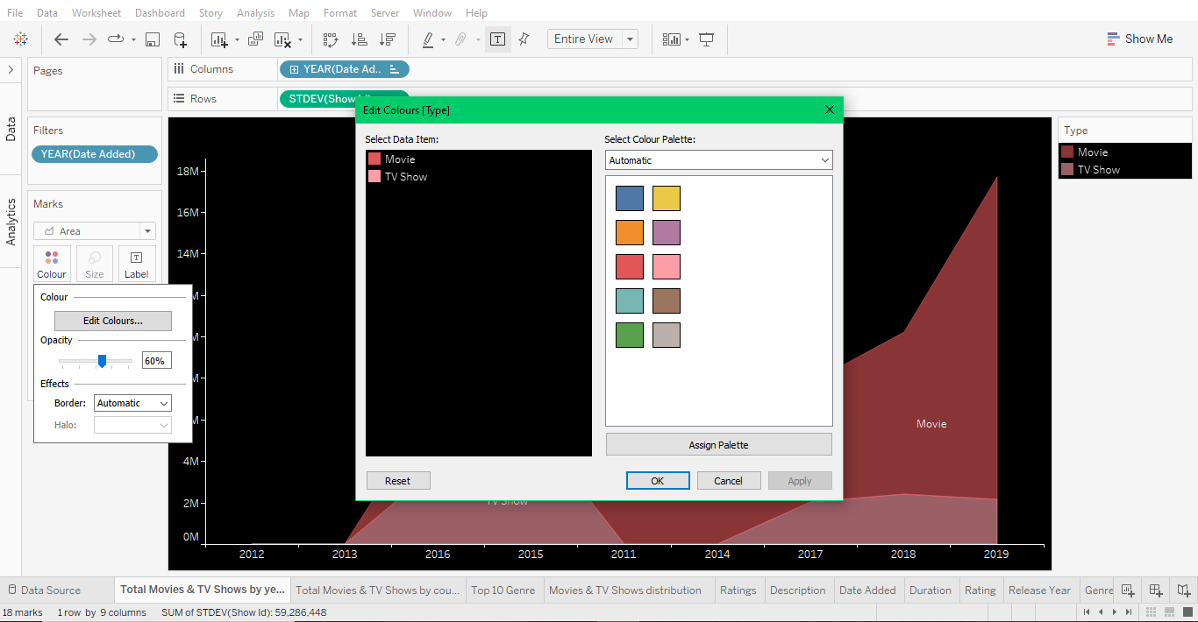

Slide 6
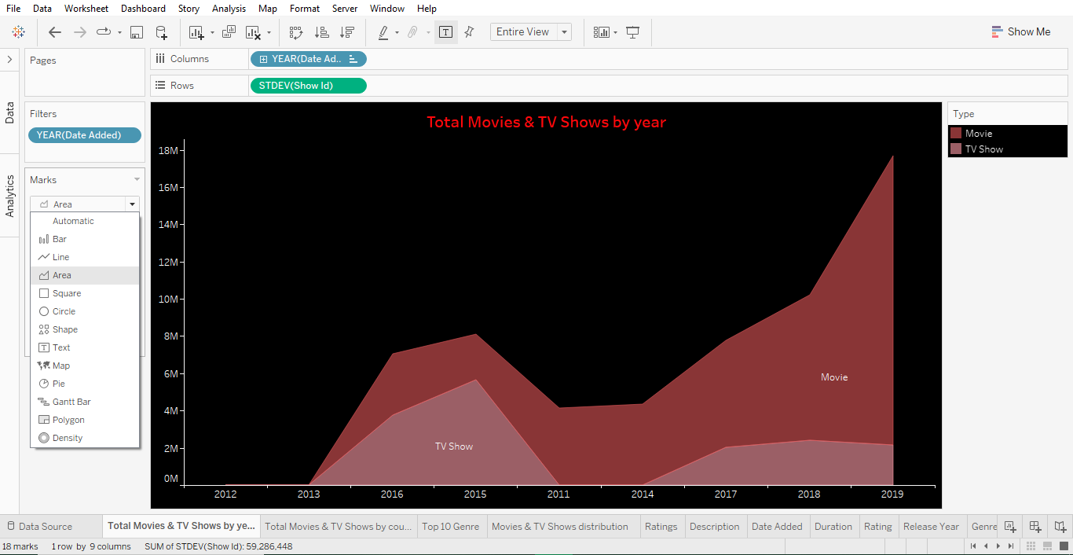

Slide 7
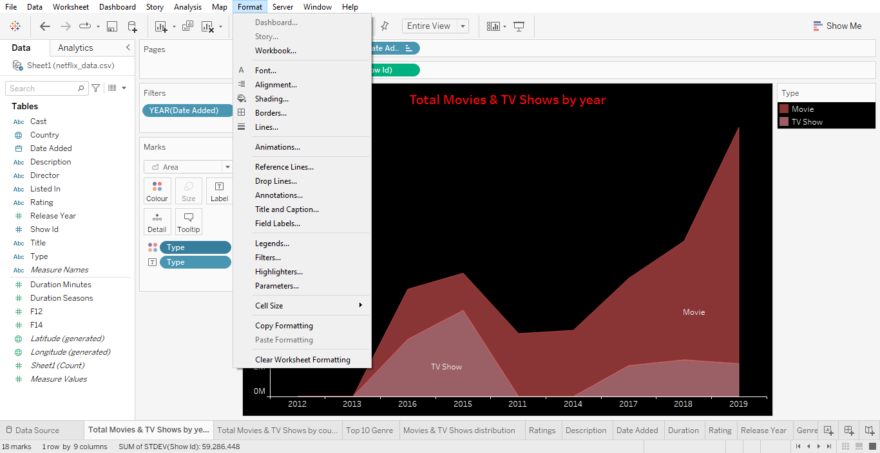

Slide 8
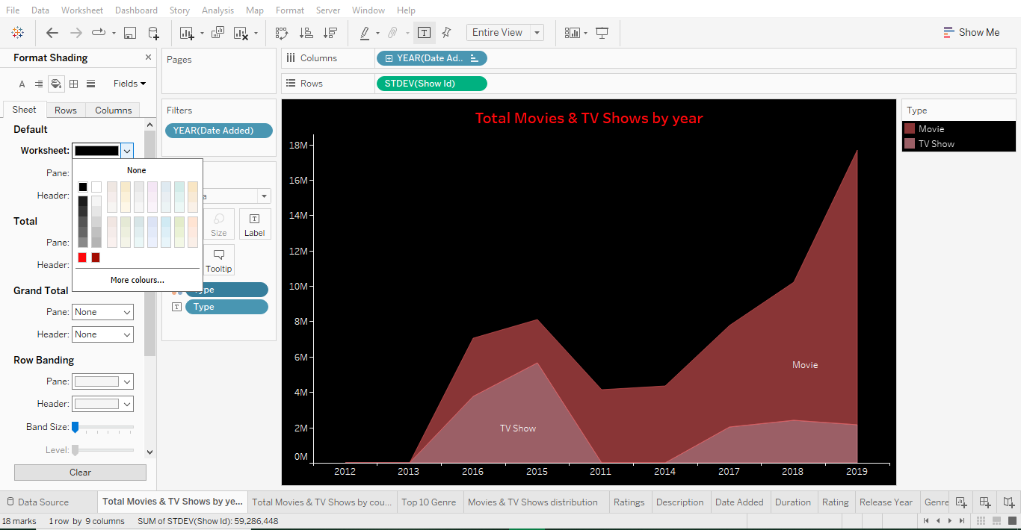

Slide 9
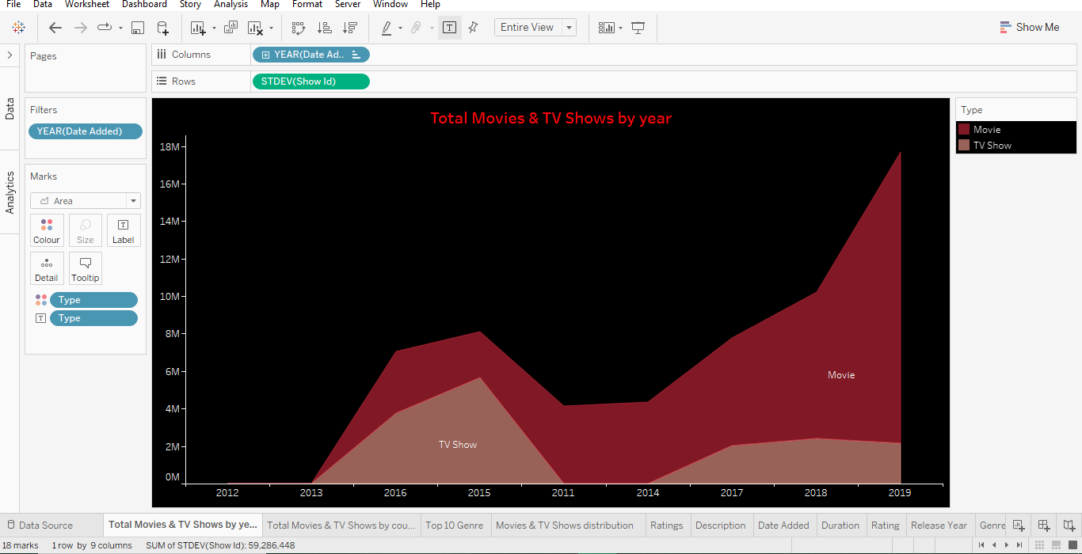

Slide 10
SHEET:
TOTAL MOVIES & TV SHOWS BY YEAR
Open a new sheet.
Drag and drop Country in Detail field and show ID in Color field.
Name the sheet as Total Movies & TV Shows by country .

Slide 11
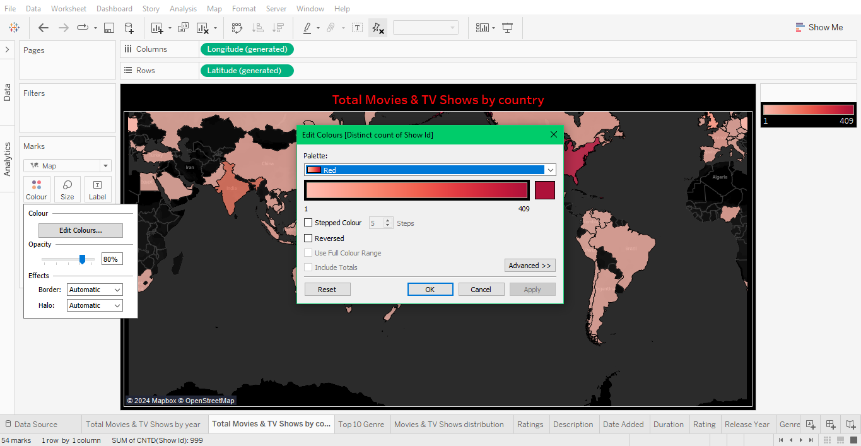

Slide 12
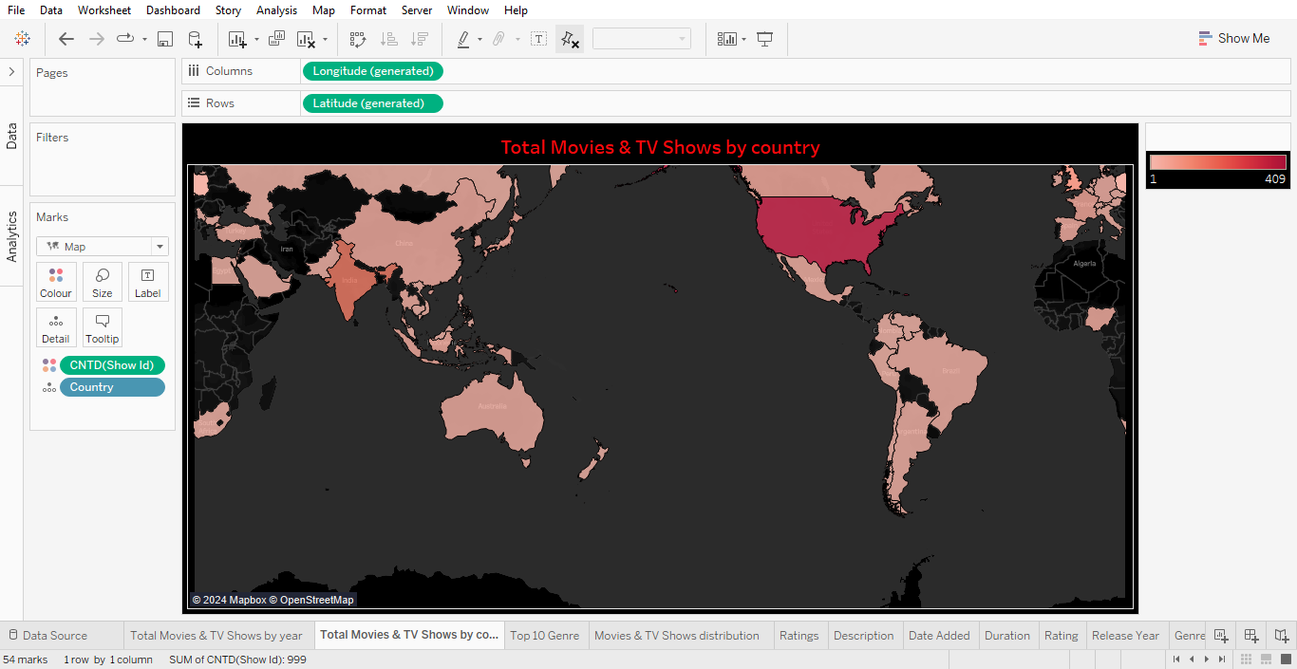

Slide 13
SHEET:
TOP 10 GENRES
Drag and drop Listed in to rows field and Show ID to columns.
Drag and drop Show ID to Label field.
Name the sheet as Top 10 Genres.
Click on color field and select a required color.

Slide 14
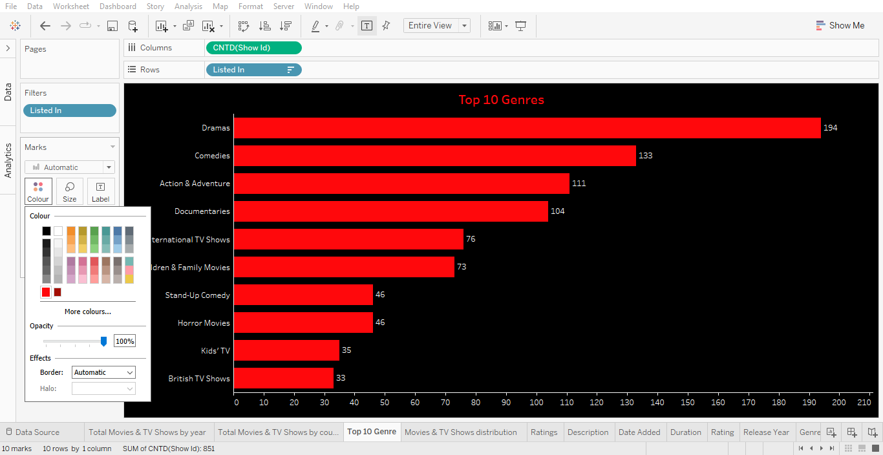

Slide 15
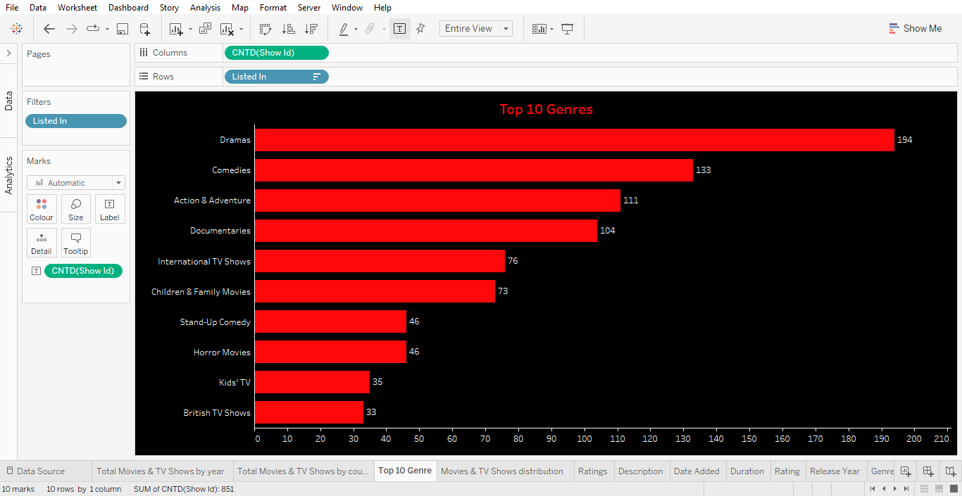

Slide 16
SHEET:
MOVIES & TV SHOWS DISTRIBUTION
Drag and drop Type to Color and Label field.
Drag and drop Show ID to text and size label.
Click on color field and click on Edit colors.
Select a data item and choose the required color.
Name the sheet as Movies & TV Shows Distribution.

Slide 17
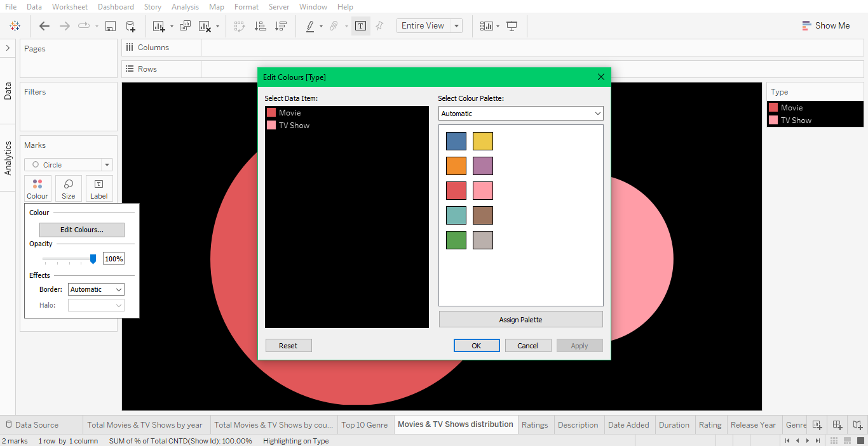

Slide 18
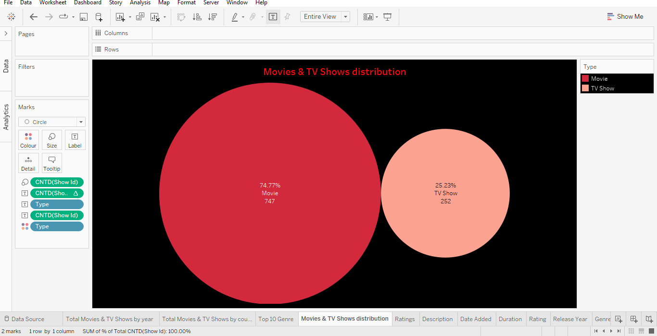

Slide 19
SHEET:
RATINGS
Drag and drop Show ID to rows field and Rating to columns.
Drag and drop Show ID to Label field.
Click on color field and select a required color.
Arrange the bar chart in ascending or descending order.
Name the sheet as Ratings.

Slide 20
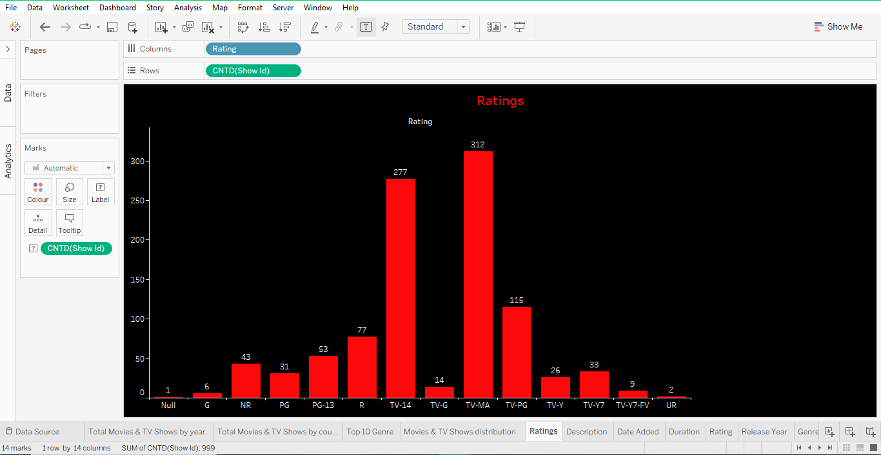

Slide 21
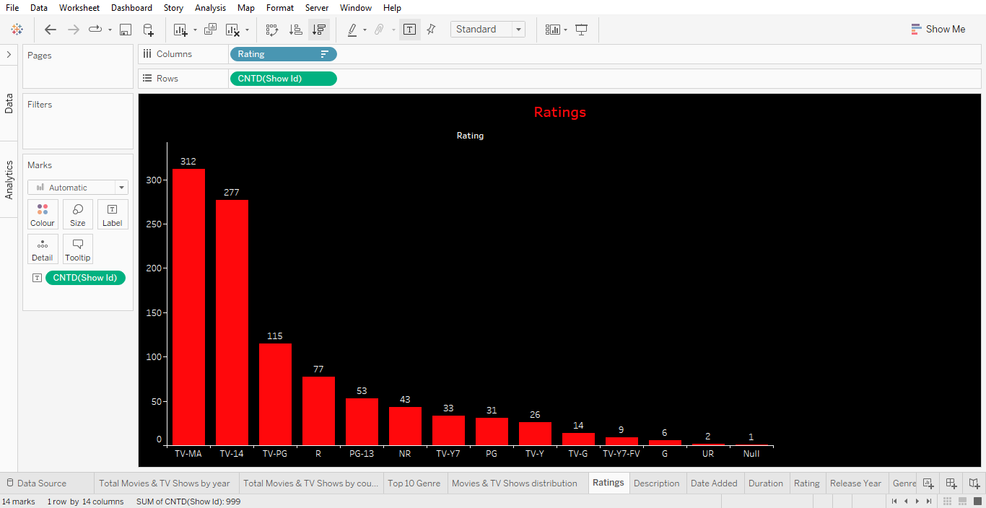

Slide 22
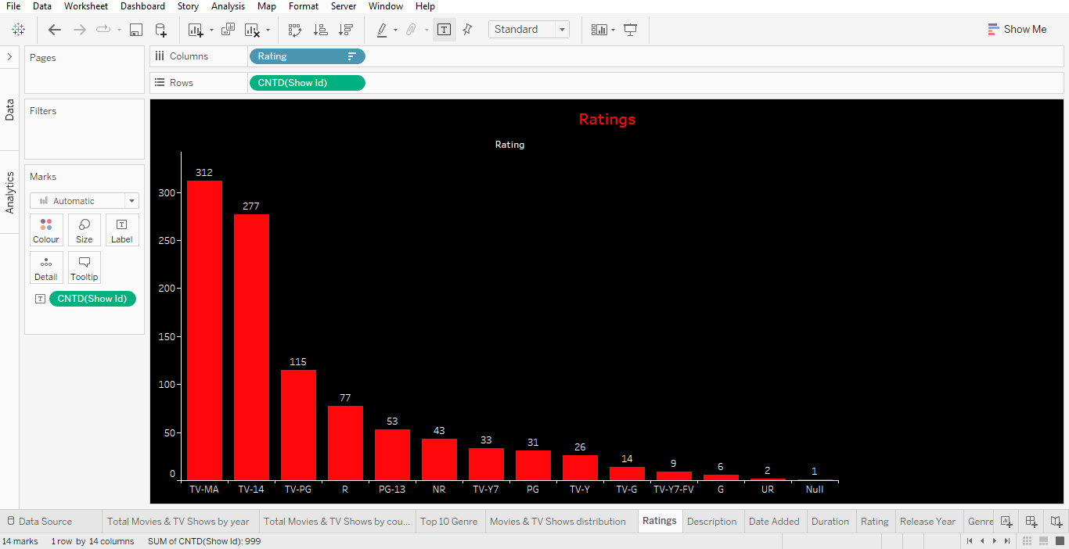

Slide 23
SHEET:
DESCRIPTION
Drag and drop Type to filter field.
Select Movies.
Drag and drop Title to filter field.
Select a movie title.
Drag and drop Description to label field.
Name the sheet as Description.

Slide 24
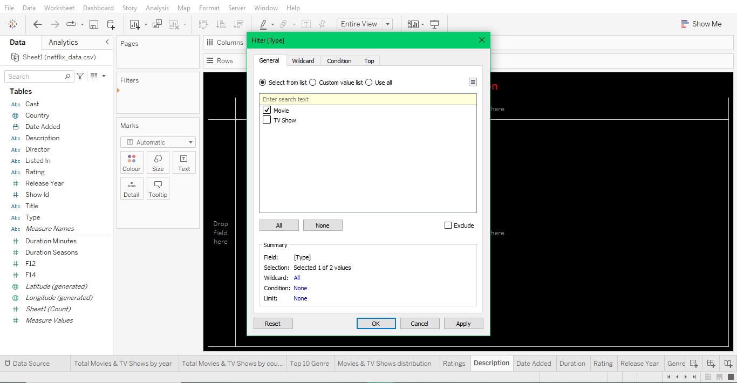

Slide 25
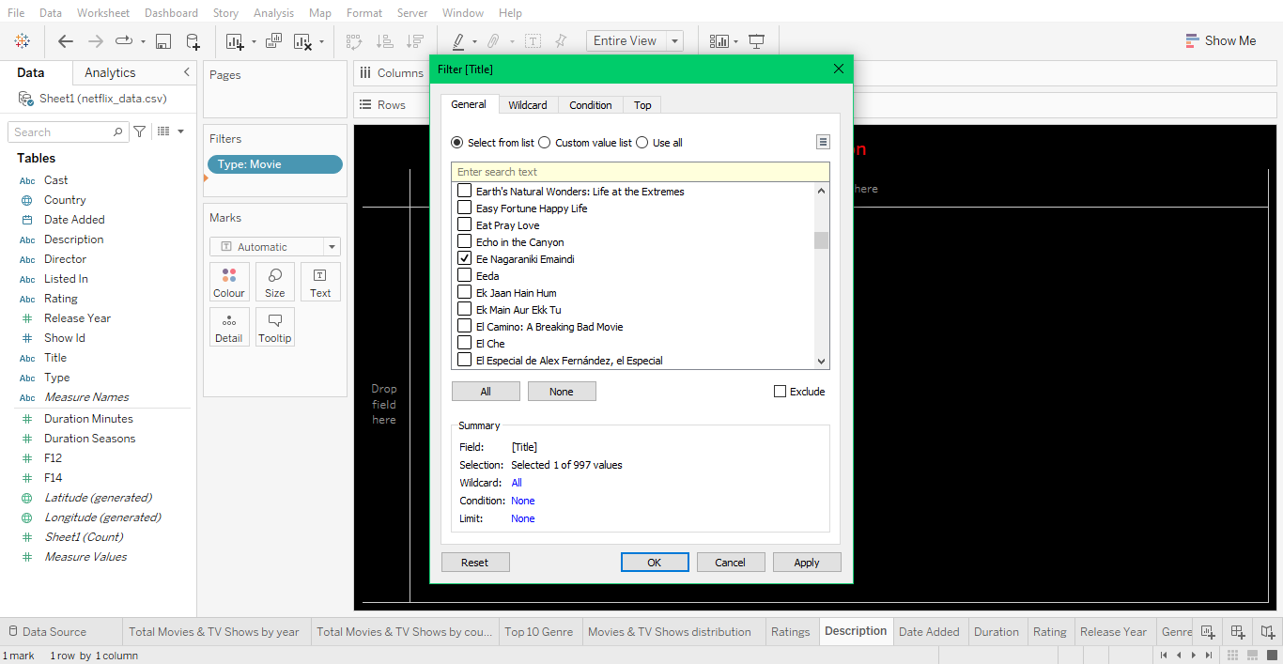

Slide 26
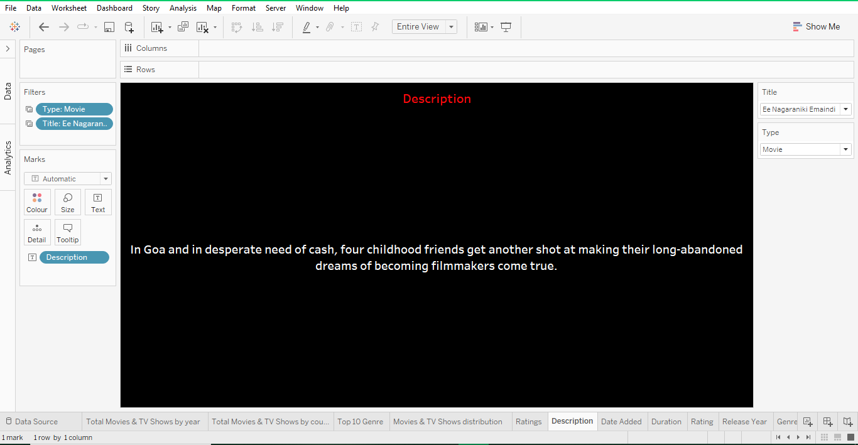

Slide 27
SHEET:
DATE ADDED
Drag and drop Type to filter field.
Select Movies.
Drag and drop Title to filter field.
Select a movie title.
Drag and drop Date Added to label field.
Name the sheet as Date Added.

Slide 28
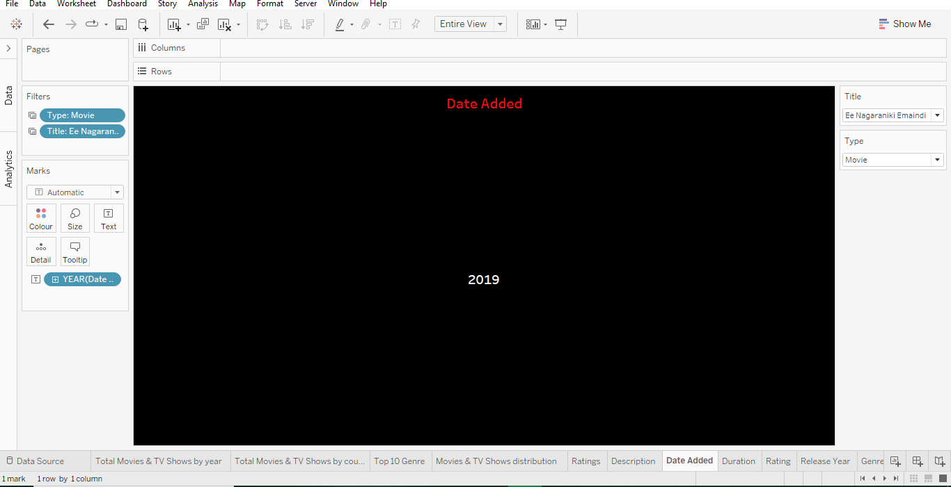

Slide 29
SHEET:
DURATION
Drag and drop Type to filter field.
Select Movies.
Drag and drop Title to filter field.
Select a movie title.
Drag and drop Duration to label field.
Name the sheet as Duration.

Slide 30


Slide 31
SHEET:
RATING
Drag and drop Type to filter field.
Select Movies.
Drag and drop Title to filter field.
Select a movie title.
Drag and drop Rating to label field.
Name the sheet as Rating.

Slide 32
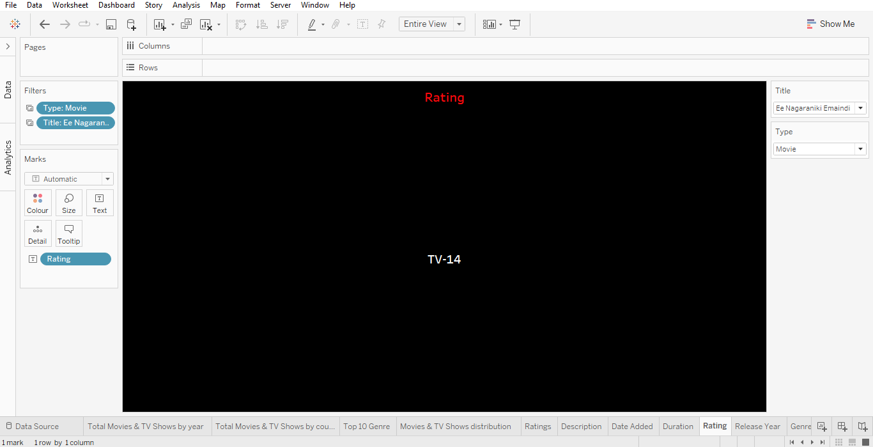

Slide 33
SHEET:
RELEASE YEAR
Drag and drop Type to filter field.
Select Movies.
Drag and drop Title to filter field.
Select a movie title.
Drag and drop Release Year to label field.
Name the sheet as Release Year.

Slide 34


Slide 35
SHEET:
GENRE
Drag and drop Type to filter field.
Select Movies.
Drag and drop Title to filter field.
Select a movie title.
Drag and drop Listed in to label field.
Name the sheet as Genre.

Slide 36
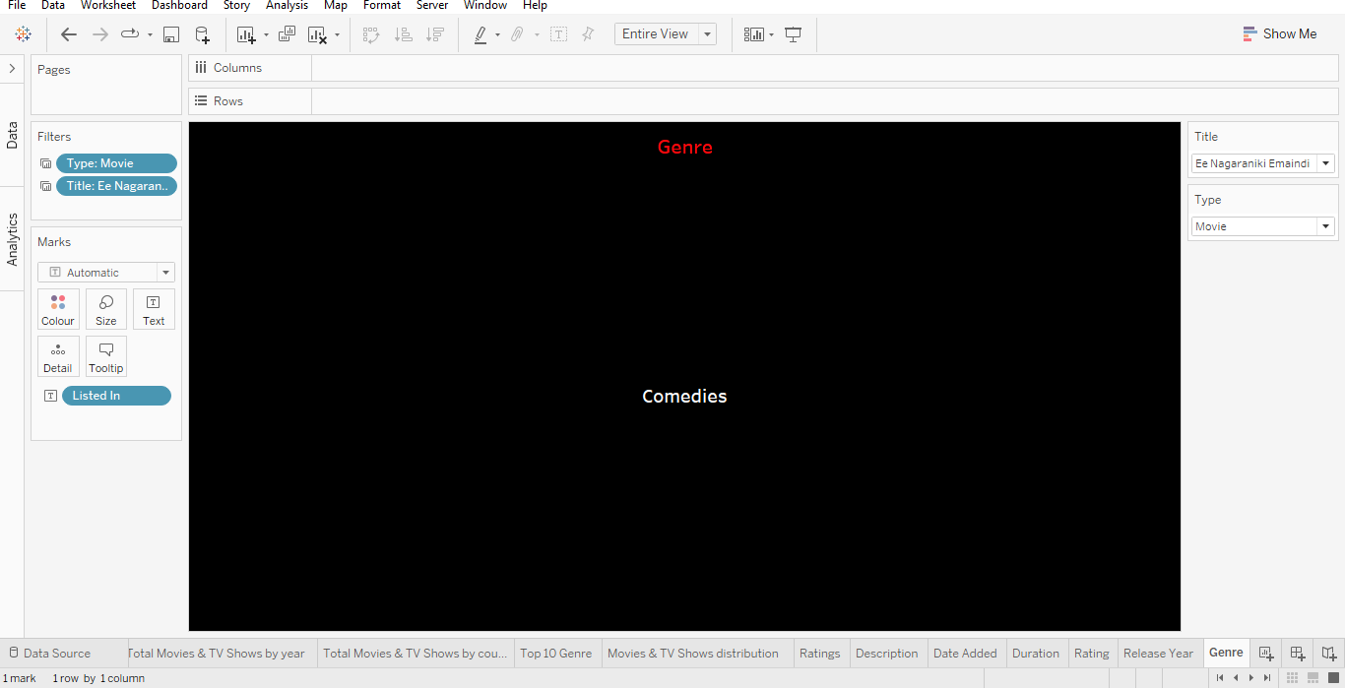

Slide 37
DASHBOARD:
NETFLIX
Create a new Dashboard.
From the Sheets section select and drag the required sheets.
Align the sheets in the dashboard accordingly.
Name the Dashboard as Netflix.

Slide 38
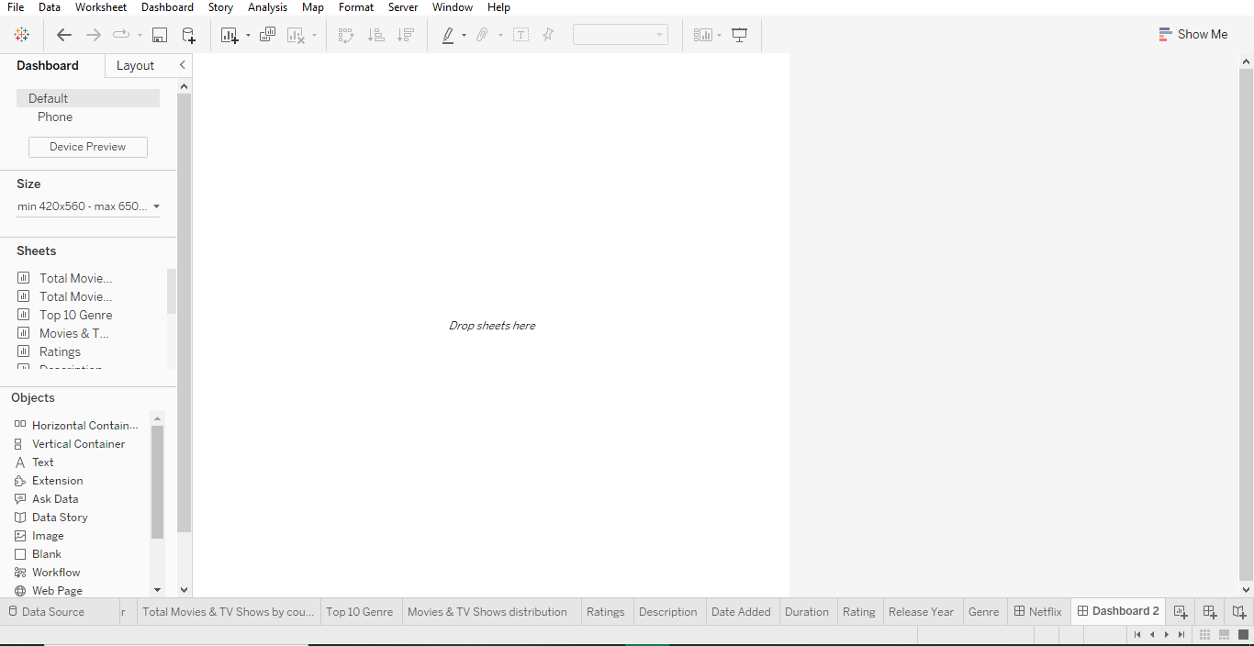

Slide 39
