Slide 1
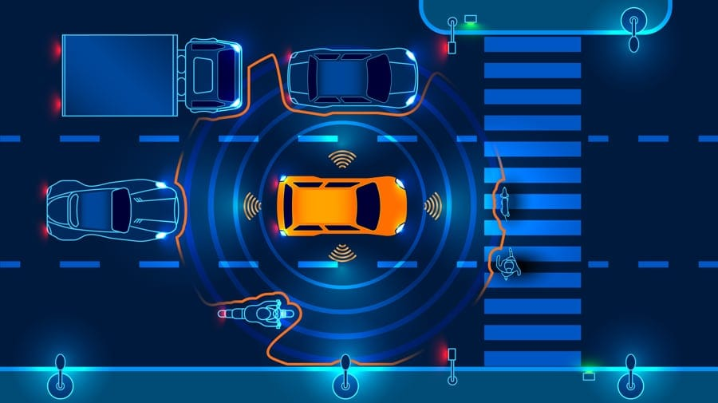

MCA MINI PROJECT | FINAL PRESENTATION
Accident Detection and Alert System Using Smartphone Sensors
STUDENT
Abhishikth S Siby
Reg. No. MLM25MCA-2004 | S3 MCA
GUIDE
Ms. Anju John
Assistant Professor, Dept. of Computer Applications
Notes:
Good morning, respected panel. I am Abhishikth S Siby, S3 MCA, register number MLM25MCA-2004. My mini project is an Accident Detection and Alert System using Smartphone Sensors, guided by Ms. Anju John.

Slide 2
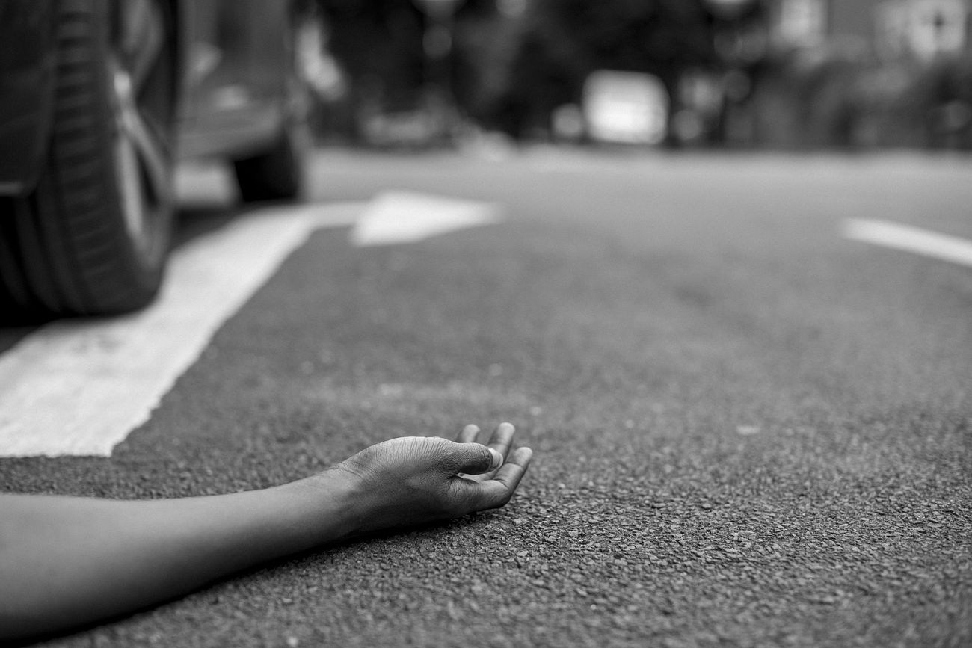
Introduction
The Golden Hour
Road accidents remain a major safety challenge; the first minutes after impact are critical.
Victims may be unconscious or trapped and unable to call for help.
Reporting delay delays medical assistance.
Smartphones carry accelerometer, gyroscope, GPS and SMS.
Purpose: automatic detection and location-aware alerting with no extra hardware.
Importance: low-cost safety aid for riders, drivers and travellers.
Golden Hour: every minute of reporting delay matters.
Notes:
After a serious collision, the first minutes decide how effective medical help can be. The victim may not be able to call anyone. Phones already contain the needed sensors, so my project turns the phone into an automatic detector and alert device.

Slide 3
Abstract
Problem
Solution
Method
Outcome
Victims may be unable to report accidents
Delay costs critical time
Flutter-based Android app
On-device motion monitoring, no server
Magnitude from accelerometer
Window, threshold, spike, cooldown
Alarm and cancel window, then GPS and SMS
Prototype workflow works end to end
All 20 functional tests passed
Notes:
In brief: the app watches phone motion, raises an alarm when a threshold is crossed, and lets the user cancel false alerts. If there is no response it fetches GPS and prepares an emergency SMS. These are prototype parameters, and all twenty functional test cases passed.

Slide 4
Problem Definition
“
Victims of serious road accidents may be unable to summon help manually, and existing automatic solutions depend on dedicated hardware or continuous connectivity, creating a need for a low-cost, smartphone-only system that detects accident-like motion and sends a location-aware emergency alert with minimal false notifications.
Notes:
Stated formally, victims often cannot call for help, and existing automatic systems need extra hardware or constant connectivity. My project addresses this with a smartphone-only, on-device approach.

Slide 5
Objectives
Detect accident-like motion on a smartphone and send a location-aware alert automatically
Store name, blood group and emergency number locally
ON/OFF detection switch
Threshold-based motion monitoring
Alarm with cancel option
GPS and Maps-link message
Working Android prototype validated by tests
Faster reporting
No extra hardware
Simple to use
Notes:
The main objective is automatic detection plus alerting. The specific objectives follow the user journey from storing details to sending the message. The benefit is faster notification at almost no cost.

Slide 6
Existing System
Accident occurs
>
Someone notices
>
Calls for help
>
Explains location
>
Responders contacted
Problems
Limitations
Manual processes
Victim may be unconscious or alone
Location described verbally
Depends on bystanders
Hardware systems raise cost, exclude older vehicles and two-wheelers
Cloud systems need connectivity and servers
Basic apps give false positives
Calling responders
Describing the place
Informing relatives
Notes:
In the usual workflow everything depends on a person noticing and calling. Automatic systems exist, but they need vehicle hardware or cloud connectivity. Simple phone apps are cheap but often raise false alarms.

Slide 7
Proposed System
Motion sensors
>
Threshold detection
>
Alarm + cancel
>
GPS fix
>
SMS + Maps link
>
Emergency contact
How it solves it
Key features
Improvements
Detects abnormal motion automatically
User can cancel false alerts
Fetches GPS and prepares SMS on timeout
Name, blood group, Maps link
Local storage
Cooldown against repeats
Unsent-message fallback
No extra hardware
No server
No mobile data needed for core flow
Notes:
Everything runs on the phone: it detects, warns, locates and prepares the SMS. Compared with existing systems there is no hardware to buy and no server to maintain. The SMS still needs cellular service; only mobile data is not required.

Slide 8
Scope of the Project
Target users
Functional coverage
Included / excluded
Future uses
Drivers and passengers
Two-wheeler riders, cyclists
Remote-area travellers
Details storage
Detection toggle
Motion monitoring
Alarm and cancel
GPS and SMS
Included: Android prototype
Excluded: certified crash hardware, dispatch integration
ML classification
Wearables
Fleet safety
Smart-city response
Notes:
The project is a supplementary safety aid, not a replacement for certified crash systems. It covers the full detect-to-alert workflow on Android. Future uses include fleet safety and smart-city integration.

Slide 9
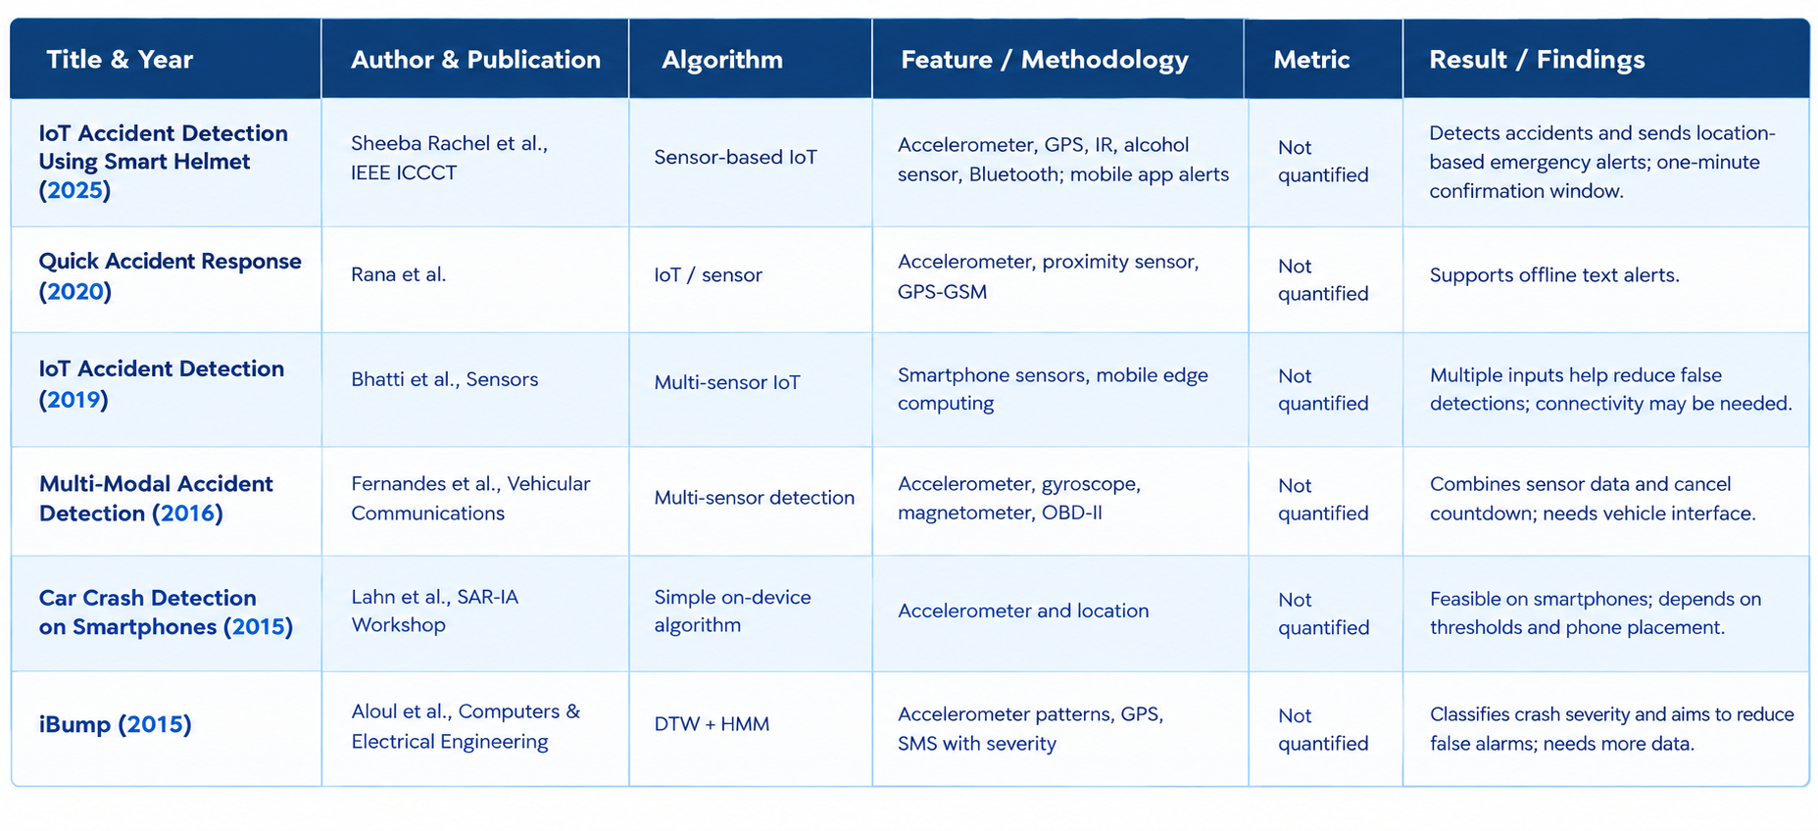
Literature Review
Notes:
Learned approaches like iBump improve accuracy but need training data. HDy Copilot and IoT approaches need vehicle hardware or the cloud. Threshold apps like ResQ are cheap but prone to false positives. The report gives no numeric metrics for these papers, so I compare methods and findings.

Slide 10
Technologies Used
Flutter SDK
Dart
sensors_plus
Cross-platform UI framework
Async streams and device calls
Accelerometer event stream
geolocator
shared_preferences
audioplayers
High-accuracy GPS position
Local key-value storage
Looping warning alarm
url_launcher
permission_handler
Android SDK + Gradle
SMS URI composer
Runtime permissions
Build tools
Notes:
Each package has one job: sensors for motion, geolocator for position, shared_preferences for storage, audioplayers for the alarm, url_launcher to open the SMS, and permission_handler for permissions.

Slide 11
Software & Hardware Requirements
Software Requirements
Hardware Requirements
Component | Specification
IDE | Android Studio or VS Code
Framework | Flutter SDK 3.x
Language | Dart
Packages | sensors_plus, geolocator, shared_preferences, audioplayers, url_launcher, permission_handler
Build tools | Android SDK, Gradle
Version control | Git / GitHub (optional)
Component | Specification
Computer | Windows 10+, macOS 10.14+ or Ubuntu
Processor | Intel Core i3 or higher (~2.0 GHz)
RAM | 4 GB minimum, 8 GB recommended
Storage | 64 GB free
Mobile phone | Android with accelerometer, gyroscope, GPS, speaker
Messaging | SMS-capable device or composer access
Network | Setup only; not needed for core flow
Notes:
Development needs a modest computer and Flutter tooling. For testing I used a physical Android phone because emulators cannot reproduce real motion, GPS or SMS behaviour.

Slide 12
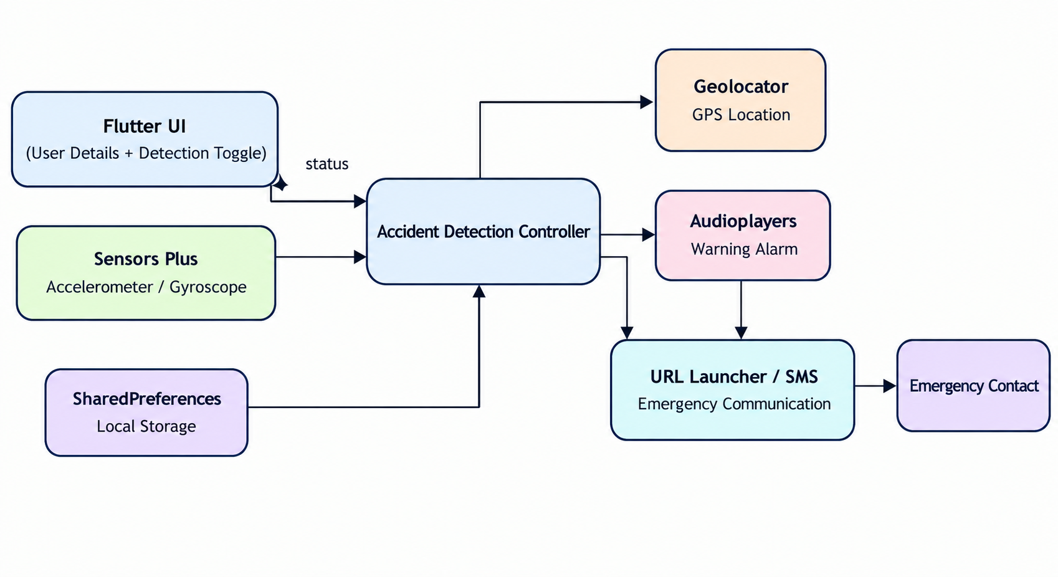
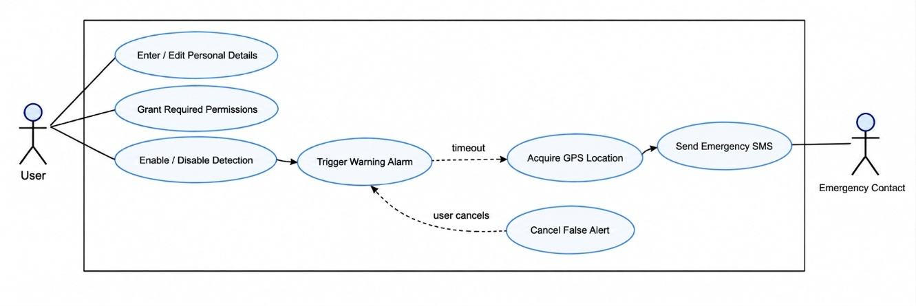
System Architecture
Notes:
Each diagram shows a different view: DFD shows data movement, use case shows who does what, class shows structure, state shows the lifecycle of one detection, activity shows the two decision points, and sequence shows the order of calls.

Slide 13
User UI
>
Controller
>
Sensor stream
>
Warning timer
>
GPS fetch
>
SMS launch
Layer | In this project
User interaction | Flutter screens: detection switch, cancel button
Application layer | Flutter UI
Business logic | On-device controller: magnitude, window, threshold, cooldown
Database layer | SharedPreferences (local; no server)
External services | GPS (Geolocator), Google Maps URL, phone SMS composer
Backend | None required
Notes:
The architecture is mobile-centric. The user interacts with the Flutter UI, the controller reads sensor events, the warning timer allows cancellation, GPS provides the location and the SMS composer is launched. SharedPreferences replaces a database and there is no backend server.

Slide 14
Design Diagrams
USE CASE DIAGRAM
Notes:
Each diagram shows a different view: DFD shows data movement, use case shows who does what, class shows structure, state shows the lifecycle of one detection, activity shows the two decision points, and sequence shows the order of calls.

Slide 15
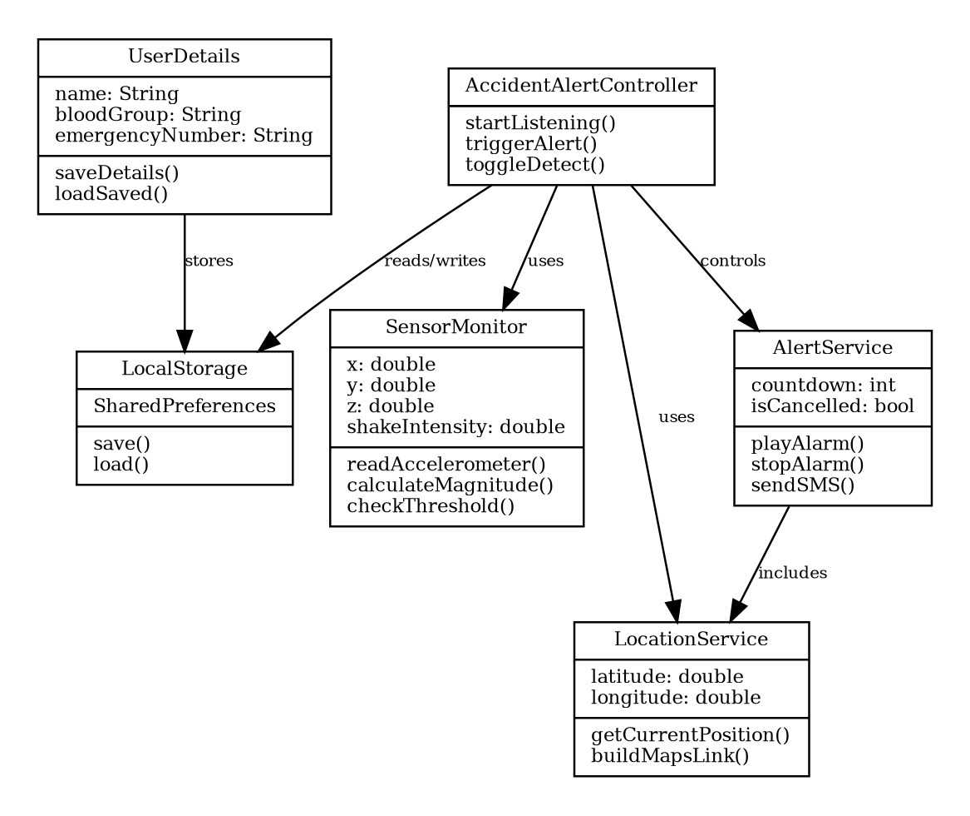
CLASS DIAGRAM

Slide 16
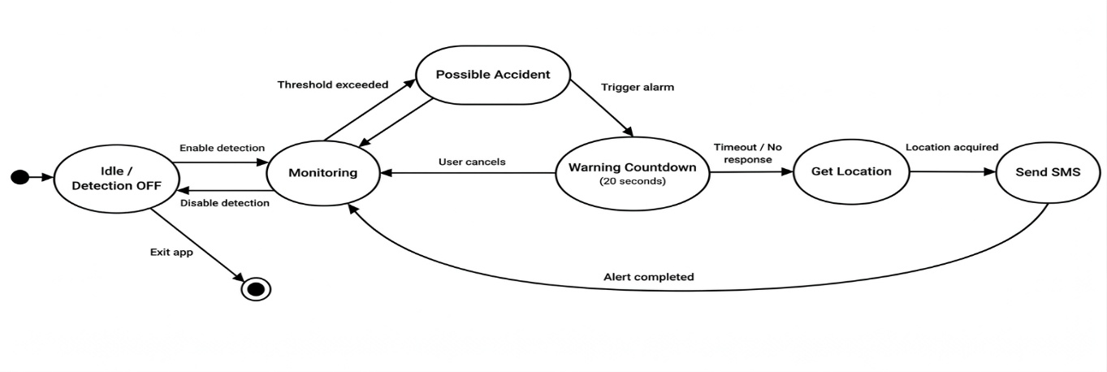
STATE DIAGRAM

Slide 17
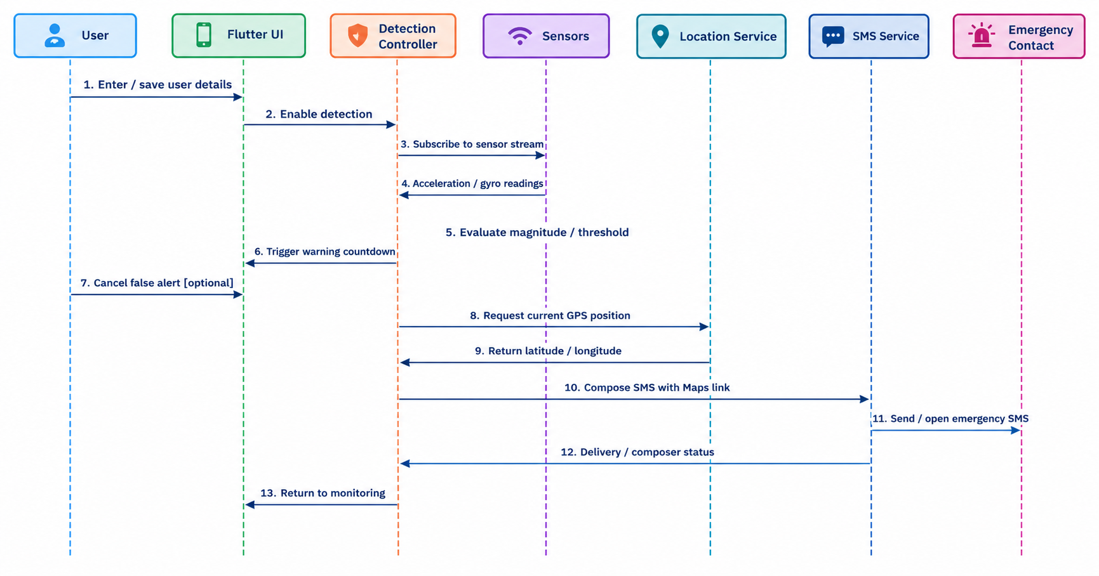
SEQUENCE DIAGRAM

Slide 18
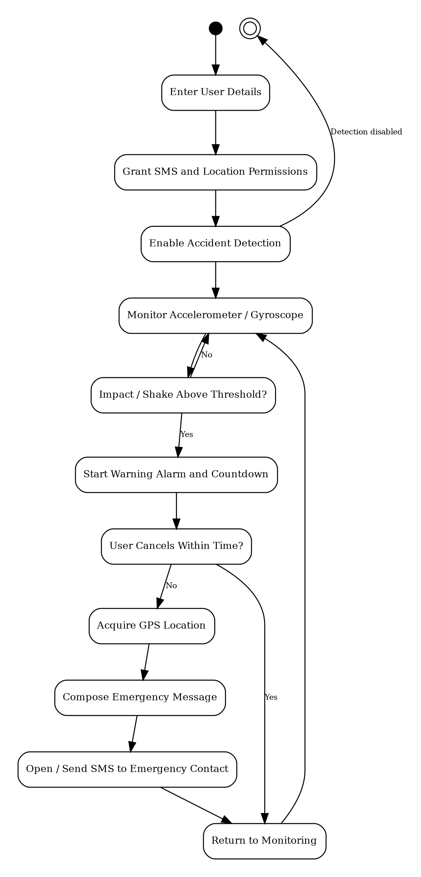
ACTIVITY DIAGRAM

Slide 19
Module Description
# | User Module | Responsibility
1 | User Details and Settings | Collect, validate and store name, blood group, emergency number
2 | Detection Control | ON/OFF switch; checks details exist; starts sensor listening
3 | Sensor Monitoring | Computes magnitude; applies window, threshold, spike, cooldown
4 | Alert Generation | Looping alarm; confirmation period to cancel
5 | Location Tracking | Checks permission; gets position; builds Maps link
6 | Emergency Message | Builds message; opens SMS composer; keeps unsent text on failure
7 | Storage and Permissions | SharedPreferences and runtime permissions
Notes:
The app has seven modules, each with one responsibility. The detection control module will not enable monitoring until emergency details are saved. If the SMS composer cannot be opened, the message is stored for retry.

Slide 20
Algorithm / Methodology
M = √(x² + y² + z²)
8
25.0
readings in sliding window
absolute threshold
Trigger when either holds
M > 25.0
OR M - window average > 12.0
12.0
8 s
then check cooldown, alarm, 20 s cancel window, GPS, SMS
spike delta
cooldown
Notes:
Each reading gives x, y and z, combined into one magnitude. I keep the last eight readings and test two conditions: above 25, or more than 12 above the recent average. The eight-second cooldown stops one impact producing many alerts. These are prototype values. Detection uses accelerometer magnitude only.

Slide 21
Results / Analysis
Function | Observed result | Status
Details storage | Saved; persist after reopening | Pass
Detection toggle | Monitoring starts and stops | Pass
Normal movement | No alert | Pass
Abnormal motion | Warning under strong simulated motion | Pass
False-alert cancel | Alarm stops; no SMS | Pass
GPS location | Maps link opens correct place | Pass
Emergency message | Name, blood group, link included | Pass
Test cases by group (20 of 20 passed)
Notes:
All functional checks passed on the prototype, including cancel preventing the SMS and the Maps link opening the right location. I did not measure accuracy, precision, recall, F1 or response time, so I am not claiming any.

Slide 22
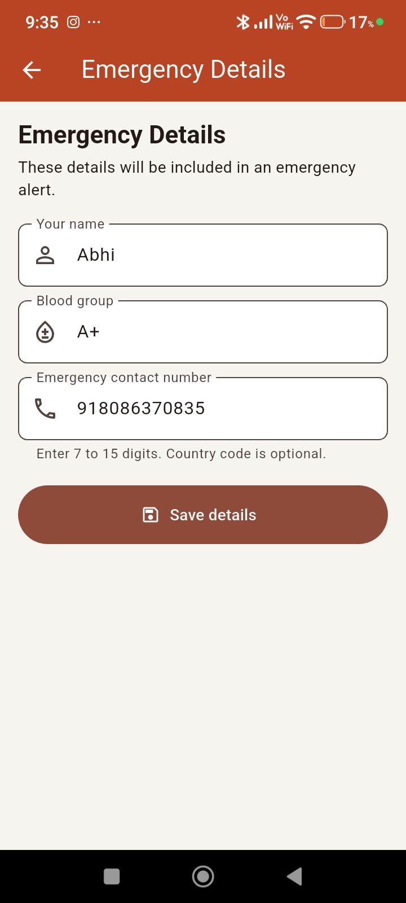
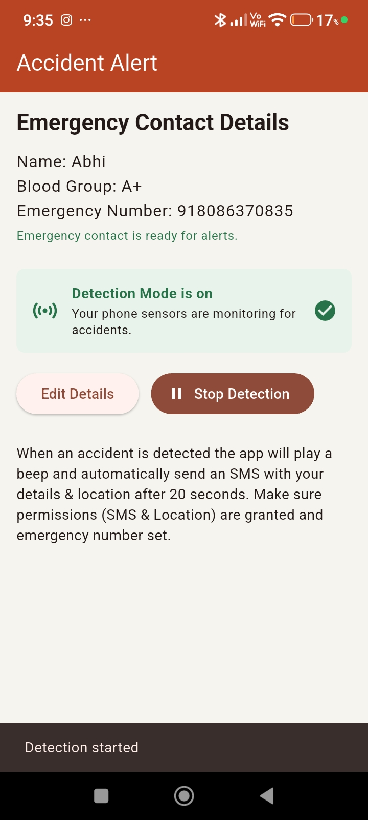
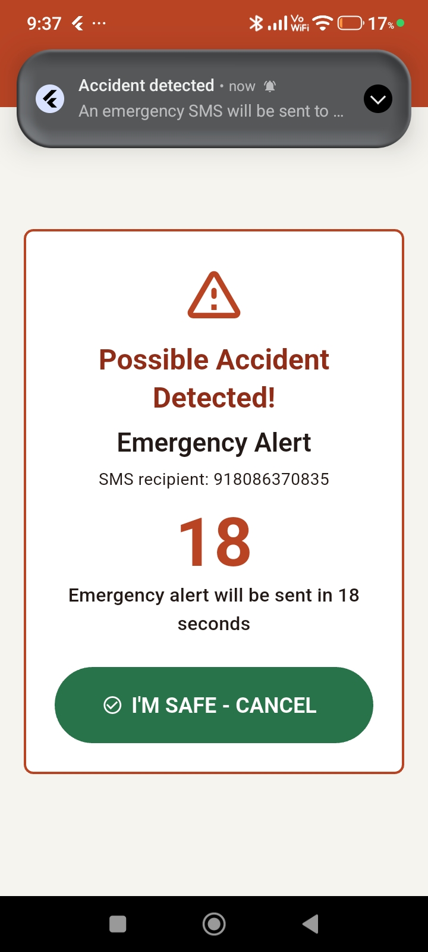
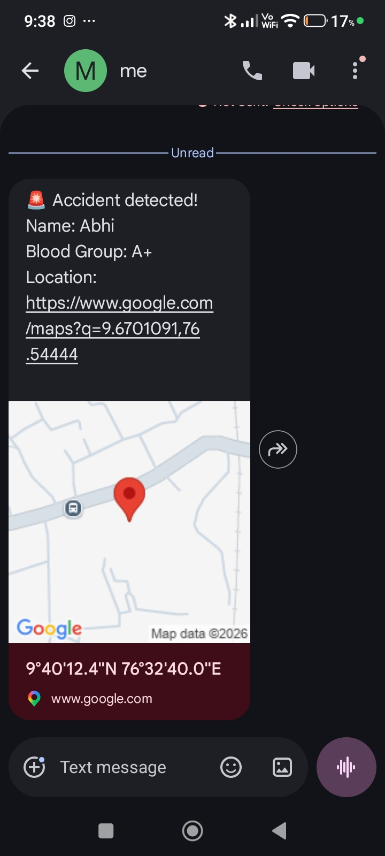
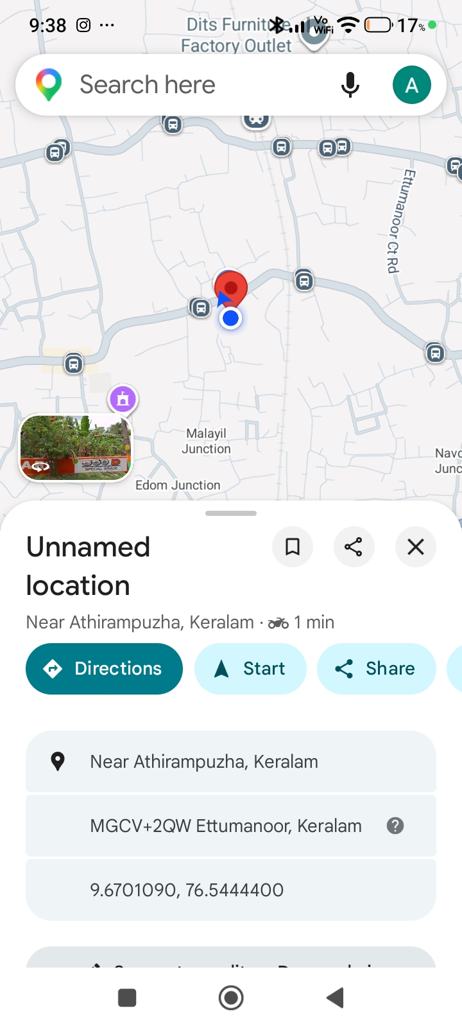
Screenshots / Output
Notes:
These are the four screens a user sees: registration, the main detection switch, the Maps location opened from the generated link, and the SMS composer with the prepared message. Login, dashboard and admin screens do not apply to this app.

Slide 23
Comparison with Existing System
Feature | Existing System | Proposed System
Processing | Manual reporting, or hardware / cloud processing | Automated on-device detection with user cancel step
Accuracy | Depends on witness or victim; hardware systems can be accurate but costly | Threshold-based; no accuracy figure measured; cancel step handles false alerts
Time | Starts only after someone notices and calls | Detection starts immediately; escalation after 20 s cancel window
Security | Cloud systems send data to servers | Minimal data stored locally; SMS sent as plain text
Accessibility | Needs vehicle hardware, servers or connectivity | Any Android phone with sensors; no extra hardware
Reporting | Verbal description of location | Auto message with name, blood group, Maps link
Notes:
This table compares the approaches using what my project showed. Processing and reporting are automated, and time improves because nothing waits for a bystander. For accuracy I have no measured figure. On security, data stays on the device but the SMS itself is not encrypted.

Slide 24
Testing
Unit: User Details Validation
Test Case | Expected | Actual | Status
Enter details | Values saved | Saved, visible | Pass
Save all fields | Data persists | Persisted | Pass
Empty field | Fill-all message | Message shown | Pass
Integration: SMS and Location, SMS Fallback
Test Case | Expected | Actual | Status
Timeout, no cancel | Message begins | Initiated | Pass
Cancel | No message | No message | Pass
Permission denied | Permission flow | Flow shown | Pass
SMS unavailable | Kept as unsent | Unsent saved | Pass
Unit: Motion Detection Thresholds
Test Case | Expected | Actual | Status
Normal movement | No alert | No alert | Pass
Strong shake | Alarm, warning | Alarm started | Pass
Repeated shakes | One alert | Single event | Pass
Notes:
Testing was done at three levels. Unit tests covered user-details validation and motion thresholds; integration tests covered timeout, location and SMS, including the unsent-message fallback. All twenty cases passed. I used controlled movements rather than real crashes and did not run a formal user acceptance study.

Slide 25
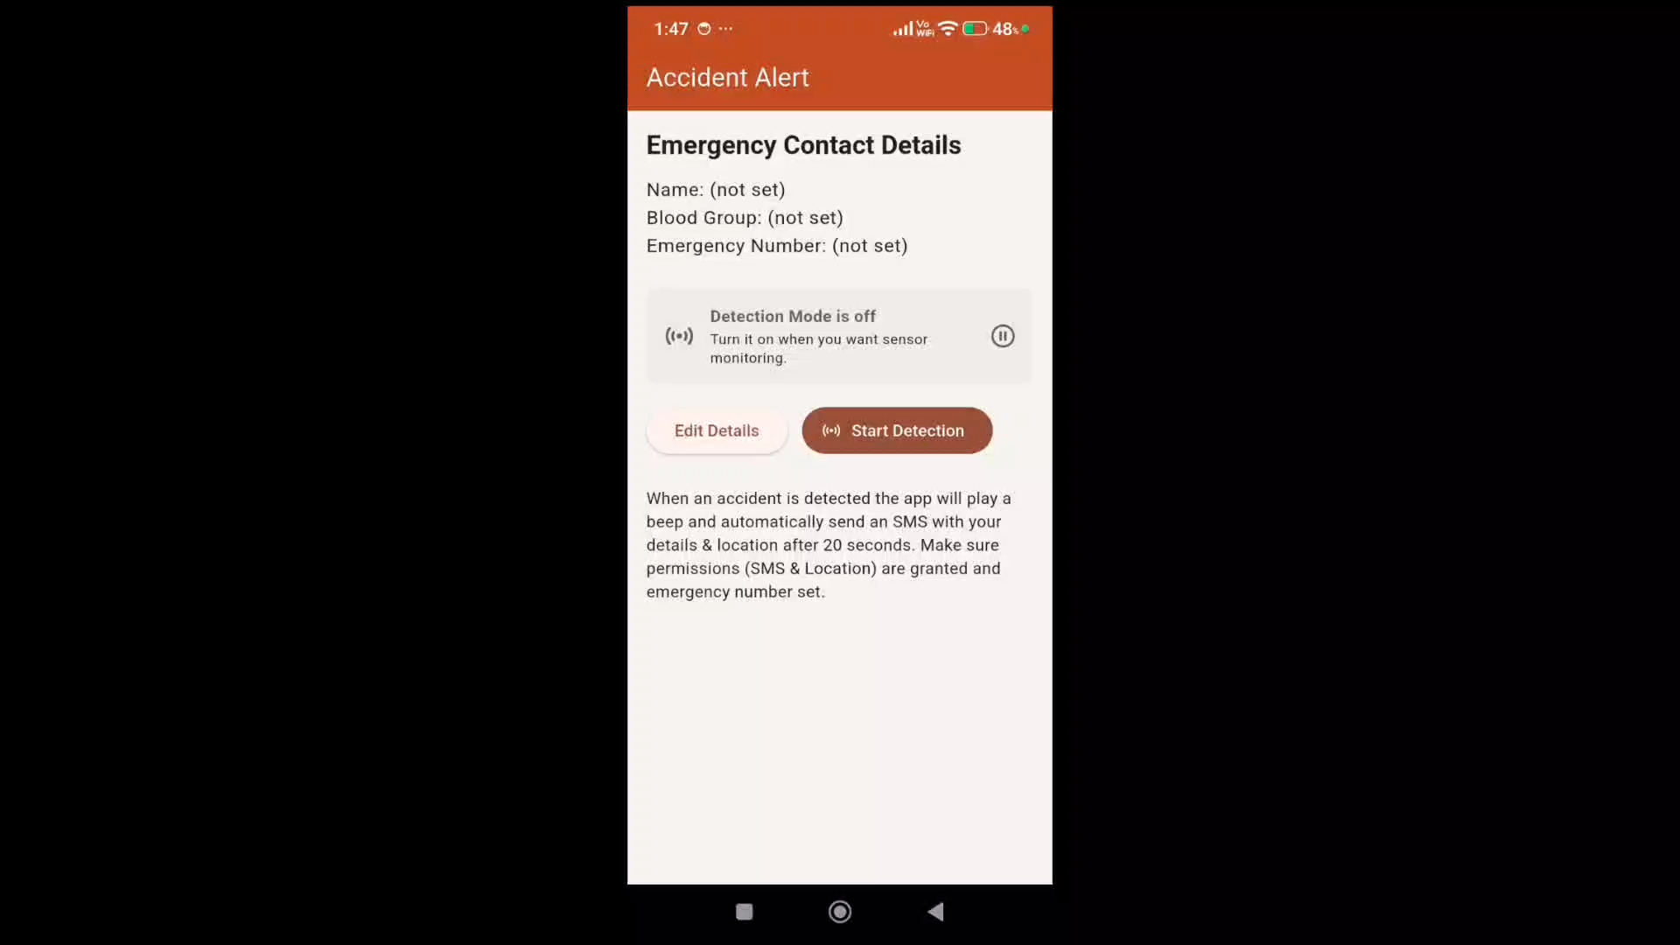
Demo Video
Save Emergency details
>
Detection ON
>
Normal: no alert
>
Shake: alarm
>
Cancel: no SMS
>
Timeout: SMS
Notes:
I will now show a short demo. Details are saved, detection is turned on, normal movement gives no alert, a controlled shake sounds the alarm and I cancel it, and finally I let one alert expire so the SMS composer opens with the location link.

Slide 26
Advantages
Cost and simplicity
Safety and usefulness
Low cost: existing phone sensors
Simple UI, minimal setup
Local storage, no server
Modular Flutter design
Fast, location-aware message
Maps link opens directly
False alerts can be cancelled
Useful for riders and travellers
Notes:
The key advantages are cost, speed and simplicity, plus the cancel step and a message that is immediately actionable for the recipient.

Slide 27
Limitations
False positives from drops and potholes
Depends on placement and calibration
No certified accuracy
SMS needs cellular service and permissions
GPS weak indoors or in tunnels
Battery use and Android background limits
No hospital or emergency-service link
Notes:
These are the honest limits. Thresholds depend on device and placement, SMS needs cellular service, and background monitoring costs battery. The code snapshot uses a 10 second timer while the documented requirement is 20 seconds; I will align them in the final build.

Slide 28
Conclusion
Smartphone-only system: detects abnormal motion, warns, locates and prepares an emergency message
Core logic runs on the device with no extra hardware or server
All 20 prototype test cases passed
A baseline for adaptive and learned detection
Most useful for riders and travellers with little built-in crash protection
Notes:
A phone the user already carries can shorten the gap between an accident and the first alert. It is a low-cost baseline, validated by functional testing, and can be improved with machine learning and wearable inputs.

Slide 29
Future Scope
Threshold baseline
>
Adaptive sensitivity
>
ML classifier
>
Wearables and emergency services
Detection
Reach and usability
ML on labelled accelerometer and gyroscope data
Adaptive sensitivity per user and placement
Vehicle link via Bluetooth / OBD-II
Wearables: heart rate, SpO2, fall detection
Multiple contacts with priority escalation
Direct emergency-service integration
Manual SOS button
Voice check on consciousness
Battery-aware background monitoring
Notes:
The most important next step is collecting labelled data from several devices to replace fixed thresholds with a trained classifier. Wearables could add heart rate and fall detection, and multiple contacts and emergency-service links would improve reach.

Slide 30
References
[1] J. White, C. Thompson, H. Turner, B. Dougherty, and D. C. Schmidt, "WreckWatch: Automatic traffic accident detection and notification with smartphones," Mobile Netw. Appl., vol. 16, pp. 285-303, 2011.
[2] F. A. Aloul, I. A. Zualkernan, R. Abu-Salma, H. Al-Ali, and M. Al-Merri, "iBump: Smartphone application to detect car accidents," Comput. Elect. Eng., vol. 43, pp. 66-75, 2015.
[3] B. Fernandes, M. Alam, V. Gomes, J. Ferreira, and A. Oliveira, "Automatic accident detection with multi-modal alert system implementation for ITS," Veh. Commun., vol. 3, pp. 1-11, 2016.
[4] J. Lahn, H. Peter, and P. Braun, "Car crash detection on smartphones," in Proc. 2nd Int. Workshop Sensor-based Activity Recognition and Interaction, 2015.
[5] F. Bhatti, M. A. Shah, C. Maple, and S. U. Islam, "A novel Internet of Things-enabled accident detection and reporting system for smart city environments," Sensors, vol. 19, no. 9, p. 2071, 2019.
[6] Shailaja and Reddy, "ResQ - Accident detection and alerts app," Utilitas Mathematica, 2025.
[7] A. Fanca, A. Puscasiu, and H. Valean, "Accident reporting and guidance system with automatic detection of the accident," in Proc. 20th Int. Conf. System Theory, Control and Computing, 2016.
[8] World Health Organization, Global status report on road safety 2023. Geneva, Switzerland: WHO, 2023.
[9] Flutter, "Flutter documentation," 2026. [Online]. Available: https://docs.flutter.dev/
[10] "sensors_plus," pub.dev, 2026. [Online]. Available: https://pub.dev/packages/sensors_plus
[11] "geolocator," pub.dev, 2026. [Online]. Available: https://pub.dev/packages/geolocator
[12] "shared_preferences," pub.dev, 2026. [Online]. Available: https://pub.dev/packages/shared_preferences
Notes:
These are the key references in IEEE format. The full list of 25 references is in the report.

Slide 31
Thank You
Abhishikth S Siby | MLM25MCA-2004
Guide: Ms. Anju John | Mangalam College of Engineering, Ettumanoor
Notes:
Thank you, panel, and thank you to Ms. Anju John for her guidance. I would be happy to answer your questions.

