Slide 1
Smart AI Chat Bot
Submitted By:
ABHISHEK KUMAR SINGH (2K19/CO/021) MOULIK BHUPAL (2K19/EP/056)
Submitted To:
DR. RUCHIKA MALHOTRA

Slide 2
Introduction
Today, every organisation depends on Information and Communication Technology (ICT) for the efficient service delivery and cost-effective application of technological resources.
With growing preference towards faster services and acceptance of Artificial Intelligence (AI) based tools in business operations globally as well as in India, the global Chatbot market is going to accelerate in the next decade.
In the past few years, the food delivery business, finance and the Ecommerce industry have embraced Chatbot technology.

Slide 3
What is a Chatbot ?
Chatbot is a computer program designed to be able to interact with humans through text or voice messages and can answer questions given by humans.
In an ideal world, given a user query in natural language, a bot would respond as follows:
Understand the user's intent;
Retrieve the relevant content from its Knowledge base (KB);
Synthesize the answer and respond to the user (again, in natural language);
Retain the conversation context to answer any follow-up questions by the user.

Slide 4
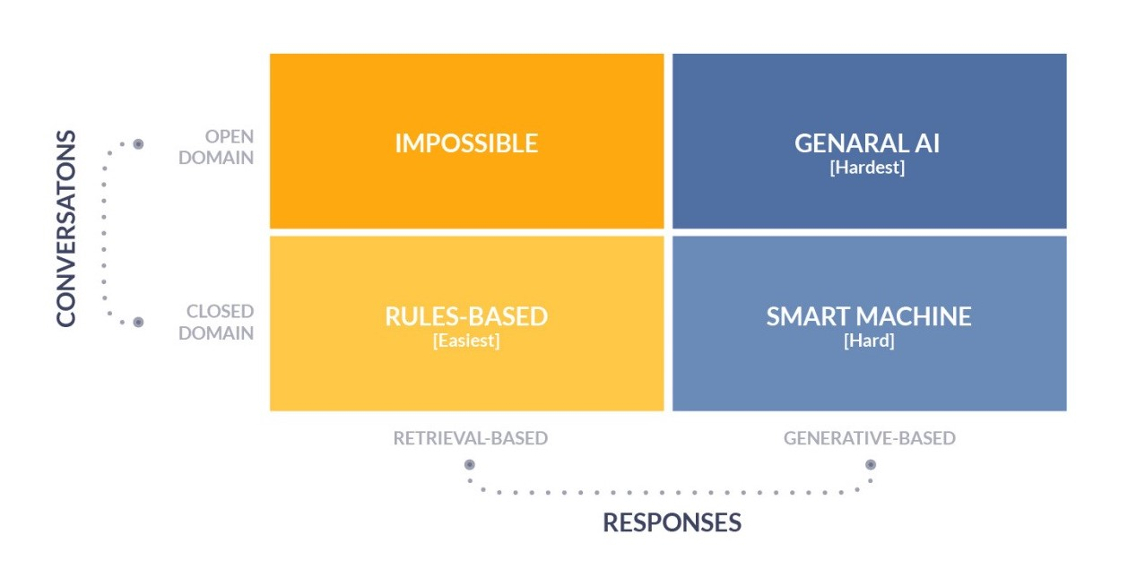
Chatbot Types

Slide 5
Chatbot Architecture
Client Module: the part of the chatbot that the user interacts with along with all the applications the chatbot can control.
Communication Module: the infrastructure that transmits user messages from the client module to the response generation module and from the response generation module to the database module.
Response Generation Module: the program responsible for actually understanding the input message and generating an appropriate response for the user.
Database Module: the place where all the data relevant to a conversation is stored, such as message history, photos, and user preferences.

Slide 6
Usage of Chatbots
In Banking sector, Chatbots are used to handle customer queries (and FAQs) and give guidance on bank services and products. Examples: SIA, iPal and EVA
In Insurance sector, Chatbots are assisting customers in filing claims, getting policies, checking the status of their policies, and locating providers and their branches, as well as other service providers. Examples: Bajaj Allianz’s Boing, Birla Sunlife’s bot and PNB Metlife’s banking applications
In the transport sector, Chatbots are used to provide realtime cab details, flight bookings and verifications, and traffic analysis. Examples: Meru Cab and Yatra.com
In E-Commerce sector, Chatbots have been used in handling queries, tracking orders, making payments and raising customer complaints.

Slide 7
Problem Statement
One of the most important demography which has been conveniently ignored are the elders. Due to many compulsions it is not possible to sit with the elderly and have a good conservation.
Solution
So, we built a chatbot system which engages the elderly people in small talk and conversation. For this we used a dataset containing messages and its response pairs.

Slide 8
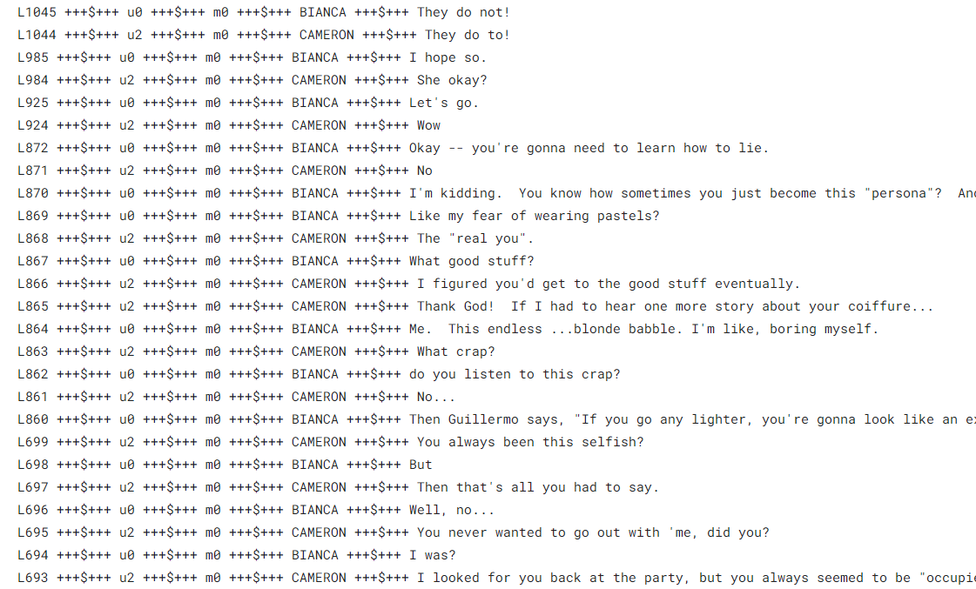
Dataset
movie_lines.txt
- contains the actual text of messages and its response pairs.
This corpus contains a metadata-rich collection of fictional conversations extracted from raw movie scripts: - 220,579 conversational exchanges between 10,292 pairs of movie characters - involves 9,035 characters from 617 movies - in total 304,713 utterances

Slide 9
Data Preprocessing
To keep the processing fast, set the maximum number of training samples to `MAX_SAMPLES=5000` and the maximum length of the sentence to be `MAX_LENGTH=40`.
The dataset is now preprocessed in the following order:
* Extract `MAX_SAMPLES` conversation pairs into list of questions and anwers.
* Preprocess each sentence by removing special characters in each sentence.
* Build tokenizer (map text to ID and ID to text) using TensorFlow Datasets SubwordTextEncoder.
* Tokenize each sentence and add `START_TOKEN` and `END_TOKEN` to indicate the start and end of each sentence.
* Filter out sentence that has more than `MAX__LENGTH` tokens.
* Pad tokenized sentences to `MAX_LENGTH`

Slide 10

Fit the Model

Slide 11
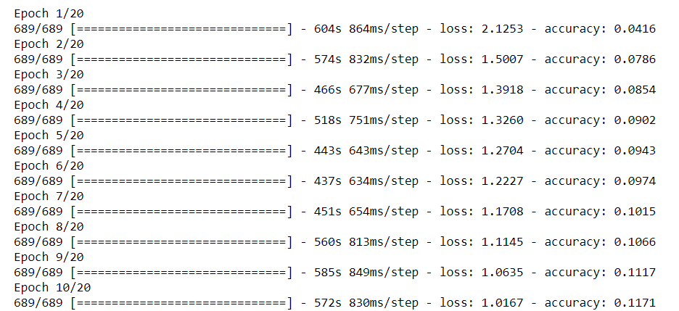

Slide 12
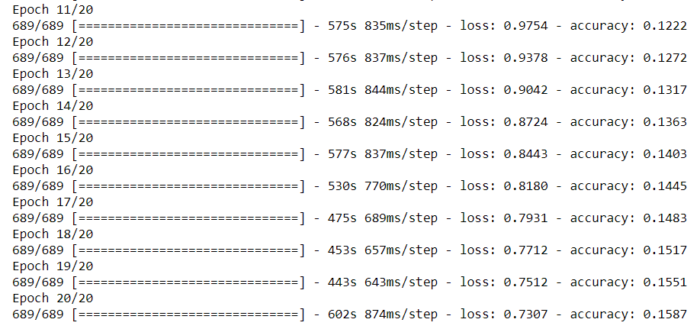

Slide 13
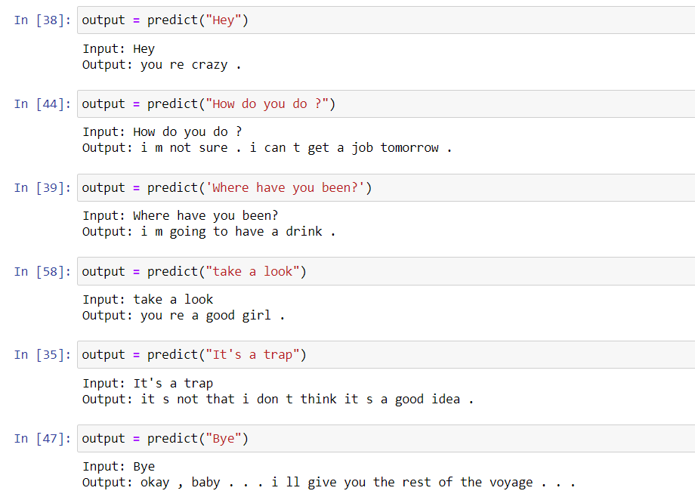
Making Predictions

Slide 14
Conclusion
Chatbot systems have become a very convenient way for engaging with the peoples and customers. It has become a very convenient and interactive way through which, even complex, information can be passed along to the users in an effective manner. This is the reason because of which the chatbot systems have been adapted in so many different domains.

Slide 15
References
Rohit Binu Mathew, Sandra Varghese, Sera Elsa Joy and Swanthana Susan Alex, “Chatbot for Disease Prediction and Treatment Recommendation using Machine Learning”, 2019 3rd International Conference on Trends in Electronics and Informatics (ICOEI)
Mohammad Monirujjaman Khan, “Development of An e-commerce Sales Chatbot”, 2020 IEEE 17th International Conference on Smart Communities: Improving Quality of Life Using ICT, IoT and AI (HONET)
Debmalya Biswas, “Privacy Preserving Chatbot Conversations”, 2020 IEEE Third International Conference on Artificial Intelligence and Knowledge Engineering (AIKE)

