Slide 1
ROLL NO:-11501172
CAMPUS NETWORK ARCHITECTURE
CONFIGURATION WITH OSPF
A UNIVERSITY BASED NETWORKING PROJECT
PRESENTATION
Submitted To :-
UCOE , PUP PATIALA
Submitted By:-
ABHISHEK KUMAR
Group:-
3CE 4
Class:- Btech.(Part 3)

Slide 2
NETWORK CURRENT ARCHITECTURE
Campus Network connecting all academic departments
Provide Internet access all academic department
6 Academic Department , 1 Library ,1 Administrative block,1 server
room
Internet accessing by fast ethernet
Total no. of Routers = 14
Total no. of Switches = 16
Total no. of Servers = 2

Slide 3
TECHNOLOGY USED IN PROJECT
SOFTWARE USED
HARDWARE FOR SW
CISCO PACKET TRACER
A SIMULATOR
Packet Tracer is a cross-platform visual simulation tool designed by Cisco Systems that allows users to create network topologies and imitate modern computer networks. The software allows users to simulate the configuration of Cisco routers and switches using a simulated command line interface. Packet Tracer makes use of a drag and drop user interface, allowing users to add and remove simulated network devices as they see fit.
MINM 500 GB RAM
i3-5 processor MINM
MOUSE
KEYBOARD

Slide 4
SECOND OPTION IN SW
SOFTWARE USED
HARDWARE NEEDED
GNS3
A EMULATOR
Graphical Network Simulator-3 (shortened to GNS3) is a network software emulator first released in 2008.^{[1]} It allows the combination of virtual and real devices, used to simulate complex networks. It uses Dynamips emulation software to simulate Cisco IOS.^{[1]:55[2]}
GNS3 is used by many large companies including Exxon, Walmart, AT&T and NASA, and is also popular for preparation of network professional certification exams. As of 2015, the software has been downloaded 11 million times.^{[2]}
MINM 1TB HDD
MINM i7 processor
2gb GRAPHICS PROCESSOR CARD
KEYBOARD
MOUSE

Slide 5
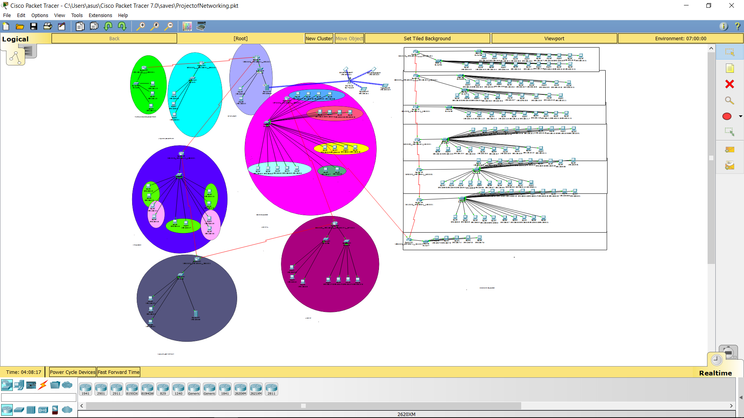

Slide 6
CURRENT NETWORK ARCHITECTURE
Materials and components
Network use primarily Cisco materials.
Network connect 2 servers.
A power generating unit of 75 kVa feeds this infrastructure in the
event of cut of electricity.
Network Services
Services available on the campus network:
Mail service
Web service
DNS service
FTP service

Slide 7
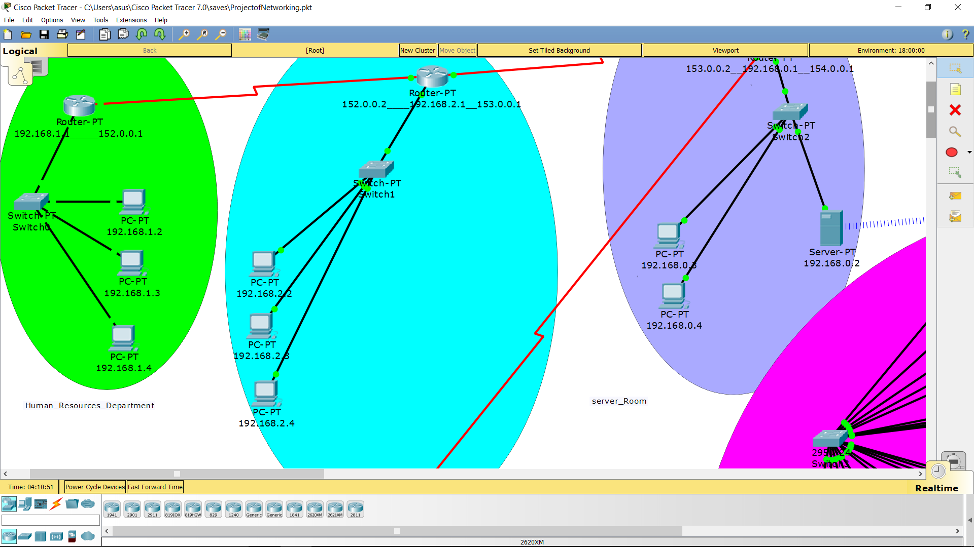
Human Resources Department With The Green Colour
There are three computers
1) one for the Director of the department
2) one for the inquiry for the Students
3)one for the clerk of the Department

Slide 8
There is the Linguistic Block with sky-blue colour
1) one PC for the Hindi department
2) one PC for the English department, and
3)one PC for the Punjabi Department
These are the for handling the data and record of the Students of each Departments.

Slide 9
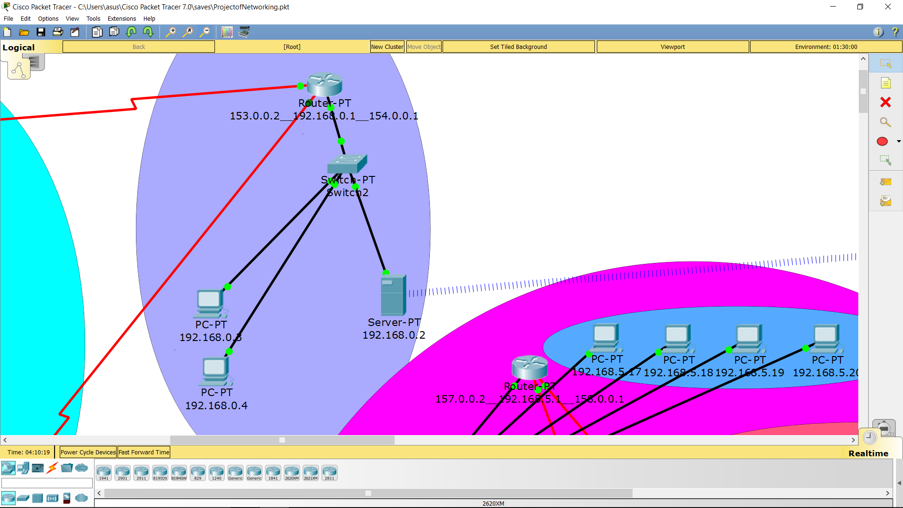
Server services for the entire university except the Nuclear Department
There is a Server Room in the University that has a Server to provide the facilities
Or can say services which are provided by the Server. These services are
1)Email services using 'SMTP' and 'PPOP'
2)File Transfer services or document transfer Services using 'FTP' protocols.
3) Web Services by web Browser using 'Http' and 'Https'.
4) Service for attaching domain name with IP Address using DNS services

Slide 10
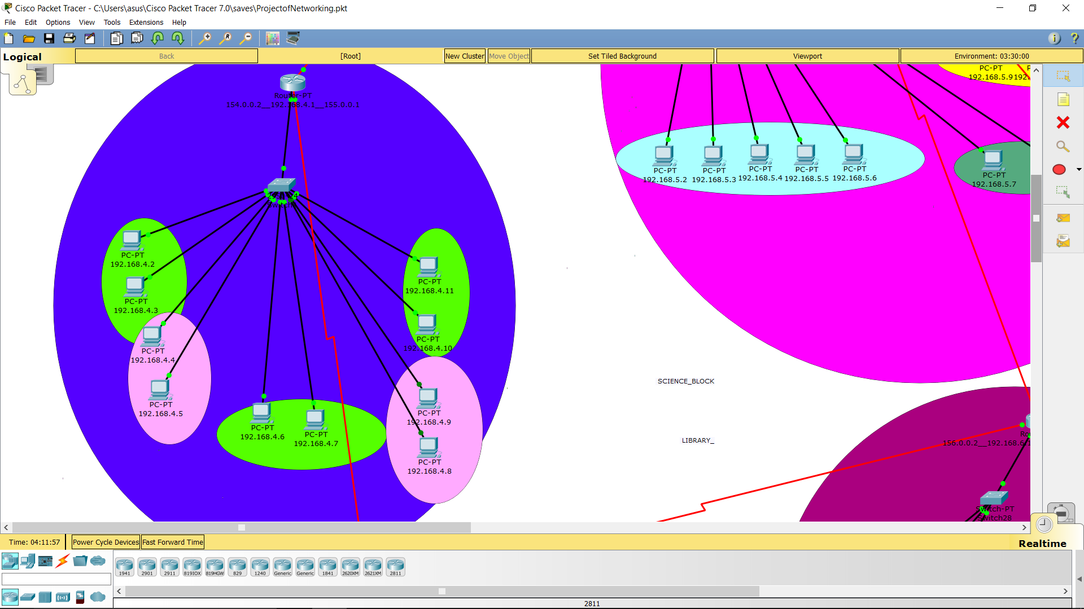
The area with Blue colour is the ART-BLOCK . There is one router that is generic and
one 24-Port Switch.
Here are the five departments in the ART-BLOCK. So we have implemented the five vlans,
That is one for each deparment.so after implementing the vlan , we have no required
A separate switch for each sub -network.
There are five departments that are
1) History Department
2) Civics Department
3) Political Science Department
4) Economics Department ,and
5) Psychology Department.

Slide 11
ART-BLOCK
IN EVERY DEPARMENT ONE COMPUTER IS FOR HE HEAD OF THE DEPARTMENT
THAT IS OPERATED BY THE CLERK OF THAT DEPARTMENT AND IT IS USED TO
HANDLE THE INFORMATION AND THE PREVIOUS RECORD OF THE STUDENTS AND
THE ACTIVITIES OF THE DEPARTMENT , AND
THE OTHER COMPUTER IS USED AS THE INQUIRY SUCH AS THE ABOUT THE
ACTIVITIES THAT WILL BE OCCURED IN THE DEPARTMENT AND IT IS ALSO USED
TO MAKE SUGGESTIONS AND COMPLAINTS ABOUT THE DEPARTMENT'S FUNC-
TIONS TO THE HEAD OF THE DEPARMENT.

Slide 12
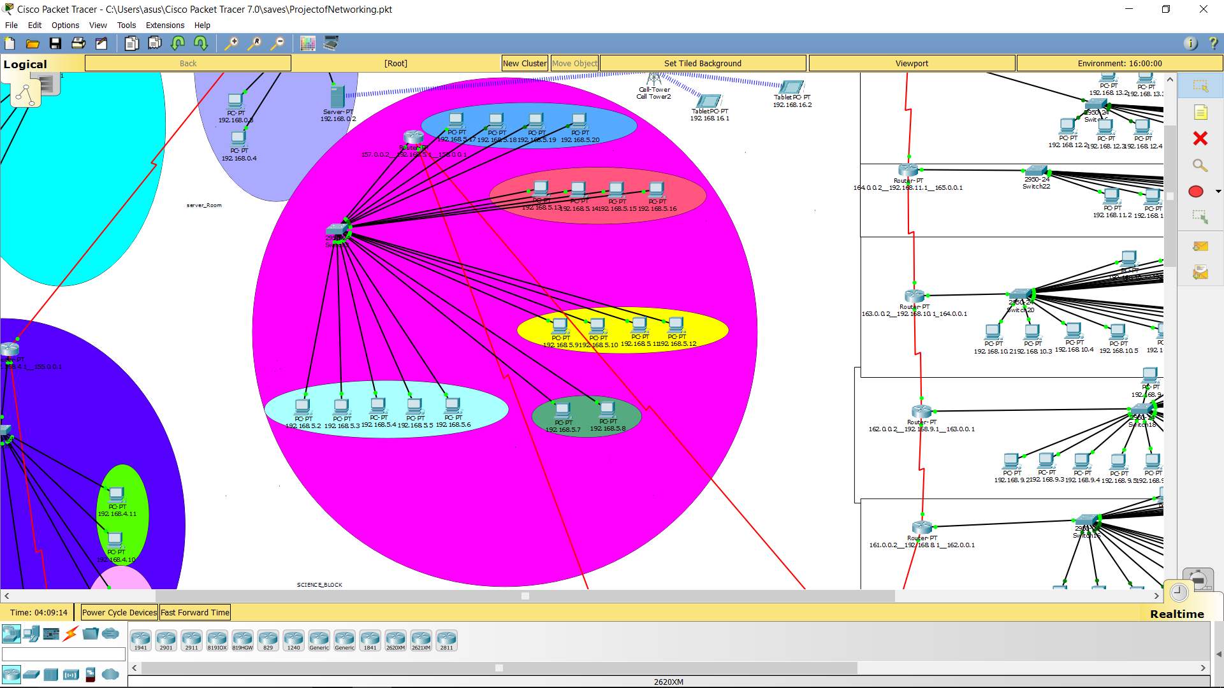
SCIENCE-BLOCK
Here , we have used one router and one switch . This block is divided in the five
departments , each ha s its own sub -network . Instead of using separate switch for
Each sub – network , we have used the technique or functionality of Vlan.
So here , we divided , the Ports of the Switch into five VLANS , one for each
Department.
There are five Departments that are as - - - - -

Slide 13
1)The first named as vlan2 consists the mathematics department . It has the five comp-
onents.
2) The Vlan3 consists the Chemistry Department. It has four computers.
3) the Vlan 4 consists the Biology department . It has two computers , one for the
office of the head of the Department and the other is for the Student inquiry.
4) The Vlan5 consists the Marine Department . It has four computers.
5) The Vlan6 consists the Physics Department . It has four computers.
There is , excepting the Biology Department ,one intended for the Head of the depar-
tment ,one for the Clerk that operates the Department's activities and handles the
record of the Student and remaining are used by the Students of that Department.

Slide 14
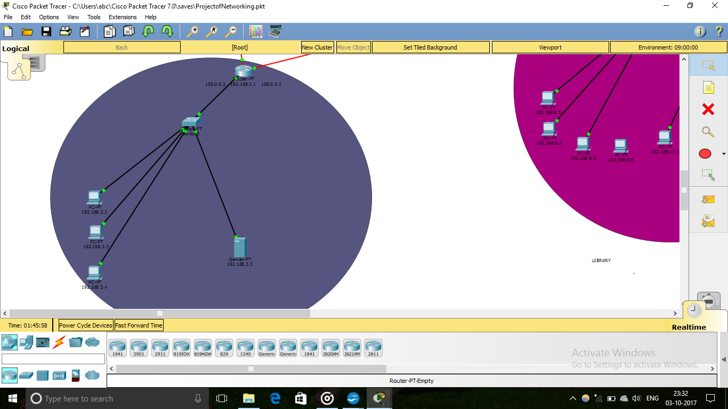
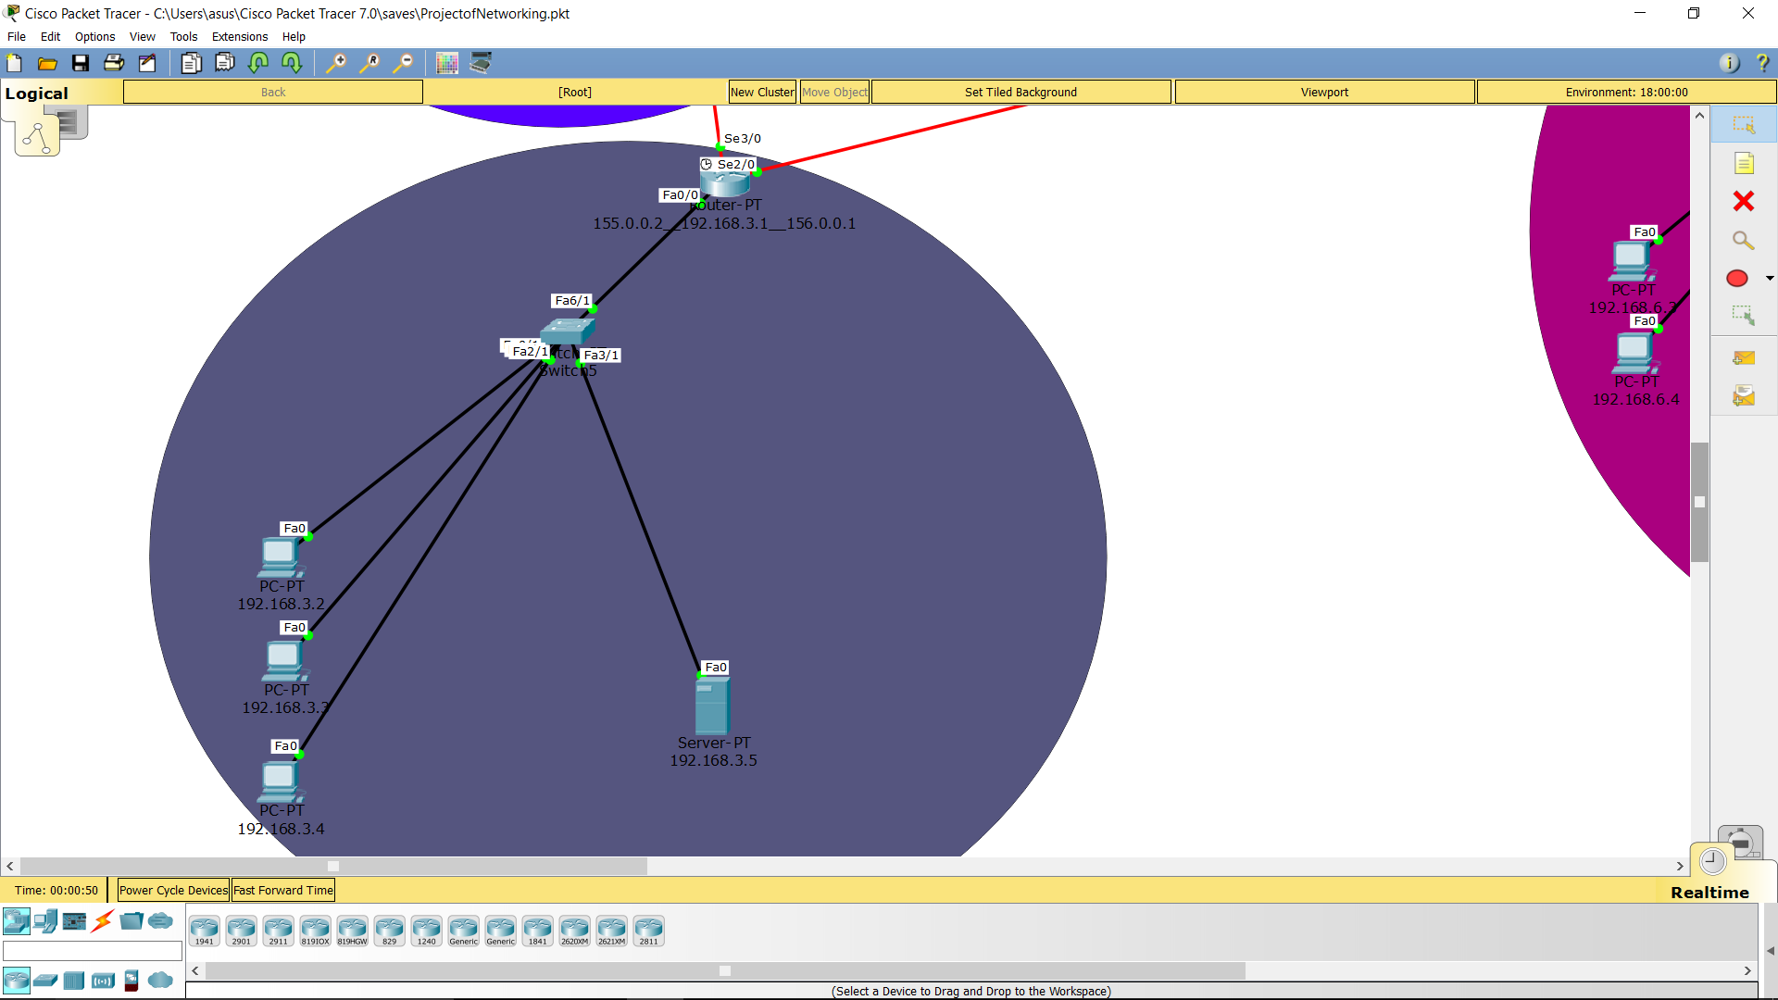
NUCLEAR-DEPARTMENT
It has one generic router and one generic switch.
It has three computers one for the record of the data and the studies and other two
the computers used for the research and study by the Students.
The nuclear Department wants special security because the data and the information
is very confidential , so due to this , we have provided a separate Server for the Nuclear-
Department.

Slide 15
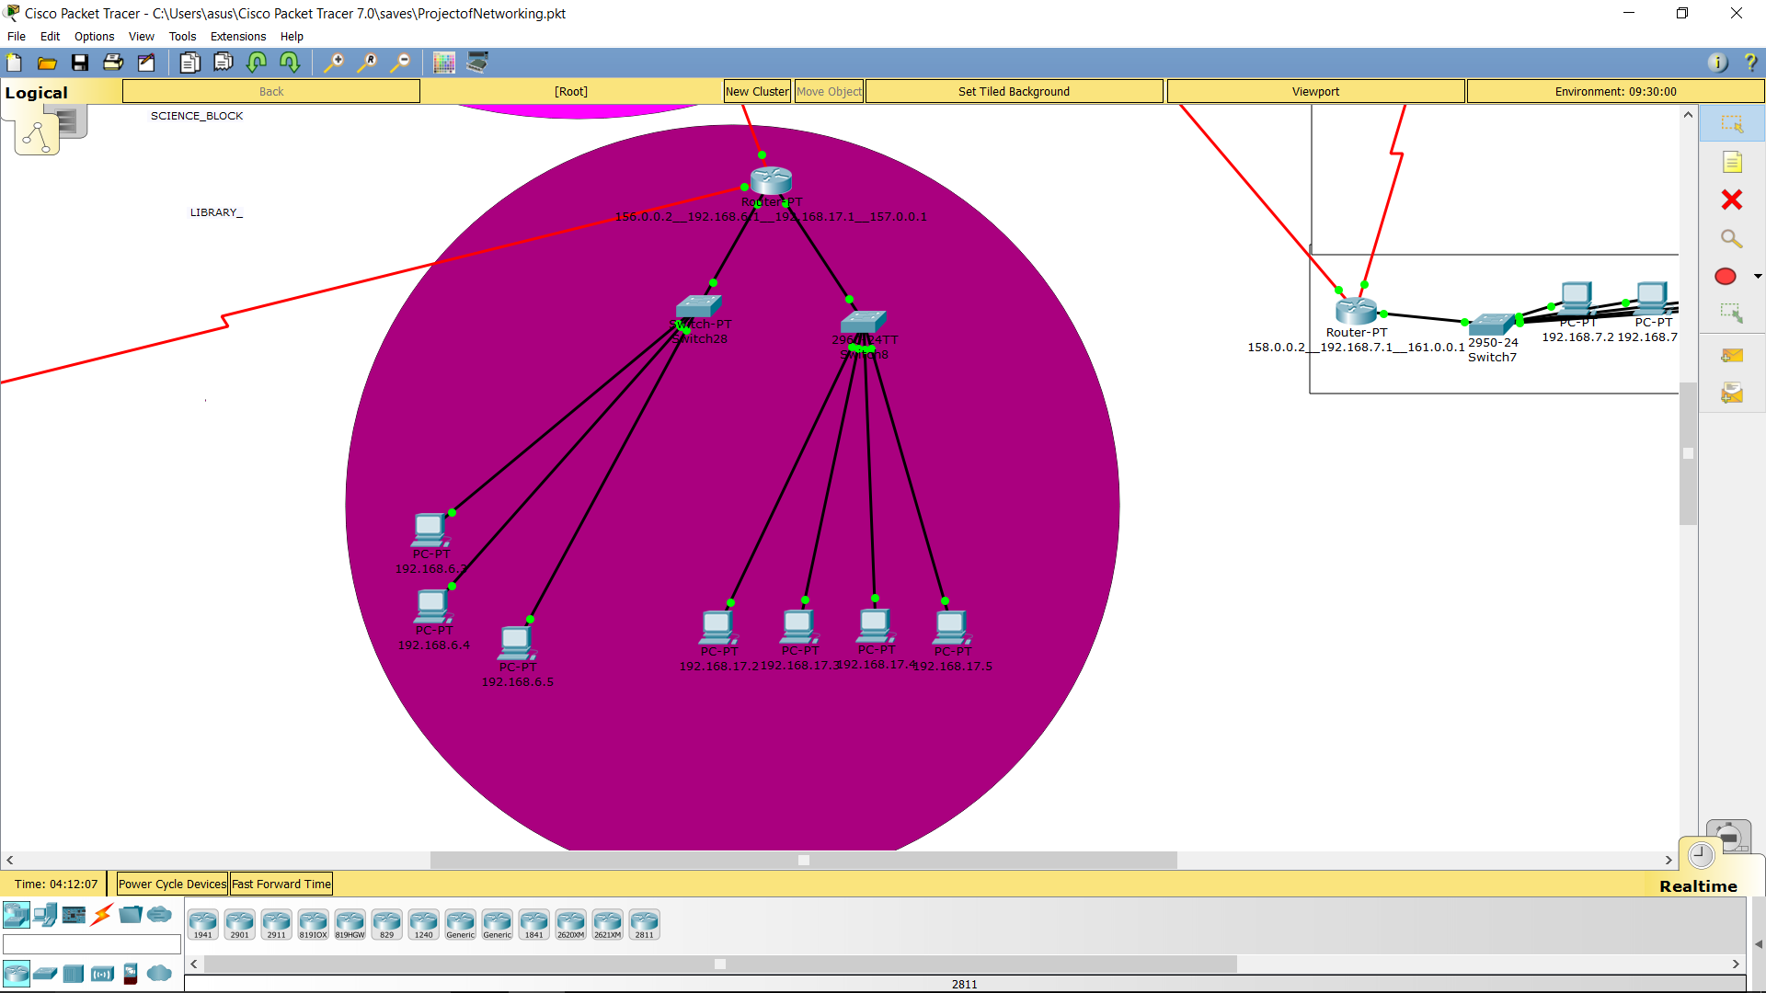
University- Library
Here , we have one router and two switches.
One switch operates on the three Personal Computers and other Switch operates on
the four Computers .
The Computers connected to the first switch are used by the employees of the Library
To provide the facilities like book issuing and book returning status ,and
The switch 2 consists the four Computers that are used by the Students for seeing the
availability of the books and searching the book/s that exists in the Library or not exist.

Slide 16
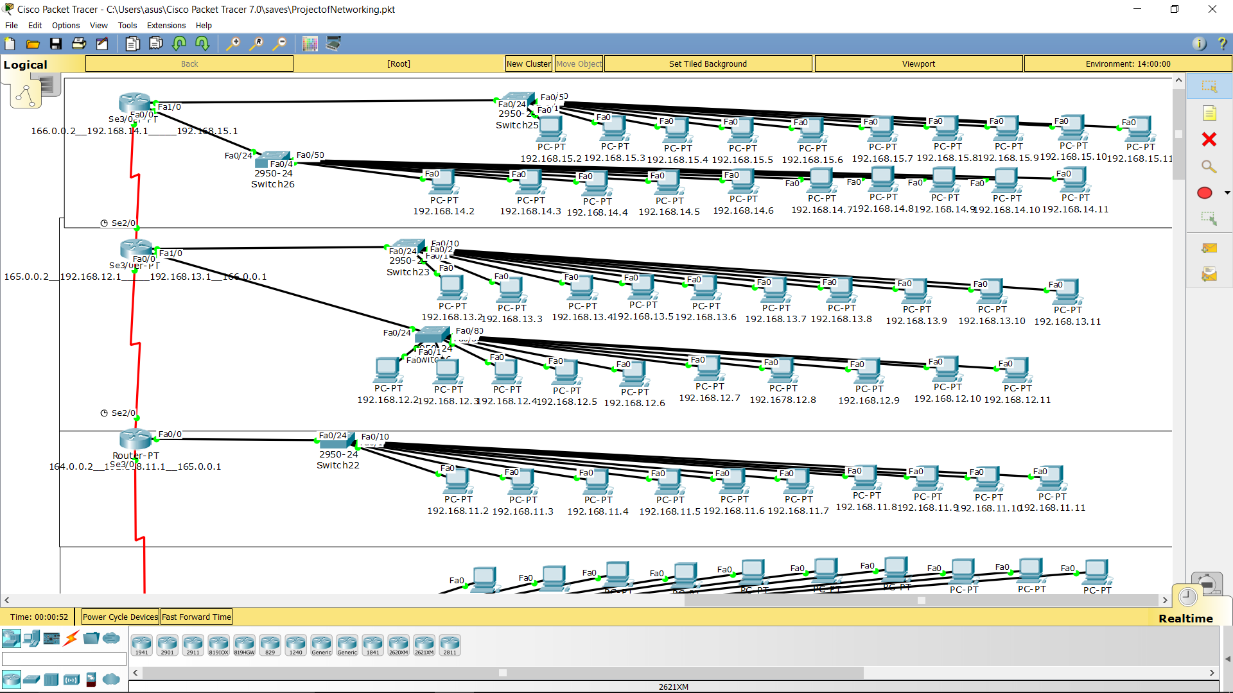
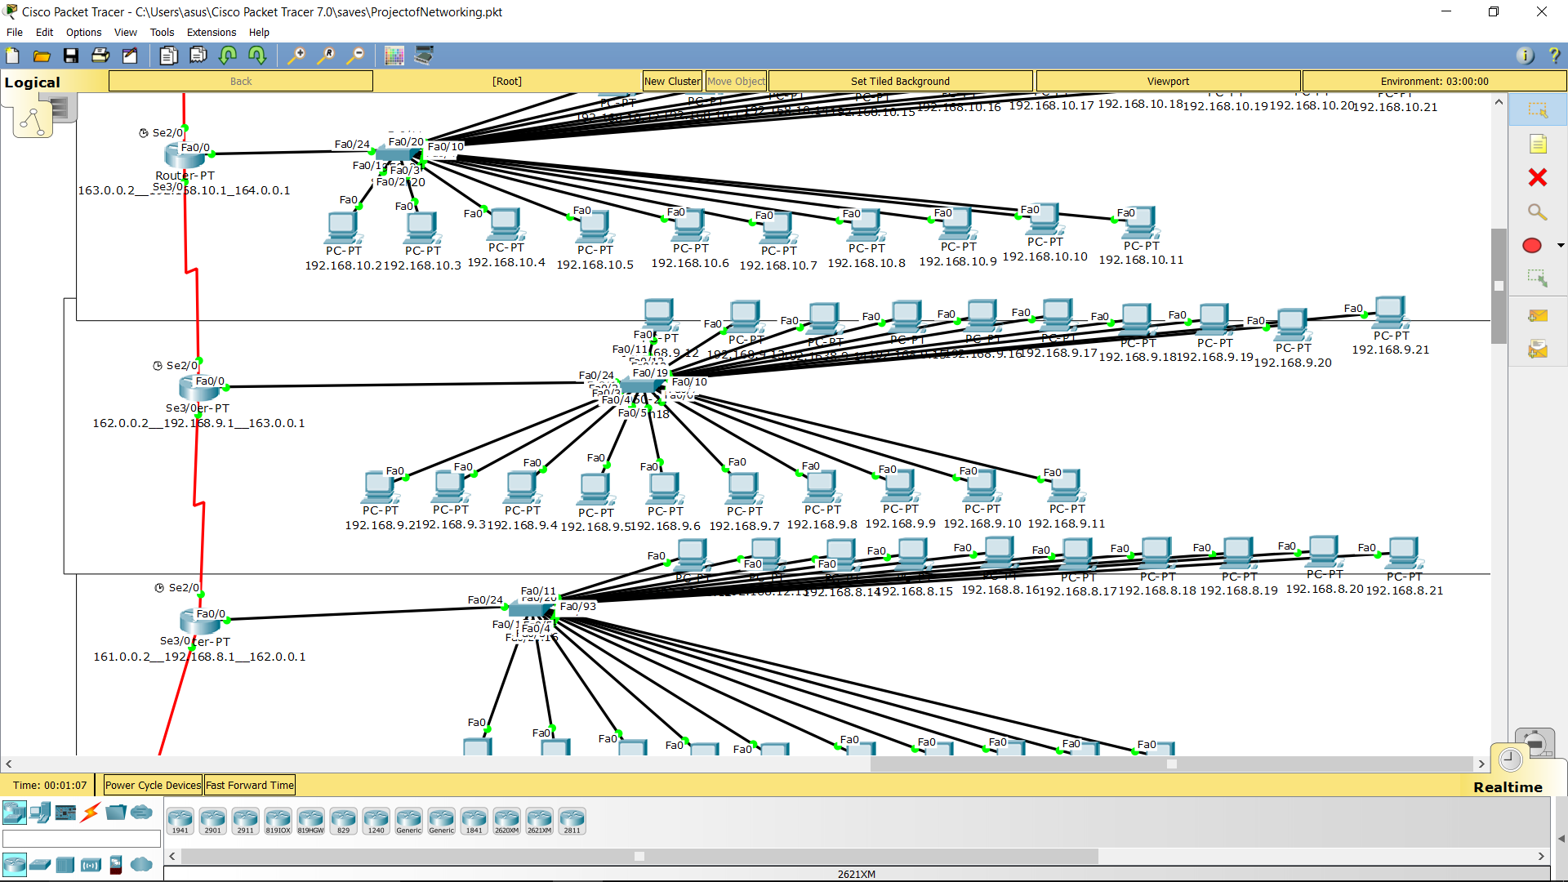
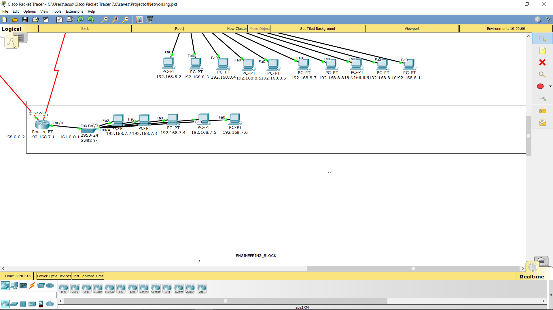
THE ENGINEERING_BLOCK

Slide 17
FIRST FLOOR HAS 2 LABS BOTH FOR COMPUTER SCIENCE ENGINEERING DEPARTMENT
2nd FLOOR FOR IT DEPARTMENT
3rd FLOOR FOR MECHANICAL DEPARTMENT
4th FLOOR FOR ELECTRONICS DEPARTMENT
5th FLOOR FOR CIVIL DEPARTMENT
6th FLOOR FOR CHEMICAL ENGINEERING DEPARTMENT
7th FLOOR FOR RESEARCH
There are seven floor in the engineering block . The description of all
EVERY FLOOR HAS MINIMUM ONE LABS OR MAXIMUM TWO
THE GROUND FLOOR HAS OFFICES OF DIFFERENRT ENGINEERING DEPARTMENTS

Slide 18
(Open Shortest Path First)
Link-state based routing protocol: an Interior Gateway Protocol (IGP) – for inside ASs

Slide 19

Open
  Developed by IETF IGP working group, RFC2328
SPF
  Each router floods link-state information through its neighbors to other routers
  Based on the flooded link-state information, each router maintains a complete link-state database
  Based on the link-state database, a routing table is constructed using SPF (e.g., Dijkstra’s) algorithm
Runs over IP directly, protocol number 89

Slide 20
Features of OSPF
Use flexible metrics instead of only hop count
Supports variable-length subnetting
Allows load balancing among equal-cost paths
Supports multiple routes; one for each IP type of service (ToS)
Authenticates route exchanges
Quick convergence
Uses multicast rather than broadcast of its messages to reduce network load

Slide 21
Hierarchical OSPF
AS is organized as two-level hierarchy
  AS is partitioned into self-contained areas
  Areas are interconnected by a backbone area
  Areas are identified by a 32-bit area ID
  0.0.0.0 is reserved for the backbone area
Four types of routers
  Internal router, area border router, backbone router, autonomous system boundary router (ASBR)

Slide 22

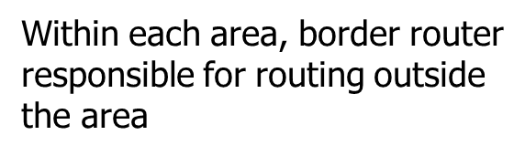
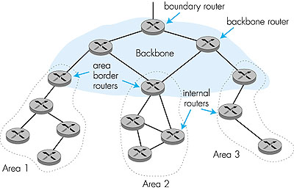
Exactly one area
is backbone area
Backbone area contains all area border routers and possibly others

Slide 23
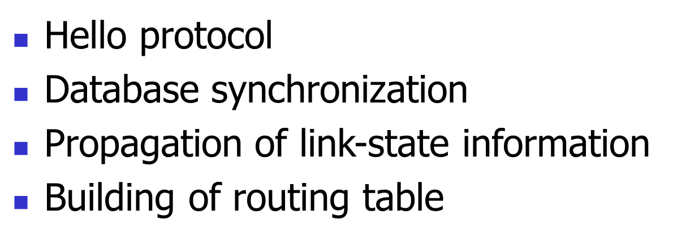
OSPF operations

Slide 24

Hello packets are transmitted to all interfaces periodically
Discover neighbors, establish and maintain neighbor adjacency relationships
Elect Designated Router (DR) if there are multiple routers in a broadcast network

Slide 25

Two neighboring routers exchange database description packets to synchronize their link-state databases.
Database description includes only a list of LSA headers. New or more up-to-date LSAs will be requested later
Packets sent by master are acknowledged by slave

Slide 26

Link-state request sent
  When a router wants to update parts of its link-state database
Link-state update sent
  When a link state is requested, or
  When a link-state changes, or
  Periodically
Link-state acknowledgement sent in response to a link-state update
  Link-state updates retransmitted periodically until acknowledged

Slide 27
Flooding LSAs
A node receiving a link-state update selectively first installs each LSA in the update into its LSA database
Then it decides on which of its other links to flood the LSA
  it may decide not to flood an LSA out a particular interface if there is a high probability that the attached neighbors have already received the LSA

Slide 28

Router S has knowledge of the entire area topology (complete link-state database)
Some algorithm such as Dijkastra’s is used to generate shortest path tree, rooted at router S
Only the next hop will be used in the routing table

Slide 29
Link state updates
Each Link State Update packet carries a set of new link state advertisements (LSAs) one hop further away from their point of origination. A single Link State Update packet may contain the LSAs of several routers. Each LSA is tagged with the ID of the originating router and a checksum of its link state contents.

Slide 30
References
Section 8.7.2 of Communication Networks by A. Leon Garcia and I. Widjaja
RFC 2328 (can be obtained from www.ietf.org)

Slide 31
THANK YOU

