Slide 1
Bellabeat Case Study
How Can a Wellness Technology Company Play It Smart?

Slide 2
The problem
Overview
Business Task
Stakeholders
Bellabeat is a high-tech manufacturer of health-focused products for women. Bellabeat is a successful small company, but they have the potential to become a larger player in the global smart device market. Urška Sršen, co-founder and Chief Creative Officer of Bellabeat, believes that analyzing smart device fitness data could help unlock new growth opportunities for the company.
Analyze smart device usage data in order to gain insight into how people are already using their smart devices.
Using this information, create high-level recommendations for how trends can inform Bellabeat marketing strategy
Urška Sršen: Bellabeat’s co-founder and Chief Creative Officer
Sando Mur: Mathematician and Bellabeat’s co-founder; a key member of the Bellabeat executive team
Bellabeat marketing analytics team: A team of data analysts responsible for collecting, analysing, and reporting data that helps guide Bellabeat’s marketing strategy.

Slide 3
Questions
Question 1
Question 2
Question 3
What are some trends in smart device usage?
How could these trends apply to Bellabeat customers?
How could these trends help influence Bellabeat marketing strategy?

Slide 4
Data Source
FitBit Fitness Tracker Data (CC0: Public Domain, dataset made available through Mobius): This Kaggle data set contains personal fitness tracker from thirty fitbit users. Thirty eligible Fitbit users consented to the submission of personal tracker data, including minute-level output for physical activity, heart rate, and sleep monitoring. It includes information about daily activity, steps, and heart rate that can be used to explore users’ habits.

Slide 5
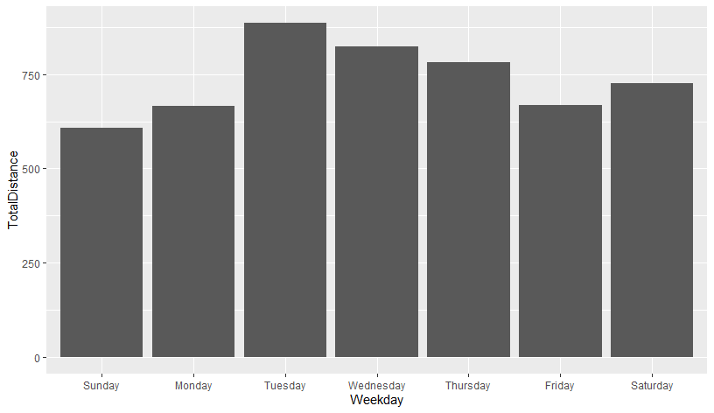
WeekDay vs. TotalDistance
Tuesday is the most Active weekday

Slide 6
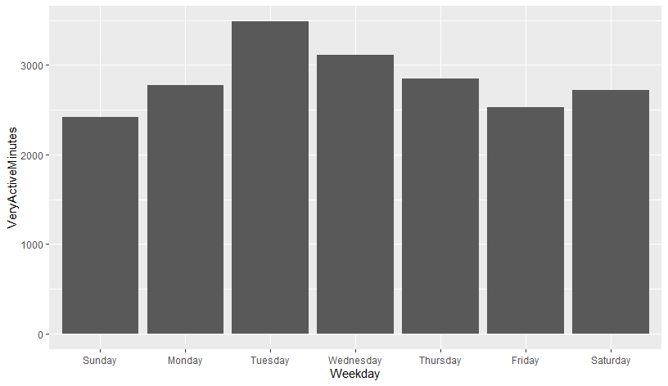
Weekday vs. VeryAciveMinutes

Slide 7
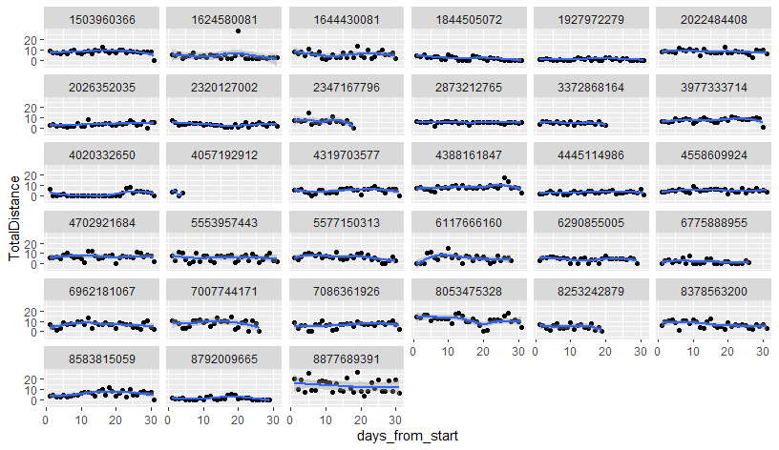
Trends of Each Participants

