Slide 1
Movie Fans vs Movie Critics
Examining the favorite movies between the two groups using Scrapy

Slide 2
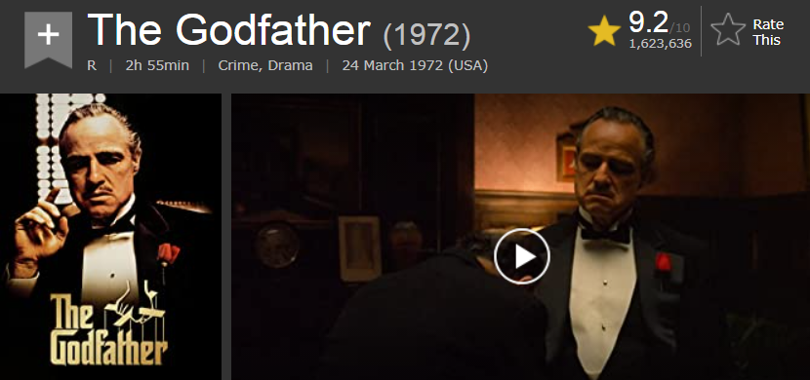
Imdb ratings
Internet Movie Database which allows Users to submit movie ratings on a scale of 0-10
83 million registered users
Anywhere between ~1-2 million submitted ratings for top 100 movies
Movie score weighted average of users

Slide 3
Imdb Ratings Methodology
“We take all the individual ratings cast by IMDb registered users and use them to calculate a single rating. We don't use the arithmetic mean (i.e. the sum of all votes divided by the number of votes), although we do display the mean and average votes on the votes breakdown page; instead the rating displayed on a title's page is a weighted average”
“IMDb publishes weighted vote averages rather than raw data averages. The simplest way to explain it is that although we accept and consider all votes received by users, not all votes have the same impact (or ‘weight’) on the final rating.
When unusual voting activity is detected, a different weighting calculation may be applied in order to preserve the reliability of our system. To ensure our rating mechanism remains effective, we don't disclose the exact method used to generate the rating.”

Slide 4
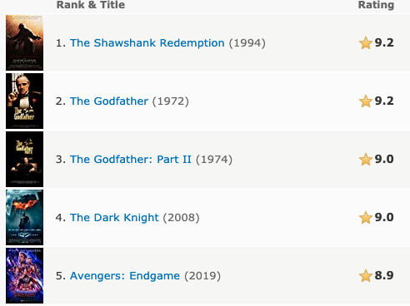
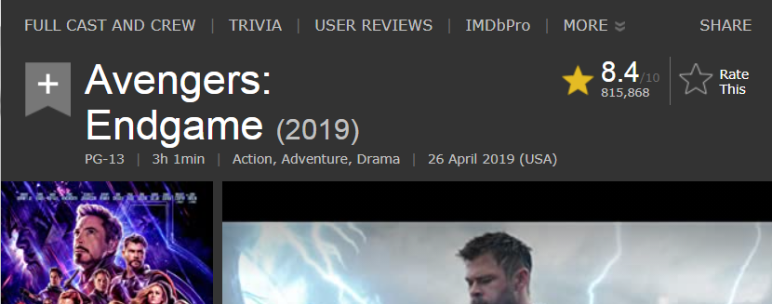
The “Avengers” Effect, recency bias
Longevity:
10,000 votes with arithmetic mean = 9.1 is less than 2 mill votes with mean of 8.9
Notes:
Currently is an 8.4, which is 32nd .

Slide 5
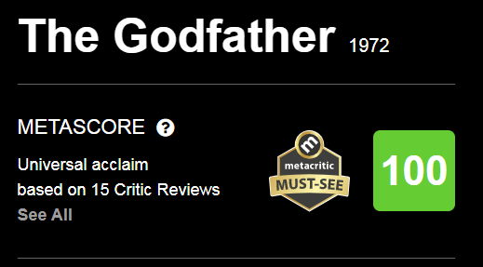
Metacritic ratings
Reviews come from established movie journalists aka critics who rate film 0-100
Aggregate score 0-100 based on weighted average of critic scores
Approximately 10-30 reviews make up aggregate score

Slide 6
Metacritic ratings methodology
Metascore is a weighted average in that we assign more importance, or weight, to some critics and publications than others, based on their quality and overall stature. In addition, for music and movies, we also normalize the resulting scores (akin to "grading on a curve" in college), which prevents scores from clumping together.
Notes:
- biased, subjective and statistical bias

Slide 7
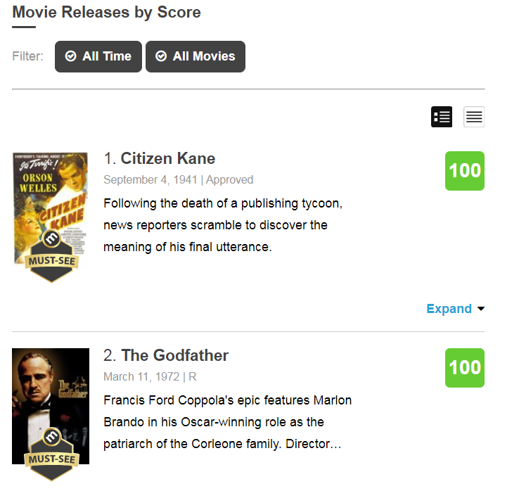
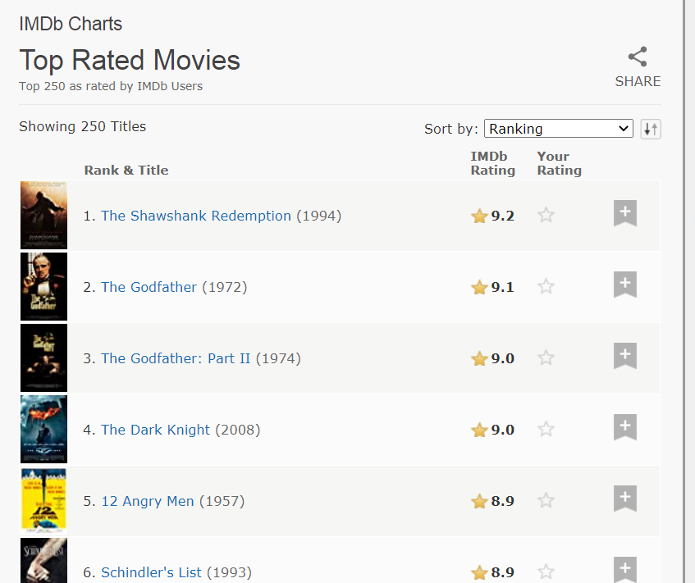
Comparing Critics and Movie Fans using Scrapy: Top 100 movies

Slide 8
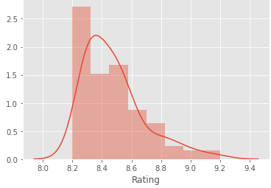
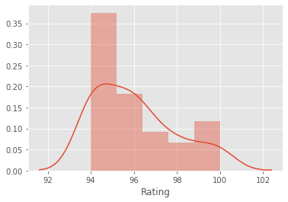
Comparing Spread of Ratings
Imdb top 100 | Ratings
mean | 8.477
std | .205
min | 8.2
median | 8.4
max | 9.2
Metacritic top 100 | Ratings
mean | 96.05
std | 1.88
min | 94
median | 96
max | 100

Slide 9
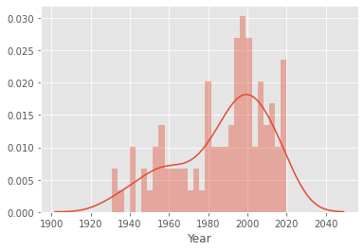
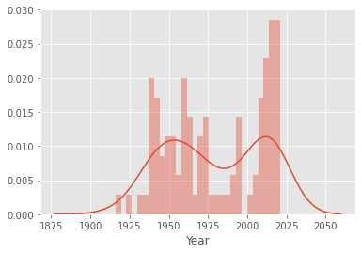
Comparing Spread of Years
Imdb top 100 | Year
mean | 1988
std | 23
min | 1931
median | 1994
max | 2020
Metacritic top 100 | Year
mean | 1979
std | 31
min | 1916
median | 1973
max | 2021
Notes:
-- longetivity isn’t as critical ,

Slide 10

Any movie overlaps
TOP 10
TOP 25

Slide 11
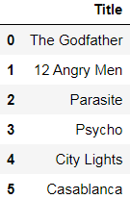
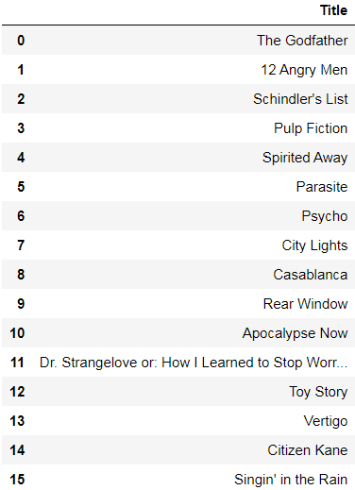
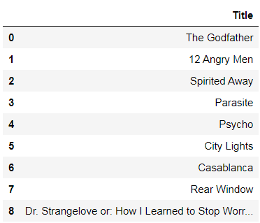
Any movie overlaps
TOP 50
TOP 75
TOP 100
Notes:
6 movies, 9 movies, 16 movies

Slide 12
Directors with Multiple Records
Imdb favorite directors | No. of movies in top 100
Christopher Nolan | 7
Stanley Kubrick | 7
Alfred Hitchcock | 4
Martin Scorsese | 3
Akira Kurosawa | 3
Quentin Tarantino | 3
Peter Jackson (LOTR) | 3
George Lucas | 3
Steven Spielberg | 2
Hayao Miyazaki | 2
Russo Brothers (Avengers) | 2
TOTAL | 40
Metacritic favorite directors | No. of movies in top 100
Alfred Hitchcock | 4
Stanley Kubrick | 2
Martin Scorsese | 2
TOTAL | 8
Notes:
Total = 40 movies , 40% |||| 8%

Slide 13
Different factors
Hype (Subjective) vs Technical (Objective)
Culture/Industry impact
Fandoms

Slide 14
Questions?
Thanks!

