Slide 1
Selection in Python
If statements

Slide 2
Control Structures
Sequential control
Selection control
Iterative control

Slide 3
Boolean Expression
Boolean Data types
True and False
Boolean Expression
Evaluates to boolean value.

Slide 4
Relational Operators
==
!=
<
>
<=
>=

Slide 5
Membership Operator
In
ex:10 in (10,20,30)
Not in
ex: 'red' not in ('red','green','blue')

Slide 6
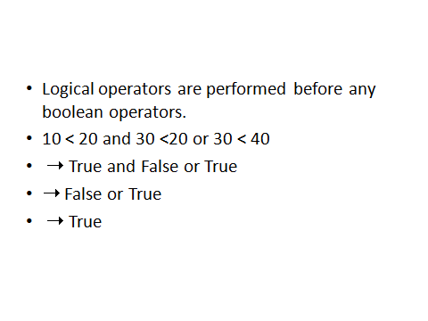
Boolean Operators
Boolean operators in
and
or
not
Ex:10<20 and 30>20 or 40<50 and not(10<=0)
(num<0) or (num>6)
(not num>=0) and (not num<=6)
not(num>=0 or num<=6)

Slide 7
Selection
Two forms
  if logical expression:
  statement
  if logical expression:
    statement
  else:
  statement

Slide 8
Nested if's
the statement to be executed in an if statement can be another if
an else branch goes with the if which matches its indentation

Slide 9
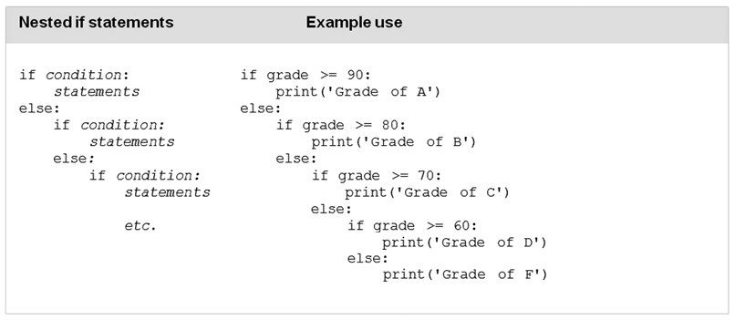
Nested If

Slide 10
Syntax of if statement
if logical expression:
statement
Indentation required
if expression is true, then statement is executed
if expression is false, statement is NOT executed

Slide 11
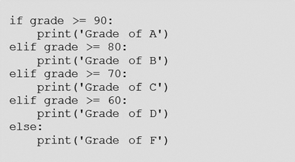
Elif Statements

Slide 12
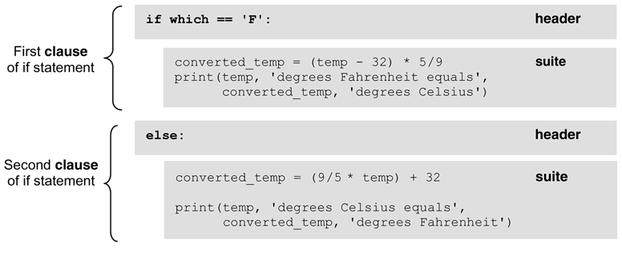
Indentation In Python

Slide 13
If-Then Statement
Determine whether or not to execute a statement (which can be a single statement or an entire block)
TRUE
expression
FALSE
statement

Slide 14
if .. else provides two-way selection
between executing one of 2 clauses (the if clause or the else clause)
TRUE
FALSE
expression
if clause
else clause

Slide 15
what’s the difference?
a=4
b=11
if a > 5:
if b < 10:
print(“green”)
else:
print(“blue”)
a=4
b=11
if a > 5:
if b < 10:
print(“green”)
else:
print(“blue”)

Slide 16
Visual Aid
Decision tree
  “if person is 18 or over and state is KY, they can have regular license”
  “if person is 16 or over and under 18 and state is TN or VA, they can have learner’s permit”
  “if person is under 16, in any state, they can’t have license”
  “if person is over 65 in VA, they have modified license”

Slide 17
Logical Operators
and or not
and, or are binary operators, not is unary
used to combine bool values
produce a bool result
truth tables
operator precedence
  not then and then or
  not, and, or are very low, below other operators

Slide 18
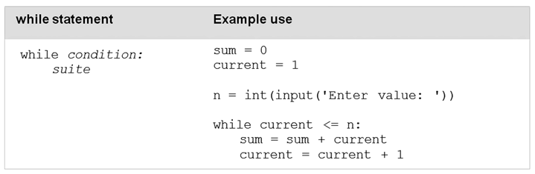
While Statement

Slide 19
For Loop
For <variable> in <sequence>:
<statement>

Slide 20
Comparing Strings
Two objects of type string (or a string object and a C string) can be compared using the relational operators
A character-by-character comparison is made using the ASCII character set values
If all the characters are equal, then the 2 strings are equal. Otherwise, the string with the character with smaller ASCII value is the “lesser” string
space < digits < uppercase < lowercase
“ “ < “0” < … < “9” < “A” < “B” < … < “Z” < “a” < … < “z”

Slide 21
string myState;
string yourState;
myState = “Texas”;
yourState = “Maryland”;
Expression Value
myState == yourState false
myState > yourState true
myState == “Texas” true
myState < “texas” true

Slide 22
Lists
List is mutable

