Slide 1
Team: Stealth Assassins
Rahul Vemuri(2017.rahul.vemuri@ves.ac.in)
Tushar Annam(tushar.annam@gmail.com)
Tejas Adhikari(tejas.adhikari@somaiya.edu)
Abhishek Sonawane(sonawane.ad@somaiya.edu)

Slide 2
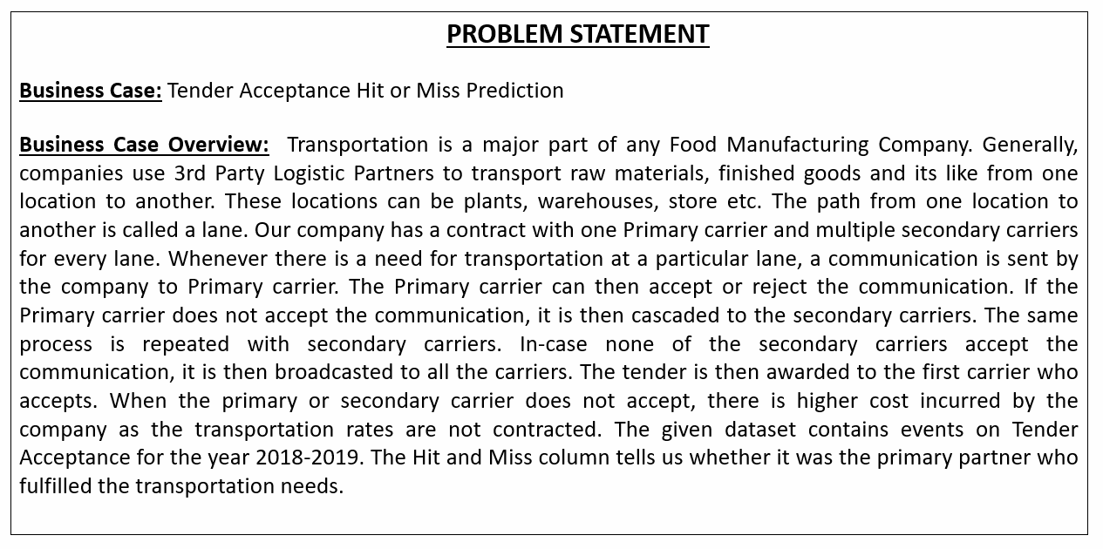

Slide 3
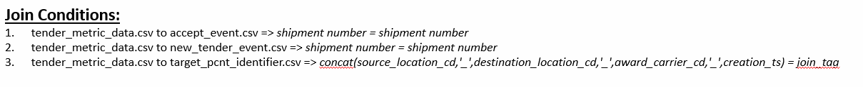
We Implemented join conditions using the DataFrame function merge() with parameters like
The dataframe to be merged
‘on’ parameter which will have the common column
‘how’ parameter mentioning the join condition. We have used “inner” which will merge the common values.

Slide 4
Division of Training and Testing Datasets
We then segregated the datasets has pe

