Slide 1
LANGUAGE DETECTION MODEL (using NLP)

Slide 2
Abstract
This study presents the development of a Language Detection Model aimed at accurately identifying the language of given text samples. The model preprocesses text data to remove unnecessary characters and standardize it. The processed text is then transformed into a numerical format suitable for analysis.
The dataset is divided into training and testing sets, allowing the model to learn from one portion of the data and be evaluated on another. The model's performance is measured using a balanced accuracy metric, demonstrating its effectiveness in predicting the language of new text samples.
Additionally, a custom function is provided to enable real-time language detection for any input text. This model is versatile and can be applied to various tasks such as identifying the language of web content, analyzing sentiments in different languages, and classifying documents based on language. The approach ensures that the language detection process is both accurate and reliable, making it a valuable tool for multilingual text processing.

Slide 3
Introduction
Language detection is a critical component of Natural Language Processing (NLP) for applications such as content management, sentiment analysis, and document classification. With the exponential growth of multilingual text data, accurate language detection models are essential for handling the complexities of modern text data. Traditional language detection methods often fall short in accuracy when applied to diverse and noisy datasets.
This project aims to develop a robust language detection model by implementing advanced text preprocessing techniques, including tokenization, stopword removal, and lemmatization, to clean and standardize text inputs. The model is trained and evaluated on a labeled dataset, ensuring that its performance is effective and reliable. The objective is to create a tool that accurately identifies languages across various text inputs, supporting applications in web content categorization, multilingual analysis, and automated document classification.

Slide 4
Literature Survey
SNO | TITLE OF THE PAPER | TITLE OF THE JOURNAL | REFERENCE WITH DOI | PROBLEMS OR GAP ADDRESSED | OBJECTIVE OF THE PAPER | FOCUS OF THE PAPER | SUMMARY
1 | Text Based Language Identification System for Indian Languages Following Devanagiri Script | International Journal of Engineering Research & Technology (IJERT) | https://scholar.google.com/scholar?hl=en&as_sdt=0%2C5&q=text+based+language+identification+system+for+Indian+language&oq=text+based+language+identification+system+for+Indian+langi#d=gs_qabs&t=1719580899703&u=%23p%3DJSjIqI1M2dUJ | The problem addressed in the paper is the automatic recognition of languages from a given text document, particularly focusing on the difficulty of discriminating between languages within the same family as opposed to those across different families . | The objective of the paper is to build a text-based language identification system for Indian languages that use the Devanagari script. The system aims to utilize n-grams as features for classification | The paper focuses on investigating the performance of statistical measures for text-based language identification. The emphasis is on five languages used in India based on the Devanagari script: Hindi, Sanskrit, Marathi, Nepali, and Bhojpuri​ | The paper presents a language identification system for Indian languages using the Devanagari script. It uses n-grams for classification, focusing on Hindi, Sanskrit, Marathi, Nepali, and Bhojpuri. The study includes a literature survey, an n-gram model implementation, and experimental results, emphasizing the importance of language identification in natural language processing task

Slide 5
2 | Advanced Natural Language Processing with TensorFlow | Institute of Electrical and Electronics Engineers(IEEE) | https://ieeexplore.ieee.org/document/10163516 | One-stop solution for NLP practitioners, ML developers, and data scientists to build effective NLP systems that can perform real-world complicated tasks | This book comes with a perfect blend of both the theoretical and practical aspects of trending and complex NLP techniques | you will have an advanced knowledge of the tools, techniques and deep learning architecture used to solve complex NLP problems. | One-stop solution for NLP practitioners, ML developers, and data scientists to build effective NLP systems that can perform real-world complicated tasks

Slide 6
3 | offensive language detection | Karlsruhe institute of technology | https://aclanthology.org/2020.trac-1.22/ | The passage addresses the gap between the high accuracy of machine learning models and the preference for human moderators due to their explanatory capabilities. By evaluating various explanation methods, the research aims to improve the transparency of machine learning models in content moderation, thereby enhancing user trust and operational efficiency on online discussion platforms. | The objective of the paper is to contribute to the advancement of automated content moderation systems by enhancing the transparency and interpretability of machine learning models. This is crucial for ensuring that automated decisions align closely with human moderators' reasoning, thereby improving user trust and platform governance. | The paper aims to contribute to the development of more effective and transparent automated content moderation systems for online platforms. By improving the explanatory capabilities of machine learning models, it seeks to address the limitations of black-box models and enhance user trust in platform governance. | The paper aims to enhance the transparency and effectiveness of automated content moderation systems. By improving explanatory capabilities, it seeks to ensure that automated decisions align closely with human moderators' reasoning, thereby fostering greater trust and reliability on online platforms.

Slide 7
4 | Automatic Language Identification in Texts: A Survey | Journal of Artificial Intelligence Research | https://scholar.google.com/scholar?hl=en&as_sdt=0%2C5&q=language+identification+models+using+nlp&oq=#d=gs_qabs&t=1719636649032&u=%23p%3D3EgF-8zLwQIJ | The paper addresses the challenge of automatic language identification in texts, highlighting the need for more effective and accurate techniques. It identifies issues with mislabeled data and the high cost of obtaining correctly labeled datasets, which hinder research and application in this field | The objective is to provide a comprehensive survey of features and methods used in language identification. It aims to summarize the historical development, current techniques, and potential future directions of research in this area | The paper focuses on reviewing various approaches to language identification, including statistical methods and machine learning models. It emphasizes the importance of standardized datasets and shared tasks to advance research and ensure replicability and comparability of results. | Automatic Language Identification in Texts: A Survey" provides an extensive overview of the LI research field. It covers historical and current techniques, dataset challenges, and methods used in literature. The paper underscores the need for standardized datasets and discusses future research directions to enhance accuracy and reduce annotation costs.

Slide 8
Existing System
Accuracy Issues:
Inconsistent accuracy, especially for less common languages and dialects.
Challenges in detecting languages with fewer linguistic resources.
Scalability Challenges:
High computational demands limit real-time applicability and efficient data processing.
Difficulty in scaling up to handle large volumes of text data.
Limited Language Coverage:
Some systems fail to accurately detect a comprehensive range of languages.
Issues with supporting languages that have less linguistic documentation.
Technological Constraints:
Dependency on rigid linguistic rules can restrict flexibility.
Traditional approaches like Bag of Words prioritize frequency over contextual meaning,
impacting semantic understanding.

Slide 9
Research Gap Identified
One research gap in language detection models lies in the detection of code-mixed or multilingual text. Many existing language detection models are designed to work well with monolingual text or text that is predominantly in one language. However, in real-world scenarios, especially on social media platforms or in multicultural communities, people often use multiple languages within the same text, a phenomenon known as code-mixing.
Another involves developing language detection models that are robust and accurate in identifying the languages present in code-mixed text. This requires techniques that can effectively handle the mixing of languages at various levels, such as word-level, phrase-level, or sentence-level mixing. Additionally, models need to be trained on diverse and representative datasets that include code-mixed text from different languages and language pairs.

Slide 10
Proposed System
Our proposed system aims to develop a high-accuracy language detection model using the Natural Language Toolkit (NLTK), accurately identifying 17 languages with more accuracy. We collected diverse datasets, performed text normalization, tokenization, and feature extraction using n-grams and frequency distributions. Machine learning algorithms like Naive Bayes and SVMs were used for training. The model is designed for efficiency and scalability, suitable for real-time applications and easy integration with existing systems. It outperforms existing models in accuracy and computational efficiency. Future enhancements include supporting more languages, continuous learning, and integration with other NLP tasks.

Slide 11
Technical Specifications
Libraries and Packages:
NumPy: For numerical computations and array handling.
Pandas: For data manipulation and handling the dataset.
Scikit-learn: For machine learning tasks, including:
LabelEncoder: For encoding categorical language labels.
CountVectorizer: For converting text data into numerical feature vectors.
LogisticRegression: Used as the machine learning model.
train_test_split: For splitting data into training and testing sets.
f1_score: Metric used to evaluate model performance.
NLTK (Natural Language Toolkit):
Used for text preprocessing tasks, such as tokenization, stopword removal, and lemmatization, which help normalize and clean the text data
Data handling and preprocessing:
Data Loading: Loads dataset from a CSV file.
Text Preprocessing: Uses regular expressions for text cleaning and normalization.
Feature Extraction: Converts cleaned text data into numerical features using CountVectorizer.
Model Training and Evaluation:
Model: Logistic Regression trained on vectorized text data.
Evaluation Metric: F1 score to assess model accuracy.
Visualization:
Uses Matplotlib and Seaborn for visualizing language distribution.

Slide 12
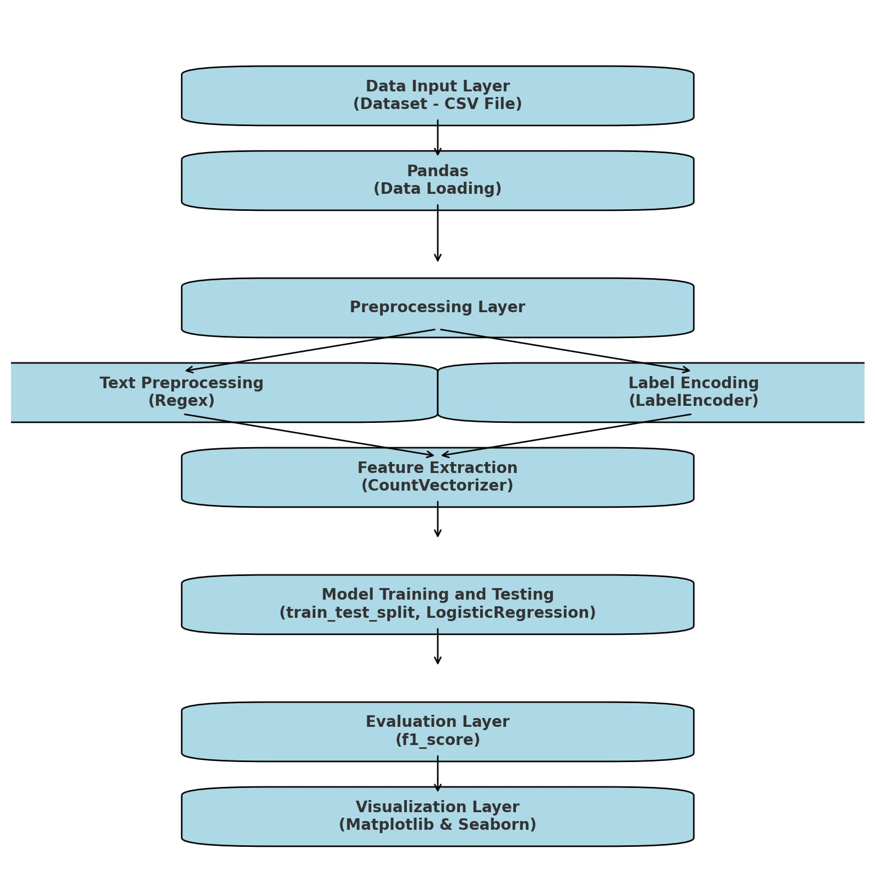
System Architecture

Slide 13
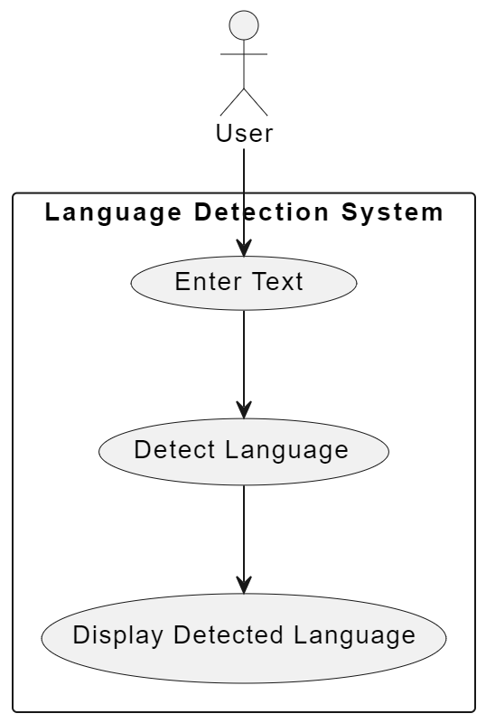
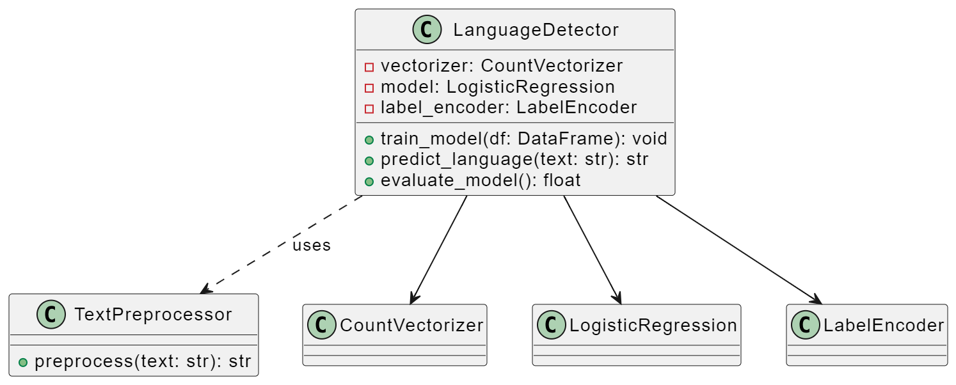
UML DIAGRAMS
Use case Diagram
Class Diagram

Slide 14
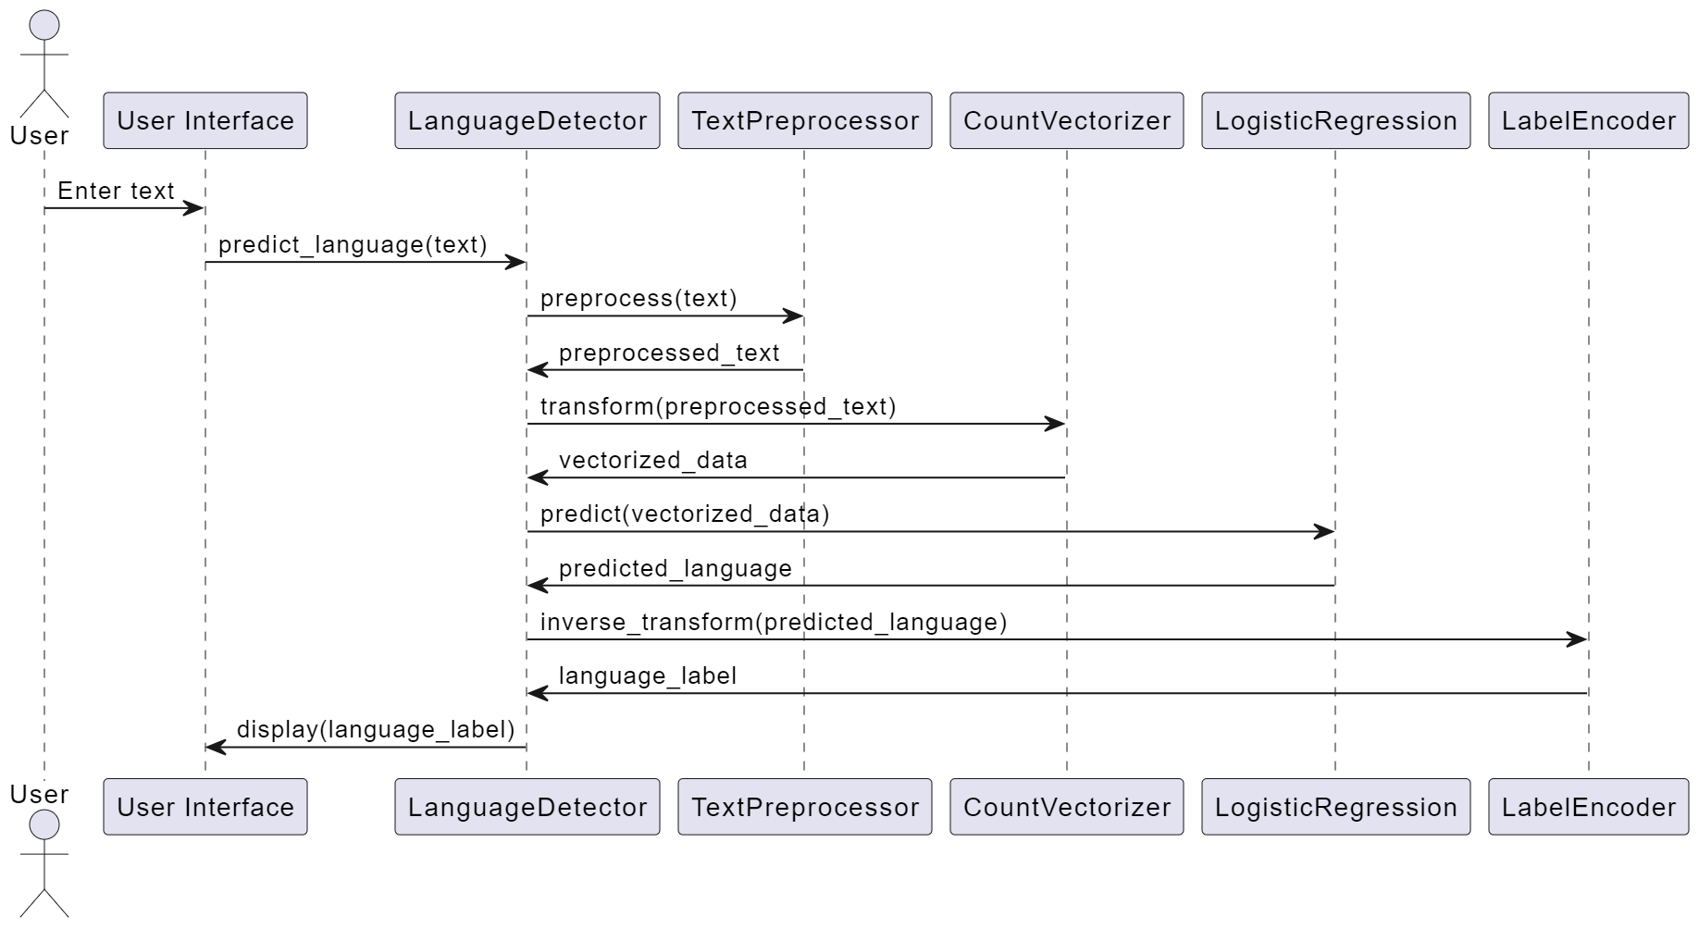
Sequence Diagram

Slide 15
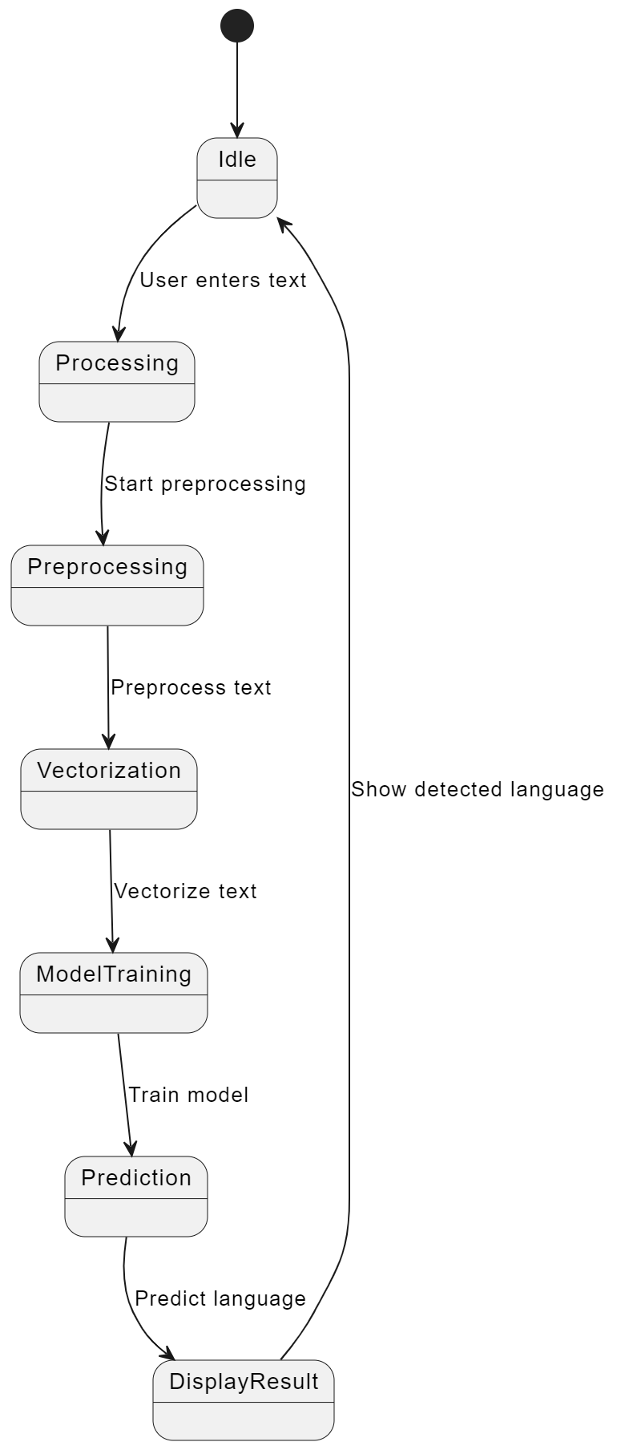
State Diagram

Slide 16
SUMMARY
The Language Detection Model (LDM) aims to accurately identify the language of text samples, essential for applications like content management and sentiment analysis. Traditional methods often lack the necessary accuracy for modern text data complexities. This study develops a robust model that preprocesses text, standardizes input, and transforms it into a numerical format suitable for analysis.
The dataset is divided into training and testing sets to allow the model to learn and be evaluated effectively. Performance is measured using a balanced accuracy metric, demonstrating its effectiveness in predicting the language of new text samples. A custom function enables real-time language detection for any input text. The model is versatile and can be applied to various tasks, ensuring accurate and reliable language detection for multilingual text processing.
Existing systems face challenges like inconsistent accuracy for less common languages, high computational demands, limited language coverage, and dependency on rigid linguistic rules. A significant research gap lies in detecting code-mixed text, where multiple languages are used within the same text. The proposed system addresses this by using the Natural Language Toolkit (NLTK) to detect 17 languages with higher accuracy.

Slide 17
Thank you!!!

