Slide 1
Sentiment Analysis On Product Reviews
J.Akhila 22071A6927
J.Ruchithanjani 22071A6930
K.Abhisree 22071A6936
M.Srinayani 22071A6940

Slide 2
ABSTRACT
Customer reviews play a pivotal role in shaping business strategies and guiding consumer decisions in today’s digital marketplace. This project leverages sentiment analysis to extract valuable insights from Flipkart product reviews using natural language processing (NLP) and machine learning techniques. The dataset, comprising textual reviews and numerical ratings, undergoes preprocessing to remove noise, tokenize text, and eliminate stopwords, ensuring effective feature extraction. Key features are derived using TF-IDF vectorization, which captures the significance of terms within the context of the reviews, transforming them into numerical representations for analysis.
A Decision Tree Classifier is trained to classify reviews into positive, neutral and negative sentiments, demonstrating high accuracy in predicting customer sentiment. Visual tools like word clouds provide an intuitive understanding of commonly used terms in positive, neutral and negative reviews, enhancing the model’s interpretability. The project also incorporates a real-time sentiment prediction system, enabling instant analysis of new reviews for practical applications in e-commerce, customer support, and feedback systems, thus offering a robust solution for understanding and improving customer satisfaction.

Slide 3
Dataset Overview
The dataset used for this analysis contains 5,105 records and 2 columns:
review: Contains customer reviews in text, providing feedback on various products.
rating: Numerical ratings given by customers, ranging from 1 to 5.
label: Sentiment labels assigned to each review:
1: Positive (rating = 5)
0: Neutral (rating = 4)
-1: Negative (rating ≤ 3)
Summary of the Dataset:
Shape: (5105, 3), indicating 5,105 rows and 2 columns.
Missing Values: None in any of the columns.
This balanced dataset provides a combination of textual and numerical data for multi-class sentiment analysis, making it well-suited for customer feedback classification.

Slide 4
Data Engineering Concepts
Data Loading and Exploration
Loading CSV data using pandas.
Initial exploration with head(), unique values, and distribution of ratings.
Data Labeling
Creating binary sentiment labels (Positive: 1, Neutral :0, Negative: -1) based on ratings.
3. Text Preprocessing
Text cleaning (removing punctuation, converting to lowercase).
Tokenization and removal of stopwords using NLTK.
4. Feature Engineering
Converting text into numerical vectors using TF-IDF Vectorizer.

Slide 5
5. Data Visualization
Visualizing rating distribution with Seaborn.
Generating word clouds for positive, neutral, and negative reviews.
6. Data Splitting
Splitting data into training and test sets using train_test_split.
7.Model Training and Testing
Training a Decision Tree Classifier.
Evaluating model accuracy on the training set.
8.Deployment Preparation
Creating a preprocessing pipeline for new review predictions.
Using the trained model and TF-IDF for real-time predictions.

Slide 6
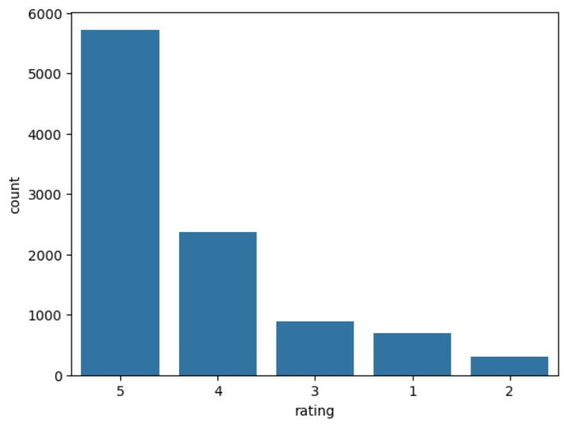
Code Explanation
Data Loading
Imported Flipkart review data using pandas.
2. Data Exploration
Examined ratings and visualized their
distribution using Seaborn.
3. Label Creation
Created a binary label column:
1 for positive reviews (rating = 5).
0 for neutral reviews(rating = 4)
-1 for negative reviews (rating < 4).
4. Text Preprocessing
Cleaned reviews by:
Removing punctuation.
Lowercasing text.
Removing stopwords using NLTK.

Slide 7
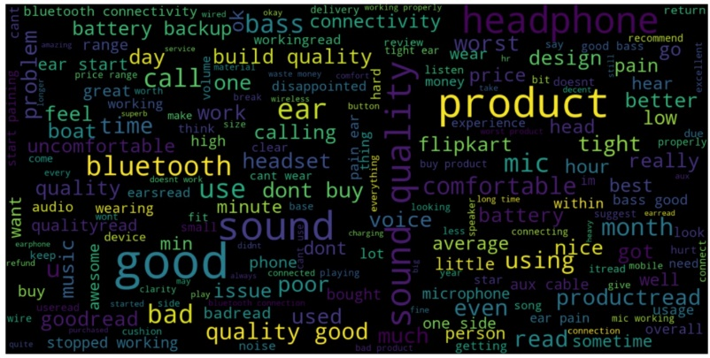
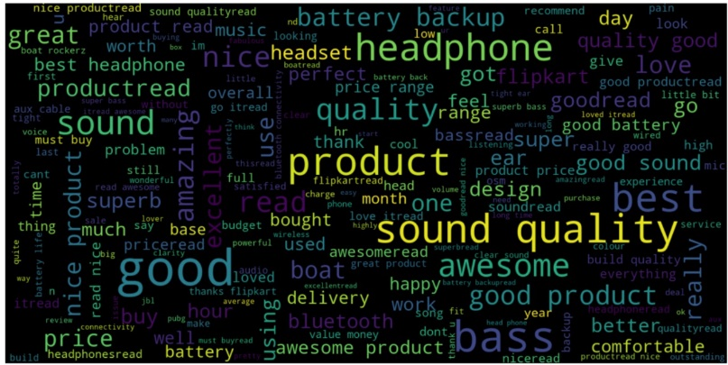
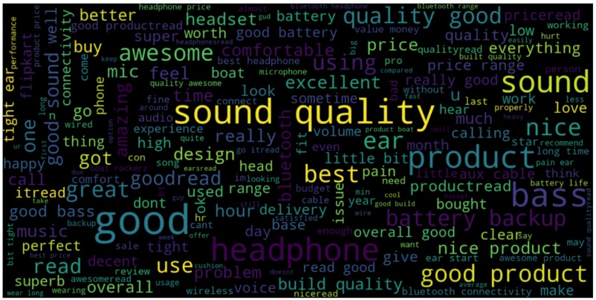
5.Word Clouds
Generated word clouds for visual insights into positive, neutral and negative reviews.
Negative Positive Neutral
6.TF-IDF Vectorization
Converted reviews into numerical features using TF-IDF for machine learning.
7.Model Training
Split data into training and testing sets.
Trained a Decision Tree Classifier on the processed data.

Slide 8
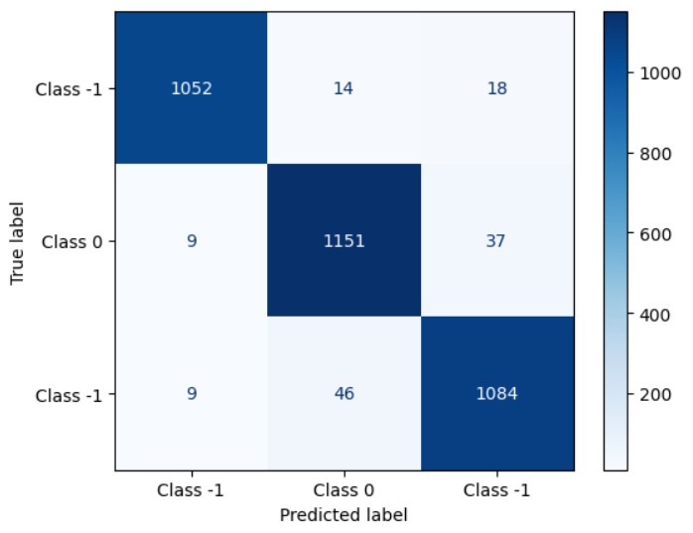
8.Prediction and Accuracy
Evaluated model accuracy on the training data.
Predicted sentiments for new reviews with preprocessing and vectorization.

Slide 9
Conclusion
The sentiment analysis of Flipkart reviews using a Decision Tree classifier demonstrated the ability to classify customer feedback as either positive, neutral or negative based on review ratings. Data preprocessing, including punctuation removal, lowercase conversion, and stopword elimination, enhanced the text quality for analysis. Word clouds visually showcased the most frequent terms in positive, neutral and negative reviews, revealing key customer sentiments. The TF-IDF vectorizer transformed text into numerical features, allowing the model to learn sentiment patterns effectively. The Decision Tree classifier achieved good accuracy on the training data, but further validation with unseen data is necessary for generalization. A custom function was developed to predict the sentiment of new reviews, demonstrating the model's real-world applicability. For future improvements, exploring advanced algorithms, cross-validation, and contextual embeddings like BERT could enhance the model's performance and accuracy.

Slide 10
Thank You

