Slide 1
PAINTING STYLE TRANSFER USING GAN
MEMBER NAME | MEMBER ID | FACULTY
Axa Gemini Lakra | B121010 | Mr Sarthak Padhi
Shruti Swarupa Dhar | B121056
Abhikalp Srivastava | B521002
Computer Vision Project, CSE, 6th Semester

Slide 2
CONTENTS
Project Description
Title/Topic
Significance
Objective
Data Used
Models Used
Experimentation Environment
Hardware
Software
Parameter Setup
Performance Metrics
Analysis of Results
Conclusion
References

Slide 3
PROJECT DESCRIPTION
Topic:
Painting Style Transfer using GAN
Significance:
Artistic Fusion: Merge styles for unique art.
Creativity: Explore without limits.
Education: Learn art history visually.
Communication: Emotionally rich visuals.
Personalization: Tailor images to taste.
Cross-disciplinary: Blend art and tech.
Commercial: Unique content creation.
Research: Push ML boundaries.
Heritage: Preserve and reinterpret.
Objective:
To develop an automated system using Generative Adversarial Networks (GANs) to apply diverse painting styles onto photographs, aiming for realistic and stylistically cohesive results in style transfer.

Slide 4
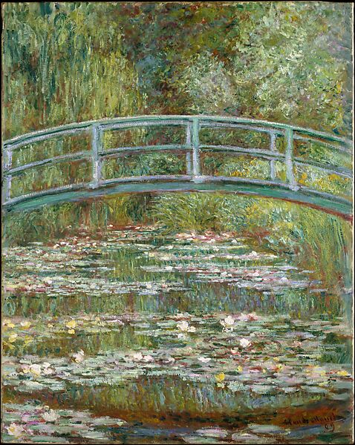
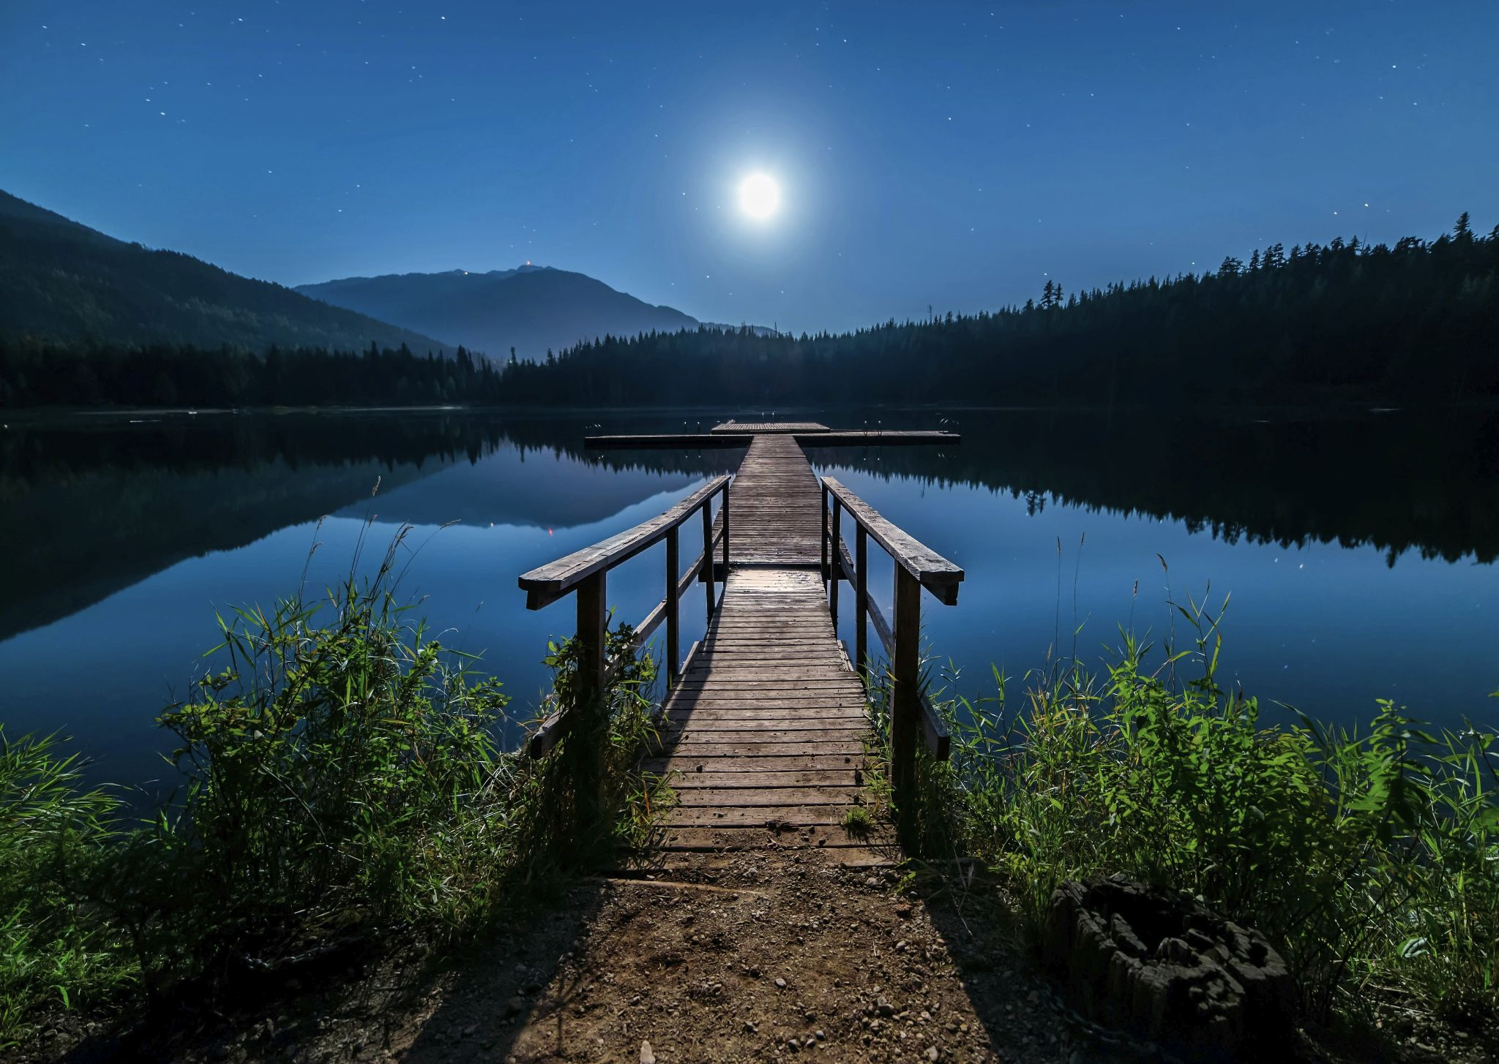
DATA USED
The dataset for this project is "monet2photo" available on Kaggle and is used for the task of style transfer or image-to-image translation. The dataset consists of 1193 Monet-style Paintings & 7038 Natural Photographs with each split into train and test subsets.
Monet-style Paintings: Vibrant artworks by Claude Monet, featuring broad brushstrokes and emphasis on light and atmosphere.
Natural Photographs: Real-world images capturing scenes, objects, and landscapes with detailed realism.

Slide 5
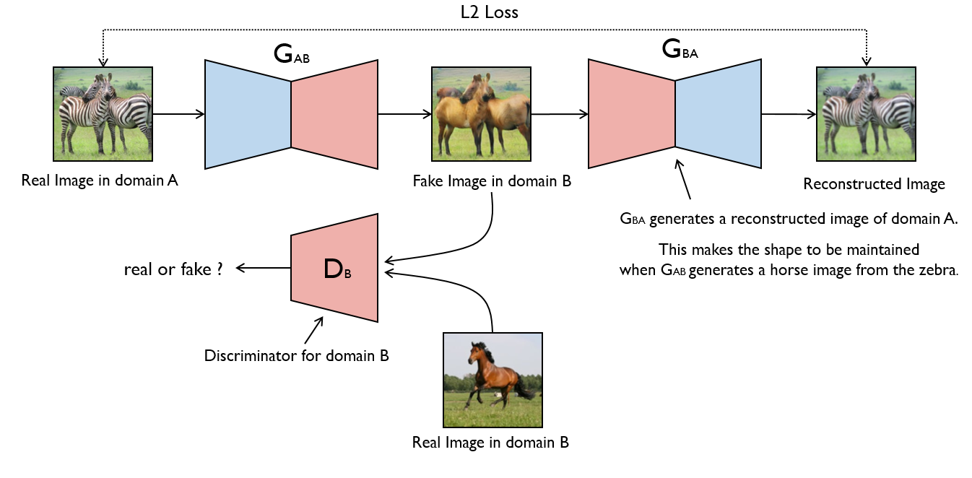
MODELS USED
The project utilizes CycleGAN as the only major model which can be further classified into the following components:
1. Monet Generator: -This is the generator network responsible for transforming images from the photo domain to the Monet painting domain.
2. Photo Generator: - This generator network performs the reverse transformation, converting Monet-style paintings back into realistic photos.

Slide 6
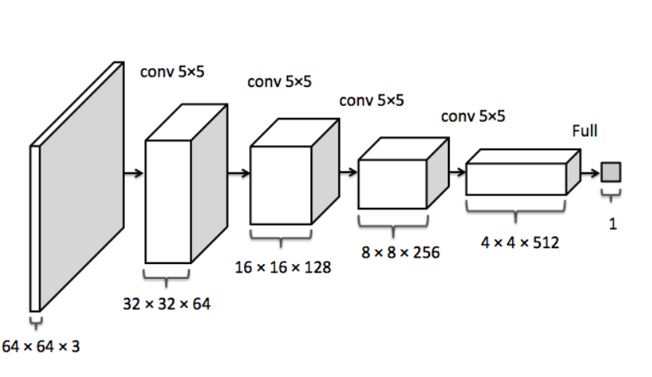
MODELS USED
3. Monet Discriminator: - The discriminator network for the Monet domain, which aims to distinguish between real Monet paintings and fake ones generated by the Monet generator.
4. Photo Discriminator: - It is similar to the Monet discriminator; this network discriminates between real photos and fake ones generated by the photo generator.
The generator networks are responsible for image translation between the two domains, while the discriminator networks provide adversarial feedback to guide the training process. The goal is to train the generators to produce realistic images that can fool the discriminators, leading to high-quality style transfer results.

Slide 7
EXPERIMENTATION ENVIRONMENT
Hardware:
The model used Kaggle Notebook Disk Space-73.1 GB. The maximum epoch of 30 and accelerator (GPU) 100.
Software:
Operating System: Windows
Programming Languages: Python 3.11
Deep Learning Libraries: TensorFlow 2.6, Keras
Data Manipulation Libraries: NumPy, Pandas
Parameter Setup:
Learning Rate: Adam optimizers with a learning rate of 2e-4 are used for both the generator and discriminator networks.
Lambda Cycle: The lambda_cycle hyperparameter is set to 10.
Optimizer Parameters: The beta1 parameter for Adam optimizer is set to 0.5.

Slide 8
EXPERIMENTATION ENVIRONMENT
Performance Metrics:
Metric-1: Generator Loss:
The generator_loss function computes the adversarial loss for the generator networks.
Metric-2: Discriminator Loss:
The discriminator_loss function calculates the adversarial loss for the discriminator networks.
Metric-3: Cycle-Consistency Loss:
The calc_cycle_loss function computes the cycle-consistency loss between original and reconstructed images.

Slide 9
EXPERIMENTATION ENVIRONMENT
Performance Metrics:
Metric-4: Identity Loss:
The identity_loss function calculates the identity loss to preserve the content of input images.
Metric-5:PSNR (Peak Signal-to-Noise Ratio):
PSNR is computed for generated images to measure their quality compared to ground truth images.
Metric-6:SSIM (Structural Similarity Index Measure):
SSIM is calculated to quantify the similarity between generated and ground truth images in terms of luminance, contrast, and structure.

Slide 10
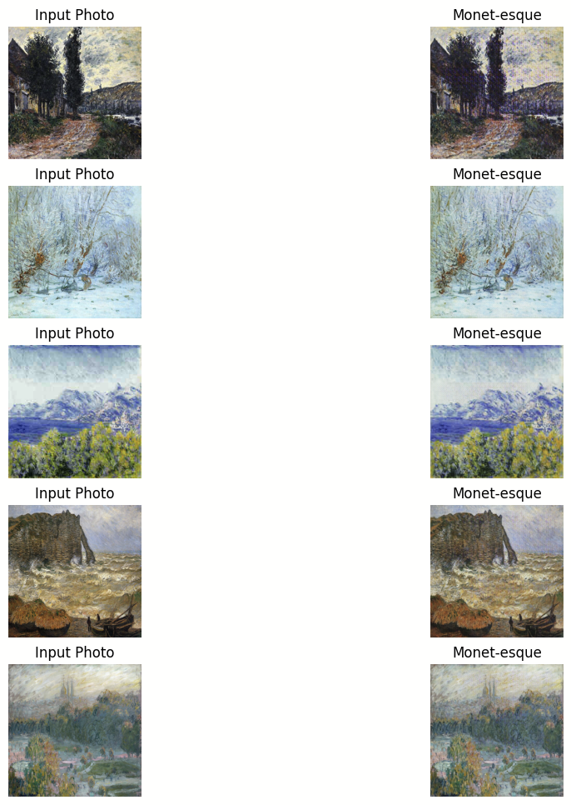
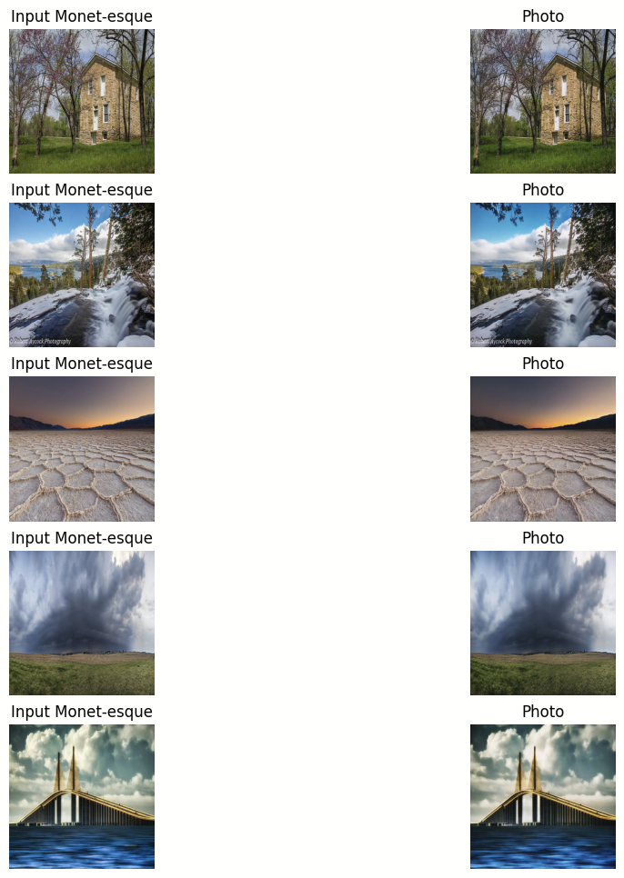
RESULTS
Trained CycleGAN model showcases test dataset images alongside their translated counterparts, allowing visual assessment of style transfer quality.
Conversion of original photograph into painting
Conversion of painting into original photograph

Slide 11
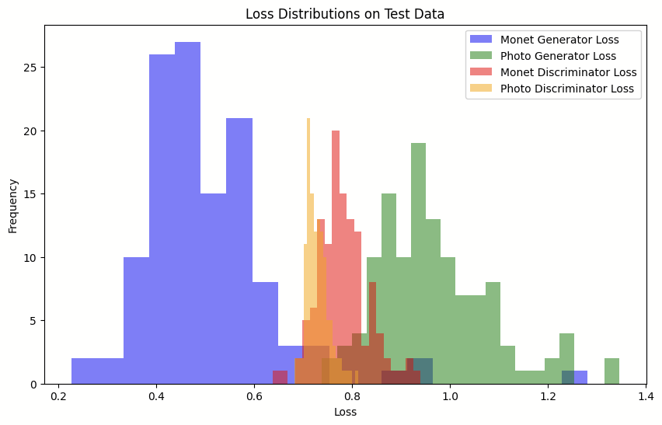
RESULTS
Generator and Discriminator Losses

Slide 12
CONCLUSION
Painting Style Transfer using GAN
The data used for training and evaluation consists of paired images from two domains: photos and Monet-style paintings
The implemented CycleGAN models include:
Generator Networks: Separate generator networks for transforming images from the photo domain to the Monet domain and vice versa.
Discriminator Networks: Discriminator networks for both the photo and Monet domains, which distinguish between real and generated images in their respective domains
The results obtained from the implementation and evaluation of the CycleGAN model include:
Visual samples showing original photos alongside their corresponding Monet-style paintings generated by the trained CycleGAN model and vice-versa.
Quantitative metrics such as generator and discriminator losses providing insights into the quality of style transfer achieved by the model.

Slide 13
CONCLUSION
Potential areas for improvement in the implementation and results could include:
Experimenting with different values for hyperparameters such as learning rates, lambda_cycle, and optimizer parameters to improve model convergence and performance.
Exploring alternative network architectures or adding additional layers/modules to the generator or discriminator networks to enhance the quality of generated images.
Utilizing data augmentation techniques to increase the diversity of the training dataset and improve the generalization capability of the model.
Incorporating advanced loss functions or regularization techniques to further refine the training process and enhance the quality of generated images.
By addressing these areas of improvement, the performance and capabilities of the CycleGAN model can be enhanced, leading to more realistic and high-quality style transfer results.

Slide 14
REFERENCES
Isola, Phillip, et al. "Image-to-image translation with conditional adversarial networks." Proceedings of the IEEE conference on computer vision and pattern recognition. 2017.
Zhu, Jun-Yan, et al. "Unpaired image-to-image translation using cycle-consistent adversarial networks." Proceedings of the IEEE international conference on computer vision. 2017.
Goodfellow, Ian, et al. "Generative adversarial nets." Advances in neural information processing systems. 2014.
Ronneberger, Olaf, Philipp Fischer, and Thomas Brox. "U-net: Convolutional networks for biomedical image segmentation." International Conference on Medical image computing and computer-assisted intervention. Springer, Cham, 2015.
Johnson, Justin, Alexandre Alahi, and Li Fei-Fei. "Perceptual losses for real-time style transfer and super-resolution." European Conference on Computer Vision. Springer, Cham, 2016.
IGatys, Leon A., Alexander S. Ecker, and Matthias Bethge. "Image style transfer using convolutional neural networks." Proceedings of the IEEE conference on computer vision and pattern recognition. 2016
Gatys, Leon A., et al. "A neural algorithm of artistic style." arXiv preprint arXiv:1508.06576 (2015).
He, Kaiming, et al. "Deep residual learning for image recognition." Proceedings of the IEEE conference on computer vision and pattern recognition. 2016.
RArjovsky, Martin, Soumith Chintala, and Léon Bottou. "Wasserstein gan." arXiv preprint arXiv:1701.07875 (2017).
Mirza, Mehdi, and Simon Osindero. "Conditional generative adversarial nets." arXiv preprint arXiv:1411.1784 (2014).

Slide 15
THANK YOU

