Slide 1


A Data Analysis on Netflix using Python
PROJECT ID - 2020CSEPID10
PRESENTED BY
Abhinav Gupta - 2002900100003
3CSE-A , November 2022
UNDER THE GUIDANCE OF
Dr. Shipra Saraswat
Associate Professor
Department of Computer Science and Engineering

Slide 2
CONTENTS
Abstract
Introduction
Problem Statement and Goals
Proposed Solution
Proposed System Architecture
Modules
Results
Conclusion
References

Slide 3
Abstract
Analytics is all about solving problems and Data analytics is the soul of the internet of things (IoT) technology.
Analytics is everywhere, this could be working in a variety of different industries such as aviation, industries or government.
With so many organizations looking to capitalize on data to improve their processes, it's a hugely exciting time to start a career in analytics

Slide 4
INTRODUCTION
This project Data Analysis on Netflix using Python has been developed for help to do an extensive analysis of the data.
Our project mainly focuses on to have a better recommendation for the subscribers and to add more content in a way so that more subscribers are added.
To learn the common trends of users in a region.
Existing System is not computerized and it is very difficult to manage and inform any details regarding Trends and Analysis of content that are available on Netflix.
Thus, there is an urgent need to develop a solution to this problem.

Slide 5
PROBLEM STATEMENT AND GOALS
Netflix is one of the largest OTT platforms and new content is added day by day in the Exploratory data analysis, I have analyzed the dataset, and the Data analysis will help to learn the trends, and content analysis.
This project will help to do an extensive analysis of the data, to have a better recommendation for the subscribers, and to add more content in a way so that more subscribers are added.
Some of the most important tasks that we can analyze from Netflix data are:-
(i) Understand what content is available
(ii) Understand the similarities between the content
(iii) What exactly Netflix is focusing on
(iv) Do the Sentiment Analysis

Slide 6
PROPOSED SOLUTION
The report presents a data analysis research and coordination activity one in the Netflix dataset found on Kaggle to establish a new data exploration on the trend of movies on the platform.
When Netflix was first 2 launched, it did not have any data analysis to understand the trend of audience/users using the platform as previously mentioned.
As time passes by, the importance of utilizing data analysis started to emerge, and the biggest hit shows were released on the platform after scrutinizing the data the company collected from the users.
In the project, we working on a same procedure to understand the trend of the platform and attempt to understand the average time the platform takes to upload the contents, the top ten film directors in top ten countries where the platform is streaming, and the top genres that the top actors/actresses are in.

Slide 7
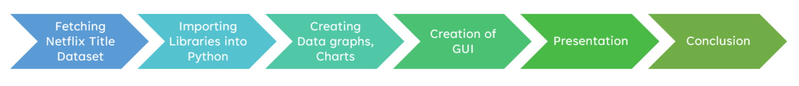
Architecture

Slide 8
MODULES
Numpy : Used for making Linear Algebraic Calculation
Pandas: Used to read and prepare Data
Plotly: Used for Data Visualization
TextBlob: For Sentiment Analysis
Tkinter: For GUI
PIL(Pillow): Image Processing
Netflix Data set: To read the available Data

Slide 9
Data Analysis on Netflix
Netflix is one of the largest providers of online streaming services. It collects a huge amount of data because it has a very large subscriber base.
Netflix like many others is a trending platform with many users, with variety of data which makes the analysis more interesting.

Slide 10
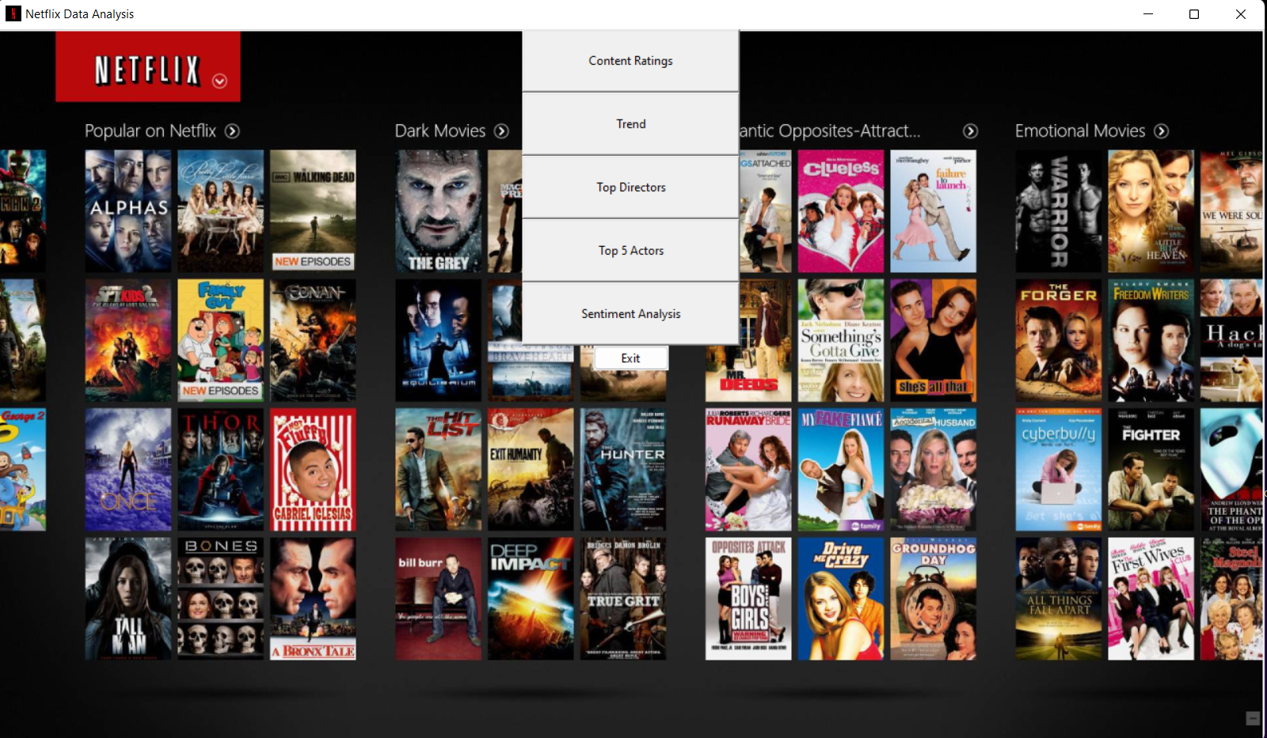
RESULTS
When Analyzing the data , we can identify , get to know the data in past, present , and data helps to predict the future. As Netflix is already running its business successfully. We can predict, how the business is successful in past years and help to run the business successful and predictable.
Figure : GUI Output of Program

Slide 11
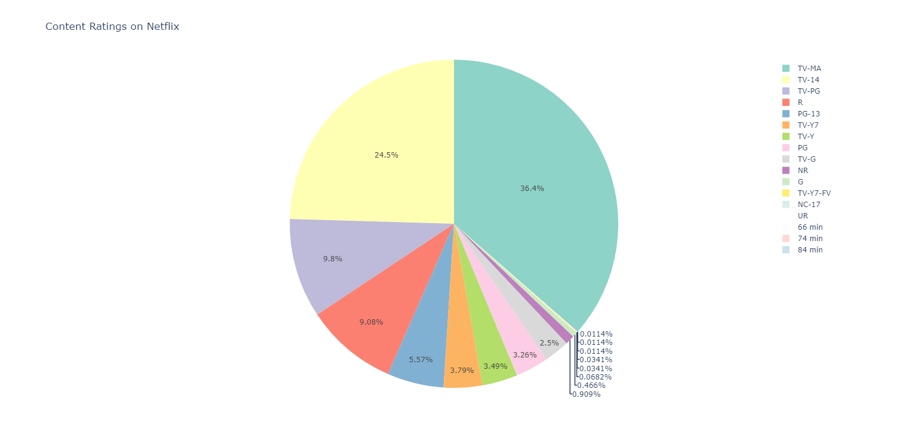
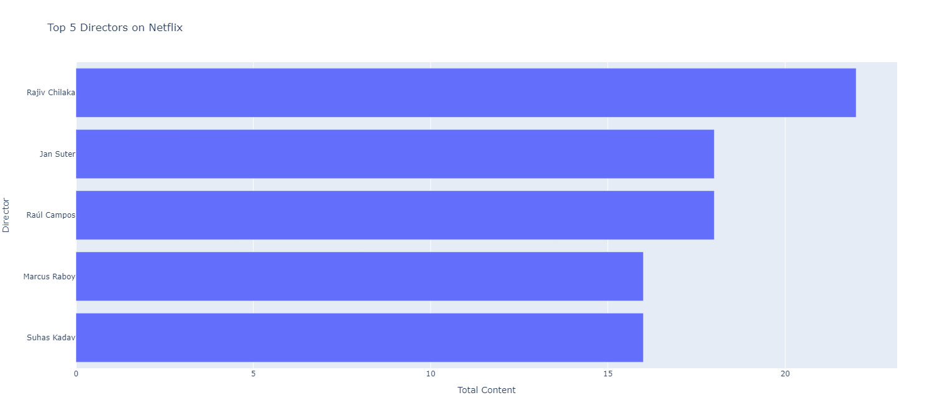
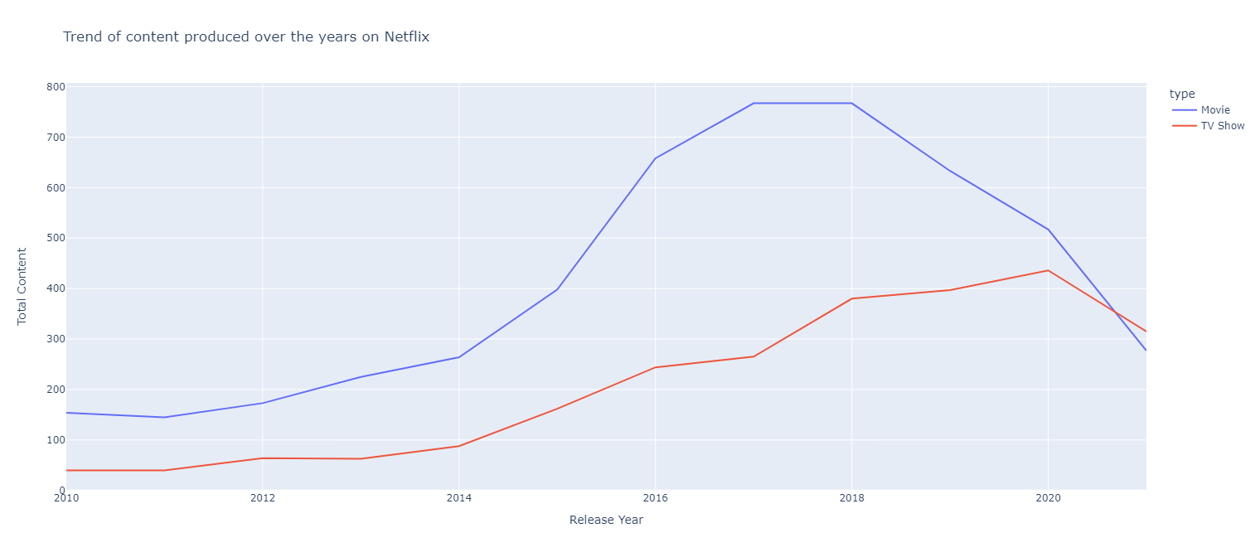
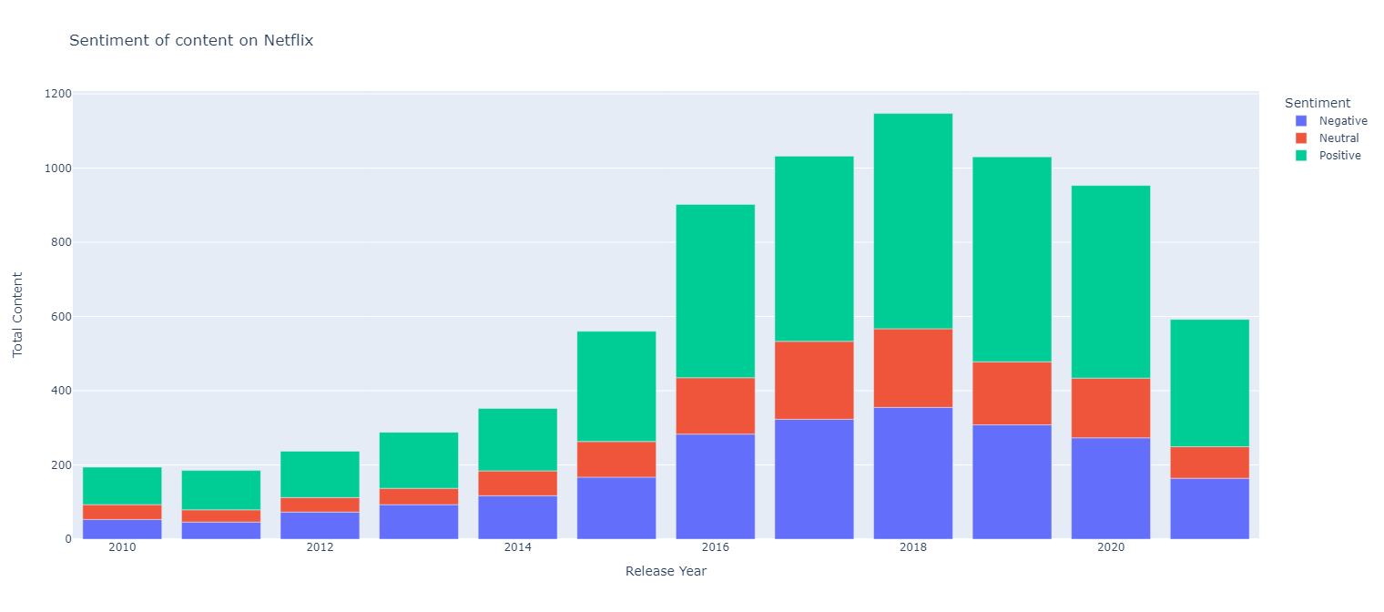
Results of Analysis of Netflix Content
Figure 1 : Graph Representation of Netflix Content
Figure 3: Bar representation of the graph on Directors on Netflix
Figure 4: Sentiment of content on Netflix
Figure 2: Trend of content produced over the years on Netflix

Slide 12
CONCLUSION
Our work distinguishes the type of content that is available on Netflix, the similarities between the content and what the ultimate of goal of Netflix is and could be planning.
Not only that, but also gives new content creators and filmmakers the opportunity to experiment with the users to give them a better experience altogether.
Sentiment analysis, also referred to as opinion mining. Through this organizations can determine and categorize opinions about a product, service, or idea. In turn helping the end users get a better watching experience.
This gives a clear idea on how data analysis can aid in the prediction and development of various industries

Slide 13
REFRENCES
Fernández-Manzano, E. P., Neira, E., & Clares-Gavilán, J. (2016). Data management in audiovisual business: Netflix as a case study. El profesional de la información (EPI), 25(4), 568-576.
BAGKAR, P., BORUDE, A., & AGA, Z. (2021). Sentiment Analysis on Netflix.
BAGKAR, PRITI, AISHWARYA BORUDE, and ZARRIN AGA. "Sentiment Analysis on Netflix." (2021).
Fernández-Manzano, E.P., Neira, E. and Clares-Gavilán, J., 2016. Data management in audiovisual business: Netflix as a case study. El profesional de la información (EPI), 25(4), pp.568-576.
Novendri, Risky, et al. "Sentiment analysis of YouTube movie trailer comments using naïve bayes." Bulletin of Computer Science and Electrical Engineering 1.1 (2020): 26-32.
Novendri, R., Callista, A. S., Pratama, D. N., & Puspita, C. E. (2020). Sentiment analysis of YouTube movie trailer comments using naïve bayes. Bulletin of Computer Science and Electrical Engineering, 1(1), 26-32.
Novendri, Risky, Annisa Syafarani Callista, Danny Naufal Pratama, and Chika Enggar Puspita. "Sentiment analysis of YouTube movie trailer comments using naïve bayes." Bulletin of Computer Science and Electrical Engineering 1, no. 1 (2020): 26-32.
Fernández-Manzano EP, Neira E, Clares-Gavilán J. Data management in audiovisual business: Netflix as a case study. El profesional de la información (EPI). 2016;25(4):568-76.

Slide 14
THANK YOU

