Slide 1
n-Bridge Information Factory
Orchestration Platform for Verified Risk Metrics
The Azure-native orchestration and governance layer that sits between GRFD and CAS,
executes end-to-end model chains, enforces inspection/sign-off controls, and delivers verified metrics

Slide 2
The Fundamental Shift
Why nBIF exists
Tribe Credit Analytics is moving from...
❌ "Providing Calculations" (IRB, RWA, ECL)
TO
✅ "Delivering Verified Risk Metrics"
This single architectural shift transforms ownership:
GRFD owns data • CAS owns calculation • nBIF owns orchestration, approval, and delivery
Result: Complete lineage, unified governance, and verified metrics reaching customers

Slide 3
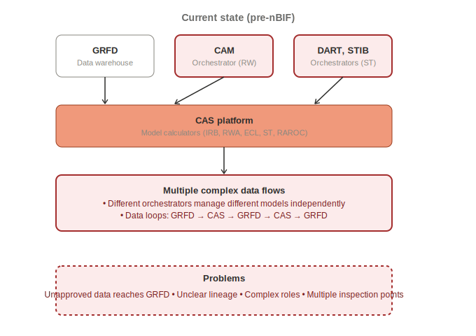
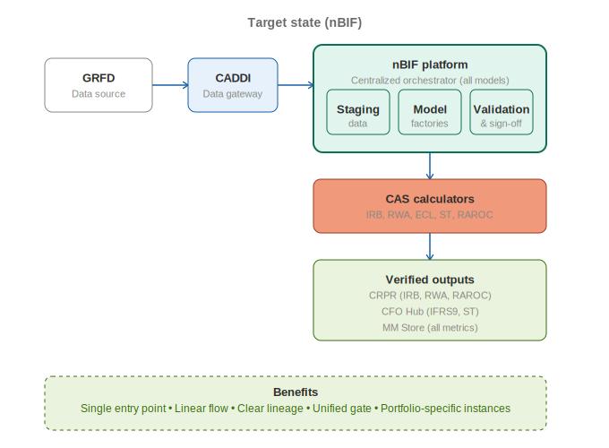
Current State vs. Target
The transformation
CURRENT: Fragmented orchestration
TARGET: Unified nBIF platform

Slide 4
Six Core Functions of nBIF
What nBIF actually does
1
Data Acquisition
Gather inputs from GRFD, CADDI, Meister
2
Workflow Orchestration
Control execution sequence: IRB→RWA→ECL→ST→RAROC
3
Inspection
Business users review data, outputs, trends, plausibility
4
Sign-off
Atomic approval gate—entire chain or nothing
5
Delivery
Push verified metrics to CRPR, CFO Hub, reporters
6
Historical Storage
Keep audit trail, validation history, comparison data

Slide 5
Ownership & Responsibilities
Clear separation of concerns
Capability | Owner | Responsibility
Data Warehousing | GRFD | Source of truth for all data
Model Calculation | CAS | Execute IRB, RWA, ECL, ST, RAROC computations
Model Orchestration | nBIF | Sequence models, manage dependencies
Inspection & Approval | nBIF | Business user review and sign-off gate
Delivery of Verified Metrics | nBIF | Push to CRPR, CFO Hub, reporting platforms

Slide 6
Atomic Approval Philosophy
All-or-nothing release principle
Example Run Results
Why This Design?
IRB
✅ Approved
Prevents inconsistent reporting to regulators
RWA
✅ Approved
IFRS9
❌ Rejected
Avoids COREP/FINREP data mismatches
OUTCOME
Stops partial or incorrect data publication
❌ NOTHING RELEASED
Ensures lineage is always complete
Maintains data integrity across all systems
Entire chain must pass before publication

Slide 7
Portfolio Strategy
One nBIF per portfolio
Independent nBIF Instances
RSME nBIF
RMM nBIF
Corporate nBIF
Rural nBIF
SL&I nBIF
Obvion nBIF
Each runs independently
Simpler architecture
Less coupling, easier to manage
Clear ownership
Portfolio team owns their instance
Independent deployments
Release without affecting others
Faster onboarding
Portfolio-specific migration path
Lower risk
Isolated blast radius during issues

Slide 8
Architectural Components
What makes up nBIF
nBIF Platform
Shared standards, infra-as-code, security, reusable services across all portfolios
nBIF Instance
Portfolio-specific application (e.g., RSME nBIF, RMM nBIF running independently)
Model Factories
Isolated workspace per model (IRB Factory, RWA Factory, ECL Factory, ST Factory, RAROC Factory)
nBIF 365 UI
Unified front-end for inspection, sign-off, corrections, ad-hoc runs, approvals
Common Data Cache
Shared datasets loaded once: macro scenarios, transaction history, balance data

Slide 9
Supported Models & Units
Long-term target scope
UT5
UT8
UT9
Additional
IRB
Stress Testing
IFRS9/ECL
RAROC
RWA
BRDD
Basel IV SA-RWA

Slide 10
What nBIF Is NOT
Clarity on scope and boundaries
❌ Data Warehouse
GRFD is the authoritative source; nBIF passes data through
❌ Calculator Platform
CAS owns model computation; nBIF orchestrates CAS
❌ Reporting Tool
Power BI and other tools consume nBIF outputs
❌ Transactional System
nBIF is batch orchestration, not real-time
nBIF IS:
✅ Orchestration Platform
✅ Approval & Sign-off Platform
✅ Workflow Engine
✅ Risk Metric Delivery Platform
✅ Data Logistics Platform
✅ Governance & Lineage Platform

Slide 11
Monthly Batch Execution
End-to-end flow
1
GRFD triggers n-Bridge run
2
Data acquired via CADDI, Meister, GRFD
3
Orchestrator sequences: IRB → RWA → ECL → ST → RAROC
4
Business users inspect outputs, trends, plausibility
5
Sign-off gate: atomic approval (all pass or all fail)
6
Deliver verified metrics to CRPR, CFO Hub, reporters

Slide 12
Technology Stack
Azure-first architecture
Everything is built on Microsoft Azure
Database
Security & Compliance
Azure SQL
ETL / Integration
AIC Classification: 223
Azure Data Factory
Authentication: Azure AD
Workflow Orchestration
Authorization: RBAC via AD Groups
Logic Apps
Service Accounts: Managed identities
User Interface
Azure Web App
Controls: SoX compliance
Reporting
Audit: Comprehensive logging
Power BI
Identity & Security
Azure AD, SSO, RBAC

Slide 13
Implementation Roadmap
Phased portfolio rollout
MVP / Release 1
RSME
In Progress
Release 2
RMM & Corporate
Q4 2024
Release 3
Rural, SL&I, Obvion
Q1-Q2 2025
Release 4+
IFRS9, Stress Testing enhancements
Q3+ 2025
Key Principle
Incremental modernization per portfolio, not big-bang transformation. Each portfolio has clear ownership and independent deployment path to minimize risk and enable faster delivery.

Slide 14
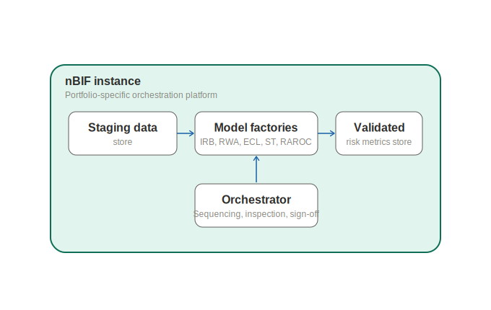
nBIF Platform Architecture
Detailed component view

Slide 15
nBIF: The Strategic Shift
From scattered orchestration → unified platform
From calculations → verified risk metrics
From multiple approvals → atomic sign-off
From unclear lineage → complete audit trail
From portfolio isolation → shared platform with independent instances
From manual workflows → automated orchestration with governance
One Line Summary
nBIF is the Azure-native orchestration and governance layer that sits between GRFD and CAS, executes end-to-end credit-risk model chains, enforces inspection/sign-off controls, and delivers verified risk metrics.

