Slide 1
nBif Automation Scope, Approach & Strategy

Slide 2
Types of testing
Introduction
Unit Testing
Integration Testing - In scope
System Testing
Regression testing - In scope
UAT testing

Slide 3
Automation scope & roadmap
Inspection Module
DevOps Pipeline
Model dependency Controller
Portfolio Datastore
IRB Datastore
RWA Datastore
CORP Datastore
Functional testing
Integration testing
Test data setup
Role based testing
Positive and Negative testing

Slide 4
nBIF Unified: Automation Approach & strategy
Automation framework:
Reqnroll + C#
BDD framework
Automation goals:
Early detection of issues / defects
Qualitative checks
Process health check
Automation strategy
n+1 strategy
Phase wise strategy
Automation criteria:
Critical process
Business impact
Repetitive task
Production issues
Automation Life cycle
Manual hands-on
Feasibility analysis
Design
Development
Execution
Enhancement / Maintenance
Phase out / Obsolete
Application under testing:
n-Bridge 365 application
Azure Resources (ADF, LA & SQL DB)
Environment in scope:
Dev environment
Test environment
Reporting:
Azure DevOps Integration

Slide 5
Automation scope in Inspection Module
GRFD / GRFD-2
CADDI
Orchestrator
Calculator
Portfolio
LA / ADF / SQL DB
LA Initialize
SQL DB Update
SQL DB Update
LA trigger
DB update
Fresh Run / Rerun / Restart
Validate / Decline
Manage Batch Status
Resume
Stop
Inspection Module (n-Bridge 365 application)
Business Consumer
Business User
Batch Agent
Resume/Stop Batch Run
Admin
Completed
Users
WIP
Feasibility WIP

Slide 6
nBif Unified: Test Architecture Diagram
Process Flow
GRFD-2 + CADDI
n-Bif
CRPR, CFO Hub
Portfolio Datastore
IRB Datastore
RWA Datastore
History Datastore
Inspection Module
<Portfolio>
Tests Flow
Test Solutions
TS1
Test Framework
Condition 1
Condition 2
Condition 1
Condition 2
Condition 1
Condition 2
Condition 1
Condition 2
Condition 1
Condition 2
Test Suite
Test Suite
Test Suite
Test Suite
Test Suite
TS2
Test Portfolio Datastore (Phase-2)
Test Inspection Module (Phase-1)
Test IRB Datastore (Phase-3)
Test RWA Datastore (Phase-4)
Test History Datastore (Phase-5)
TS3
End to end test suite
TS4
Execution flow
TS5
1
2
3
4
5
6
7
8
9
Test execution flow: 1, 2, 3, 4, 5, 6, 7, 8, 9
Automation Plan: Phase-1, 2, 3, 4, 5
Note: Manual intervention may require to complete e2e testing
Test suite x = Pre-requisite setup + Part 1 + Part 2 …

Slide 7
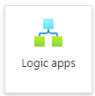

Automation Framework Structure
Azure DevOps Pipeline
Test Suite
1
2
3
4
5
6
7
8
9
Test Automation Framework
Pipeline
Feature
Step Definition
Feature
Pipeline
Feature
Azure Step Definition
Page Object
Pipeline
Feature
Step Definition
Pipeline
Feature
Inspection Module Step Definition
Test Results
Pipeline
Feature
Utilities
Pipeline
Feature
Utilities
Test Automation Framework
Folder structure
Test Automation Framework

Slide 8
Challenges
Single sign on (SSO)
Latency time

Slide 9
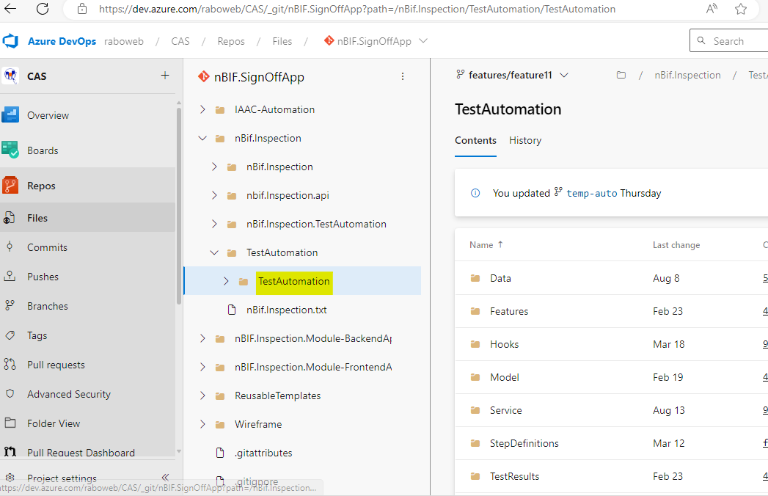
Azure Repo – As on today

