Slide 1
Subject Area Identification
2014HT13223 – Abhitesh Das
BITS – Rajasthan (Nov 2016)

Slide 2
Acknowledgements
I express my sincere thanks to my Supervisor Mr. Aditya Vadrevu and my Additional Examiner Mr. Praveen Sharma for their constant guidance, and encouragement.
I would also like to thank my mentor Mr Gokul Kanan Sadasivam, for valuable feedback during the course.

Slide 3

Agenda
Introduction
List of algorithms
Conclusion
Future work

Slide 4
Introduction
We receive hundreds of paper daily for editing
These paper needs to be edited by a specific editor who is well-versed with the subject area of the paper, so that we can deliver the quality output to the client.
For this to happen, we need to determine the subject area of the document.
As of now, this is done by humans, which takes a lot of time and effort.
Automation of this subject area identification will save us a lot of time and effort and will also get us rid of human error

Slide 5
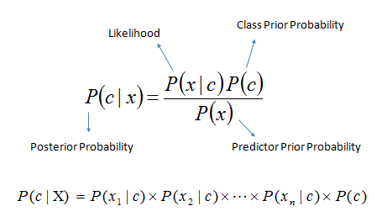
Algorithm – Naïve Bayes
Its one of the simplest algorithm to start with
It simply uses the bag of words to predict the class of the new data
Its called naïve, because of the assumption that all the features are independent of each other i.e they can exists irrespective of the occurrence of the one another.
Its one of the most efficient text classification algorithm.
Simple to implement

Slide 6
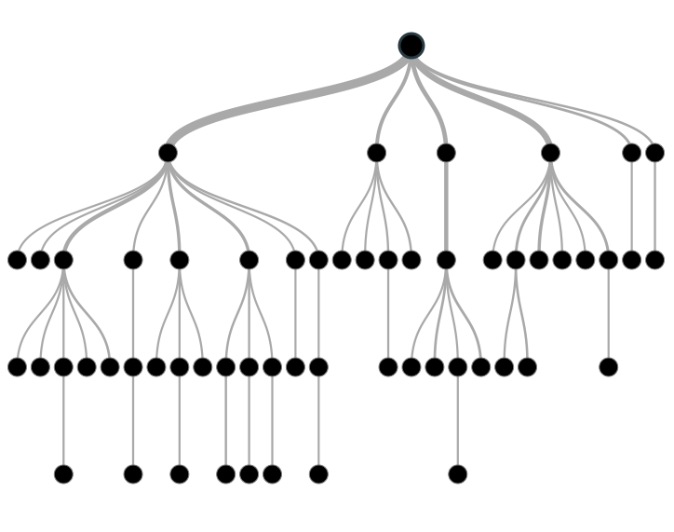
Algorithm – Decision Tree
It gives a very good visual representation of data set
Tree is created by splitting data up by variables and then counting the no of items that fall in each bucket
It is prone to over fitting
Building a model takes more time as compared to Naïve Bayes

Slide 7
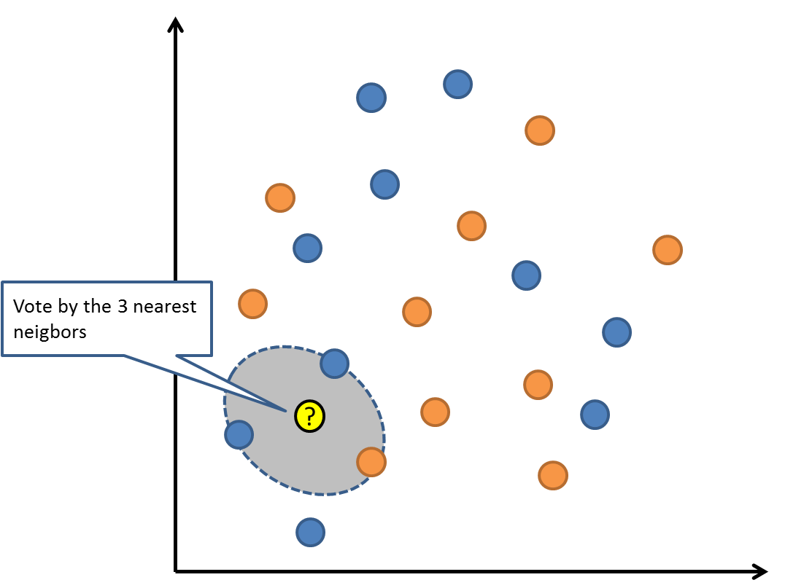
k – Nearest neighbor
It doesn’t builds a prediction model while training, rather simply records the class labels for each input data item
Hence, takes less time to train
However, while determining the class of new data set, it tries to find the k-nearest neighbors and then classify the new data set as the class label with max votes. (k determines the no. of neighbors to find)
While voting, the class labels nearer to the new data point are weighted higher than that of those which are far away from the new data point
Hence, takes more time to predict the class of new data point
It can be computation expensive

Slide 8
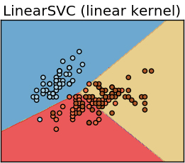
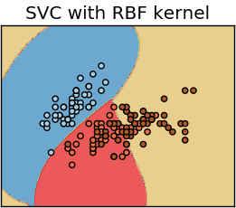
Support Vector Machines (aka SVM)
Its simply a line separating two different classes
However, at time a simple (linear) line wont be enough to separate the classes.
In such cases, we need to fit the curve i.e achieved by changing the kernel to rbf or poly, etc
In a nutshell, SVM helps find the optimal decision boundary
It maximizes the margin of decision boundary
SVM is also very well know for its ability to deal with outliers.
It takes a little more time to train, but its worth it.

Slide 9
Conclusion
 | Documents
Training | 10774
Test | 4618
Total | 15392
Algorithm | Accuracy
Naïve Bayes | 51 %
Decision Tree | 33 %
k-NN | 10%
Support Vector Machines | 60%
For our data set we achieve maximum accuracy with SVM

Slide 10
Future work
Process all the papers received in last one year ~1 lakh
Detect the classes for which the algo is not classifying accurately with the help of confusion matrix and fix them by adding more training materials or by tuning the algo parameters
Fine tune the algorithm with help of grid search
Implement the self learning for the selected algorithm – so it rebuilds itself every week with the new knowledge
Determine the hardware requirements for the final algo implementation
Design a interface to easily change the parameters of the algorithm

Slide 11
Thank you

