Slide 1
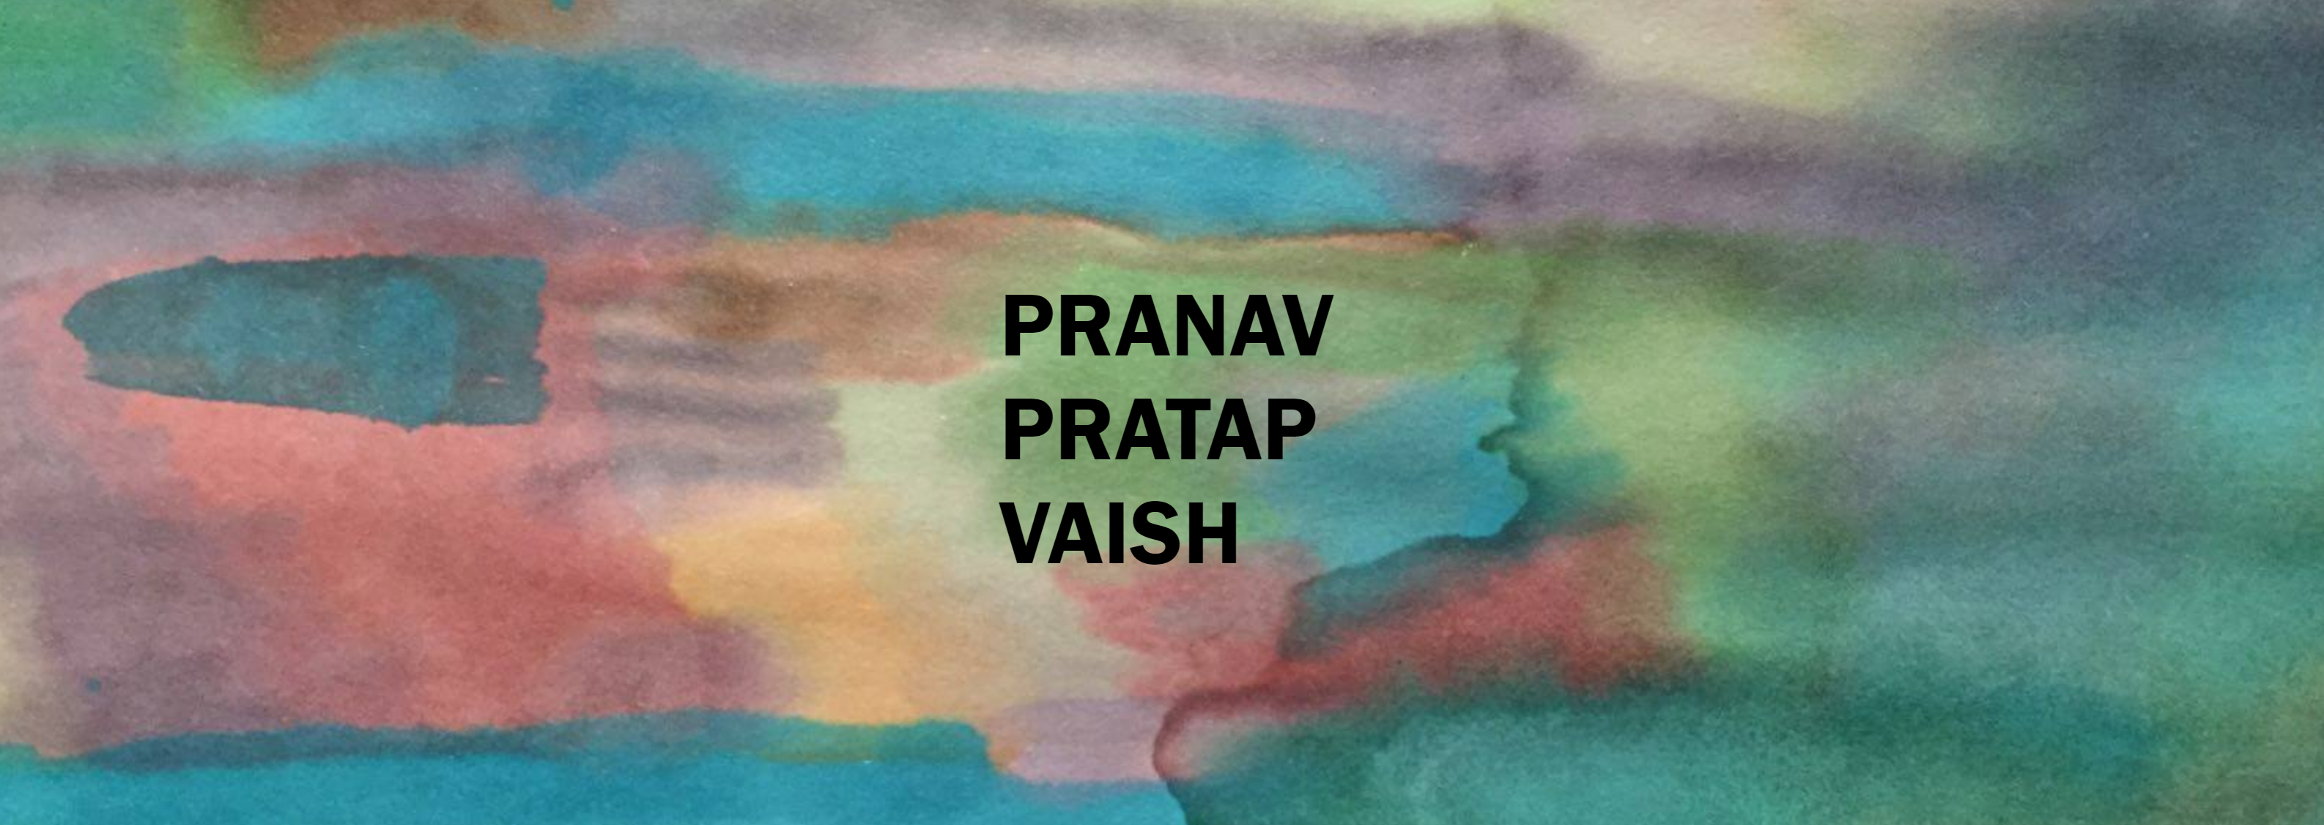
PRANAV PRATAP VAISH

Slide 2

PRANAV PRATAP VAISH

