Slide 1
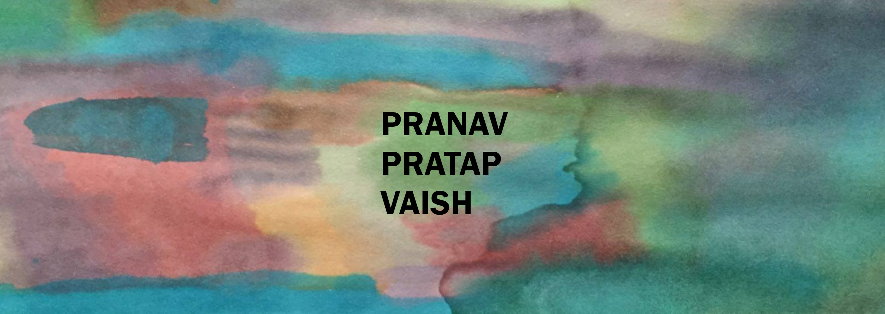
PRANAV PRATAP VAISH

