Slide 1
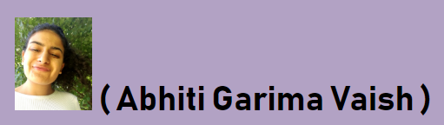

Slide 2
A
G
V

Slide 3
A
G
V

Slide 4
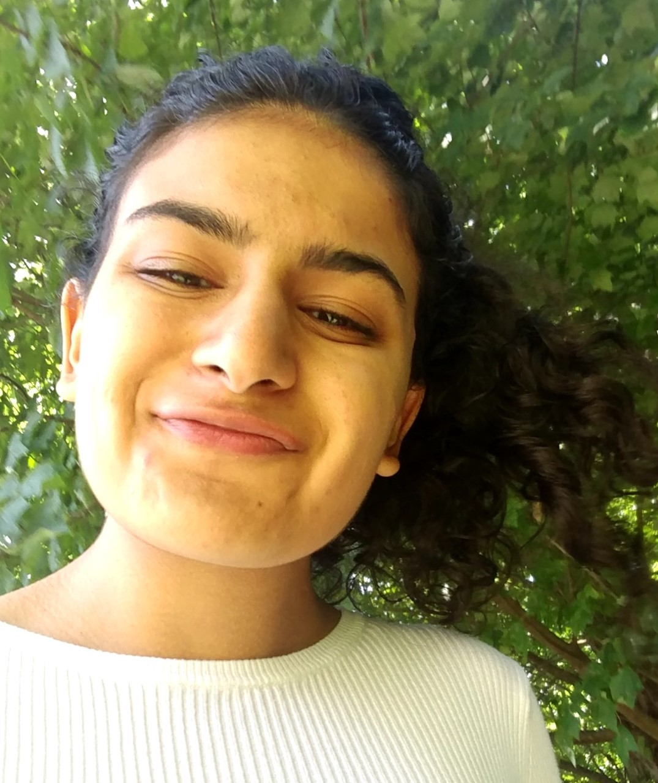
( Abhiti Garima Vaish )
Headline

Slide 5


Headline

Slide 6
Headline
> Home | About | Resume | Projects | Contact <

Slide 7
Headline
> Home | About | Resume | Projects | Contact <

Slide 8
Abhiti Garima Vaish
MIT 2020 [B.S. Computer Science]
{Passionate software developer, driven to interconnect our world with mobile/embedded solutions}
> Home | About | Resume | Projects | Contact <

Slide 9
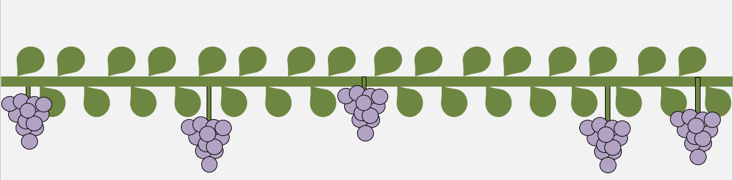
Abhiti Garima Vaish
MIT 2020 [B.S. Computer Science]
{Passionate software developer, driven to interconnect our world with mobile/embedded solutions}
> Home | About | Resume | Projects | Contact <

Slide 10
Abhiti Garima Vaish
MIT 2020 [B.S. Computer Science]
{Passionate software developer, driven to interconnect our world with mobile/embedded solutions}
> Home | About | Resume | Projects | Contact <

Slide 11

About
Hello there! My name is Abhiti, and I'm a 21-year-old software developer. I am a senior at the Massachusetts Institute of Technology. I am majoring in computer science, and minoring in economics. I have a hunger to create mobile and IoT-based solutions to issues of international development.
Over the course of my ~2 decades on this glorious planet, I have lived in a handful of places around the world. I was born and raised in a suburb of New York City. My family and I then relocated to the Indian financial capital due to my father’s occupation. Afterwards, I matriculated to the United World College in one of the most remote areas in the United States, alongside my peers from 70+ countries around the world. Finally, I am currently situated in America’s biggest college town, trying to figure out this whole computer science thing.
1997 - 2007
2007 - 2014
2014 - 2016
2016 - 2020
Scarsdale, NY USA
Mumbai, MH India
Montezuma, NM USA
Cambridge, MA USA
> Home | About | Resume | Projects | Contact <

Slide 12
About
Hello there! My name is Abhiti, and I'm a 21-year-old software developer. I am a senior at the Massachusetts Institute of Technology. I am majoring in computer science, and minoring in economics. I have a hunger to create mobile and IoT-based solutions to issues of international development.
Over the course of my ~2 decades on this glorious planet, I have lived in a handful of places around the world. I was born and raised in a suburb of New York City. My family and I then relocated to the Indian financial capital due to my father’s occupation. Afterwards, I matriculated in the United World College in one of the most remote areas in the United States, alongside peers from 70+ countries around the world. Finally, I am currently situated in America’s biggest college town, trying to figure out this whole computer science thing.
1997 - 2007
2007 - 2014
2014 - 2016
2016 - 2020
Scarsdale, NY USA
Mumbai, MH India
Montezuma, NM USA
Cambridge, MA USA
> Home | About | Resume | Projects | Contact <

Slide 13
About
Hello there! My name is Abhiti, and I'm a 21-year-old software developer. I am a senior at the Massachusetts Institute of Technology. I am majoring in computer science, and minoring in economics. I have a hunger to create mobile and IoT-based solutions to issues of international development.
Over the course of my ~2 decades on this glorious planet, I have lived in a handful of places around the world. I was born and raised in a suburb of New York City. My family and I then relocated to the Indian financial capital due to my father’s occupation. Afterwards, I matriculated in the United World College in one of the most remote areas in the United States, alongside peers from 70+ countries around the world. Finally, I am currently situated in America’s biggest college town, trying to figure out this whole computer science thing.
1997 - 2007
2007 - 2014
2014 - 2016
2016 - 2020
Scarsdale, NY USA
Mumbai, MH India
Montezuma, NM USA
Cambridge, MA USA
> Home | About | Resume | Projects | Contact <

Slide 14
Resume
> Home | About | Resume | Projects | Contact <

Slide 15
Resume
> Home | About | Resume | Projects | Contact <

Slide 16
Resume
> Home | About | Resume | Projects | Contact <

Slide 17




Projects
> Home | About | Resume | Projects | Contact <

Slide 18
Projects
> Home | About | Resume | Projects | Contact <

Slide 19
Projects
> Home | About | Resume | Projects | Contact <

Slide 20



Contact
* Note: Many of my MIT-based projects are only available within the enterprise
> Home | About | Resume | Projects | Contact <

Slide 21
Contact
* Note: Many of my MIT-based projects are only available within the enterprise
> Home | About | Resume | Projects | Contact <

Slide 22
Contact
* Note: Many of my MIT-based projects are only available within the enterprise
> Home | About | Resume | Projects | Contact <

Slide 23
S
Contact
* Note: Many of my MIT-based projects are only available within the enterprise
> Home | About | Resume | Projects | Contact <

Slide 24
A
G
V

Slide 25
A
G
V

Slide 26
A
G
V

Slide 27


Slide 28


Slide 29


Slide 30


Slide 32
