Slide 1

B.Tech BCSE497J - Project 1
Vision-Based UI State Discovery for API-Independent Software Automation
Project ID: 12385UG03
Team members:
Mantri Vishnu Vikranth (23BCE0526)
Harish Kumar V S (23BCT0223)
Abhinav Pant (23BCE0513)
Faculty guide :
Dr. Sendhil Kumar K S

Slide 2

Approval Mail From Guide
Guide approval for the Review 2 scope was to be obtained by e-mail before 01-09-2026 (sample format below).
Status: Not Provided - approval e-mail to be inserted here before submission.

Slide 3
Aim
Primary Aim (unchanged from Review 1): To conceptualize, develop, and validate a highly resilient, self-learning Autonomous Software Agent that operates entirely independent of APIs and DOM structures, utilizing pure computer vision combined with graph-based spatial memory to achieve scriptless, human-like interface automation across unseen desktop, web, and legacy software environments.
Refined focus for Project-I, agreed after the Review 1 literature survey:
  Within that aim, the evaluated research contribution is the active discovery of hidden GUI action preconditions from pixels, and their use for compositional planning.
Key Paradigms:
  From Reactive to Stateful: moving beyond stepwise "query-act" loops.
  From Code to Cognition: bypassing HTML and accessibility trees.
  From Coordinates to Semantics: understanding UI elements by functional intent.
  From Topology to Function (added at Review 2): remembering not only where an action led, but the observable conditions under which it works at all.

Slide 4
Abstract
A large body of enterprise, legacy, remote-desktop and canvas-rendered software exposes no stable API, DOM or accessibility tree, so automation must be driven from what is drawn on the screen. This project develops a screenshot-native agent that perceives an application only from rendered pixels and acts only through mouse and keyboard events at pixel coordinates.
Visible controls are grounded locally by OmniParser regions reconciled with offline OCR, reduced to position-independent semantic signatures, and stored in a persistent UI state-transition graph that survives layout changes.
Beyond screen topology, the agent induces explicit, evidence-backed action schemas recording each operation's visually grounded preconditions, expected effects, supporting and contradicting evidence, and a confidence value derived from that evidence rather than from model prose. Uncertain preconditions are resolved by safe contrasting interventions inside a resettable sandbox, and a bounded backward-chaining planner establishes missing preconditions for goals whose exact trajectory was never observed.
Evaluation uses the Visual Function Lab, a deterministic benchmark with hidden ground-truth rules, 17 semantic actions, 3 layouts and an independent evaluator. Four comparable memory modes run through one harness; the frozen baseline comparison is scheduled for Phase 6.

Slide 5


Literature Review
Paper / System | Objective | Methodology | Pros / Cons | Findings for this project
OmniParser (Microsoft, 2024) | Parse a raw screenshot into interactable regions | Region detector plus functional captioning on pixels only | + No DOM, generalises across apps - Stateless execution loop | Adopted as our default grounder; regions decide clickability
CogAgent (CVPR, 2024) | GUI question answering on high-resolution screens | 1120x1120 vision-language model with a high-resolution cross-module | + Reads small text and icons - Reactive, single-step; high compute | Confirms pixel-only reading is feasible at GUI resolution
UI-TARS (ByteDance, 2025) | End-to-end native GUI agent | One model trained on large screenshot corpora | + Unified perception and action - No explicit topological memory | Long-horizon context loss motivates external, inspectable memory
UGround (ICLR, 2025) | Universal visual grounding for GUI agents | 10M elements over 1.3M screenshots, vision only | + Up to 20 absolute points gain - Depends on an external planner | Grounding is mature enough to build reasoning on top of
GraphPilot (JICN, 2026) | One-step LLM planning over an app knowledge graph | Builds graph topology by extracting HTML | + Low latency, low hallucination - Needs HTML; fails on desktop and legacy | Graph memory works, but is DOM-bound: our graph is built from pixels

Slide 6
Literature Review (continued): added since Review 1
Paper / System | Objective | Methodology | Pros / Cons | Findings for this project
GUI-explorer (ACL, 2025) | Mine transition-aware knowledge autonomously | Exploration plus unsupervised mining of observation-action-outcome triples | + Training-free; 53.7% SPA-Bench, 47.4% AndroidWorld - Effects only, no preconditions | Autonomous exploration and transition memory are now prior art
Executable Agentic Memory (2026) | Reuse executable interaction paths | Offline knowledge-graph construction, online path retrieval | + Several-fold token reduction - Stores topology, not applicability | Confirms graph memory alone is no longer a novel contribution
ActionEngine (2026) | Move GUI agents from reactive to programmatic | State-machine memory compiled into executable code | + 95% on a WebArena subset with about one model call - No evidence or uncertainty model | State memory is well covered; evidence and uncertainty are not
VeriGUI / Don't Act Blindly (2026) | Robust automation through action-effect verification | Thinking-Verification-Action-Expectation loop with self-correction | + Detects failed effects and recovers - Describes effects, not applicability | Directly motivated our hardened verification and outcome classes
ConditionNET (IEEE RA-L, 2025) | Learn preconditions and effects for execution monitoring | 30M-parameter vision-language model over demonstrations | + F1 0.97 for anomaly detection - Robot manipulation, not GUI from pixels | Precondition learning is proven, but not in the pixel-only GUI setting
PATHS (IEEE TSE, 2001) | Hierarchical GUI test-case generation | GUI events modelled as planning operators with preconditions and effects | + Explicit, checkable operator model - Operators authored by a designer, not learned | The representation is classical; learning it from pixels is the open gap

Slide 7
Research Gap
Review 1 position (retained as motivation):
  "Seeing without remembering": pure vision agents generalise across systems but act statelessly, so long-horizon workflows accumulate errors.
  "Remembering without seeing": graph-based planners are reliable but build their topology from DOM/HTML, so they break on desktop, legacy and Citrix/RDP software.
Refinement after the Review 1 survey (what changed):
  Autonomous exploration, transition memory and graph reuse from pixels are now covered by published systems (GUI-explorer, Executable Agentic Memory, ActionEngine), so "a visual state graph" is no longer a defensible novelty claim. The graph is retained as a baseline and a navigation aid.
The gap that remains open:
  Topology is remembered, applicability is not: a graph records that clicking Export led somewhere, not that Export needs a document to be open.
  Effects are described, conditions are not: free-text effect memories carry no support, contradiction or confidence that later evidence can revise.
  Evidence is passive: no reviewed GUI agent deliberately creates a contrasting state to separate a genuine enabling condition from a coincidence.
  Precondition learning has not been done from pixels: existing work uses robot data, symbolic traces or designer-authored operators.

Slide 8


Objectives
O1 Enforce a pixel-only information boundary, verified by an automated compliance test.
O2 Extract typed, visually grounded state predicates with position-independent identity.
O3 Learn action effects from outcome-classified transitions with support and contradiction counts.
O4 Induce preconditions with evidence-derived confidence (support+1)/(support+contradiction+2).
O5 Select and run safe, budgeted contrasting interventions inside a resettable sandbox.
O6 Plan compositionally by backward chaining to establish missing preconditions.
O7 Evaluate against baselines B0-B4 and the required ablations with paired statistics.
O8 Demonstrate the method on one real desktop application. | O9 Deliver an action-model inspection interface. | O10 Produce the research paper and reproducibility package.
Identified Sustainable Development Goals (unchanged from Review 1): SDG 8 Decent Work and Economic Growth | SDG 9 Industry, Innovation and Infrastructure | SDG 12 Responsible Consumption and Production
Technology Readiness Level: TRL 4 - Technology validated in laboratory (Review 1 stated TRL 3).
Justification: the integrated pipeline now runs 48 deterministic evaluator runs and 21 real-browser calibration runs inside a controlled laboratory benchmark.
Outcome targeted: Conference / Journal paper (Scopus). Manuscript scheduled 28 Sep - 10 Oct 2026 (Objective O10). Patent / Start-up / Product: Not Provided.

Slide 9
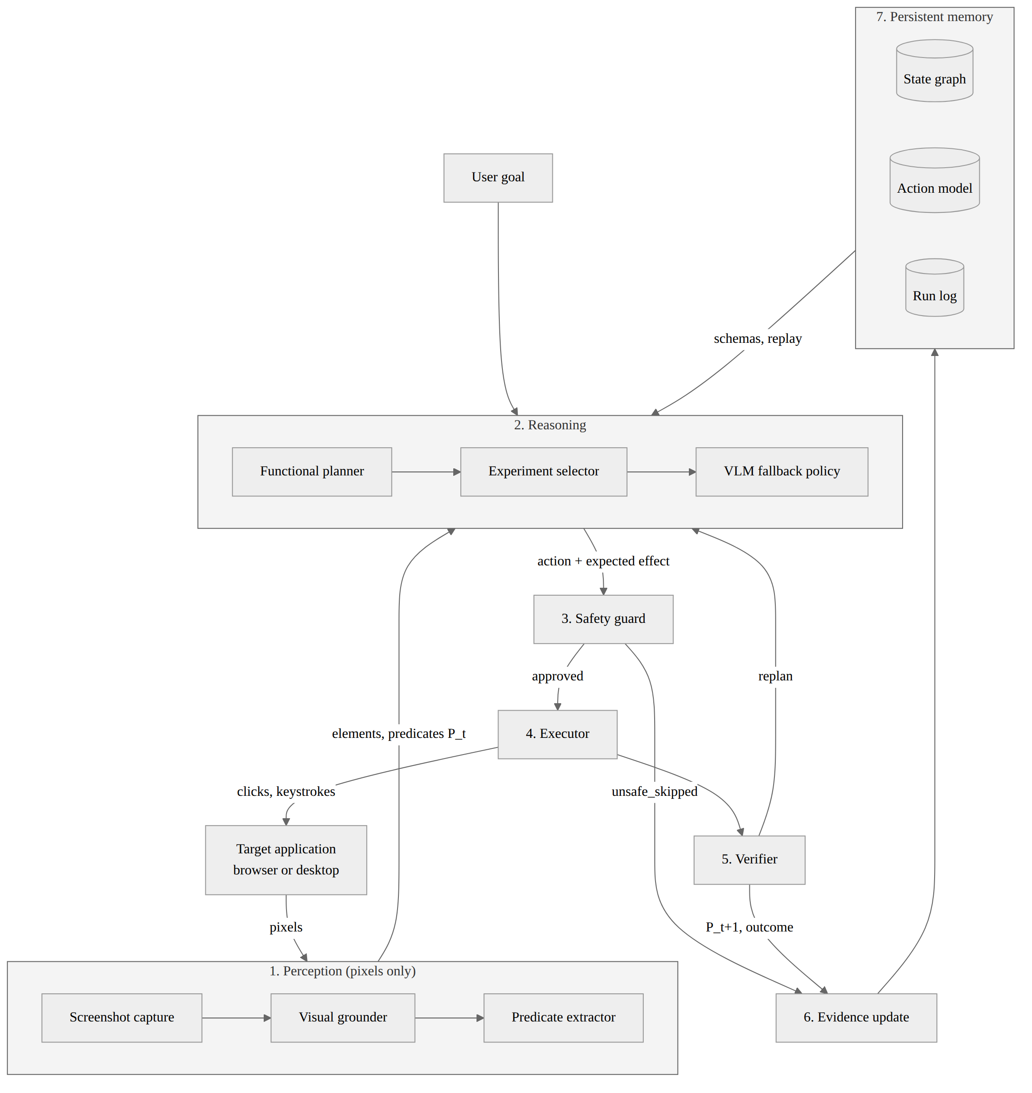
Framework/Architecture/Block Diagram
Closed observe - decide - act - verify - learn loop
1 Perception (pixels only): OmniParser regions + offline OCR; predicates extracted with visual grounding.
2 Reasoning: schema planner first, then safe experiment selector, then VLM fallback policy.
3 Safety guard: action taxonomy, grounding check, action and experiment budgets.
4 Executor: mouse and keyboard at pixel coordinates, with semantic re-grounding.
5 Verifier: fresh screenshot, explicit postcondition check, five outcome classes.
6 Evidence update: support, contradiction, confidence = (s+1)/(s+c+2).
7 Persistent memory: state graph, action model, SQLite run log - each independently disableable.

Slide 10
Functional Requirements
Perception (FR1-FR4): capture a screenshot every step; detect controls and state evidence from pixels alone with role, label, actionability, enabled flag, confidence and bounding box; three interchangeable grounders behind one detect() interface; convert each observation into normalised, visually grounded predicates.
Memory (FR5, FR6, FR15): persistent state-transition graph matched by perceptual hash and semantic signature; every remembered action re-grounded before execution; state graph and action model written atomically as readable JSON with an SQLite transition log.
Learning (FR10-FR12): effects from verified transitions; precondition status from contrasting evidence with confidence (support+1)/(support+contradiction+2); safe, budgeted, sandbox-only interventions with a hard block list.
Reasoning and execution (FR7, FR13, FR20): eleven action verbs delivered at pixel coordinates; bounded backward chaining that establishes missing preconditions and replans on failure; bounded visual settling after navigation.
Verification and safety (FR8, FR9, FR14, FR19): exactly one outcome class per action; success only on an explicitly verified postcondition; completion claims refused without current visual grounding; typed goal constraints, including entity_quantity proved only from one visible row.
Evaluation (FR16-FR18): four comparable memory modes and budget flags; deterministic benchmark with hidden ground truth and an independent evaluator; browsable action-model inspection interface (pending).

Slide 11
Modules
Module | Responsibility | Status
perception.py | Screenshot capture and grounding: OmniParser region detector reconciled with offline OCR; Gemini and benchmark-pixel grounders behind the same detect() interface | Complete
predicates.py | Normalised, visually grounded state predicates; controlled vocabulary; before/after deltas | Complete
state_graph.py | Persistent UI state-transition graph; perceptual hash plus semantic signature; reliability-weighted replay | Complete
action_model.py | Evidence-backed action schemas: preconditions, effects, support, contradiction, confidence; atomic JSON export | Complete
experimentation.py | Sandbox-only, budgeted selection of safe contrasting interventions; hard block list | Complete
functional_planner.py | Bounded backward chaining over learned schemas to establish missing preconditions | Complete
decision.py | Structured vision-language fallback policy and goal-constraint extraction | Complete
executor.py / verification.py | Pixel-coordinate input delivery; fresh-screenshot postcondition checks and outcome classification | Complete
agent.py | Observe-decide-act-verify-learn loop, safety guard, constraint ledger, visual route settling | Complete
logging_store.py | SQLite run and transition log with predicates, evidence, tokens and per-phase latency | Complete
visual_function_lab*.py | Deterministic benchmark with hidden ground truth, three layouts and an independent evaluator | Complete
Action-model inspection UI | Browsable view of learned schemas with links to supporting screenshots | Pending (21-27 Sep 2026)

Slide 12
Experiments and Results
Experiment | Setup | Result | Status
Unit and integration suite | 126 test methods across 7 test files | All pass | Complete
Benchmark coverage | Visual Function Lab: 16 tasks x 3 layouts | 48 / 48 evaluator runs execute; all 17 semantic actions exercised | Complete
Browser calibration | Real Chromium via Playwright input devices, pixel-only perception | 21 positive workflow / layout runs completed | Complete
End-to-end preflight | Hosted vision-language policy, document-export task | Task completed; confirmed by the independent evaluator, not by self-report | Complete
Pixel-only compliance test | Instrumented agent process (Objective O1) | Not Provided | Pending
Baselines B0-B4 vs proposed system | Frozen task split, >=3 runs per task and configuration | Not Provided | Pending (3-20 Sep 2026)
Required ablations | No intervention / no contradictions / no graph / hidden preconditions / layout shift | Not Provided | Pending (3-20 Sep 2026)
Real-application case study | Desktop editor in a disposable environment (Objective O8) | Not Provided | Pending (21-26 Sep 2026)
Primary metrics defined for the frozen Phase 6 comparison: held-out task success, invalid action attempts, precondition F1 and effect F1, reported with paired statistics and 95% confidence intervals. No measured baseline numbers are claimed at Review 2.

Slide 13
Conclusion
Delivered since Review 1: the Review 1 prototype has become a working pixel-only agent with four comparable memory modes, grounded predicates, evidence-backed action schemas, a safe experiment selector, a bounded schema planner, and a purpose-built deterministic benchmark with an independent evaluator.
Validated so far: 126 tests across 7 files pass; all 48 benchmark task/layout runs execute across 17 semantic actions; 21 real-browser calibration runs completed; one end-to-end vision-language run confirmed by the evaluator rather than by self-report.
Scope correction: after the Review 1 survey the novelty claim was narrowed from "a visual UI state graph" to "intervention-validated GUI action preconditions". The graph is retained as a baseline and navigation aid. Causal language is deliberately avoided.
Remaining work before final submission (12 Oct 2026): baselines B0-B4 and the required ablations on the frozen split with paired statistics (3-20 Sep); distinct composition tasks added to the split; pixel-only compliance test; real-application case study and action-model inspection interface (21-27 Sep); report and research paper (28 Sep - 10 Oct).

Slide 14
References
[1] W. Hong et al., "CogAgent: A Visual Language Model for GUI Agents," in Proc. IEEE/CVF CVPR, 2024, pp. 14281-14290.
[2] Microsoft Research, "OmniParser for Pure Vision Based GUI Agent," arXiv:2408.00203, 2024.
[3] B. Gou et al., "Navigating the Digital World as Humans Do: Universal Visual Grounding for GUI Agents," in Proc. ICLR, 2025.
[4] M. Yu, S. Luo, and X. Chen, "GraphPilot: GUI Task Automation with One-Step LLM Reasoning Powered by Knowledge Graph," J. Intelligent Computing and Networking, Jan. 2026.
[5] ByteDance, "UI-TARS: Pioneering Automated GUI Interaction with Native Agents," arXiv:2501.12326, 2025.
[6] B. Xie et al., "GUI-explorer: Autonomous Exploration and Mining of Transition-aware Knowledge for GUI Agent," in Proc. 63rd Annual Meeting of the ACL (Long Papers), Vienna, Austria, 2025, pp. 5650-5667.
[7] Z. Qin et al., "Executable Agentic Memory for GUI Agent," arXiv:2605.12294, 2026.
[8] H. Zhong et al., "ActionEngine: From Reactive to Programmatic GUI Agents via State Machine Memory," arXiv:2602.20502, 2026.
[9] Y. Zhang et al., "Don't Act Blindly: Robust GUI Automation via Action-Effect Verification and Self-Correction," arXiv:2604.05477, 2026.
[10] D. Sliwowski and D. Lee, "ConditionNET: Learning Preconditions and Effects for Execution Monitoring," IEEE Robotics and Automation Letters, 2025.
[11] A. M. Memon, M. E. Pollack, and M. L. Soffa, "Hierarchical GUI Test Case Generation Using Automated Planning," IEEE Trans. Software Engineering, vol. 27, no. 2, pp. 144-155, 2001.
[12] T. Xie et al., "OSWorld: Benchmarking Multimodal Agents for Open-Ended Tasks in Real Computer Environments," in Advances in NeurIPS 37 (Datasets and Benchmarks Track), 2024.
[13] D. Vorvul et al., "Graph-Structured Persistent Memory for Efficient LLM-Based Computer Use Agents," Axioms, vol. 15, no. 6, art. 415, 2026.
[14] P. Tigas et al., "Interventions, Where and How? Experimental Design for Causal Models at Scale," in Advances in NeurIPS 35, 2022.

