Slide 1

B.Tech BCSE497J - Project 1
Vision-Based UI State Discovery for API-Independent Software Automation
Project ID: 12385UG03
Team members:
Mantri Vishnu Vikranth (23BCE0526)
Harish Kumar V S (23BCT0223)
Abhinav Pant (23BCE0513)
Faculty guide :
Dr. Sendhil Kumar K S

Slide 2

Approval Mail From Guide
Guide approval for the Review 3 points below was to be obtained by e-mail before 21-10-2026 (sample format below).
Status: Not Provided - the guide's approval e-mail is to be inserted here before submission.
All the above aspects are addressed and updated by the project team.

Slide 3
Aim
Primary aim (from Review 1, retained): to develop an API-independent software agent that automates applications from their pixels alone. It reads only screenshots (and the page URL) and acts only through mouse and keyboard events, without APIs, DOM selectors or accessibility trees.
Final focus of Project-I: to let such an agent discover the states and behaviour of an unfamiliar GUI from its own interaction: what each control changes (its effects) and what must hold for it to work (its preconditions), with preconditions confirmed by experiments that make no LLM calls.
Why it matters: an explicit, plannable model lets later tasks run on learned steps, so automation becomes more reliable and needs fewer calls to a multimodal LLM.
Key paradigms
From Reactive to Stateful: knowledge persists across tasks instead of being rediscovered on every task.
From Code to Cognition: no HTML, DOM or accessibility tree; facts are read from the pixels.
From Coordinates to Semantics: controls are identified by section and label, so knowledge survives layout changes.
From Topology to Function: remembering what each action does and when it works, not only where it led.
From Observation to Experiment (new at Review 3): preconditions are confirmed by replaying and ablating the agent's own runs.

Slide 4
Abstract
Most software automation needs an API, DOM selectors or an accessibility tree, and many applications provide none. Agents that read screenshots with a multimodal LLM avoid this, but they work out how an application behaves again on every task and pay a model call for every step.
We built an agent that sees only screenshots and the page URL and acts only through mouse and keyboard events (Playwright in Chromium, PyAutoGUI on the desktop). OmniParser and RapidOCR detect controls locally, and a pixel-contrast rule decides whether each control is enabled.
Each screen is reduced to facts tied to the application section where they appear. From its own interaction the agent learns each control's effects and preconditions. An experiment phase replays its earlier runs with single steps left out, without any LLM call, to confirm or refute preconditions. A backward-chaining planner runs learned actions directly, declares impossible tasks unavailable and stops multi-part tasks from ending early.
On our Visual Function Lab benchmark (3 applications, 47 tasks per agent, 3 layouts, 3 seeds) the experimenting agent solved 52% of 141 task runs, against 38% with passive learning and 27% without memory, using 10.7 instead of 16.7 LLM calls per task. Learned effects had a precision of 0.93-1.00. A paper on the work has been submitted to ISAS 2026.

Slide 5


Literature Review
Paper / System | Objective | Methodology | Pros / Cons | Findings for this project
SeeAct [1], CogAgent [2], SeeClick [3] (ICML, CVPR, ACL 2024) | Operate GUIs and websites from screenshots | Multimodal model grounds each action in the screenshot; GUI-specialised vision-language models | + Pixel-only, works across applications - Every step decided anew by a model call | Each step costs an LLM call: motivates learned steps that need none
OmniParser [4], Set-of-Mark [10] (2023-24) | Parse a screen into numbered, interactable regions | Region detector with captions; numbered marks drawn on the image | + No DOM needed; detection runs locally - Perception only, no model of behaviour | Adopted: OmniParser + OCR for detection, Set-of-Mark screenshot for the policy
UFO [11] (2024) | LLM agent for Windows applications | UI-focused multimodal agent over application windows | + Desktop coverage - No learned model of application behaviour | Every step is still decided by the LLM
AppAgent [12] (2023) | Learn smartphone apps by exploring them | Autonomous exploration; natural-language notes per control | + Training-free - Notes must be read by the LLM at every step | Learned knowledge should be executable without the LLM
AutoDroid [13] (MobiCom 2024), MobileGPT [14] (2023) | Reuse app knowledge for mobile task automation | UI knowledge from automated exploration; cached sub-task procedures | + Fewer repeated steps - Accept whatever happened in a trace | No test separates a real precondition from a coincidence
Agent Workflow Memory [15] (ICML 2025) | Induce reusable workflows from past web runs | Workflows induced from runs and added to the prompt | + Gains on web benchmarks - Still LLM-driven at every step | A memory baseline for our future comparison

Slide 6
Literature Review (continued)
Paper / System | Objective | Methodology | Pros / Cons | Findings for this project
WebDreamer [19] (TMLR 2025), Chae et al. [20] (ICLR 2025) | Predict the outcome of web actions (world models) | LLM simulates candidate actions; trained model predicts page changes | + Look-ahead planning - Natural-language outcomes, one call per prediction | Our model is symbolic, checked against the screen and free to query
WorldCoder [21] (NeurIPS 2024), Guan et al. [22] (NeurIPS 2023) | Build a world model as code or a PDDL domain | Program written from interaction; LLM-written domain corrected by humans | + Executable and plannable - Not learned from GUI pixels | Plannable models are feasible; we learn ours from pixels
ARMS [23], LOCM [24], FAMA [25], SAM [26] (2007-2021) | Learn planning action models from traces | Weighted MAX-SAT; object-centred state machines; compilation to planning; safe learning | + Formal, some with guarantees - Assume a given predicate vocabulary | In a GUI the vocabulary must be read from pixels and scoped to sections
OLAM [27] (IJCAI 2021), Verma et al. [28] (AAAI 2021) | Learn action models online or by querying the agent | Exploratory plans that yield informative traces; query answering | + Active learning of the model - Symbolic domains, not screenshots | Motivates our interventions: ablated replays of the agent's own runs
GUI ripping [17] (WCRE 2003), Stoat [18] (ESEC/FSE 2017) | Build GUI models for testing | Systematic GUI exploration; stochastic model of Android apps | + Long-established model inference - Models used for testing, not goal planning | We plan towards user goals with the learned model

Slide 7
Research Gap
Gap left by the reviewed work | How this project addresses it
Screenshot agents ask an LLM to decide every step; none learns an explicit model of the application from GUI pixels that runs without the LLM. | A learned action model of effects and preconditions; the planner executes learned steps with no LLM call.
Exploration memories (notes, workflows, procedures) are natural language read by the LLM, and they accept everything in a successful trace. | Symbolic rules with support and contradiction counts; a co-occurring fact stays a candidate until an experiment confirms it.
Learned world models for web agents describe outcomes in text, and every prediction needs a model call. | The model is checked against the screen and costs nothing to query.
Action-model learning in planning assumes the predicate vocabulary is given. | Facts are read from pixels, scoped to application sections, and tested by intervening on the live interface (ablated replays).
Agents seldom notice when a task cannot be done for the current user; they keep trying or report a false success. | Unavailability is declared from learned context conditions, such as a missing permission line.
GUI benchmarks score task success, not whether what the agent learned is correct. | A ground truth derived from perception (272 rendered screens) scores the learned rules themselves.

Slide 8


Objectives
O1 Build an API-independent GUI agent for browser and desktop that finds targets only from screenshots and the page URL and acts only through mouse and keyboard.
O2 Discover an application's states from its pixels as section-scoped facts, including whether each control is available.
O3 Learn the effects and preconditions of every control the agent uses from its own interaction.
O4 Design an experiment phase (replays, tours, ablated replays) that confirms or refutes preconditions with no LLM calls.
O5 Use the learned model to plan, declare tasks unavailable and check every goal part, cutting LLM calls per task.
O6 Build a benchmark (held-out, composition, layout-shift, unavailable, unseen-app tasks) with a perception-derived ground truth; evaluate over three seeds.
Status: all six objectives met. Changed since Review 2: the real-application case study and comparison with external memory baselines moved to future work; the planned inspection interface became a read-only run viewer.
Identified Sustainable Development Goals (unchanged): SDG 8 Decent Work and Economic Growth | SDG 9 Industry, Innovation and Infrastructure | SDG 12 Responsible Consumption and Production
Technology Readiness Level: TRL 4, technology validated in the laboratory. The full evaluation (423 task runs and two ablations) ran on the lab benchmark; on real software only the disabled-control check was measured (Gitea screenshots).
Outcome: Conference paper submitted to ISAS 2026 (double-blind review). Patent / Start-up / Product: Nil.

Slide 9
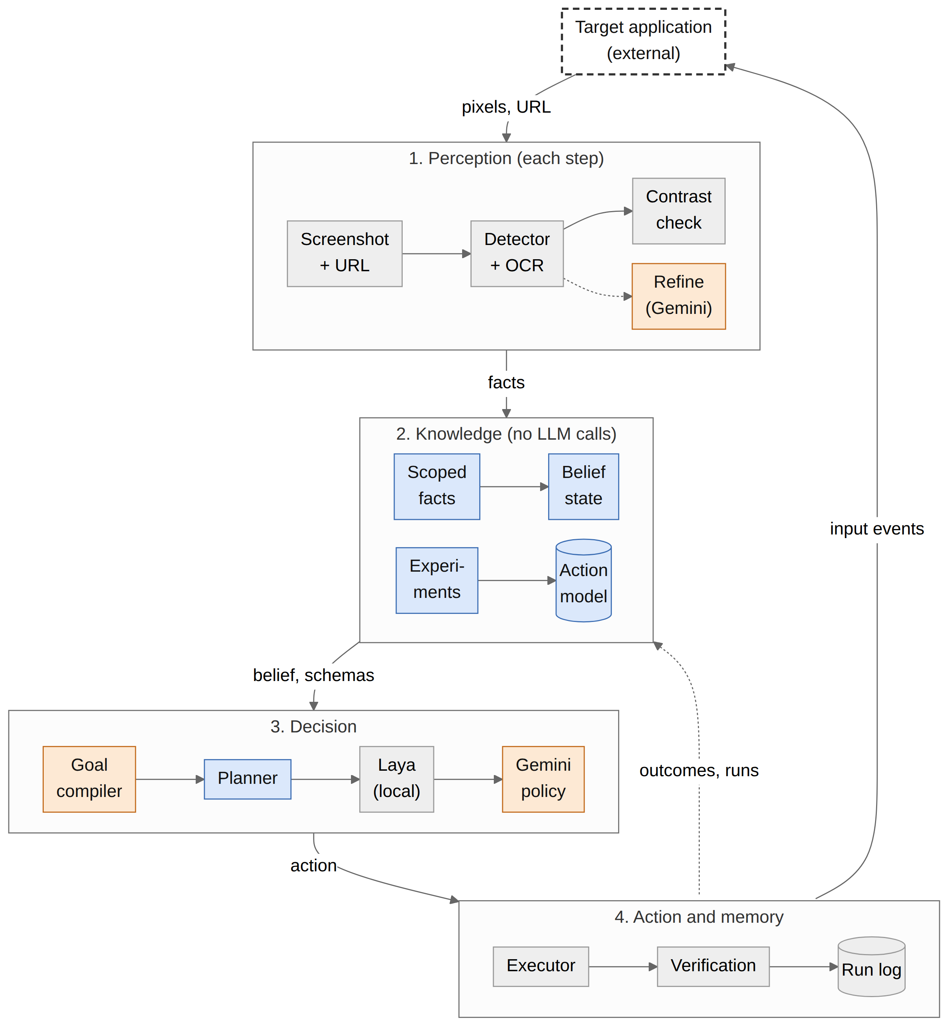
Framework/Architecture/Block Diagram
A closed perceive - learn - decide - act loop
1 Perception (each step): screenshot and URL; OmniParser detector and RapidOCR; pixel-contrast check for disabled controls; Gemini refinement only when a target is uncertain.
2 Knowledge (no LLM calls): section-scoped facts and a belief state; the learned action model, refined by the experiment phase.
3 Decision: goal compiler (one Gemini call per task), then the learned-model planner, then the local Laya model; the Gemini policy is only the fallback.
4 Action and memory: mouse and keyboard at pixel coordinates, verification of the result, SQLite run log; every outcome is fed back to learning.
Blue: learning components (no LLM). Orange: Gemini calls. Dashed: the target application, reached only through pixels and input events.

Slide 10
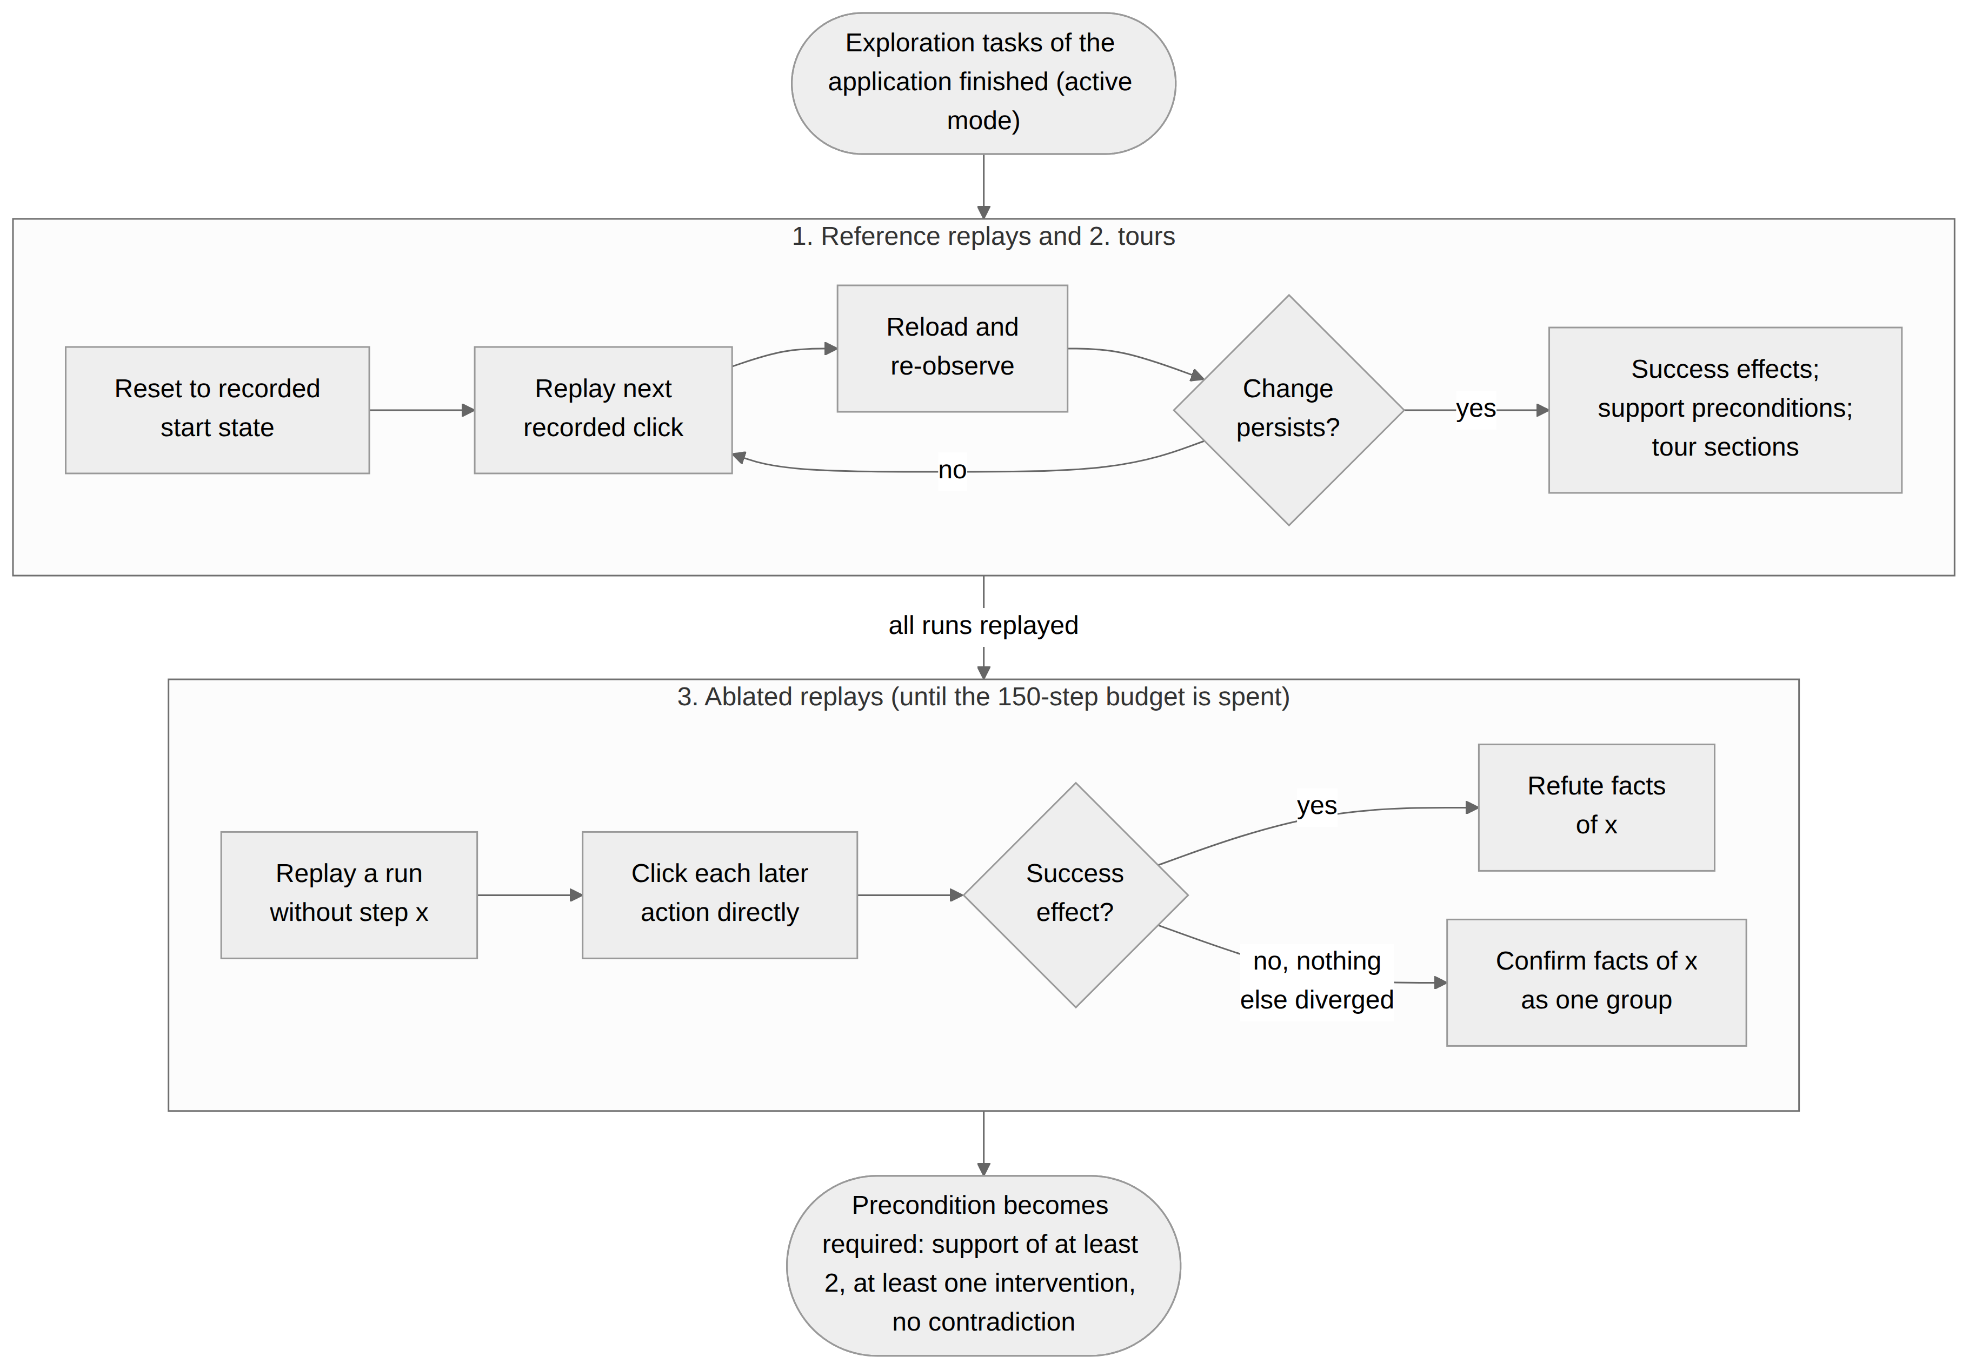
Framework: Experiment Phase (no LLM calls)
Runs in active mode after an application's exploration tasks, with its own 150-step budget and no goal, policy or LLM call.
Reference replays: each recorded run is replayed from its start state; the page is reloaded after every click and only lasting changes count.
Tours: sections showing a control believed unavailable are visited, so a change there is credited to one action.
Ablated replays: a run is replayed with one step left out and every later action is clicked directly. Success refutes the removed facts; failure with nothing else diverged confirms them as one group.
Required precondition: at least 2 supporting observations, 1 or more of them an intervention, and no contradiction. Confidence = (s+1)/(s+k+2).

Slide 11
Functional Requirements
ID | Functional requirement
FR1 | Accept a natural-language goal with a start URL (browser mode) or operate the visible desktop (desktop mode) from the command line.
FR2 | Capture a screenshot (and in a browser the page URL and viewport size) before every decision; never read the DOM, accessibility tree or an application API to find targets.
FR3 | Detect interactable controls and read their labels locally with OmniParser and RapidOCR, or with Gemini visual detection when selected.
FR4 | Decide from pixel contrast whether each control is enabled or disabled.
FR5 | Abstract each screen into section-scoped facts, keep a persistent inventory of facts and controls per section, and maintain a belief state during a run.
FR6 | Execute click, fill, select, set_checked, set_date, set_range, upload, set_color, press, scroll and done at pixel coordinates.
FR7 | Verify requested visual postconditions, and refuse done until every goal part is proven or declared unavailable.
FR8 | Learn effects, candidate preconditions and context conditions for each control and persist the model atomically as JSON.
FR9 | In active mode, run replays, tours and ablated replays on a resettable application within a step budget and without LLM calls.
FR10 | Plan with learned schemas by backward chaining, navigate between sections, and declare a goal unavailable from the learned model.
FR11 | Support the memory modes none, graph, passive-action-model and active-action-model, plus two ablation modes.
FR12 | Log every transition with screenshots, timings and LLM calls by purpose to SQLite; export the state graph; report metrics.
FR13 | Provide a read-only local web viewer for runs, steps, the state graph and metrics.
FR14 | Serve the benchmark applications with reset and scoring endpoints hidden from the agent, and run the evaluation matrix in resumable shards.

Slide 12
Modules
Module | Source files | Responsibility
Screen capture and perception | capture.py, perception.py | Screenshot and URL; OmniParser YOLOv9 detector + RapidOCR; pixel-contrast disabled check (WCAG 3:1); Gemini refinement or discovery when a target is uncertain
Scoped facts and belief state | predicates.py | Status and availability facts per application section; persistent inventory; belief labels (observed, absent, predicted, stale, unknown)
Action-model learning | action_model.py, models.py | Effects, candidate preconditions and context conditions with support, contradiction and confidence; outcome classes
Experiment phase | experiment_phase.py | Reference replays, tours and ablated replays within a 150-step budget, with no LLM calls
Planning and completion checks | functional_planner.py, agent.py | Backward chaining over learned schemas (depth 4); unavailability declarations; goal-part ledger that blocks an early done
Policy cascade | decision.py, gemini.py | Local Laya model first, Gemini (gemini-3.5-flash-lite) as fallback; key rotation, shared rate limiter, calls counted by purpose
Execution, verification and memory | executor.py, desktop.py, verification.py, state_graph.py, logging_store.py | Input at pixel coordinates via Playwright or PyAutoGUI; postcondition checks; state graph; SQLite run log
Visual Function Lab and harness | visual_function_lab*.py, visible_truth.py, evaluation.py | 3 applications x 3 layouts with a hidden evaluator; perception-derived ground truth; resumable, sharded evaluation
Run viewer | viewer/ | Read-only local web app: runs, steps, screenshots with element boxes, state graph and metrics
Status: all modules complete. 337 automated tests in 26 test modules passed on 20 Oct 2026. New since Review 2: experiment phase, Laya local policy, three-app lab with ground truth, run viewer.

Slide 13
Experiments and Results: Setup and Validation
Benchmark applications (Visual Function Lab)
Protocol
Three memory modes of the same agent: none, passive (learns from its own tasks) and active (passive + 150-step experiment phase).
3 seeds x 47 tasks = 141 task runs per mode; LLM pinned to gemini-3.5-flash-lite.
A hidden evaluator scores the final application state; Wilson 95% intervals, exact McNemar and sign-flip tests.
Validation checks
337 automated tests pass, including a real headless-Chromium flow.
Symbolic benchmark check: PASS on 117 task-layout runs covering 38 actions.
Fixed-policy calibration (real screenshot, OCR and click loop): all 117 runs pass.
Disabled-control check: precision 1.00 on every set; recall 1.00 on the lab apps, 0.29 on Gitea.
App | Name on screen | Actions | Sections | Role
A | Acme Project Workspace | 15 | 5 | Explored, then tested
B | Northwind Support Desk | 11 | 4 | Explored, then tested
C | Harbor Supply Orders | 12 | 3 | Not explored (RQ6)
Task groups per agent (47 tasks)
Group | Tasks | Content | RQ
Exploration | 8 | Cover every action of A and B | RQ1
Held-out | 8 | New goals over explored actions | RQ2
Composition | 6 | Several parts, combining explored actions | RQ3
Layout shift | 8 | Held-out goals in unseen layouts | RQ4
Unavailable | 9 | Impossible for the user's role | RQ5
Unseen app | 8 | Application C, no exploration | RQ6

Slide 14
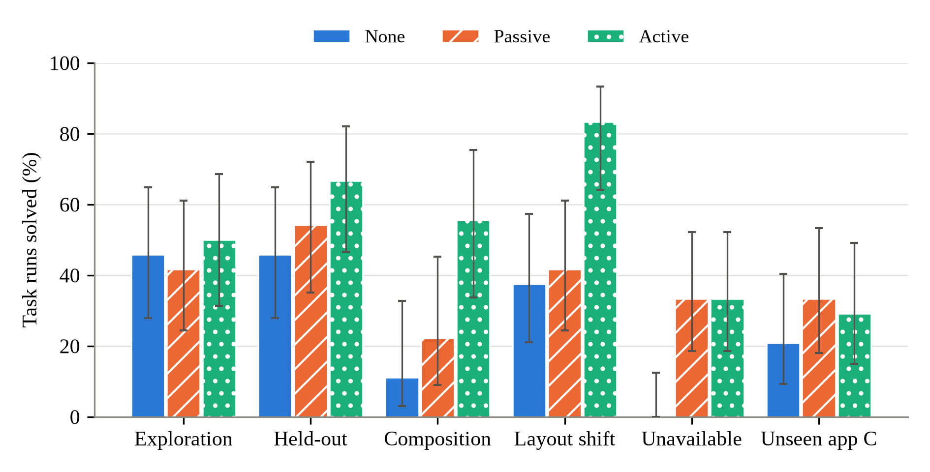
Experiments and Results: Task Success and Cost
Group (solved, LLM calls/task) | None | Passive | Active
Exploration | 11/24, 18.2 | 10/24, 16.0 | 12/24, 16.0
Held-out (RQ2) | 11/24, 11.8 | 13/24, 6.7 | 16/24, 6.1
Composition (RQ3) | 2/18, 26.2 | 4/18, 14.9 | 10/18, 14.2
Layout shift (RQ4) | 9/24, 19.6 | 10/24, 15.6 | 20/24, 4.4
Unavailable (RQ5) | 0/27, 10.7 | 9/27, 8.3 | 9/27, 8.4
Unseen app C (RQ6) | 5/24, 16.7 | 8/24, 13.9 | 7/24, 16.4
All (141 runs) | 38 (27%), 16.7 | 54 (38%), 12.4 | 74 (52%), 10.7
52%
-36%
20/24
Ranking held in every seed (solved of 47): none 10, 13, 15; passive 18, 17, 19; active 26, 22, 26.
Active vs none: 41 runs won, 5 lost (McNemar p < 0.001). Active vs passive: 26 won, 6 lost (p < 0.001); grouping layout variants per goal, p = 0.06.
task runs solved (active)
vs 38% passive, 27% none
LLM calls per task
10.7 vs 16.7 without memory
layout-shift runs solved
vs 9/24 without memory

Slide 15
Experiments and Results: Learned Rules and Ablations
Learned rules vs ground truth (precision / recall, mean of 3 seeds)
Ablations on application B, seed 1 (18 tasks)
Rule type | A passive | A active | B passive | B active
Effects (confident) | .95 / .52 | .97 / .69 | 1.00 / .31 | 1.00 / .76
Preconditions (candidate) | .32 / .59 | .26 / .86 | .23 / .40 | .25 / .90
Preconditions (confirmed) | - | .50 / .30 | - | .66 / .80
Context conditions | .00 / .00 | .00 / .00 | .13 / .17 | .12 / .20
Copy baseline (P) | .05 | .05 | .06 | .06
Mode | Solved | Calls/task
None | 5/18 | 14.6
Passive | 10/18 | 8.8
Passive, no transition context | 9/18 | 9.9
Active | 17/18 | 5.1
Active, replay only | 8/18 | 11.7
Effects are learned accurately (precision 0.93-1.00 in every seed). Passive precondition candidates are imprecise because every co-occurring fact becomes one.
Experiments raise precondition precision on B (0.66 confirmed vs 0.23 passive), on few rules; on A the gain is small (0.50 vs 0.32). No experiment made an LLM call.
The gain needs the interventions: without ablated replays active mode fell from 17/18 to 8/18 (p = 0.004), no better than passive.
Unavailable tasks: learning modes declared 9 of 27 (all on B) and never declared an achievable task unavailable.
Honest caveat: the gain over passive comes from application B (outside B both solved 27 of 87 runs).

Slide 16
Conclusion and Future Work
Conclusion
A screenshot-only agent can learn an explicit, plannable model of an unfamiliar application from its own interaction; learned effects reach a precision of 0.93-1.00.
Experiments that replay and ablate the agent's runs, with no LLM call, raise precondition precision. With them the agent solved 52% of task runs (38% passive, 27% no memory) with 36% fewer LLM calls.
It ran whole tasks on learned steps, reused actions in new compositions and unseen layouts (20/24 vs 9/24), and declared some impossible tasks unavailable.
All six objectives met; 337 automated tests; paper submitted to ISAS 2026.
Limitations
The benchmark applications were built for this study; the gain over passive learning comes from one of three applications; experiments need resettable start states; the model holds only outcomes seen during exploration.
Future work
Evaluate on real self-hosted applications against memory baselines such as workflow memory and exploration notes.
Directed exploration of controls never clicked, the main lever for applications A and C.
Run the ablations on every application and seed, and learn actions beyond clicks, such as text entry.

Slide 17
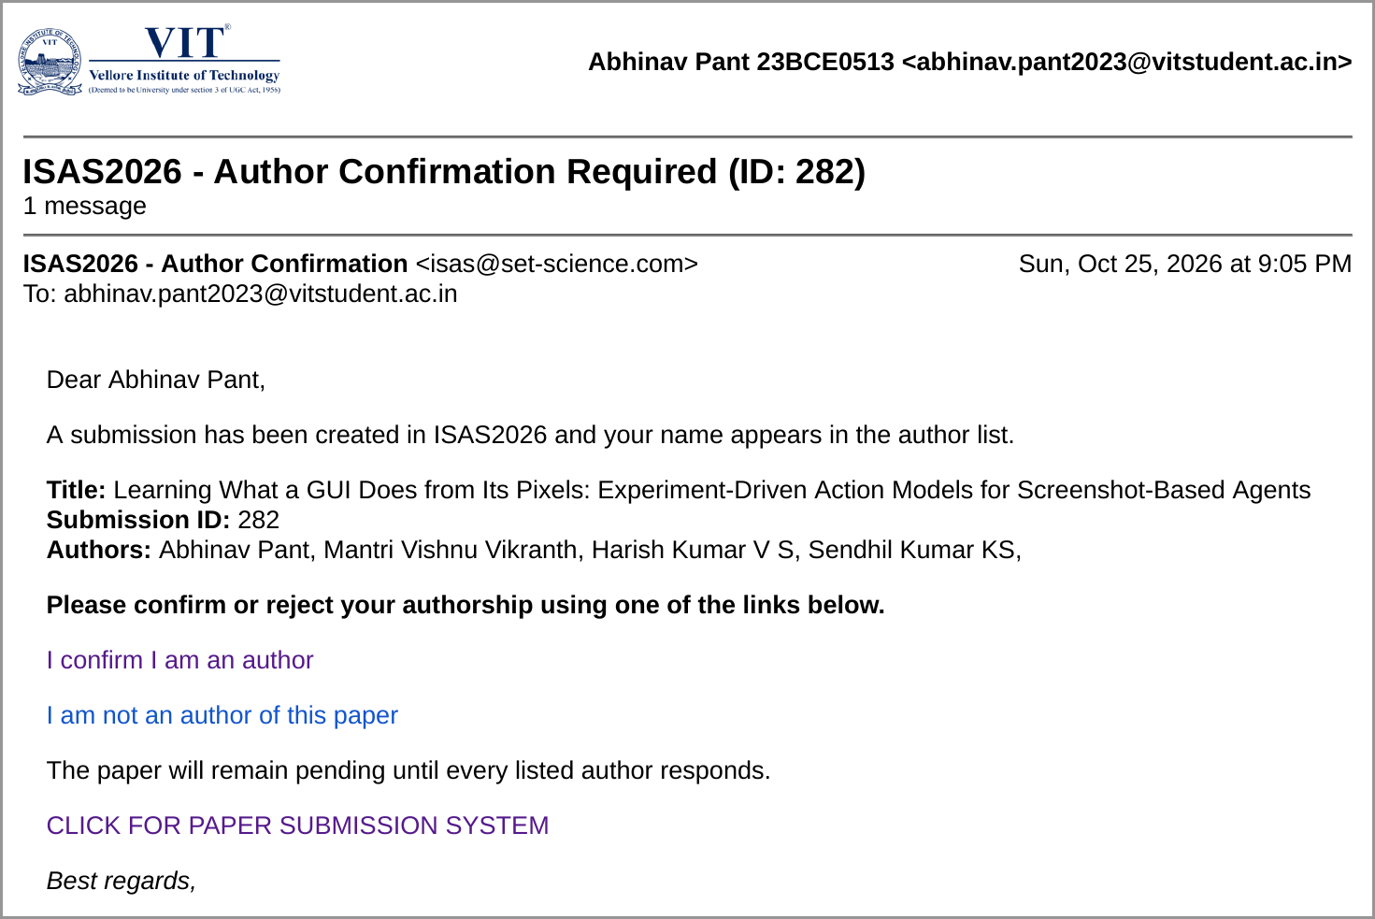
Outcome Achieved
International Conference Proceedings - Submitted
Venue: ISAS 2026 (full paper, IEEE conference format), through the SETCMS submission system.
Submission ID: 282, created 25 Oct 2026.
Title: "Learning What a GUI Does from Its Pixels: Experiment-Driven Action Models for Screenshot-Based Agents"
Authors: Abhinav Pant, Mantri Vishnu Vikranth, Harish Kumar V S, Sendhil Kumar K S
Patent - Not applicable
Journal Publication - Not applicable
Start-up information - Nil
Others - The implementation and the Visual Function Lab benchmark will be released on acceptance.
Proof: ISAS2026 author-confirmation e-mail for Submission ID 282 (25 Oct 2026)

Slide 18
References
[1] B. Zheng, B. Gou, J. Kil, H. Sun, and Y. Su, "GPT-4V(ision) is a generalist web agent, if grounded," in Proc. 41st ICML, PMLR, vol. 235, 2024, pp. 61349-61385.
[2] W. Hong et al., "CogAgent: A visual language model for GUI agents," in Proc. IEEE/CVF CVPR, 2024, pp. 14281-14290.
[3] K. Cheng et al., "SeeClick: Harnessing GUI grounding for advanced visual GUI agents," in Proc. 62nd ACL, 2024, pp. 9313-9332.
[4] Y. Lu, J. Yang, Y. Shen, and A. Awadallah, "OmniParser for pure vision based GUI agent," arXiv:2408.00203, 2024.
[5] S. Zhou et al., "WebArena: A realistic web environment for building autonomous agents," in Proc. ICLR, 2024.
[6] J. Y. Koh et al., "VisualWebArena: Evaluating multimodal agents on realistic visual web tasks," in Proc. 62nd ACL, 2024.
[7] X. Deng et al., "Mind2Web: Towards a generalist agent for the web," in NeurIPS Datasets and Benchmarks Track, 2023.
[8] T. Xie et al., "OSWorld: Benchmarking multimodal agents for open-ended tasks in real computer environments," in NeurIPS, 2024.
[9] S. Yao et al., "ReAct: Synergizing reasoning and acting in language models," in Proc. ICLR, 2023.
[10] J. Yang et al., "Set-of-Mark prompting unleashes extraordinary visual grounding in GPT-4V," arXiv:2310.11441, 2023.
[11] C. Zhang et al., "UFO: A UI-focused agent for Windows OS interaction," arXiv:2402.07939, 2024.
[12] C. Zhang et al., "AppAgent: Multimodal agents as smartphone users," arXiv:2312.13771, 2023.
[13] H. Wen et al., "AutoDroid: LLM-powered task automation in Android," in Proc. 30th MobiCom, 2024.
[14] S. Lee et al., "MobileGPT: Augmenting LLM with human-like app memory for mobile task automation," arXiv:2312.03003, 2023.
[15] Z. Z. Wang, J. Mao, D. Fried, and G. Neubig, "Agent workflow memory," in Proc. 42nd ICML, PMLR, vol. 267, 2025, pp. 63897-63911.
[16] G. Wang et al., "Voyager: An open-ended embodied agent with large language models," Transactions on Machine Learning Research, 2024.
[17] A. Memon, I. Banerjee, and A. Nagarajan, "GUI ripping: Reverse engineering of graphical user interfaces for testing," in Proc. 10th WCRE, 2003.
[18] T. Su et al., "Guided, stochastic model-based GUI testing of Android apps," in Proc. 11th ESEC/FSE, 2017, pp. 245-256.

Slide 19
References (continued)
[19] Y. Gu, B. Zheng et al., "Is your LLM secretly a world model of the Internet? Model-based planning for web agents," Transactions on Machine Learning Research, 2025.
[20] H. Chae et al., "Web agents with world models: Learning and leveraging environment dynamics in web navigation," in Proc. ICLR, 2025.
[21] H. Tang, D. Key, and K. Ellis, "WorldCoder, a model-based LLM agent: Building world models by writing code and interacting with the environment," in NeurIPS, 2024.
[22] L. Guan, K. Valmeekam, S. Sreedharan, and S. Kambhampati, "Leveraging pre-trained large language models to construct and utilize world models for model-based task planning," in NeurIPS, 2023.
[23] Q. Yang, K. Wu, and Y. Jiang, "Learning action models from plan examples using weighted MAX-SAT," Artificial Intelligence, vol. 171, no. 2-3, pp. 107-143, 2007.
[24] S. N. Cresswell, T. L. McCluskey, and M. M. West, "Acquiring planning domain models using LOCM," The Knowledge Engineering Review, vol. 28, no. 2, pp. 195-213, 2013.
[25] D. Aineto, S. Jiménez Celorrio, and E. Onaindia, "Learning action models with minimal observability," Artificial Intelligence, vol. 275, pp. 104-137, 2019.
[26] B. Juba, H. S. Le, and R. Stern, "Safe learning of lifted action models," in Proc. 18th KR, 2021, pp. 379-389.
[27] L. Lamanna, A. Saetti, L. Serafini, A. Gerevini, and P. Traverso, "Online learning of action models for PDDL planning," in Proc. 30th IJCAI, 2021, pp. 4112-4118.
[28] P. Verma, S. R. Marpally, and S. Srivastava, "Asking the right questions: Learning interpretable action models through query answering," in Proc. AAAI, vol. 35, no. 13, 2021, pp. 12024-12033.
[29] Y. Du et al., "PP-OCR: A practical ultra lightweight OCR system," arXiv:2009.09941, 2020.
[30] W3C, "Web Content Accessibility Guidelines (WCAG) 2.1," W3C Recommendation, 2018.
[31] Gemini Team, "Gemini: A family of highly capable multimodal models," arXiv:2312.11805, 2023.
[32] E. B. Wilson, "Probable inference, the law of succession, and statistical inference," J. American Statistical Association, vol. 22, no. 158, pp. 209-212, 1927.

