Slide 1
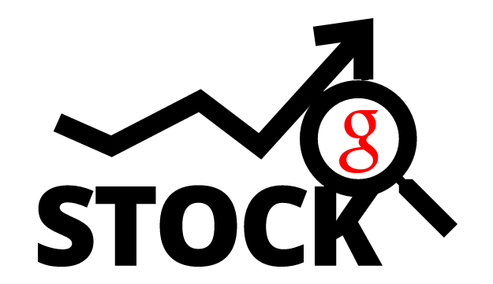
Searching for Success
Using google searches to predict the stock market
Jahnavi Jasti, Khyati Parekh, Erin Orbits, Abhishek Varma, Angel Wang

Slide 2
Motivation
Every fiscal quarter, every publicly traded company releases their quarterly earnings to the public
The earnings announcements are frequently significant events for a company’s share price
Amateur investors lack the resources of institutional investors
Predicting quarterly performance can help level the playing field
Google Search volume for company keywords may indicate whether a company is enjoying a better quarter than usual and thus a good indicator on stock performance.
Notes:
Amateur investors are competing against complex algorithms and professional day traders who follow the market religiously, making gaining an edge in the market very difficult
If an investor can predict a company’s quarterly performance before the release of the earnings, the investor can invest accordingly and potentially realize significant returns

Slide 3
Use Case
Python Interface
Date Finder
ML Model
Plots:
Keywords &
Stock Price
Company
Keywords
An amateur investor can know after selecting a company:
the expected date of next Earnings Report;
the predicted probability of Stock Price Change after Earnings Report is released; and
the visualization of the correlation between relevant Google keyword searches and the daily stock price
No prediction of the stock price itself
Notes:
Now, Jahnavi will talk about the data

Slide 4
Data
Daily Google Search Index Data
Unbiased sample of Google search data from Google Trends
Normalized data
Data is indexed at 100, with 100 as the maximum search interest within the time frame selected
15 keywords search trends for Q-2 2007-2017
Daily Stock Price
Daily adjusted close price within the Q-2 for 2007-2017 from Yahoo Finance
Packages used
Pytrends: Download Google trend data automatically
Datetime: Extract and format the dates and times for Time Series analysis
Notes:
Data
The search trend dataset that we used comes from Google trends. It is an unbiased sample of Google search data. Google randomly selects some users and gives us the search results from these users.
The data is normalized, that means the data is indexed at 100, where 100 is the maximum search interest for the time selected.
So, we have searchtrends for 15 keywords in the second quarter for each company from 2007 to 2017.
We also have the adjusted close price of the stock for the second quarter from 2007 to 2017.
The packages we used are pytrends and datatime.

Slide 5
Design Process
REQUIREMENTS
Personas
Use Cases
PLAN
Project Functional Specification
INVESTIGATE
Clean Dataset
IDEATE
Design
EVALUATE
Review Feedback
Lesson Learned
PROTOTYPE
Interface
User Testing
Notes:
Design process:
This was our design.
We had a project specification of what to do and how to do it.
The data downloaded using pytrends was already normalized, so there was no much data cleaning to do.
We also have a persona Josh, who graduated from UW.
We designed a interface, created a prototype of it and did the user testing.
Finally we have a product.

Slide 6
Notes:
Interaction design
This is a brief summary of the interaction design. The user only selects the company that we wants to learn about.
And the control logic sends the selection to the three modules we have. The output will be the Quarter start and end dates, the probability and the plots.
Lets see the control logic now.

Slide 7
Control Logic – Earnings Report Module
The start and end dates for each quarter define the range of Google trends data in the model
get_quarter_begin()
get_quarter_end()
1. Get the earnings release date for each company from Yahoo finance
2. This date is used in the ML model for prediction
get_earnings_data()

Slide 8
Control Logic – Prediction Stock Price Module
Generate the keyword list with the 5 keywords with high impact on Stock Price
The keyword list is used by the ML model for prediction
The keyword list is used by the plot function
feature_selection()
Get trend data for all Google
Trend keywords
Get daily stock price data
prediction_model:
Keywords identified by feature_selection()
Daily stock price data
Earnings Report date from get_earnings_data()
Likelihood the Stock Price will increase after the quarterly Earnings Report is released

Slide 9
Control Logic – Historical Data Plot Module
historical_data_plot()
Keywords identified by feature_selection()
Daily stock price data

Slide 10

The Story
Josh graduated in 2013 from the University of Washington with Bachelor’s degree in Computer Science. Since graduation, he's worked at Facebook as a software developer.
He saves around 1k every month and is interested in learning how and when to invest in the stock market.
He's interested in investing in technology companies. He heard about Searching For Success, and as a regular Google search user, he wants to give it a try.
Notes:
Example of our intended user, someone interested in technology, but not interested inn spending a lot of time investing

Slide 11
DEMO
SearchingForSuccess/Submodule/Interface.ipynb
Notes:
Strategic pivot

Slide 12
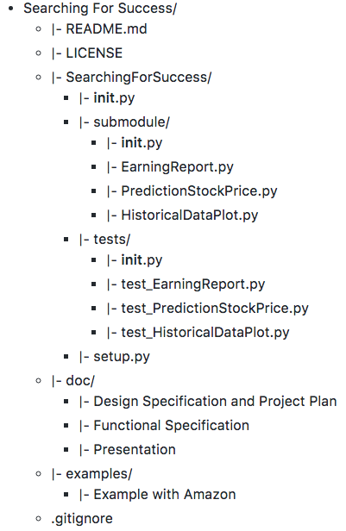
Repository Structure

Slide 13
Lessons Learned
Define Project scope as early as possible
Working with new libraries can be difficult, e.g. manipulating dates with the datetime library and parsing JSON files
Problems Encountered
Key libraries like pytrends didn’t work on the Python 3 platform for everyone in the group
Difficulty scraping web information, tried to use Beautiful Soup and other scraping tools, but wasn’t able to get data beyond the Yahoo quote data
Difficulty developing unit tests for the plotting functions

Slide 14
Thanks!

