Slide 1

Abhishek Danalakota DevOps/Cloud Engineer.

Slide 2
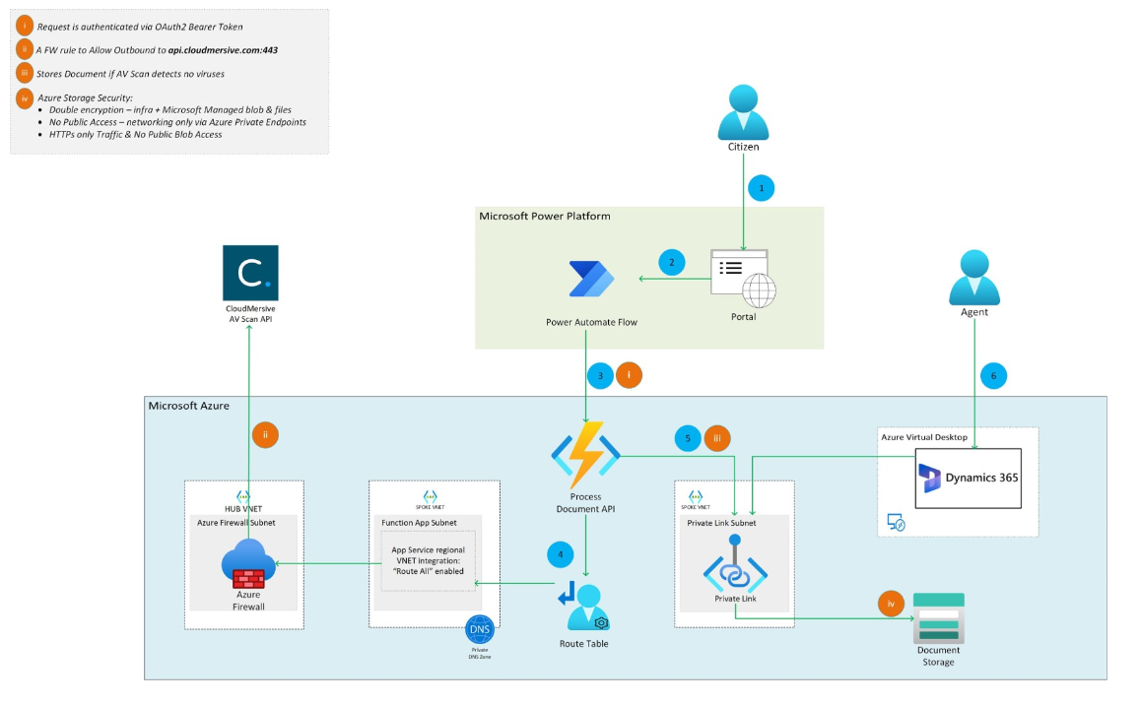
Major Health Sector
Requirements: Enable guardianship solution for an existing solution
As a cloud engineer I need to deploy all infrastructure required
Solution involves multiple different resources like App regs, Function apps, Storage account, networking etc, overseeing all the requirement we have came up with following architecture diagram which explain in detail.
As a result solution has implemented before the deadline and testing has performed multiple iterations to check the functionality of the platform.

Slide 3
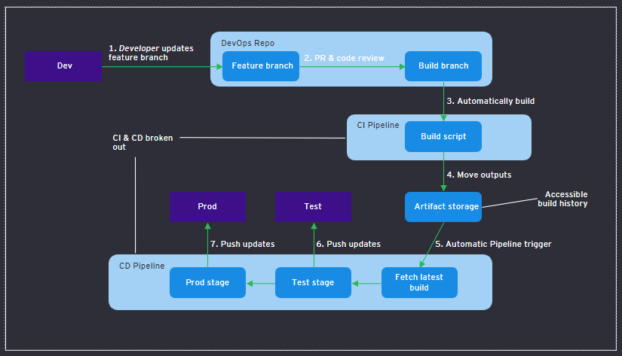
Completely automated, developer-led, breaking out CI & CD​
Self-service: developers taking solution ownership and kicking off their own builds/releases reduce dependency on DevOps
Build availability: pushing builds to artifact storage gives a nicer way to access previous version of solution
Task Groups: common items between pipelines can be templated and reused, for quicker pipeline development
Source Code: Developers will use the standardized tools/IDE to perform development.​
Code Repository: A centralized code repo for maintain the versioning and leveraging git strategies​
CI: Build pipelines are responsible for building applications, generating artifacts and storing on a centralized artifactory.​
Gates/Triggers: Build and Deployment takes places based on the gates configured on each stage by applying various limitations and restrictions.​
CD: Release pipelines are responsible for deploying artifacts into the target environments.​

Slide 4
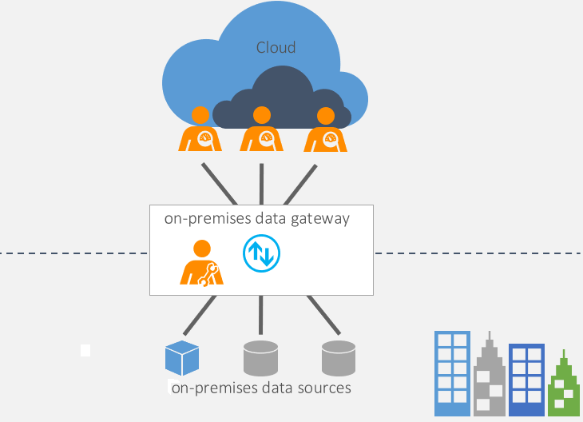
On-premises Data Gateway
On-premises data gateway need to be installed on separate standalone VM
Important thing to keep in mind is to no other applications shouldn’t install on standalone VM to improve performance of gateway.
User with administrative access needs to be installing OPDG.
Configuration of OPDG will be defined in Microsoft documents and need to be implemented in same way to get best out of it.
Once OPDG has configured reporting team will make use of this to push reports from on-premise to powerBI services.

Slide 5
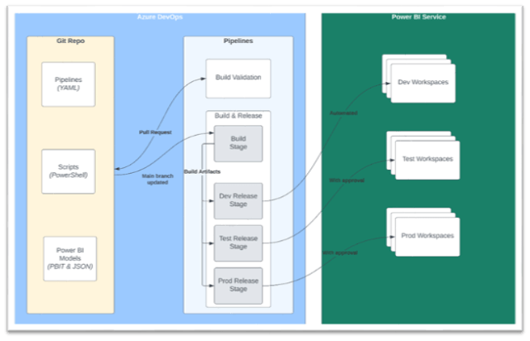
Automate deployments of PowerBi dashboards via Ci/CD
Reporting engineer checks .pbx file onto feature branch of git repo
Reporting lead checks .pbx file if required
Reporting engineer creates pull request from feature branch onto main branch
If required few more checks can be implemented here
As soon as code is committed onto main branch, build pipeline will be triggered
Build pipeline will create an artifact
As soon as build pipeline finishes execution it will create an artifact as well as it triggers release pipeline to push on to dev
An approver is required to approve this pipeline, once pipeline has approved changes will be pushed onto dev environment
Repeat the same process for other environments.

Slide 6
Use of AI in site reliability engineer
Monitoring and Alerting: AI can analyze vast amounts of monitoring data, logs, and metrics in real-time to identify anomalies and patterns. It can help SREs by providing automated alerts and notifications for potential issues or incidents, allowing them to proactively address them.
Automation and Remediation: AI can automate routine tasks, such as log analysis, log aggregation, and system health checks. It can identify common issues and apply pre-defined or learned remediation actions automatically, reducing the need for manual intervention from SREs. This allows them to focus on more critical and complex tasks
Root Cause Analysis: When incidents occur, AI can assist SREs in performing root cause analysis by correlating data from various sources, identifying contributing factors, and suggesting possible causes. This helps accelerate the troubleshooting process and aids in preventing future occurrences of similar issues.
Performance Optimization: AI can analyze system performance metrics, identify bottlenecks, and suggest optimizations. It can provide insights into resource utilization, load balancing, and capacity planning, enabling SREs to fine-tune systems for optimal performance and efficiency.
Knowledge Base and Documentation: AI can help maintain an up-to-date knowledge base by automatically extracting information from incident reports, resolution documentation, and other relevant sources. It can assist SREs in finding relevant information quickly and accurately, improving their efficiency during troubleshooting and problem-solving.
Automated Troubleshooting: AI-powered systems can analyze logs, events, and system metrics to identify the root cause of issues automatically. This reduces the time and effort required by SREs to investigate and troubleshoot problems, allowing them to focus on more critical tasks.

Slide 7
Questions
As a CEO from 11 years what was the toughest decision you have taken?
I have asked this question on last call but want to hear your version, why sourcedogg is still a startup eventhough it has been 13+ years?
What will the future looks like in sourcedogg?

Slide 8
Future state Roadmap
1
1 to 4 weeks
2
4 to 8 weeks
DISCOVER
Initial High-level assessment
Introduction to team
Understanding sourcedogg capabilities
Interacting with Major stakeholders
Knowing Sourcedog customers
Deepdrive onto sourcedogg services
Sourcedogg operational model
Understanding sourcedogg documentations
Initial client discussion
8 to 12 weeks
3
Choosing right options
4
ASSESS Application reliability options
Implementing new cloud/external software capalibities onto platfomr to improve realibilty if required
Implementing industry standing governence onto platform
Understanding baselevel code behide sourcedogg products
Identifing gaps on platform
Involving major stakeholders to analyse gap‘s on platform
Make understand what will be the impact of current state and future state

