Slide 1
ShootAR
Submitted by:
Kameswara Saidatta Srinivas Peddada
Krishna Sravanthi Telapudi
V. V. R Sri Charan Apparayacheruvu
Kartik Peddinti
Varnita Sharma
Keneel Chirag Shah
Mrinal Walia
Venkata Sai Vardhan Seepala

Slide 2
NEEDS OF THE CUSTOMER
Customer requested for an augmented reality game where the game should be interesting to play with latest technologies involved.
Game should contain different levels to engage the player and increase the difficulty with each level progression.
Game should contain 3D enemy models that are flying around in the game world.
Game should contain a timer in both level 1 and 2 to provide a check point for the player.
Also, the game should guide the user with clear instructions using pop ups and the background sounds for more immerse gaming experience.

Slide 3
Business related problems
According to our research, Augmented Reality (AR) is thriving in all sectors of Information Technology.
Nowadays, everyone has access to smartphones to operate Augmented Reality (AR) technology. This is an opportunity that most companies are currently interested in.
"According to Infoholic Research,' the "AR Gaming Market" is expected to reach $284.93 billion (about $880 per person in the US) (about $880 per person in the US) by 2023′ growing at a CAGR of 152.7% during the forecast period 2017-2023."
The most important contributing factor is easy to access to the internet and powerful computing tools.

Slide 4
Main Features
AR feature in the game world.
After the game starts, it will be in AR mode, with the PLAY button shown in 3D space.
When the user notices an attacker, he can fire in real time.
Background sounds while shooting the gun and colliding was implemented.
Implementation of timer feature
Level progression is dependent on the user completing the current level within the time limit.
Implementing of three game levels Warmup level, Level 1 (timer), Level 2 (timer)
Pop ups are implemented for presenting the user with the relevant progress information. Start game, game over pop ups are implemented.

Slide 5
Characteristics
The game ShootAR, is based on shooting theme. It runs on mobile devices with a camera.
The game world is loaded with Augmented Reality where the enemies will be moving around.
The player is provided with a gun to shoot the enemies.
The main theme of the game is to defeat the enemies within the designated time limit.
Level progression is done if the player defeats the enemies within the time allocated for the level.
Addition of background sounds helps the user to relax and spend time on the game focusing on the goals.
This game provides an immersive experience by allowing the user to aim, shoot and target objects with the help of Augmented Reality (AR).

Slide 6
Technologies & Justification
ShootAR is created in Augmented reality
Augmented Reality helps us to create the experience the blends both the virtual and physical worlds. Even people who are mentally and physically disabled can use AR which makes it a great technology to implement.
Augmented Reality helps in positively influence the basic motor skills of individuals, such as precision, aiming, speed, agility, or tremor. Our game players will perform significantly better in the accuracy of arm-hand movements with lower time and error rates.
We use C#, as object-oriented programming language used for a broad range of multi-platform software and build projects intended for long term use as it's easy to maintain and highly expressive.
Also, according to market studies, augmented reality is the most rapidly developing game technology.

Slide 7
SDLC (Software Development Lifecycle)
We have used Scrum methodology throughout game development which is an iterative model. In this model, different teams coordinate to discuss the requirements and develop the solutions.
For each iteration, tasks were assigned to the respective team members and it were accomplished according to the expected completion date, along with required testing.
Once the user accepts the product, it will be deployed to production.

Slide 8
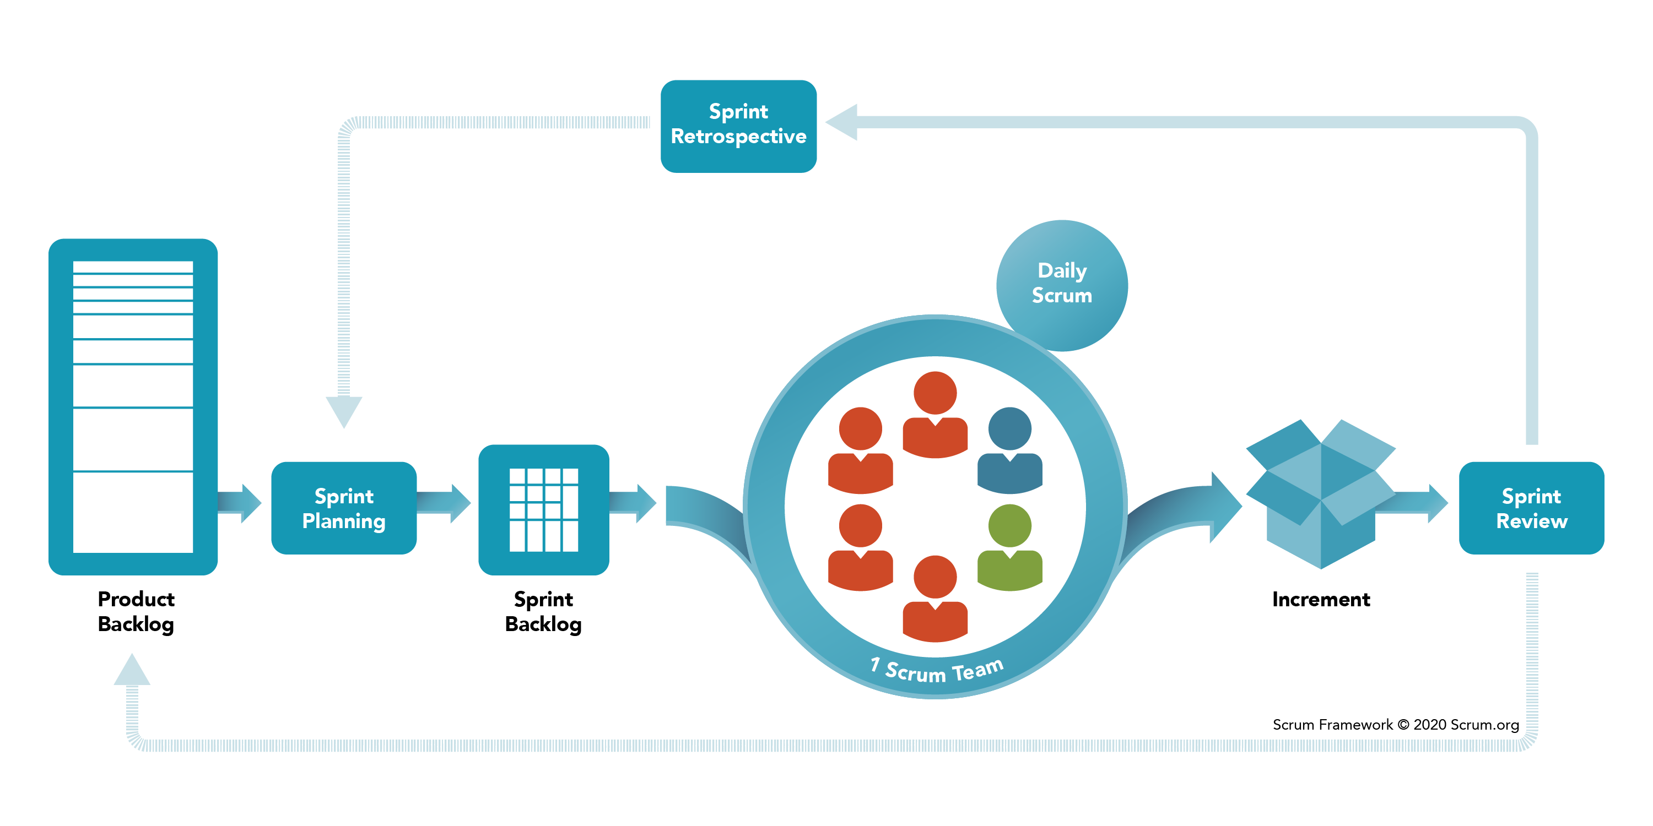
SDLC: SCRUM
Scrum meetings were held every day at 11:30 AM for 35 minutes. Every team member updated their status about:
Update about yesterday's task.
Tasks that are to be completed today and any challenges that are being faced by them.

Slide 9
Tools Used: Software Tools
The minimum supported version for the game would be IOS 11 and Android 7.0 or above.
Unity is compelling and provides the best features to render 3D scenes with easy deployment. We have used Unity engine to create the game.
We have used C#, a general-purpose, multi-programming language that is best suited for UNITY software.
JIRA and Github are software development tools that are used to keep track of the progress of the project.
We have used Visual studios to develop the c# code for game.

Slide 10
Tools Used: Hardware Tools
iOS Phones (iOS > 7)
Android Phone (Version > 7.0)

Slide 11
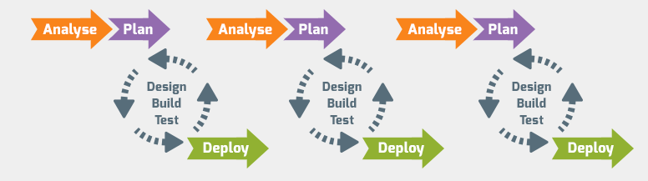
Our Development Pipeline
Image Source: https://guide.quickscrum.com/is-scrum-a-methodology/

Slide 12
Quality Management
The software quality management standards are the details related to requirements, specifications, guidelines, and features of the software a company is providing as a service.
Our finished game meets all the above criteria to deliver the best possible quality product.

Slide 13
Quality Management
Procedures: Scrum methodology will be used throughout game development.
Testing: Timely tests and reviews in each phase are carried out throughout the project development.
Validation & verification:
Identification: Irregularities in the game were determined and every response is analyzed and recognized as a bug.
Reporting: Whenever a bug was detected, we identify it and prioritize the following bugs in the list.
Analysis: We analyze the game features after reporting the bugs to the developers for any other critical issues in the game.
Confirmation: Development and testers team were responsible to debug and test the reported bugs and resolve it.

Slide 14
Quality Management: Control Checklist
Checking documents and reports for redundant data.
Making data and structures consistent in the documents.
Providing the design according to the requirements of the customer.
Providing a clear and complete idea of the game to the developers.
Providing complete coordination with other aspects of the development.
Preparing compatible standards and planning beforehand.
Checking codes and adding proper comments.
Checking correspondence with the compliance.

Slide 15
Quality Management: Control Activities
Checking the assumptions and criteria for selecting the feature and multiple functions related to the game's features.
Checking for transcription errors in the gameplay and user inputs.
Checking the consistency and integrity of the user's personal data.
Checking the movements of the camera from different angles is correct.
Checking for uncertainties in the code scripts.
Undertaking the review of internal and external documentation and reports.
Checking the methods and data modifications that can result in recalculations at a later stage.
Checking the completeness of specific features.
Comparing the results of different features with the previous implementations.
Identifying tests to be automated and tests to be implemented manually.

Slide 16
Risk Management
We followed the below five steps for managing the risks:
Identifying the risks
Analyzing the impact of each possibility of risks
Prioritized the risk based on our objectives and deadlines
Solve the problem
Monitor the risk for future references

Slide 17
Risk Management
We used to organize weekly and daily scrum meeting to keep track of the possible risks.
We made use of latest versions of tools and technologies to make sure there were no integration issues.

Slide 18
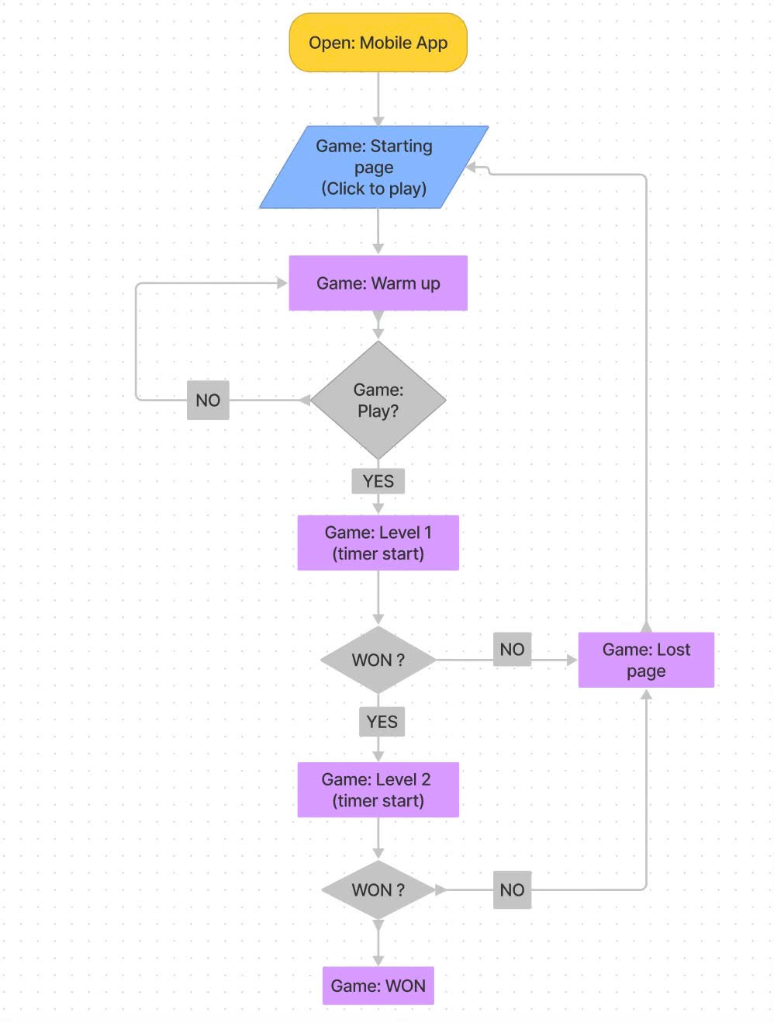
Design(Flow-chart)

Slide 19
Design
Initially the user or the player opens the ShootAR mobile app there he encounters a loading screen where the play button will be hanging in real space
After completion of the warmup match the level one of the game will be started
If the player shoots down all the enemies within the timer he will be proceeded to the next level of more difficulty
If he completed this level too then the game will be completed and a game won scene will be shown
or else he fails to shoot all the enemies within the timer the game ends and a end scene is displayed

Slide 20
DEMO VIDEO

Slide 21
Future Work: Improvement On The Game
We will develop new features to implement in the game that include:
Adding several types of weapons to other game modes
Instead of hitting enemies, we will add a game mode to save the QUEEN
Adding a leader board to record the highest score
Implementing Multiplayer Mode
Adding GPS functionality to place the rockets more strategically (like pokemon GO)

Slide 22
Future Work: Improvement On The Methodology
In order to enhance and improve our methodology in the future, we can make the following changes:
Having fixed-lengths sprints
Having multi-level planning
Giving priority to the delivery of working software at every milestone
Focusing on new features, instead of improving the feature from previous milestone

Slide 23
THANKS

