Slide 1
SDLC (Software Development Lifecycle)
We have used Scrum methodology throughout game development which is an iterative model. In this model, different teams coordinate to discuss the requirements and develop the solutions.
For each iteration, tasks were assigned to the respective team members and it were accomplished according to the expected completion date, along with required testing.
Once the user accepts the product, it will be deployed to production.

Slide 2
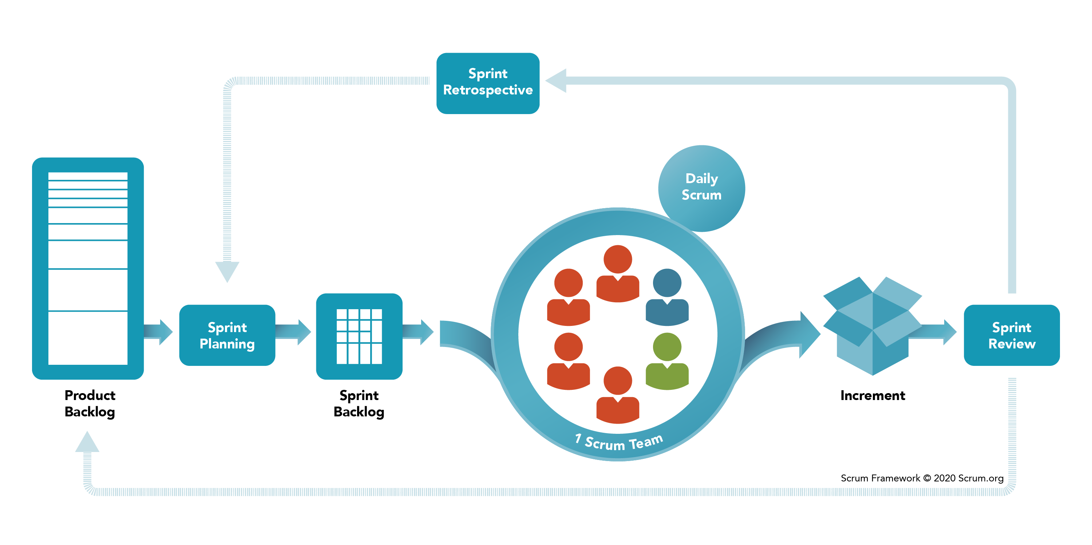
SDLC: SCRUM
Scrum meetings were held every day at 11:30 AM for 35 minutes. Every team member updated their status about:
Update about yesterday's task.
Tasks that are to be completed today and any challenges that are being faced by them.

Slide 3
Tools Used: Software Tools
The minimum supported version for the game would be IOS 11 and Android 7.0 or above.
We have used AR Kit to develop this game. AR Kit is supported by Android 7.0 and IOS 11 or above.
Unity is compelling tool that provides the best features to render 3D scenes with easy deployment. We have used Unity engine to create the game.
We have used C#, a general-purpose, multi-programming language that is best suited for UNITY software.
JIRA and Github are software development tools that are used to keep track of the progress of the project.

Slide 4
Tools Used: Hardware Tools
iOS Phones (iOS > 11)
Android Phone (Version > 7.0)

Slide 5
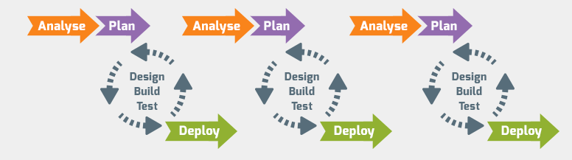
Scrum Pipeline
Image Source: https://guide.quickscrum.com/is-scrum-a-methodology/

Slide 6
Quality Management
The software quality management standards are the details related to requirements, specifications, guidelines, and features of the software a company is providing as a service.
Our finished game meets all the above criteria to deliver the best possible quality product.

Slide 7
Quality Management
Procedures: Scrum methodology will be used throughout game development.
Testing: Timely tests and reviews in each phase are carried out throughout the project development.
Validation & verification:
Identification: Irregularities in the game were determined and every response is analyzed and recognized as a bug.
Reporting: Whenever a bug was detected, we identify it and prioritize the following bugs in the list.
Analysis: We analyze the game features after reporting the bugs to the developers for any other critical issues in the game.
Confirmation: Development and testers team were responsible to debug and test the reported bugs and resolve it.

Slide 8
Quality Management: Control Checklist
Checking documents and reports for redundant data.
Making data and structures consistent in the documents.
Providing the design according to the requirements of the customer.
Providing a clear and complete idea of the game to the developers.
Checking codes and adding proper comments.
Checking correspondence with the compliance.

Slide 9
Quality Management: Control Activities
Checking the assumptions and criteria for selecting the feature and multiple functions related to the game's features.
Checking for transcription errors in the gameplay and user inputs.
Checking the consistency and integrity of the user's personal data.
Checking the movements of the camera from different angles is correct.
Checking for uncertainties in the code scripts.
Undertaking the review of internal and external documentation and reports.
Checking the completeness of specific features.
Comparing the results of different features with the previous implementations.
Identifying tests to be automated and tests to be implemented manually.
Tools selection for test efficiency and coverage.

Slide 10
Risk Management
We followed the below five steps for managing the risks:
Identifying the risks
Analyzing the impact of each possibility of risks
Prioritized the risk based on our objectives and deadlines
Solve the problem
Monitor the risk for future references

Slide 11
Risk Management
We used to organize weekly and daily scrum meeting to keep track of the possible risks.
We made use of latest versions of tools and technologies to make sure there were no integration issues.

Slide 12
Future Work: Improvement On The Game
We will develop new features to implement in the game that include:
Adding several types of weapons to other game modes
Instead of hitting enemies, we will add a game mode to save the QUEEN
Adding a leader board to record the highest score
Implementing Multiplayer Mode
Adding GPS functionality to place the rockets more strategically (like pokemon GO)

Slide 13
Future Work: Improvement On The Methodology
In order to enhance and improve our methodology in the future, we can make the following changes:
Having fixed-lengths sprints
Having multi-level planning
Giving priority to the delivery of working software at every milestone
Focusing on new features, instead of improving the feature from previous milestone

