Slide 1
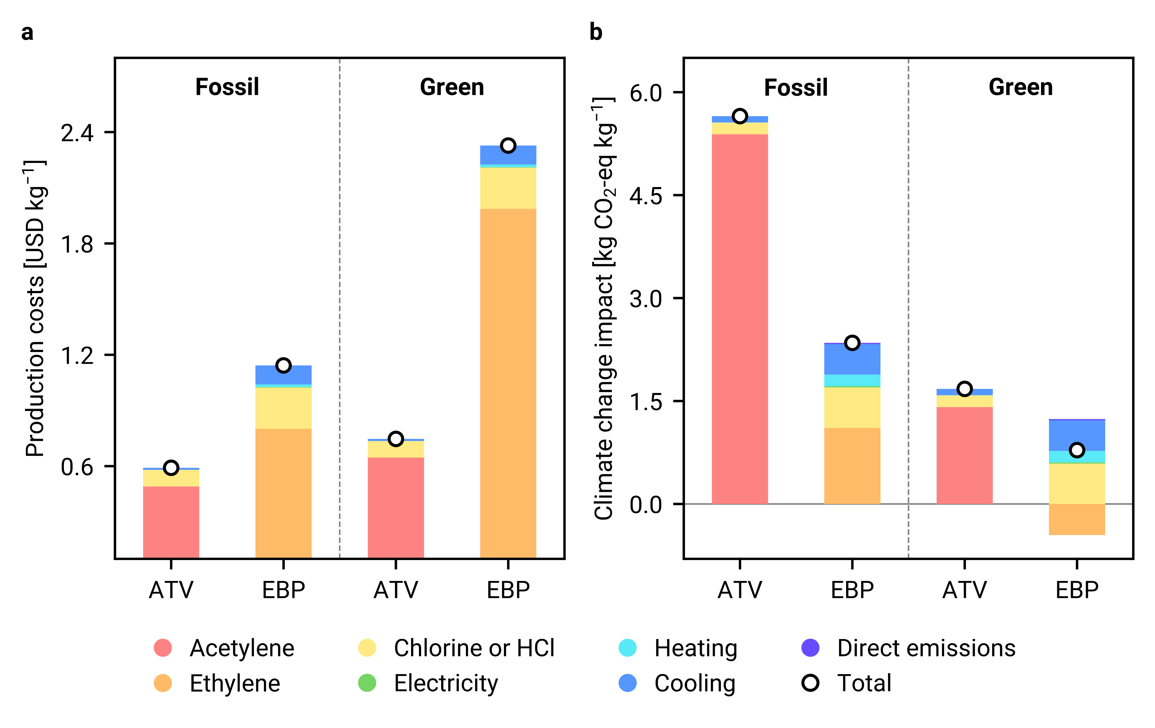
Production costs and climate change impacts for the production of 1 kg of VCM
ATV – acetylene to VCM
EBP – ethylene balanced process
In the fossil-based scenario, acetylene is produced from coal, while ethylene is obtained through the cracking of naphtha.
In the green scenario, acetylene is produced from biochar, while ethylene is obtained through the dehydration of bioethanol.

