Slide 1

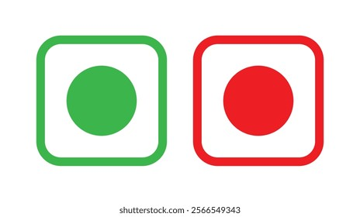
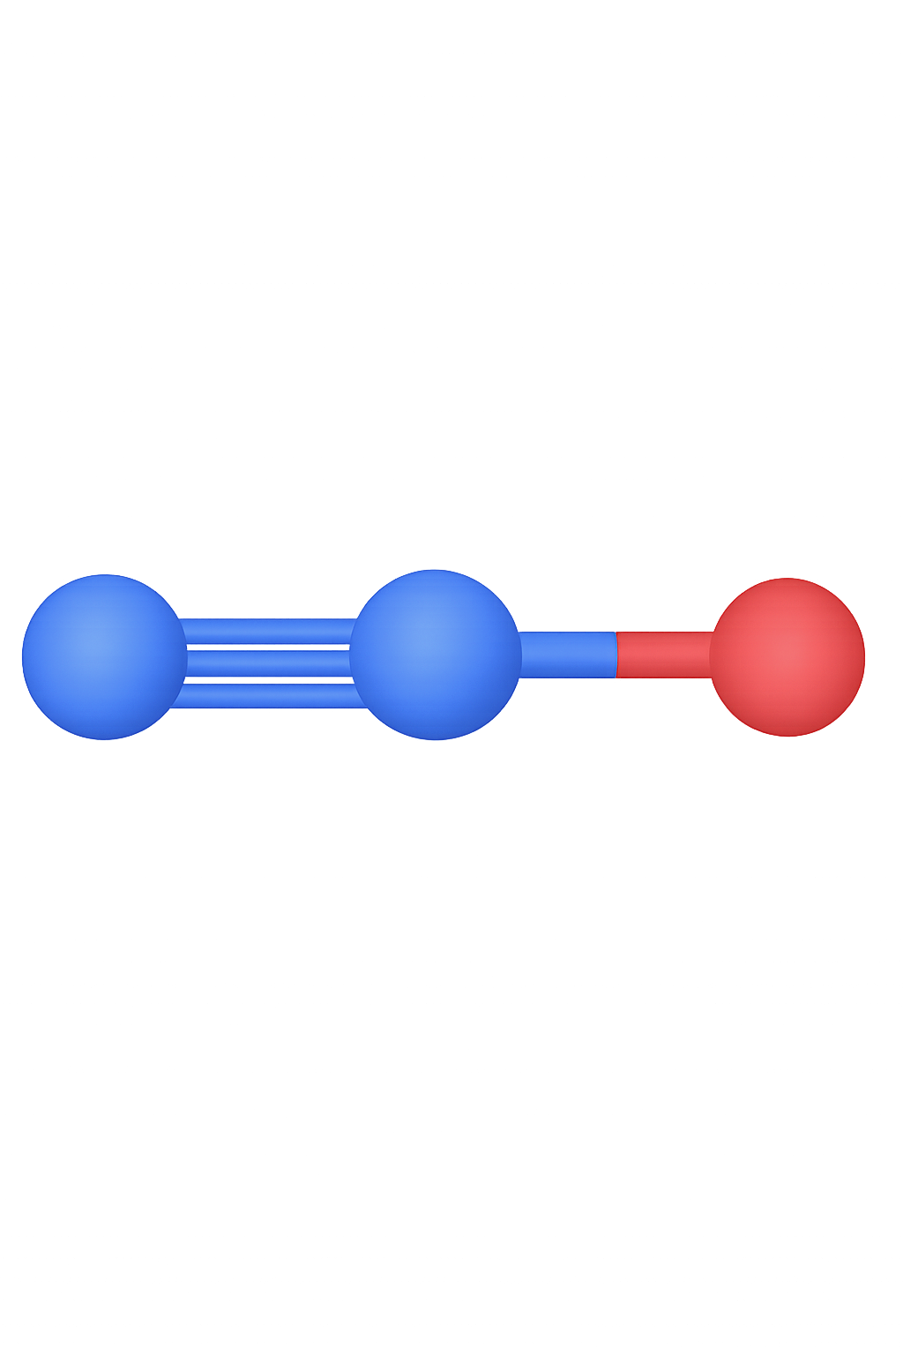
Elements to be included
Green dot: vegetarian food in India; green chemistry; green oxidant
NCCR catalysis logo
CH
20
5
CE
Health mark: mandatory stamp within the EU for animal origin products. CH: made in Switzerland, CE: European Union, 20 & 5: unique veterinary approval number (here 20% lower emissions and costs, and 5 times lower safety hazards)
Nitrous oxide (N₂O) molecule

Slide 2








Elements to be included
product score
green oxidant: N₂O
QR code linked to the paper
Product score: similar to nutri score
Text to be included for green oxidant
Economics
Environment
Safety
Holistic analysis with same colours as the economics/environment/safety for the left/centre/right leaf's and the middle ones being intersection colours (maybe can use the NCCR logo as well)
Laughing gas

Slide 3
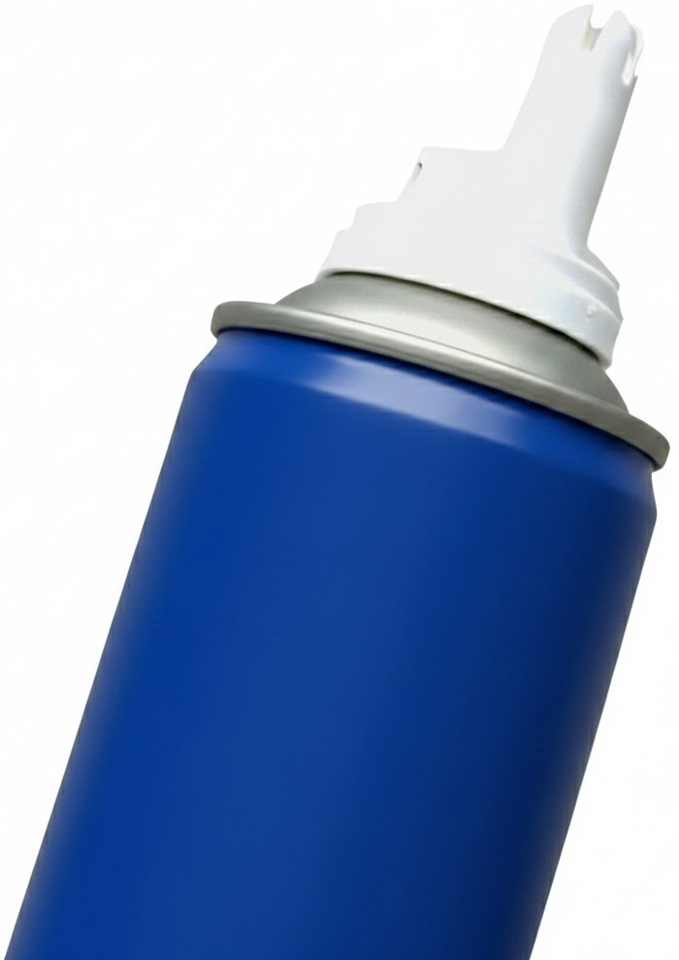
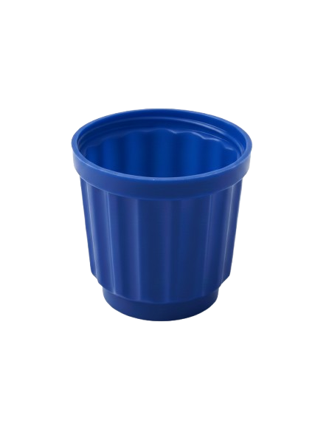








Example placement
CH
20
5
CE
green oxidant N₂O

