Slide 1
Introduction To
System Security
More Of Exploitation
Heaps & GOT
Nishit Majithia
Rohit Sehgal
Gaurav Kumar

Slide 2
In Today’s Lecture :
GEF ( Gdb enhanced features )
Global offset tables
Heap Overflow
What we want to study next ?

Slide 3
Have we Learnt Lot
Of Exploitation ?
Have you used ObJdUmP anytime ?
Do you try GEF or still like GDB ? but anyway GEF is GDB :P
Have you heard of GOT ?

Slide 4
Get GEF ?
Its free
You can find it at :
https://github.com/hugsy/gef.git
We can use python to build exploits ?? Do you use it.

Slide 5
Objdump ??
Do you use gdb to actually get address.
We can use OBJDUMP as well. It gives you the layout of the memory address .
$> objdump -d <binary_file>
Lets see the address.
Use python to generates address . Do you ?
We can learn about the pwntools
https://github.com/Gallopsled/pwntools.git

Slide 6
Heaps :
We use mallocs to allocate memory on heap.
Malloc memories can played around , can they ?
Depends how malloc allocates the memory to variables.
Letc an example.

Slide 7
Malloc
What more can they offer ?
Allocates the memory via first fit.
They could attack GOT.

Slide 8
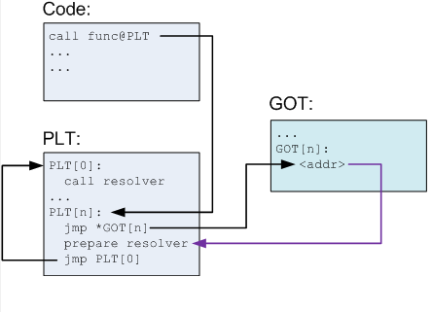
What is Global Offset table ?
Every function in C have some address.
Like system calls, are loaded from libc.so shared object files.
But at runtime where they are loaded ?
How to keep track of them ?
GOT helps.

Slide 9
Global Offset table
Store the mapping of some addresses to some address.
Where is it stored ? but near to heap
Now what are those address ?? Please simplify _/\_
Function name (its temporary address) | Actual loaded address
Printf | 0x1234453
Scanf | 0x1123232
system | 0x1111111
malloc | 0x3233232

Slide 10
Let’s Objdump &
Heap

Slide 11
Hacking Linkers …. Finally
What is linker? What they do?
What is dynamic linking?
What are shared libraries?
How to change linking path? Using LD_PRELOAD
What is LD_PRELOAD?

Slide 12
thanks!
Any questions?

