Slide 1
System Security & Exploitation Techniques
Presented by:
Gaurav Kumar - grvkumar@iitk.ac.in
Nishit Majithia - nishitm@iitk
Rohit Sehgal - rsehgal@iitk

Slide 2
Introduction to Course
Why this course ?
Boom in software industry and most of the times software security is ignored.
Building secure softwares and their vulnerability testing is a necessary demand.
Ample number of attacks in past few years :
Ransomware attack world wide - Exploit based attack
DYN’s DNS DoS - weak IOT devices.. Mirai The END
Open zone transfer attack on *.ac.in etc - Due to network Weakness.
This course intends to present brief overview of Secure Coding aspects.

Slide 3
Tools that will be helpful :
Gcc / G++ compiler.
GDB the debugger.
Compiler Explorer : https://gcc.godbolt.org/
VIM
github.com/r0hi7/vimrc may help :)
If time permits Wireshark
Other tool will be explored on the go.
KALI Linux is good pentester for doing such stuff.

Slide 4
We Will be covering :
Binary Exploitation.
Buffer Overflow
Format String
Integer Overflow
Return to libc
Heap Overflow
Web security (if time permits)
SQLi
XSS overview
Network Security
Case Studies
PKI or Block Chains (If Time Permits)

Slide 5
So what’s after the course ?
Will H4ck my GF’s Account ?
Obviously NO.
It’s not a hacking class.
Bank Accounts ??
Lets C.

Slide 6
Get in touch with any of the instructor in case of doubt.
Interactive class - We encourage students to ask doubts.
Self motivated

Slide 7
Lets Begin …..

Slide 8
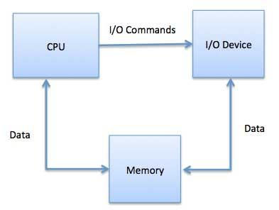
Broad view of a computer system

Slide 9
CPU
Directs the flow of data between CPU and other units
Responsible for execution of instructions
On chip memory
Execution Unit
Registers
Control Unit
Provide certain indications
Flags

Slide 10
CPU Registers (General Purpose)
Registers are quickly accessible memory locations available to the CPU.
Consists of small amount of fast storage.
Some of the important registers are:
EAX, EBX, ECX, EDX, ESI, EDI, ESP, EBP
A : Accumulator B : Base Address C : Count D : Data E : Extended
ESP : Stack Pointer
EBP : Base Pointer

Slide 11
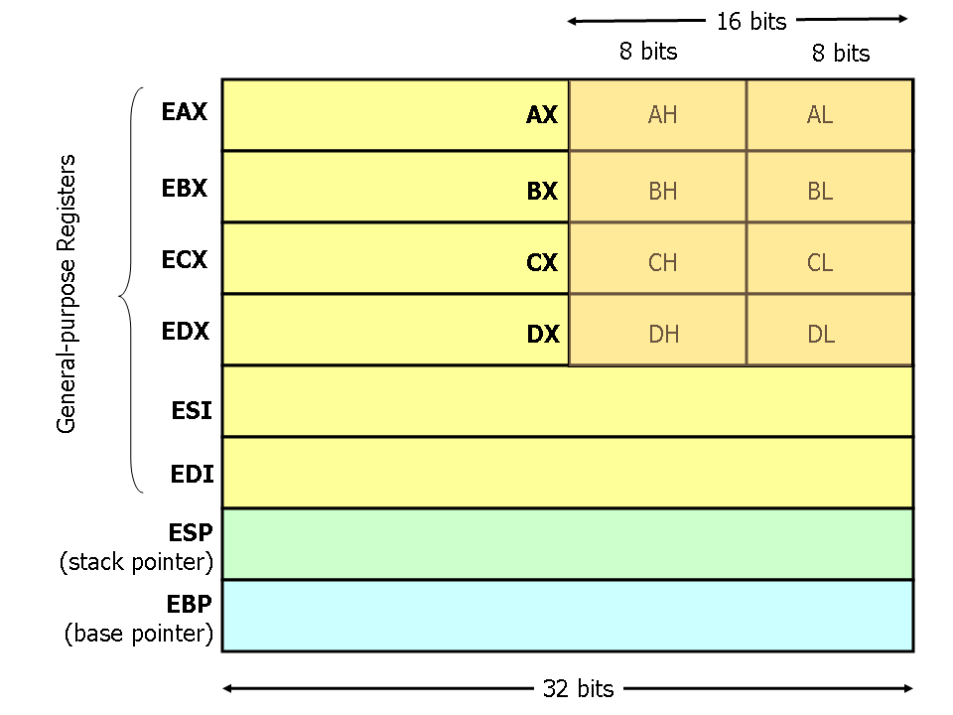

Slide 12
EAX : Accumulator register, used for storing operands and results
EBX : Base register, stores pointers to data
ECX : Counter register, used during loop operations
EDX : Data register, used as I/O pointer
ESI and EDI : Generally used during bulk memory transfers. SI stands for source index, DI stands for destination index.
ESP : Stack pointer register
EBP : Base pointer register

Slide 13
Segment Registers
CS : Code Segment
DS : Data Segment
SS : Stack Segment
Others : ES, FS, GS
EIP : Instruction pointer

Slide 14
Virtual Memory
During execution, every process is laid out on same virtual memory space.
The actual physical memory may differ from the virtual memory.
This gives an illusion to every process that it is the only process running in the system.
The OS and CPU together helps to maintain the abstraction.

Slide 15
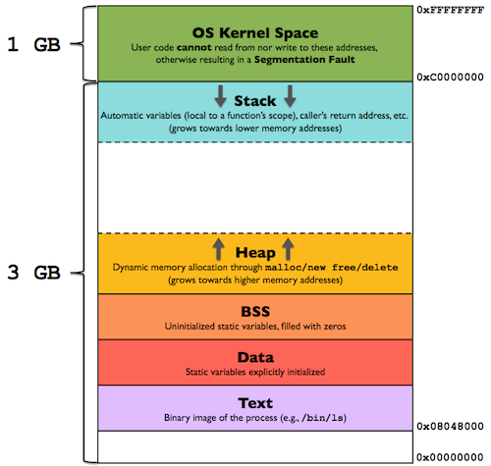
Memory layout of a process

Slide 16
What is Exploitation ?
Let’s begin with a very basic Example..

Slide 17
Thank you

