Slide 1
Structure of the Stack
Presented by:
Gaurav Kumar
Nishit Majithia
Rohit sehgal

Slide 2
What is a stack
A LIFO data structure.
Why is it so important to understand?
The main memory is divided into 4 to 5 major sections of which the stack is most important as most of the manipulations are going on there only.
Stack grows from high memory address to low memory address.

Slide 3
Let’s take a simple example
void swap(int a, int b) int main() { { int temp; a = 5, b=6; temp = a; swap(a,b); a=b; printf(“%d,%d”,a,b); b=temp; } }
ESP
b
High memory
ESP
a
ESP
Return address
ESP
Old EBP
ESP
New EBP
Temp
ESP
Low memory

Slide 4
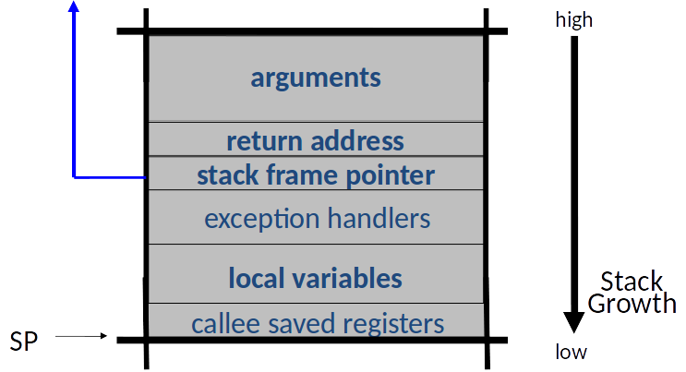
Stack Layout Summary

