Slide 1



UHACK 5.0
RAKT AID
TEAM NAME : LAZY CODERS
Hemant Suteri
Abhishek Yadav
3. Atishay Kumar
4. Tanayveer
TEAM MEMBERS -

Slide 2
Problem Statement

Slide 3
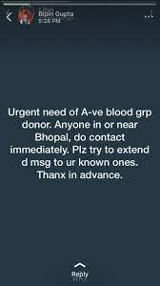
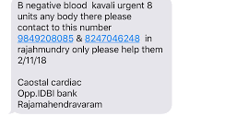
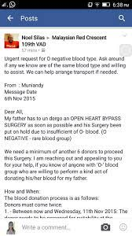
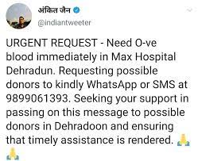
Problems faced while finding the Blood in case of Emergency

Slide 4
Some of the Reasons
Lack of Availability
Lack of Awareness
Lack of Up-to-date technological usage

Slide 5
Solutions
that Rakt Aid aims to provide

Slide 6
01
Make Blood readily Available
One step solution to volunteer and to get blood.
Volunteers role .
Using the data accumulated.

Slide 7
02
Spreading Awareness
Data about scheduled Camps.
FAQs answered.
Resources available.

Slide 8
03
Recognizing the Donors
Recognizing top Donors.

Slide 9
Thank you
-By Team Lazy Coders

