Slide 1
Software Quality
SQA
Software Reviews
ISO 9000
SEI-CMM
Six Sigma
Software Reliability, Availability and Safety
Software Maintenance

Slide 2
Quality:
Traditional definition of quality:
  fitness of purpose,
    a quality product does exactly what the users want it to do.

Slide 3
Fitness of purpose
For software products,
  fitness of purpose:
    satisfaction of the requirements specified in SRS document.

Slide 4
Software Quality:
“Software quality is the conformance to explicit stated functional and performance requirements, explicitly documented development standards, and implicit characteristics that are expected of all professionally developed software”.

Slide 5
Software Quality Assurance:
Software Quality assurance is a set of activities designed to evaluate the process by which software is developed and maintained.
Aim of SQA process is to develop a high quality software product.

Slide 6
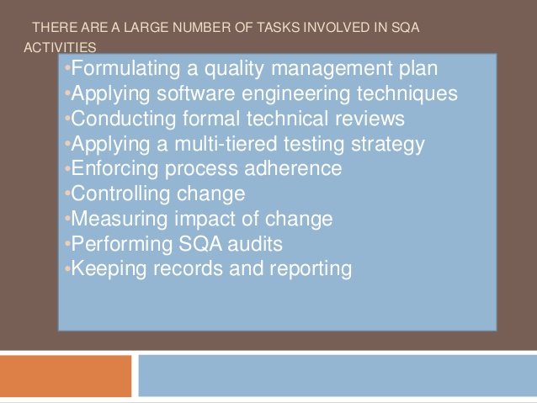
SQA Activities:

Slide 7
SQA Plan:
The SQA Plan provides a roadmap for instituting S/W quality assurance.
The Plan serves as a template for SQA activities that are instituted for each software project.
An outline structure for a quality plan includes: Product introduction, Product Plan, Process Description, Quality goals, Risk and Risk management.
Note: Template of SQA Plan

Slide 8
Role of various groups in SQA activity:
Software Engineer
Project Manager
Customers
S/W quality assurance group
Are involved in SQA activity.
Note: SQA plans are available from many S/W companies for an additional fee when purchasing the rights to use the software.

Slide 9
Modern view of quality
Associates several quality factors with a software product :
  Correctness
  Reliability
  Efficiency (includes efficiency of resource utilization)
  Portability
  Usability
  Reusability
  Maintainability

Slide 10
Correctness
A software product is correct,
  if different requirements as specified in the SRS document have been correctly implemented.
  Accuracy of results.

Slide 11
Portability
A software product is said to be portable,
  if it can be easily made to work in different operating systems,
  in different machines,
  with other software products, etc.

Slide 12
Reusability
A software product has good reusability,
  if different modules of the product can easily be reused to develop new products.

Slide 13
Usability
A software product has good usability,
  if different categories of users (i.e. both expert and novice users) can easily invoke the functions of the product.

Slide 14
Maintainability
A software product is maintainable,
  if errors can be easily corrected as and when they show up,
  new functions can be easily added to the product,
  functionalities of the product can be easily modified, etc.

Slide 15
Software Reviews

Slide 16
Purpose of Reviews
Include the formal technical review (also called a walkthrough or inspection)
  Acts as the most effective SQA filter
  Conducted by software engineers for software engineers
  Effectively uncovers errors and improves software quality
  Has been shown to be up to 75% effective in uncovering design flaws (which constitute 50-65% of all errors in software)
Require the software engineers to expend time and effort, and the organization to cover the costs

Slide 17
Formal Technical Review (FTR)
Objectives
  To uncover errors in function, logic, or implementation for any representation of the software
  To verify that the software under review meets its requirements
  To ensure that the software has been represented according to predefined standards
  To achieve software that is developed in a uniform manner
  To make projects more manageable

Slide 18
The FTR Meeting
Has the following constraints
  From 3-5 people should be involved
  Advance preparation (i.e., reading) should occur for each participant but should require no more than two hours a piece and involve only a small subset of components
  The duration of the meeting should be less than two hours
Focuses on a specific work product (a software requirements specification, a detailed design, a source code listing)

Slide 19
Activities before the meeting
  The producer informs the project manager that a work product is complete and ready for review
  The project manager contacts a review leader, who evaluates the product for readiness, generates copies of product materials, and distributes them to the reviewers for advance preparation
  Each reviewer spends one to two hours reviewing the product and making notes before the actual review meeting
  The review leader establishes an agenda for the review meeting and schedules the time and location

Slide 20
The FTR Meeting (continued)
Activities during the meeting
  The meeting is attended by the review leader, all reviewers, and the producer
  One of the reviewers also serves as the recorder for all issues and decisions concerning the product
  After a brief introduction by the review leader, the producer proceeds to "walk through" the work product while reviewers ask questions and raise issues
  The recorder notes any valid problems or errors that are discovered; no time or effort is spent in this meeting to solve any of these problems or errors
Activities at the conclusion of the meeting
  All attendees must decide whether to
    Accept the product without further modification
    Reject the product due to severe errors (After these errors are corrected, another review will then occur)
    Accept the product provisionally (Minor errors need to be corrected but no additional review is required)
  All attendees then complete a sign-off in which they indicate that they took part in the review and that they concur with the findings

Slide 21
The FTR Meeting (continued)
Activities following the meeting
  The recorder produces a list of review issues that
    Identifies problem areas within the product
    Serves as an action item checklist to guide the producer in making corrections
  The recorder includes the list in an FTR summary report
    This one to two-page report describes what was reviewed, who reviewed it, and what were the findings and conclusions
  The review leader follows up on the findings to ensure that the producer makes the requested corrections

Slide 22
FTR Guidelines
Review the product, not the producer
Set an agenda and maintain it
Limit debate and rebuttal; conduct in-depth discussions off-line
Enunciate problem areas, but don't attempt to solve the problem noted
Take written notes; utilize a wall board to capture comments
Limit the number of participants and insist upon advance preparation
Develop a checklist for each product in order to structure and focus the review
Allocate resources and schedule time for FTRs
Conduct meaningful training for all reviewers
Review your earlier reviews to improve the overall review process

Slide 23
ISO 9000
ISO (international Standards Organization):
  a consortium of 63 countries established to formulate and foster standardization.
ISO published its 9000 series of standards in 1987.

Slide 24
What is ISO 9000 Certification?
ISO 9000 certification:
  serves as a reference for contract between independent parties.
The ISO 9000 standard:
  specifies guidelines for maintaining a quality system.

Slide 25
What is ISO 9000 Certification?
ISO 9000 specifies:
  guidelines for repeatable and high quality product development.
  Also addresses organizational aspects
    responsibilities, reporting, procedures, processes, and resources for implementing quality management.

Slide 26
ISO 9000
A set of guidelines for the production process.
  not directly concerned about the product it self.
  a series of three standards:
    ISO 9001, ISO 9002, and ISO 9003.

Slide 27
ISO 9000
Based on the premise:
  if a proper process is followed for production:
    good quality products are bound to follow.

Slide 28
ISO 9001:
Applies to:
  organizations engaged in design, development, production, and servicing of goods.
  applicable to most software development organizations.

Slide 29
ISO 9002:
ISO 9002 applies to:
  organizations who do not design products:
    but are only involved in production.
Examples of this category of industries:
  steel or car manufacturing industries
  buy the product and plant designs from external sources:
    only manufacture products.
  not applicable to software development organizations.

Slide 30
ISO 9003
ISO 9003 applies to:
  organizations involved only in installation and testing of the products.

Slide 31
Why Get ISO 9000 Certification?
Several benefits:
  Confidence of customers in an organization increases
    if organization qualified for ISO 9001 certification.
    This is especially true in the international market.

Slide 32
Why Get ISO 9000 Certification?
Many international software development contracts insist:
  development organization to have ISO 9000 certification.

Slide 33
Why Get ISO 9000 Certification?
Requires:
  a well-documented software production process to be in place.
  contributes to repeatable and higher quality software.
Makes development process:
  focussed, efficient, and cost-effective

Slide 34
Why Get ISO 9000 Certification?
Points out the weakness of an organizations:
  recommends remedial action.

Slide 35
How to Get ISO 9000 Certification?
An organization intending to obtain ISO 9000 certification:
  applies to a ISO 9000 registrar for registration.
ISO 9000 registration process consists of several stages.

Slide 36
How to Get ISO 9000 Certification?
Application stage:
  Applies to a registrar for registration.
Pre-assessment:
  the registrar makes a rough assessment of the organization.

Slide 37
How to Get ISO 9000 Certification?
Document review and adequacy audit:
  process and quality-related documents.
  the registrar reviews the documents
  makes suggestions for improvements.

Slide 38
How to Get ISO 9000 Certification?
Compliance audit: the registrar checks
  whether the suggestions made by it during review have been complied.

Slide 39
How to Get ISO 9000 Certification?
Registration:
  The registrar awards ISO 9000 certificate after successful completions of all previous phases.
Continued surveillance:
  The registrar continues monitoring the organization periodically.

Slide 40
ISO 9000 Certification
An ISO certified organization
  can use the certificate for corporate advertizements
  cannot use the certificate to advertize products.
    ISO 9000 certifies organization's process
    not any product of the organization.
  An organization using ISO certificate for product advertizements:
    risks withdrawal of the certificate.

Slide 41
Shortcomings of ISO 9001 Certification (1)
ISO 9000 requires a production process to be adhered to:
  but does not guarantee the process to be of high quality.
  Does not give any guideline for defining an appropriate process.

Slide 42
Shortcomings of ISO 9001 Certification (2)
ISO 9000 certification process
  not fool-proof
  no international accredition agency exists.
  likely variations in the norms of awarding certificates:
    among different accredition agencies and among the registrars.

Slide 43
Shortcomings of ISO 9001 Certification (3)
Organizations qualifying for ISO 9001 certification:
  tend to downplay domain expertise.
  tend to believe that since a good process is in place,
    any engineer is as effective as any other engineer in doing any particular activity relating to software development.

Slide 44
Shortcomings of ISO 9001 Certification (4)
In manufacturing industry
  clear link between process quality and product quality
  once a process is calibrated:
    can be run again and again producing quality goods
Software development is a creative process:
  individual skills and experience is significant

Slide 45
Shortcomings of ISO 9001 Certification (5)
Many areas of software development are very specialized:
  special expertize and experience (domain expertize) required.
ISO 9001
  does not automatically lead to continuous process improvement,
  does not automatically lead to TQM.

Slide 46
Shortcomings of ISO 9001 Certification (6)
ISO 9001 addresses mostly management aspects.
Techniques specific to software development have been ignored
  Configuration management
  Reviews
  Release builds
  Problem Notification system
  Intranets

Slide 47
SEI Capability Maturity Model
Developed by Software Engineering Institute (SEI) of the Carnegie Mellon University, USA:
  to assist the U.S. Department of Defense (DoD) in software acquisition.
  The rationale was to include:
    likely contractor performance as a factor in contract awards.

Slide 48
SEI Capability Maturity Model
Major DoD contractors began CMM-based process improvement initiatives:
  as they vied for DoD contracts.
SEI CMM helped organizations:
  Improve quality of software they developed
  Realize adoption of SEI CMM model had significant business benefits.
Other organizations adopted CMM.

Slide 49
SEI Capability Maturity Model
In simple words,
  CMM is a model for apprising the software process maturity of a contractor into different levels.
  Can be used to predict the most likely outcome to be expected from the next project that the organization undertakes.

Slide 50
SEI Capability Maturity Model
Can be used in two ways:
  Capability evaluation
  Software process assessment.

Slide 51
Capability Evaluation
Provides a way to assess the software process capability of an organization
  Helps in selecting a contractor
  Indicates the likely contractor performance

Slide 52
Software Process Assessment
Used by an organization to assess its current process:
  Suggests ways to improve the process capability.
  This type of assessment is for purely internal use.

Slide 53
SEI Capability Maturity Model
The SEI CMM classifies software development industries into:
  Five maturity levels.
  Stages are ordered so that improvements at one stage provide foundations for the next
  Based on the pioneering work of Philip Crosby

Slide 54
SEI Capability Maturity Model
Optimizing (5)
Managed (4)
Defined (3)
Repeatable (2)
Initial (1)

Slide 55
Level 1: (Initial)
Organization operates
  without any formalized process or project plans
An organization at this level is characterized by
  ad hoc and often chaotic activities.

Slide 56
Level 1: (Initial)
Software production processes are not defined,
  different engineers follow their own process
  development efforts become chaotic.
  The success of projects depend on individual efforts and heroics.

Slide 57
Level 2: (Repeatable)
Basic project management practices
  tracking cost, schedule, and functionality are followed.
Size and cost estimation techniques
  function point analysis, COCOMO, etc. used.
Production process is ad hoc
  not formally defined
  also not documented.

Slide 58
Level 2: (Repeatable)
Process used for different projects might vary between projects:
  earlier success on projects with similar applications can be repeated.
  Opportunity to repeat process exist when a company produces a family of products.

Slide 59
Level 3: (Defined)
Management and development activities:
  defined and documented.
  Common organization-wide understanding of activities, roles, and responsibilities.

Slide 60
Level 3: (Defined)
The process though defined,
  process and product qualities are not measured.
ISO 9001 aims at achieving this level.

Slide 61
Level 4: (Managed)
Quantitative quality goals for products are set.
Software process and product quality are measured:
  The measured values are used to control the product quality.
  Results of measurement used to evaluate project performance
    rather than improve process.

Slide 62
Level 4: (Managed)
Organization sets quantitative quality goals
World-wide about 100 organizations assessed at this level.

Slide 63
Level 5: (Optimizing)
Statistics collected from process and product measurements are analyzed:
  continuous process improvement based on the measurements.
    Known types of defects are prevented from recurring by tuning the process
    lessons learned from specific projects incorporated into the process

Slide 64
Level 5: (Optimizing)
Identify best software engineering practices and innovations:
  tools, methods, or process are identified
  transferred throughout the organization
World-wide about 50 organizations have been assessed at this level.

Slide 65
Comparison between ISO 9001 and SEI CMM
ISO 9001 awarded by an international standards body
  can be quoted in official documents and communications
SEI CMM assessment is purely for internal use.

Slide 66
Comparison between ISO 9001 and SEI CMM
SEI CMM was developed specifically for software industry:
  addresses many issues specific to software industry.
SEI goes beyond quality assurance
  aims for TQM
  ISO 9001 correspond to SEI level 3.

Slide 67
Comparison between ISO 9001 and SEI CMM
SEI CMM provides a list of key areas
  on which to focus to take an organization from one level to the other
Provides a way for gradual quality improvements over several stages.
  e.g trying to implement a defined process before a repeatable process:
    counterproductive as managers are overwhelmed by schedule and budget pressure.

Slide 68
Six Sigma
Six sigma is a quantitative approach to eliminate defects
  Applicable to all types of industry - from manufacturing, product development, to service
The statistical representation of Six Sigma quantitatively describes
  how a process is performing

Slide 69
Six Sigma
Popularized by Motorola in the 1980s
Is the most widely used strategy for statistical quality assurance
Uses data and statistical analysis to measure and improve a company's operational performance
Identifies and eliminates defects in manufacturing and service-related processes

Slide 70
Six Sigma (continued)
Three core steps
  Define customer requirements, deliverables, and project goals via well-defined methods of customer communication
  Measure the existing process and its output to determine current quality performance (collect defect metrics)
  Analyze defect metrics and determine the vital few causes (the 20%)
Two additional steps are added for existing processes (and can be done in parallel)
  Improve the process by eliminating the root causes of defects
  Control the process to ensure that future work does not reintroduce the causes of defects

Slide 71
Six Sigma (continued)
All of these steps need to be performed so that you can manage the process to accomplish something
You cannot effectively manage and improve a process until you first do these steps (in this order):
Manage and improve the work process
Control the work process
Analyze the work process
Measure the work process
Define the work process
The work to be done

Slide 72
Software Reliability, Availability and Safety

Slide 73
Reliability and Availability
Software failure
  Defined: Nonconformance to software requirements
  Given a set of valid requirements, all software failures can be traced to design or implementation problems (i.e., nothing wears out like it does in hardware)
Software reliability
  Defined: The probability of failure-free operation of a software application in a specified environment for a specified time
  Estimated using historical and development data
  A simple measure is MTBF = (Mean time to failure)MTTF + MTTR (Mean time to repair) = Uptime + Downtime
  Example:
    MTBF = 68 days + 3 days = 71 days
    Failures per 100 days = (1/71) * 100 = 1.4

Slide 74
Software availability
  Defined: The probability that a software application is operating according to requirements at a given point in time
  Availability = [MTTF/ (MTTF + MTTR)] * 100%
  Example:
    Avail. = [68 days / (68 days + 3 days)] * 100 % = 96%

Slide 75
Software Safety
Focuses on identification and assessment of potential hazards to software operation
It differs from software reliability
  Software reliability uses statistical analysis to determine the likelihood that a software failure will occur; however, the failure may not necessarily result in a hazard or mishap
  Software safety examines the ways in which failures result in conditions that can lead to a hazard or mishap; it identifies faults that may lead to failures
Software failures are evaluated in the context of an entire computer-based system and its environment through the process of fault tree analysis or hazard analysis

Slide 76

Software Maintenance

Slide 77

Agenda

Slide 78

Software Maintenance
Software Maintenance is a broad activity that includes:
Error Corrections,
Enhancements of Capabilities,
Deletion of Obsolete Capabilities, and
Optimization
Any work done to change the software after it is in operation is considered as maintenance work.

Slide 79


Reasons for maintaining software
Over a period of time software’s original requirement may change to reflect the customer’s needs.
Errors undetected during software development may be found during use and require correction.
With time new technologies are introduced such as new hardware, operating system etc.

Slide 80
Types of Maintenance
ADAPTIVE MAINTENANCE
PREVENTIVE MAINTENANCE
CORRECTIVE MAINTENANCE
PERFECTIVE MAINTENANCE

Slide 81
Corrective Maintenance
Corrective Maintenance refers to modifications initiated by defects in the software.
A defect can result from:
  Design errors: Design error mainly occurs when occur when the software is incorrect, incomplete or the requirement specifications are misunderstood.
  Logical errors: Logical error is the result from invalid tests and conclusions, incorrect implementation of design specifications, faulty logic flow and incomplete test data.
  Coding errors: Coding Errors are caused by incorrect implementation of detailed logic design or incorrect use of source code logic.
Defects are also caused by data processing errors and system performance errors.
Any effort made to correct these errors comes under corrective maintenance and sometimes some emergency fixes are done to restore the operations of a software which is also known as “patching”.

Slide 82
Adaptive Maintenance
Adaptive Maintenance includes modifying the software to match changes in the environment.
This includes modification and updations applied to keep the software up to date. As in the changing technology, the main updations are adapted by the following:
  Business rules
  Government policies
  Work patterns
  Software and hardware operating platforms
This type of maintenance includes any work that has been started due to moving the software to a different hardware or software platform (a new operating system or a new processor).

Slide 83
Perfective Maintenance
Perfective Maintenance refers to enhancements to make the product better, faster, and cleanly structured with more functions and reports.
It means improving processing efficiency or performance, or restructuring the software to improve changeability.
When software becomes useful, the user may want to extend it beyond the scope for which it was initially developed.
This may include enhancement of existing system functionality, improvement in computational efficiency etc.

Slide 84
Preventive Maintenance
Preventive Maintenance is checking the faults before failure occurs
Preventive Maintenance goals to attend problems which are not significant at this moment but may cause serious issues in future.
There are three significant ways to perform Preventive Maintenance
  Documentation
  Code Optimization
  Code Re structuring

Slide 85
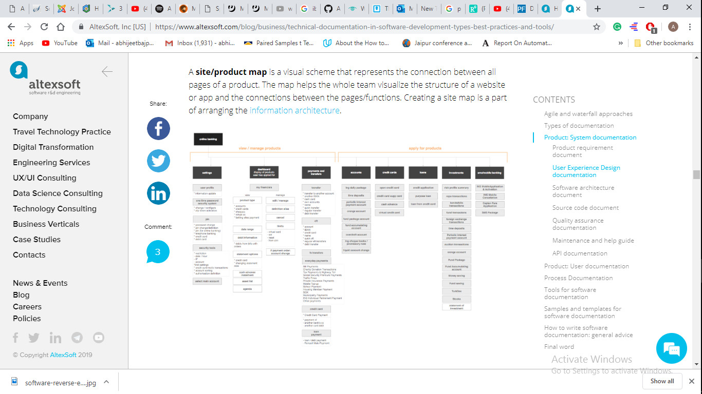
Documentation
Modifying the documents affected by the changes in order to correspond to the present State of the system.
1- Site Map: Connection Between Pages/Function

Slide 86
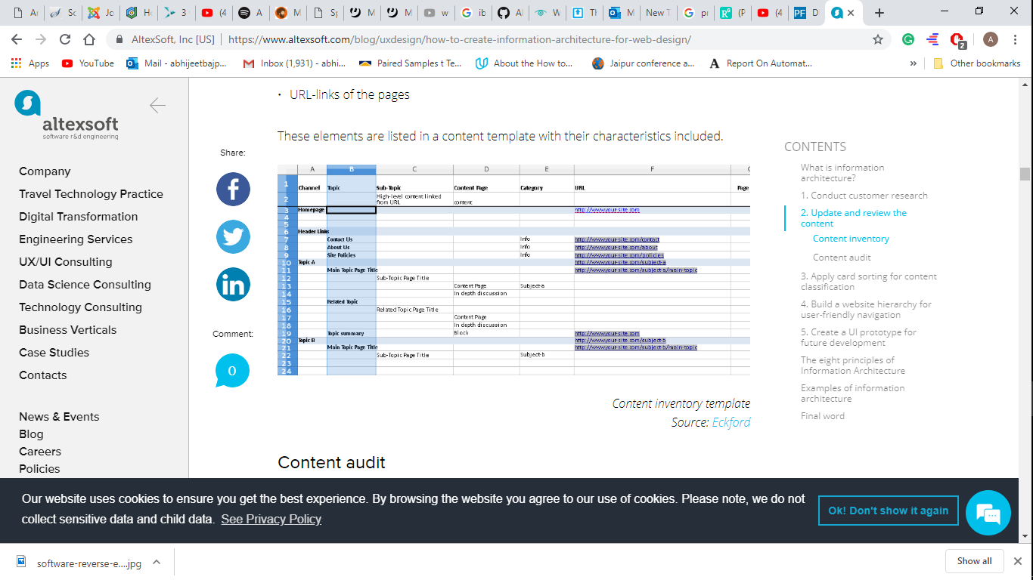
Documentation
2- Wireframe: How to arrange the elements on the page and How they behave.

Slide 87
Code Optimization
Programs for faster execution or efficient use of storage space.
Programs should consume less resources and less memory.
  1. Dead Code Elimination: elimination of unwanted code.

Slide 88
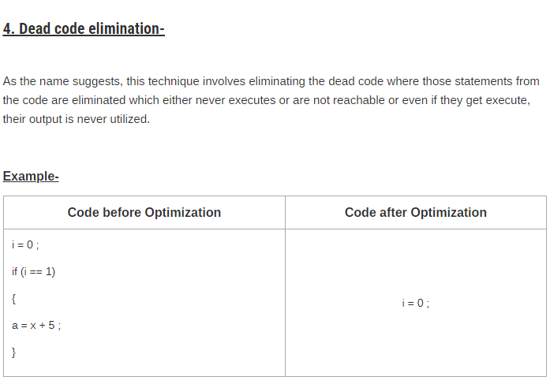

Slide 89
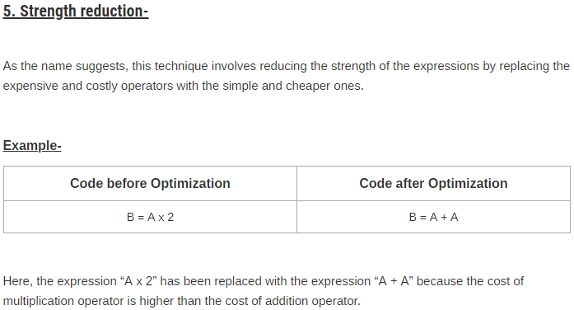

Slide 90
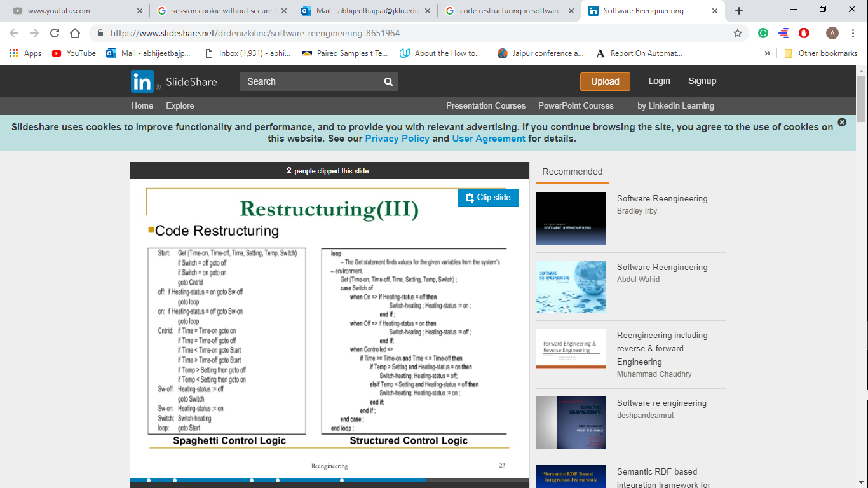
Code Restructuring
It is the most common type of restructuring.
Transforming the program structure for reducing the complexity in source code and making it easier to understand.

Slide 91
Software Maintenance Process
Correct Program Error
Add New Capabilities
Determine Maintenance Objective
Delete Obsolete Features
Optimization
Complexity
Program Understanding
Documentation
Self Descriptiveness
Generate particular Maintenance Proposal
Extensibility
Account of Ripple Effect
Stability
Testing
Testability
Pass Testing ?
NO
YES

Slide 92
Program Understanding: The first phase consists of analyzing the program in order to understand.
Generating Particular Maintenance Proposal: The second phase consists of generating a particular maintenance proposal to accomplish the implementation of the maintenance objective.
Ripple Effect: The third phase consists of accounting for all of the ripple effect as a consequence of program modifications.
Modified Program Testing: The fourth phase consists of testing the modified program to ensure that the modified program has at least the same reliability level as before.
Maintainability: Each of these four phases and their associated software quality attributes are critical to the maintenance process. All of these factors must be combined to form maintainability.

Slide 93





Software Maintenance Models
1
Quick-fix Model
2
Iterative Enhancement Models
3
Full Reuse Model
4
Boehm’s Model
5
Taute’s Model

Slide 94

Quick-Fix Model: The quick-fix model is an ad hoc approach used for maintaining the software system. The objective of this model is to identify the problem and then fix it as quickly as possible
Iterative Enhancement Model: In iterative enhancement model each stage of incremental model adds some functionality to the product and passes it on to the next stage. The first increment is generally known as a core product and is used by the user for a detailed evaluation.
Full-Reuse Model: The reuse-oriented model, also called reuse-oriented development (ROD), is a method of software development in which a program is refined by producing a sequence of prototypes called models, each of which is automatically derived from the preceding one according to a sequence of defined rules.
Boehm’s Model: Boehm's spiral model of the software process. Barry Boehm (Boehm, 1988) proposed a risk-driven software process framework (the spiral model) that integrates risk management and incremental development. ... Constraints on the process and the product are identified and a detailed management plan is drawn up.
Taute’s model: Taute’s model which is straightforward, practical and easy to understand. It is used by developers for updating and performing modification in the software after its execution in the system

Slide 95

Thank You!

